Slide 1
GPU Programming in Computer Vision
Ramakrishna Nanjundaiah
Sadiq Huq

Slide 2
General Purpose GPU vs CPU
  CPU
Perform very quickly one or two tasks at a time
Few ALU's
Poor memory interface for large data sets
  GPU
Perform large number of tasks, relatively quick.
Dozens or even hunderds of ALU's
Massive parallel memory interface, typically 10x faster than CPU inteface
Source : www.supercomputingblog.com

Slide 3
Compute Unified Device Architecture
NVIDIA ALU´s are fully programmable
The type of applications suited for CUDA is limited
Enables implementation of highly parallel algorithms
Several hundreds of threads run the same kernel
Best suited for number crunching
Flexible choice of language
Use of double should be avoided as only one 64-bit floating point units for every sixteen 32-bit unit.

Slide 4

What is Optical Flow?
Given I1 , I2 : Ω → R, we find a vector field u : Ω → R2
such that

Slide 5
Solution Methods
Horn - Schunck Method
Buxton - Buxton Method
Black - Jepson Method
General Variational Methods

Slide 6

Horn and Schunck Method
Invloves imposing global constraint of smoothness for solving the aperture problem
Solves the energy equation:
The Euler – Lagrange equation is solved for the above variation problem

Slide 7


Horn - Schunck Method: Implementation
The iteration must be repeated once the neighbors are updated
The system of equations is solved with Gauss - Seidel or Jordan method using over-relaxation techniques
High density of flow vectors but more sensitive to noise

Slide 8


Advanced Penalty Function
The energy functional is as follows:
Discretization using finite difference scheme leads to sparse LSE that can be solved with SOR
The penalty function yields better robustness against noise

Slide 9



Warping
Warping methods are capable of dealing with large displacements (coarse to fine strategy)

Slide 10
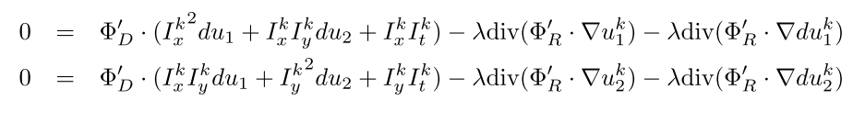

Warping: Implementation
Solving for the Euler – Lagrange equation
The the results obtained are updated such that:

Slide 11
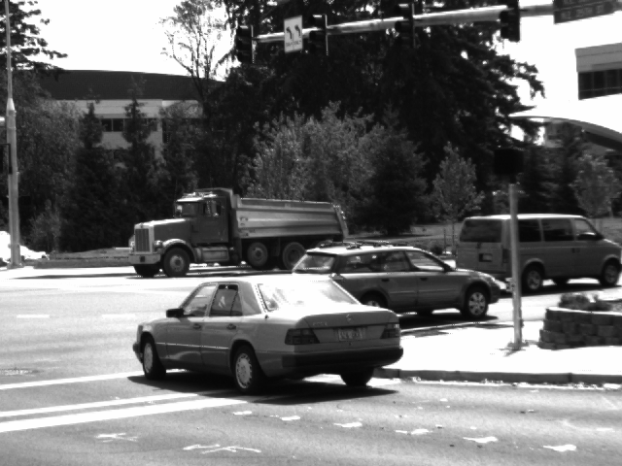

Results and Discussions

Slide 12
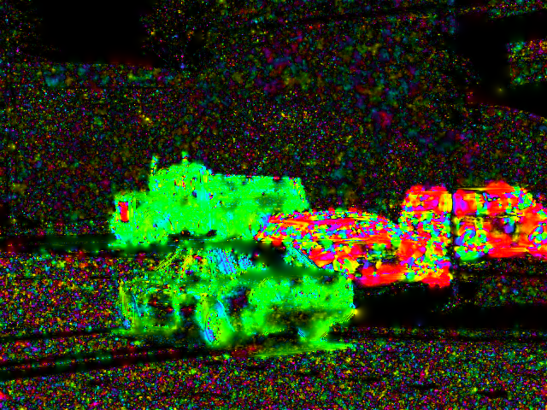
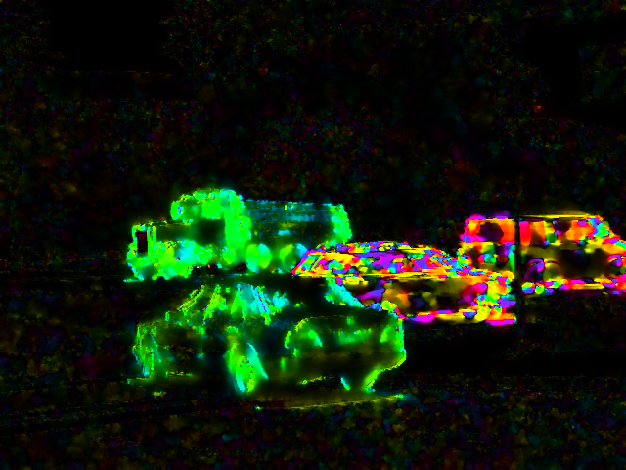
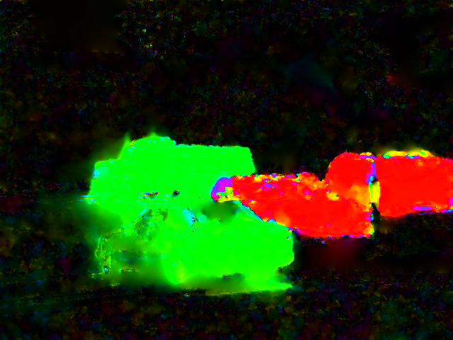
Results and Discussions

Slide 13
Live Demo

Slide 14
Results and Discussions
Questions?

