Slide 1
Does Amazon use SDN?
Sadiq S.
MSc. CS.
CS22014

Slide 2
Agenda / Topics
Introduction to AWS
Introduction to SDN
The use of SDN in AWS
A small demonstration
Conclusion

Slide 3

Introduction to AWS
Sadiq S.

Slide 4
What is AWS?
AWS is secure cloud service platform.
Amazon Web Services, Inc. (AWS) is a subsidiary of Amazon that provides on-demand cloud computing platforms and APIs.
AWS services are delivered to customers via a network of AWS Data Center located throughout the world.
Before AWS, if we wanted to host anything we will have to buy server, handle the traffic, maintain the server if it goes down, prevent it from attacks.

Slide 5
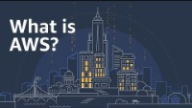
AWS in Brief:

Slide 6
Benefits of AWS:
1. Flexibility: AWS provides the user flexibility in choosing according to their need.
2. Cost-Effective:You pay only for the compute power, storage, and other resources you use.
3. Scalability: Our application can scale up or down according to our need and the traffic our server receives.
4. Security: Security is the prime aspect of AWS. AWS uses end-to-end encryption for the data.
And a lot more…
Coz of this AWS has many customer. In fact AWS has 52% market share in Cloud.

Slide 7
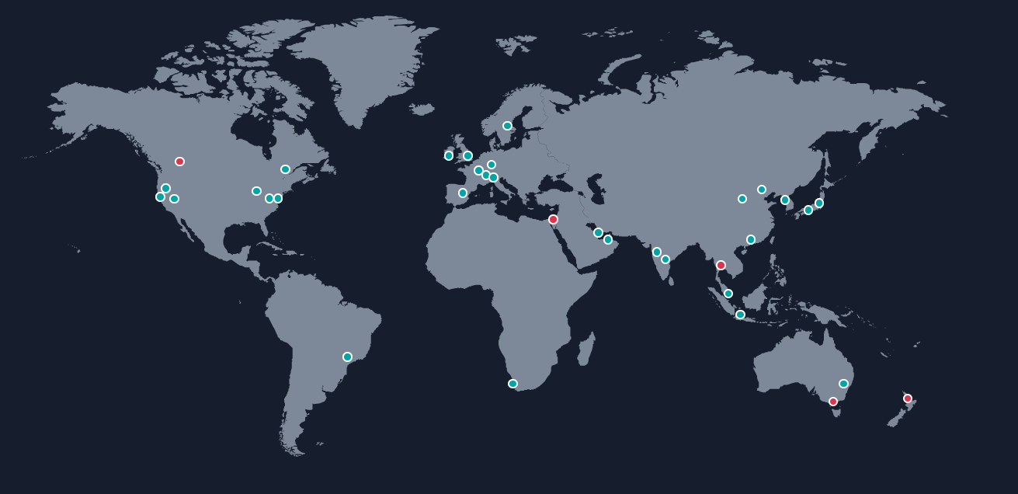
AWS Global Infrastructure:

Slide 8
Contd.
So in the last slide, we saw green and red dots. Those are Regions.
A region is basically a section of geographical region in the world.
Now inside a region there are several Availability Zone.
Inside Availability Zones there are one or more discrete data centers which contains the data of the user.
At present there are 30 regions represented by green dot and 5 upcoming regions represented by red dot of AWS all round the world. And there are 96 Availability zones across those 30 regions.
In India, there are 2 regions, one in Mumbai and another one in Hyderabad which was recently launch in 2022. Inside both there are 3 availability zone each.

Slide 9

Introduction to SDN
Sadiq S.

Slide 10
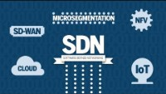
SDN in brief:

Slide 11
What is SDN?
SDN is an architecture designed to make a network more flexible and easier to manage compared to traditional way.
SDN centralizes management by separation of the networking architecture of Control Plane from the Data Plane and centralized the network controller.
SDN is enabling a programmatically efficient configuration of the network to improve the performance of networks and monitor results.
SDN architecture layers would be consisting of 3 layers: a) The application layer b) The controller layer c) The infrastructure layer

Slide 12
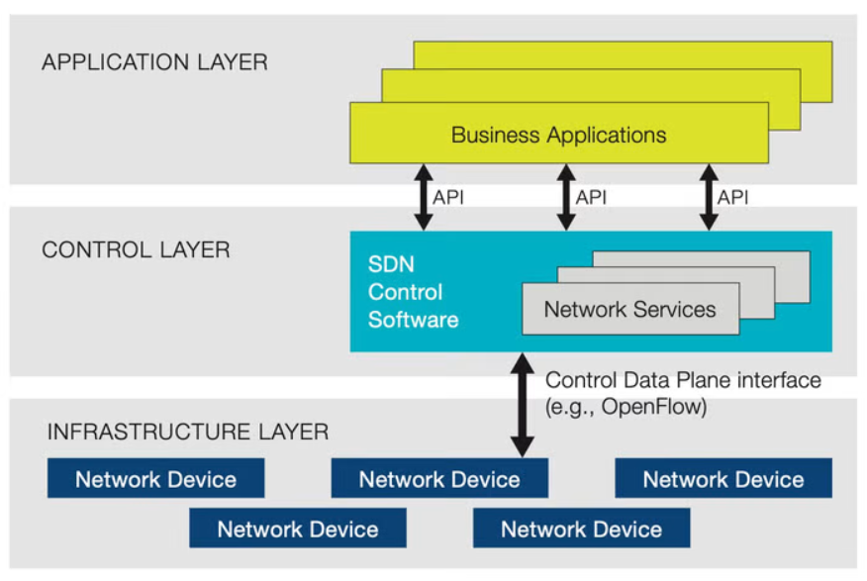
SDN architecture layers:
The application layer: It consists of the programs that
communicate network requirements to the SDN Controller. b) The control layer: The SDN Controller is considered
the mid-layer that connects the application layer and the
infrastructure layer. c) The infrastructure layer: This layer would consist
of networking devices that would control the forwarding
and data processing capabilities for the network.

Slide 13
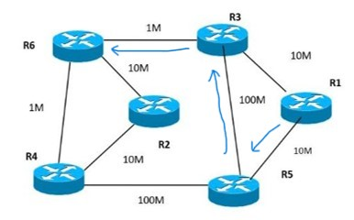
Workflow of SDN:
A router have 2 plane:
Control Plane: Control plane decides which router will
the packet be forwarded.
Data Plane: It simply follow the route giving by control
plane and carry the data packet to that designated router.
Now SDN will take the control plane of all the router and will keep it to itself.
Now SDN will do the job of Control Plane i.e., selection of the next path.

Slide 14
Key component of SDN:
Centralized Network Controller: Admin can rapidly configure the networks.
Programmable Open API: There are 2 types of Open API:
Southbound APIs
Northbound APIs
Open Flow: It is a standard communication interface between control layer and infrastructure layer.

Slide 15
The use of SDN in AWS
Sadiq S.

Slide 16
AWS VPC: the Picasso of Software Defined Networking
Amazon Virtual Private Cloud (Amazon VPC) provides a logically isolated area of the AWS cloud.
You have complete control over your virtual networking environment.
You can easily customize the network configuration for your Amazon Virtual Private Cloud.
For example, we can create public and private subnet.

Slide 17
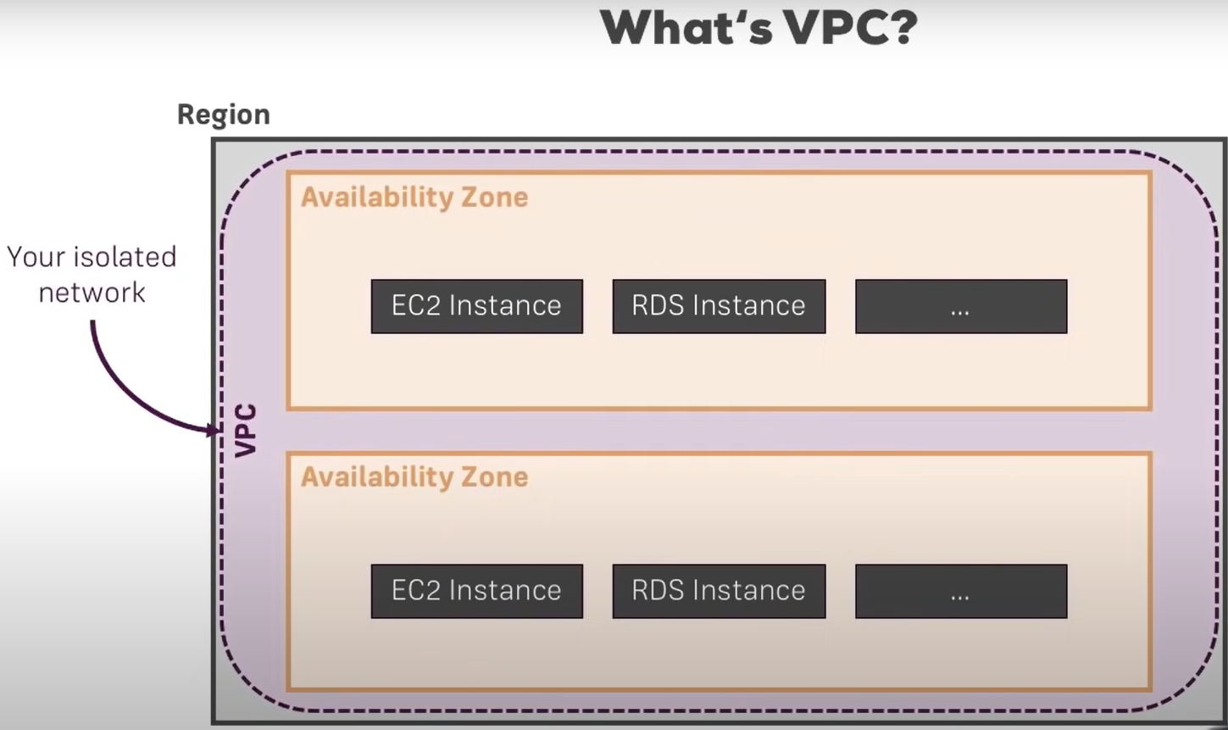
What’s VPC?
AZ is clusters of data center.
Instances in AWS are basically virtual environments.
AWS provides different instance types to enable you to choose.
We split our instances in two to
protect against failure.
VPC scans all availability zone in a
region.

Slide 18
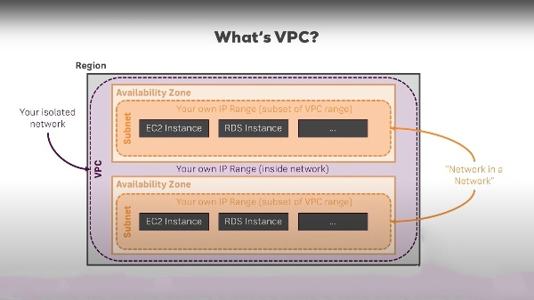
Subnet inside a VPC:

Slide 19
Contd.
Subnet is basically a sub network inside a VPC. Each subnet can be one whole AZ.
We have an own range of Internal(private) IP in the VPC.
We can assign a public IP address to the individual instance that is running in our AZ.
Instance can communicate to other instance with the help of Internal IP.
Each subnet has a own subset of the VPC IP Range.

Slide 20
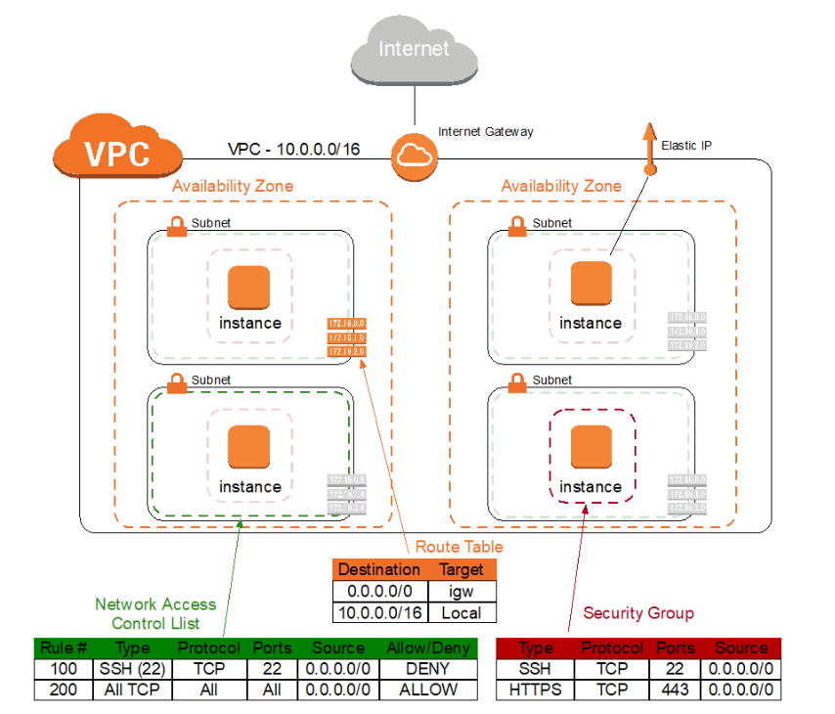
Controlling Access:
We can control access to our resources using VPC and subnet.
Security Group:
Network Access Control List:
Controlling Routing:
And many more…
There is an internet gateway which
manages all the traffic that leaves the VPC.
It is used to manage the private cloud from
the outside world. It is used to connect
to the internet.

Slide 21
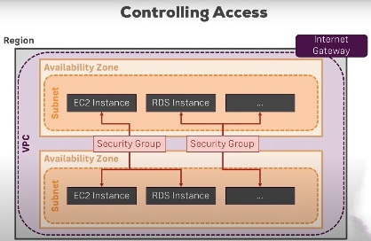
Security Group:
Applied on instances level.

Slide 22
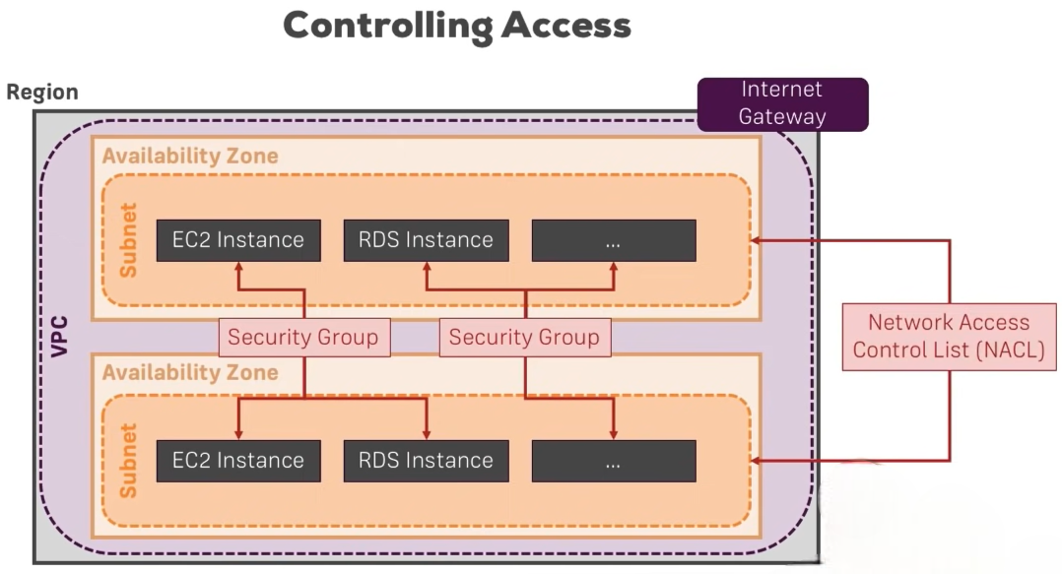
Network Access Control List:
Applied on Subnet level.

Slide 23
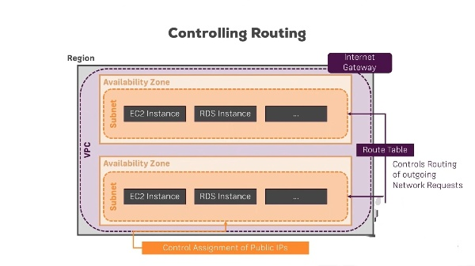
Controlling Routing:
We can go to technical level and simply route the traffic differently.

Slide 24
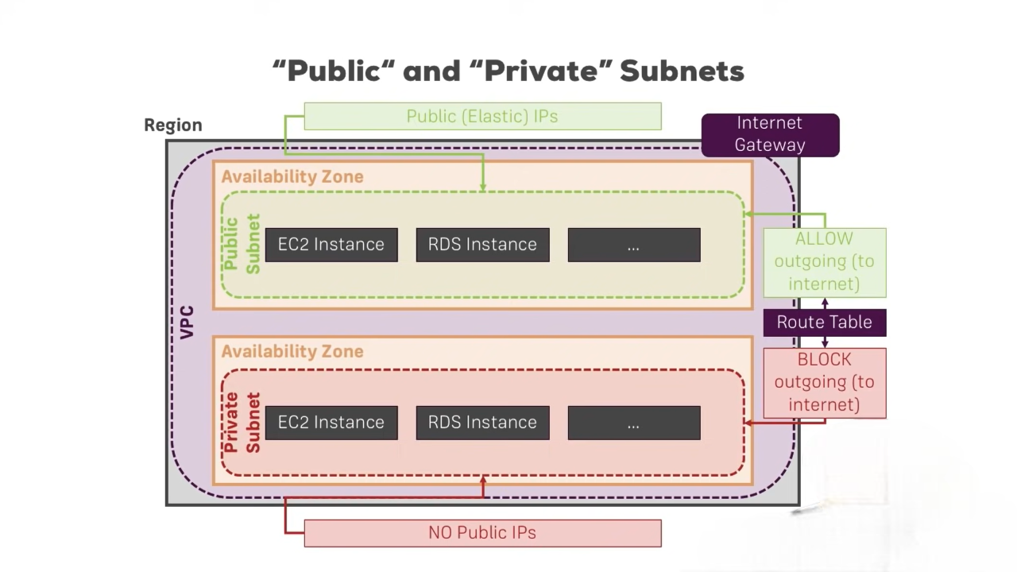
Public and Private Subnet:
We can also control the assignment of public IP Address.
If we don’t give Public IP Address to the instances, we can’t reach them from the internet.

Slide 25
Public and Private Subnet:
Private Subnet: By routing I can block or deny outgoing traffic to deny internet access for that subnet.
Public Subnet: By routing I will allow outgoing traffic to allow internet access for that subnet.
And the benefit of creating a public and private subnet is that:
The public subnet will hold the web server which should be accessible from the internet.
The private subnet will hold the database server which shouldn’t be accessible from the internet.

Slide 26
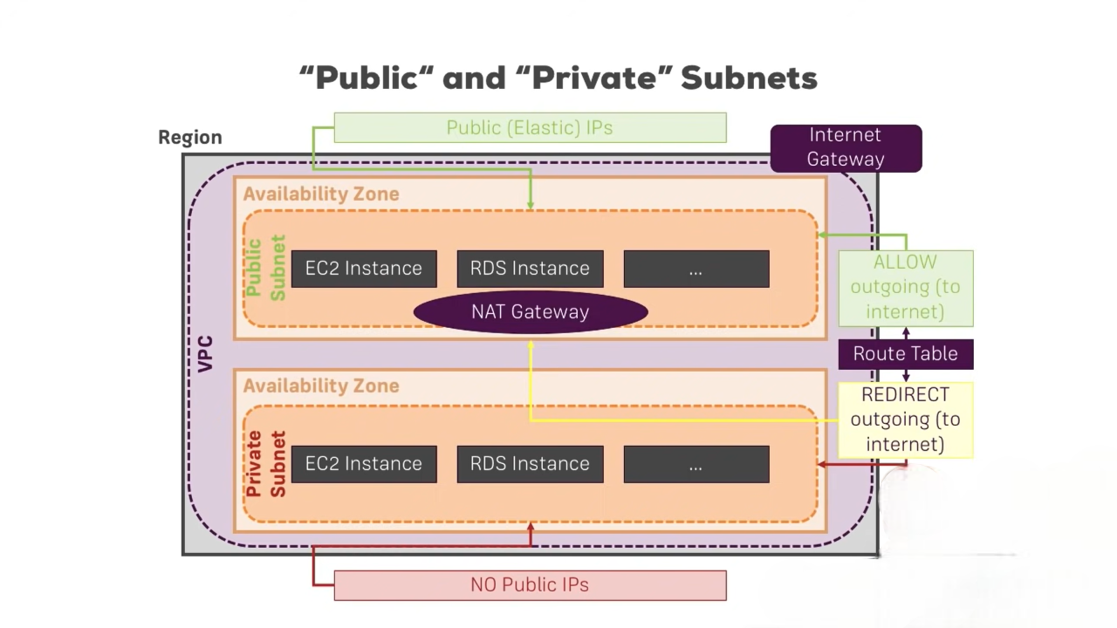
NAT Gateway:
A NAT Gateway is basically a service managed by AWS.
NAT stand for Network address
translation.
And it will translate this internal
IP into public one.

Slide 27
Demonstration:
It’s a lot of concepts here.
It can be pretty confusing but hopefully it isn’t that much if we think about the idea of protecting some resources in your network from the outside internet access.
And in general, VPC is about having your own network in the cloud.
With your own power of security.
So, now let’s do a small demonstration on NAT.

Slide 28
NAT:
NAT stand for Network address translation.
NAT are of 3 types:
Static NAT: Here we give both internal IP and public IP Address.
Dynamic NAT: Here we give a pool of public IP Address.
PAT(Port Address Translation): This is same as Dynamic NAT with overload keyword.

Slide 29
Static NAT:
Firstly we have to configure IP to the port of the router.
Then do some Routing Protocol so they can communicate to each other.
I have done RIP protocol.
Then we need to configure NAT on the router which is in between the inside(private) and outside(public).
In my case user is private and server is public.
The command to configure is first declare which is inside and outside.
Command- ip nat inside source static source_IP destination_IP.

Slide 30
Dynamic NAT:
Firstly we have to configure IP to the port of the router.
Then do some Routing Protocol so they can communicate to each other.
I have done RIP protocol.
Then we need to configure NAT on the router which is in between the inside(private) and outside(public).
Command= access-list 1 permit network wildmask
ip nat pool pool_name IP_source range netmask subnet
ip nat inside source list 1 pool pool_name

Slide 31
Conclusion:
So we learnt a brief on AWS. AWS is is a subsidiary of Amazon that provides on-demand cloud computing platforms and APIs.
Then we learnt about it’s benefit, it’s Global Infrastructure.
Then we jump to SDN. SDN centralizes management by separation of the networking architecture of Control Plane from the Data Plane and centralized the network controller.
It’s architecture, work flow, key component.
Then we got to AWS VPC: The Picasso of SDN.
We learnt controlling access, subnet, NAT Gateway, etc.
They we concluded our presentation with a small demo on NAT.

Slide 32
Thank You
Sadiq S.
MSc. CS.
CS22014

