Slide 1

GGIS 103 Lab
Intro to Lat Long, Topographic Maps and Google Earth Pro

Slide 2
Lab Objectives
Understand Longitude and Latitude
Read topographic maps
Intro to the use of Google Earth Pro

Slide 3
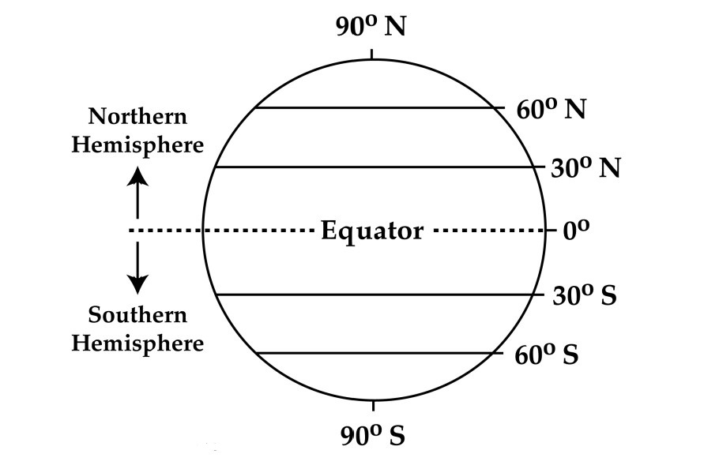
Understanding Latitude
Latitude=lateral=parallels
West-east orientation
Equator=longest latitude
  Northern/southern hemisphere
Lines run EW and parallel to the Equator
Also called "parallels" because they never intersect
0° = Equator (reference point)
0° to 90°N = Northern Hemisphere
0° to 90°S = Southern Hemisphere

Slide 4
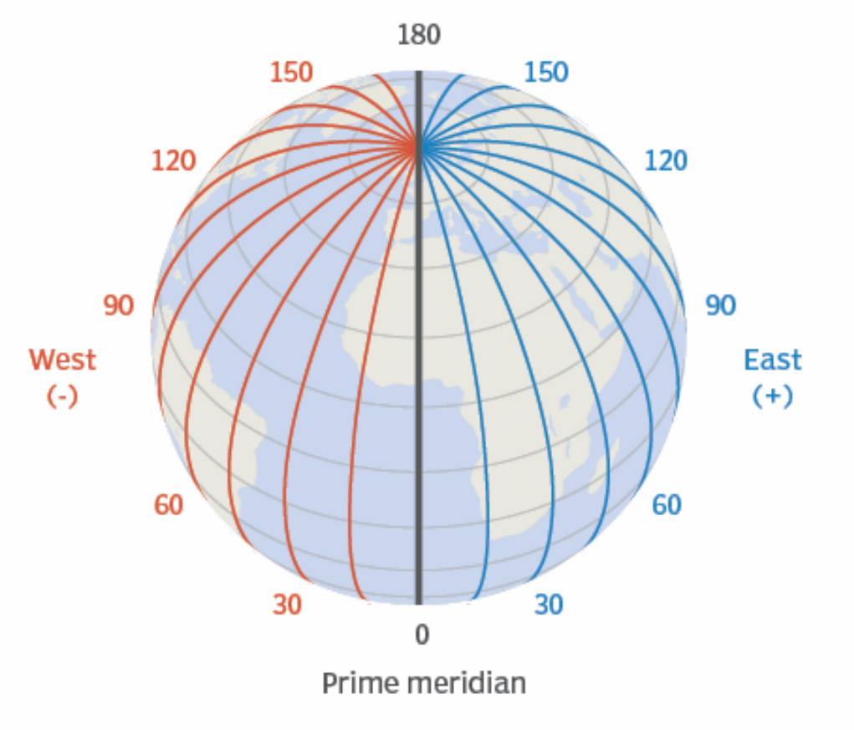
Understanding Longitude
Lines run vertically (north-south) and connect the poles
Also called "meridians"
0° = Prime Meridian in Greenwich (reference point)
0° to 180°E = Eastern Hemisphere
0° to 180°W = Western Hemisphere

Slide 5
Key Reference Lines
Equator | 0° latitude; divides Northern and Southern Hemispheres
Prime Meridian | 0° longitude; passes through Greenwich, England
International Date Line | Approximately 180° longitude; marks date change

Slide 6
Reading Coordinates
Coordinates combine latitude and longitude. Example:
40°N, 75°W
40 degrees north of Equator, 75 degrees west of Prime Meridian
Coordinates can include minutes (') and seconds (") for greater precision

Slide 7
Real-World Examples
Champaign, Illinois
40°1'N, 88°14'W
Equator
0°, any longitude
Prime Meridian
Any latitude, 0°

Slide 8
Applications & Uses
Navigation: GPS systems, maps, and route planning
Geography: Mapping climate zones and regions
Environmental Science: Tracking water resources and monitoring sites
Aviation & Maritime: Aircraft and ship navigation

Slide 9
Key Takeaways
✓ Latitude measures distance north/south of the Equator
✓ Longitude measures distance east/west of the Prime Meridian
✓ Together they create a unique address for any location on Earth
✓ Essential for navigation, mapping, and environmental monitoring

Slide 10
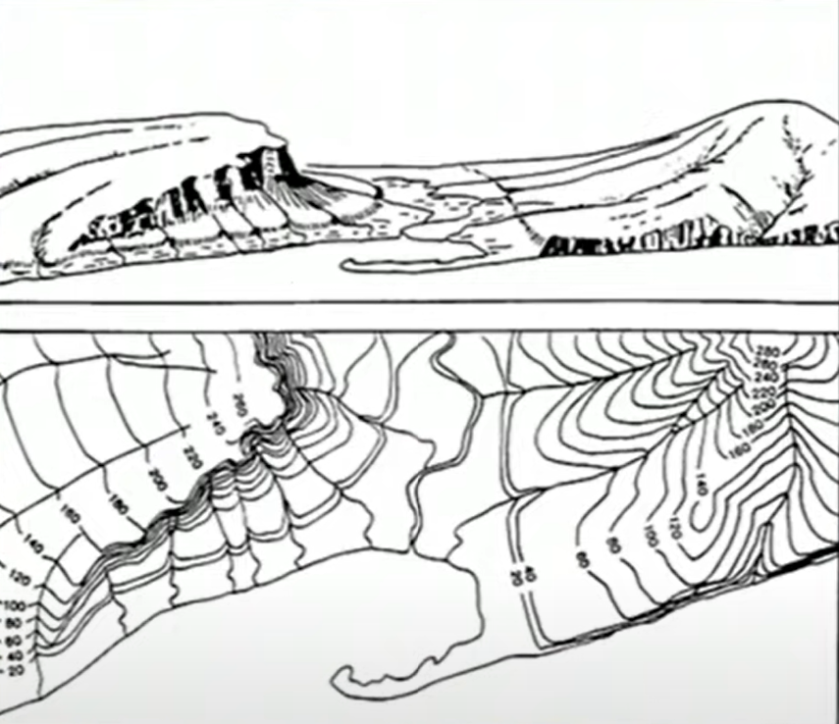
Topographic maps
Elevation and shape of terrain

Slide 11
Topographic Maps & Contour Lines
Visualizing Elevation on a 2D Map

Slide 12
What Is a Topographic Map?
Shows land-surface shape (relief) using contour lines and elevation points
Combines elevation with plan-view features (streams, roads, vegetation, buildings)
Lets you estimate slope, drainage direction, and landforms from map patterns

Slide 13
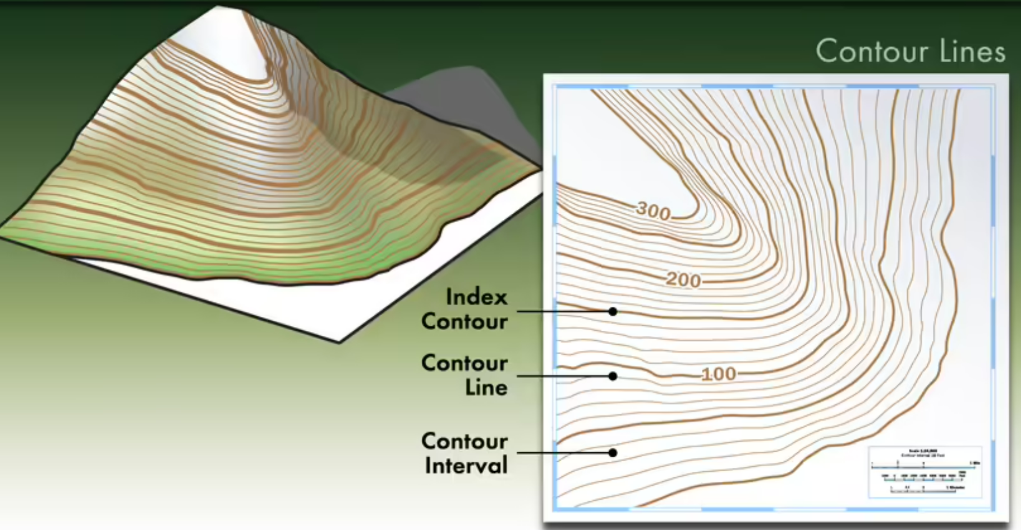
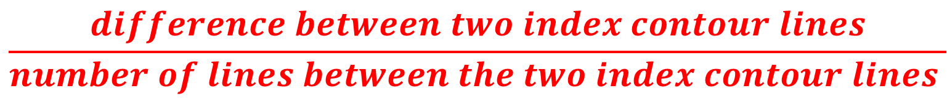
Topographic maps
Contour lines= same elevation
Index contour=every 5th line
Contour interval= change in elevation
How to determine Contour interval?
$$\frac{difference between two index contour lines}{number of lines between the two index contour lines }$$

Slide 14
Key Map Elements
Contour lines and the contour interval (vertical elevation step)
Index contours (thicker, labeled) and intermediate contours
Spot elevations and benchmarks (exact point elevations)
Scale, legend, and coordinate grid (UTM or latitude/longitude)
North arrow and map projection information

Slide 15
Contour Lines: The Basics
Each line connects points of equal elevation
Contour interval is constant on a given map (example: 20 ft)
Lines do not cross or split
Closed loops represent hills or depressions (depressions have inner ticks)
Elevation increases uphill: use labels on index contours to confirm direction

Slide 16
Contour Spacing = Slope
Lines close together = steep slope
Lines far apart = gentle slope
Even spacing = uniform slope
Very tight spacing or merging = cliff

Slide 17
Recognizing Landforms
Hill / Peak
Closed loops; elevations increase toward the center.
Valley / Stream
Contour “V” points upstream; water flows opposite the V.
Ridge / Spur
Contour “V” points downhill; high ground runs along the ridge.

Slide 18
Applications & Uses
Hiking and route planning
Site selection and construction planning
Watershed delineation and drainage analysis
Flood risk screening and terrain-based modeling
Geologic mapping and hazard assessment

Slide 19
Key Takeaways
✓ Topographic maps represent 3D terrain using contour lines
✓ Contour interval is constant; index contours help you read elevations
✓ Line spacing indicates slope steepness
✓ Contour shapes reveal hills, valleys, ridges, and depressions

Slide 20
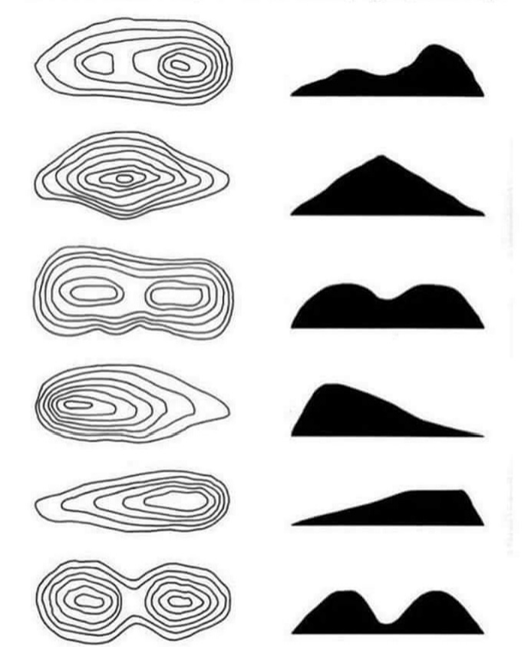
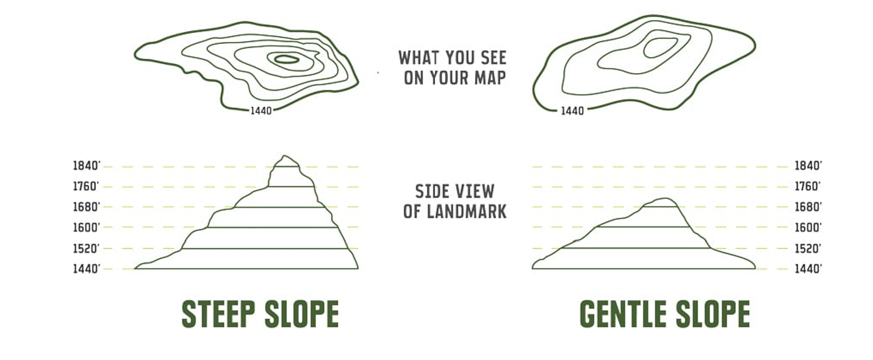
Topographic maps
Steep slope=closely spaced lines
Gentle slope= more spread-out lines

Slide 21
Lab 1 Instructions
Part 1
  Use provided text and images in lab handout to answer questions
Part 2
  Use Google Earth Pro and .kml file from Canvas to answer questions
If you finish in class, turn it in and go home
  If not, turn it in at the start of next lab

