Slide 1
GEOG/ESE 103
Lab 4 – Soils

Slide 2
Lecture goals
How to determine soil texture based on a grain size ternary diagram
What is a soil profile, and how do you classify soils based on their texture, climate and geographic location?

Slide 3
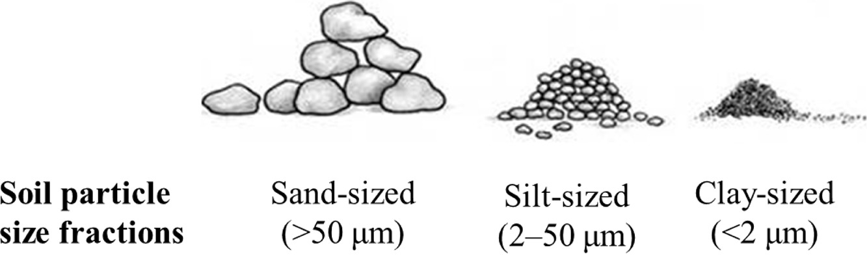
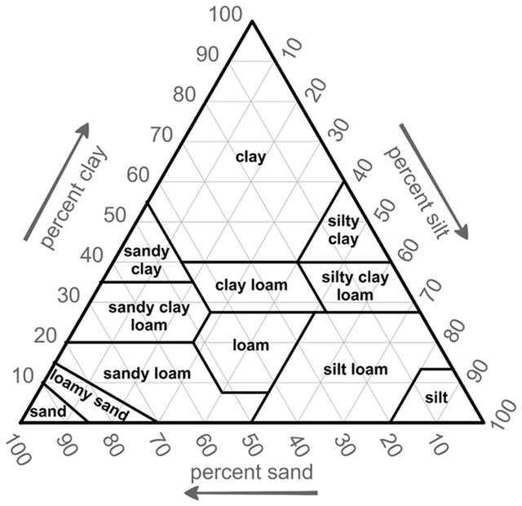
Soil texture
Adapted from Fan et al., 2019
Based on particle size
Soils rarely have single particle size; most are composite of different sized particles – soil texture is % weight of sand, silt and clay particles
Textural triangle
Groenendyk et al., (2015)

Slide 4
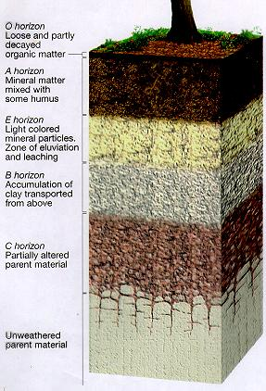
Soil profile
sequence of horizons – nearly horizontal layers of soils with different color, texture and composition
~1-2m from surface; related to water availability – hence reflects regional climate
Topsoil
Zone of
eluviation
Zone of
illuviation
Parent material
https://www.ctahr.hawaii.edu/mauisoil/a_profile.aspx

Slide 5
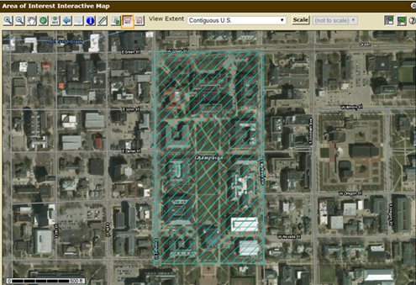
For question 1, this is what your AOI should look like

