Slide 1
GGIS/ESE 103
Lab 7 – Stream network and stream hydrology

Slide 2
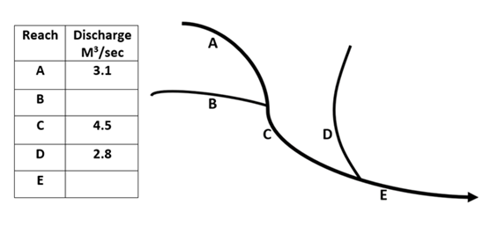
Question 1
Notes:
A stream network is a connected system of tributaries and main channels. At junctions, water from upstream branches combines, so downstream discharge is the sum of incoming flows.

Slide 3
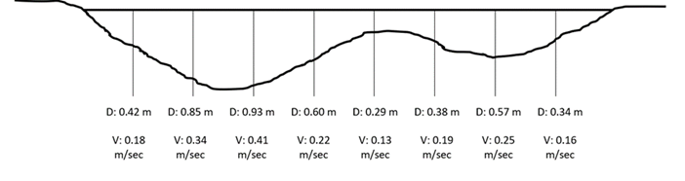
Question 2 , 3 & 4
Q= VA= V* depth*width
Q is discharge,
V is velocity, and
A is cross-sectional area
Notes:
Discharge is the volume of water passing a point per unit time. The slides use the basic relation Q=VAQ = VAQ=VA, meaning discharge equals flow velocity times cross-sectional area.
Cross-sectional area is the shape and size of the wetted channel slice. In simple cases it is approximated from depth × width, but in real channels it varies across the section, so discharge is often estimated in segments.

Slide 4
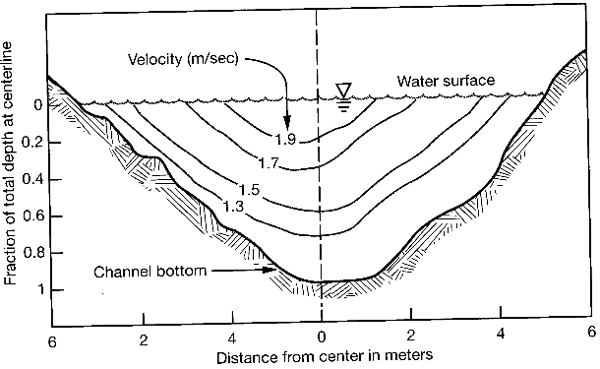
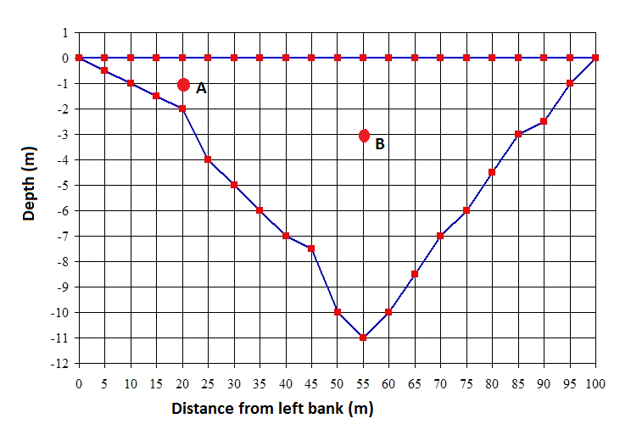
Question 5 & 6
Notes:
Water usually moves fastest near the deeper central part and slower near the banks and bed because friction is greater there. That is why some parts of the channel carry much more water than others.
The cross-section plots show that rivers are deeper in some parts than others. Deeper zones usually have greater flow capacity, and the deepest path often helps define where the strongest current moves.

Slide 5
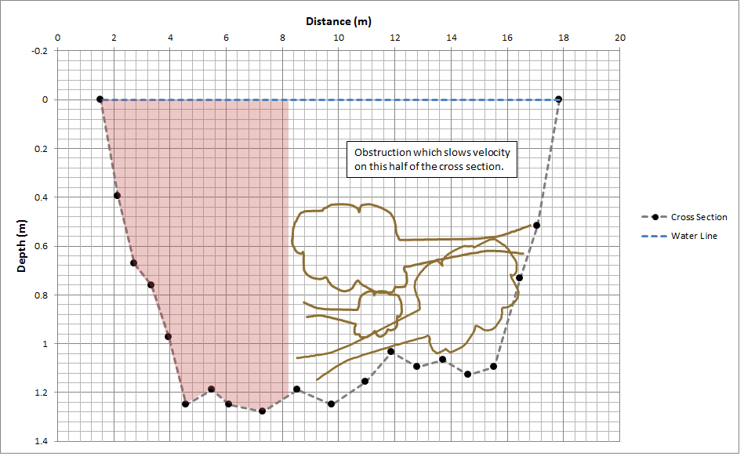
Question 7
Q = VA
= V* depth*width
Notes:
If an object blocks part of the channel, velocity drops in that area. Even if both sides have water, the obstructed side contributes less to total discharge because QQQ depends on both area and velocity.

Slide 6
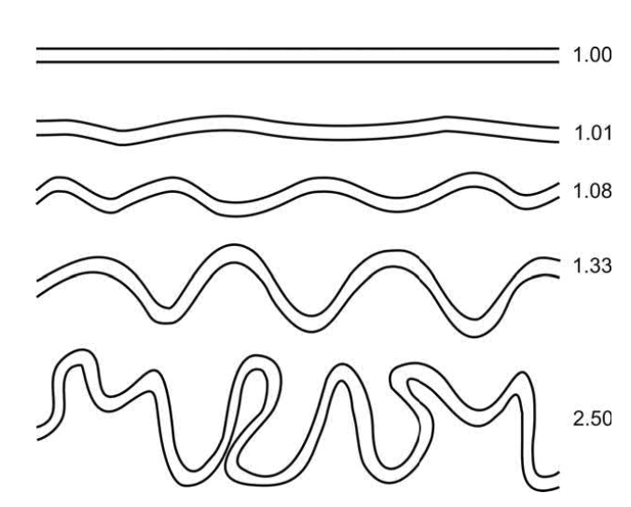
Sinuosity
Sinuosity= Length along the channel /valley length(straight line distance between the 2 points)
Inversely related to channel slope
Slope=elevation drop per unit distance
Notes:
Sinuosity measures how curved a channel is. It is the channel length divided by the straight valley length, so a straight river is near 1 and a meandering river has a higher value.
sinuosity is inversely related to slope. In general, flatter landscapes tend to allow more meandering, while steeper channels tend to be straighter.

Slide 7
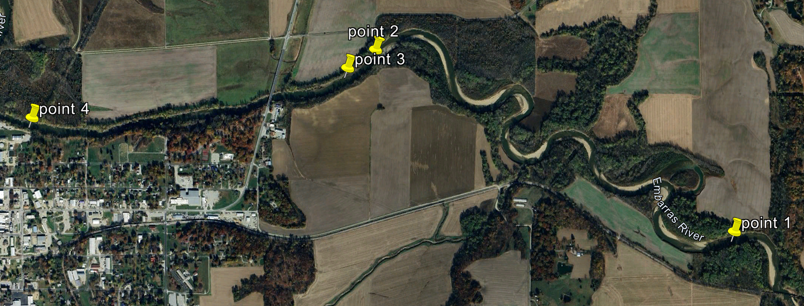
Question 8

Slide 8
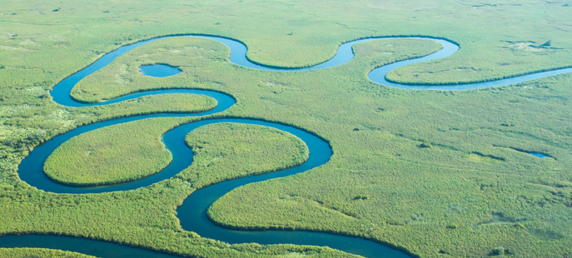
Meandering rivers
https://laurasriverfeatures.weebly.com/meanders.html
Notes:
Meanders form because flow is faster on the outer bend and slower on the inner bend. This causes erosion on the outside and deposition on the inside, which gradually shifts the bend over time.

Slide 9
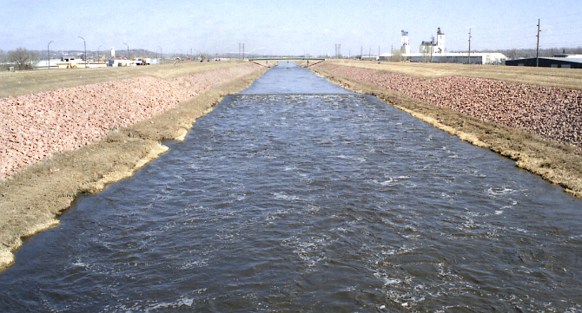
Straight rivers
Rare, usually human modified for navigation, agriculture
A channelized section of the Floyd River in Sioux City, Iowa
Notes:
Truly straight rivers are uncommon in nature. Many straight channels are human-modified, often for navigation, drainage, or agriculture, and this process is called channelization.

