Slide 1
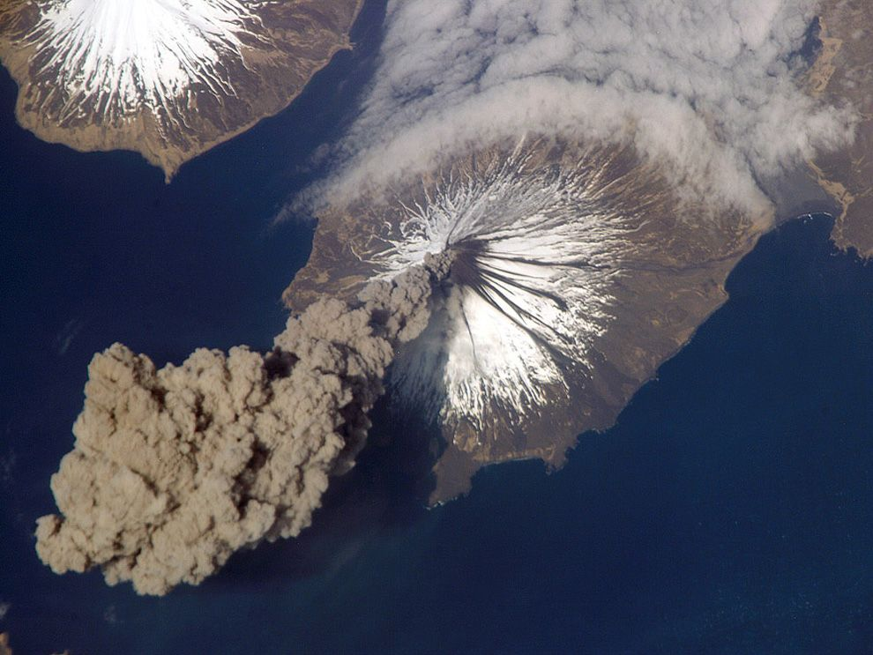
GGIS103 Earth’s Physical Systems
Week 4
Plate tectonics and Volcanoes
NASA Earth Observatory

Slide 2
Objectives
Recall tectonic processes from lecture
Explain how volcanoes are formed
Explain how continental boundaries are related to earthquakes
Describe the Richter Scale

Slide 3
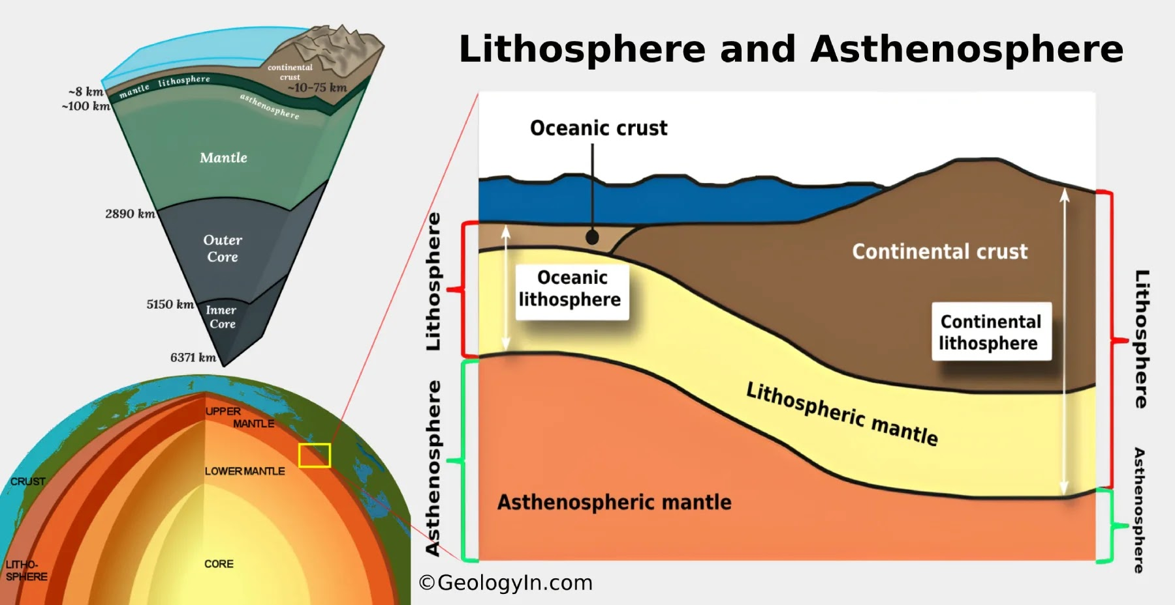
Lithosphere: Rigid top layer consisting of the crust and the very uppermost section of the mantle (the lithosphere is divided into tectonic plates)
Asthenosphere: Viscous layer below the lithosphere that undergoes more plastic deformation (tectonic plates move on top of the asthenosphere)

Slide 4
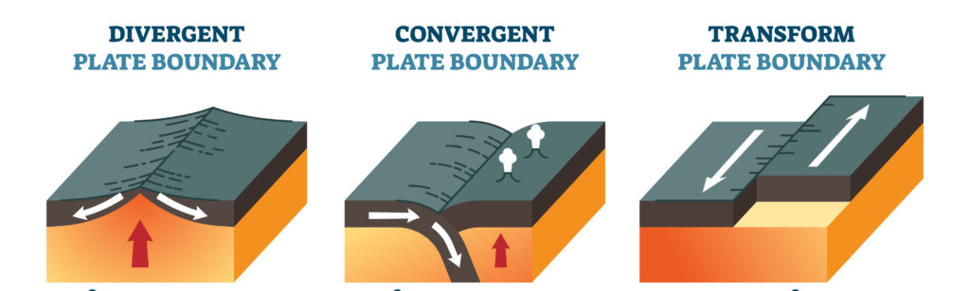
Plate Boundaries
Convergent boundaries – where two plates are colliding.
Divergent boundaries – where two plates are moving apart.
Transform boundaries – where plates slide pass each other.

Slide 5
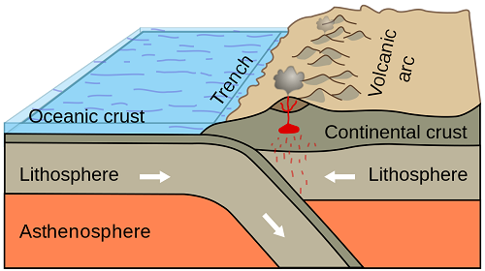
Subduction Zone
Higher density
Notes:
What kind of plate boundary does this diagram show?
One crust is thrust under the other one, usually the denser one

Slide 7
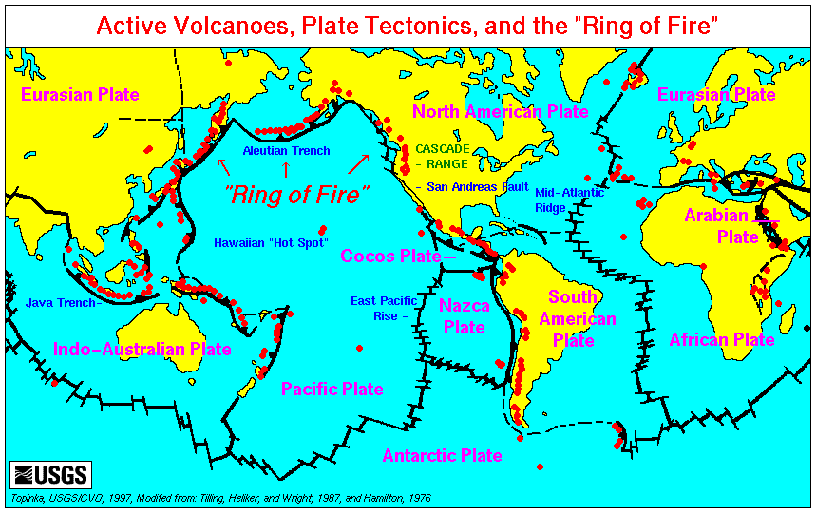
Ring of Fire
Stratovolcano (or composite volcano) — a conical volcano consisting of layers of solid lava flows mixed with layers of other rock.
Notes:
**is a path along the Pacific Ocean characterized by active volcanoes. The majority of Earth’s volcanoes take place along the Ring of Fire.
*Basically, volcanoes only form where there’s a way for the magma to migrate towards the surface – such as a plate discontinuity or an area where the crust is very thin. There are also so-called “hotspots” – areas where the underlying mantle is much hotter than in other areas, heat from this extra hot magma causes thinning of the crust and eventually it breaks and magma rises up and creates the volcano.either due to mantle plumes or lithospheric extension (it’s not clear yet which of the two theories is correct). Examples of hotspots include Hawaii and the Portuguese island of Madeira, but for the most part, volcanoes lie at the edge of tectonic plates.*question-not uniform: ring of fire, boundary of 2 plates

Slide 8
Faults
Fault: Fracture in the lithosphere (continental crust)
Convergent boundaries – Reverse fault
Divergent boundaries – Normal fault
Transform boundaries – Strike-Slip fault

Slide 9
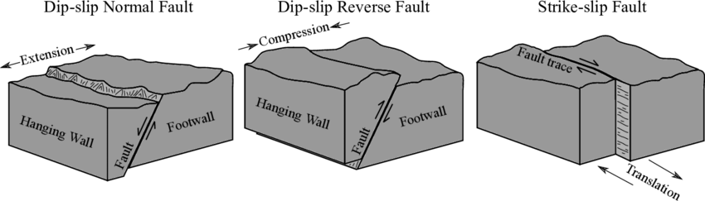
Faults

Slide 10
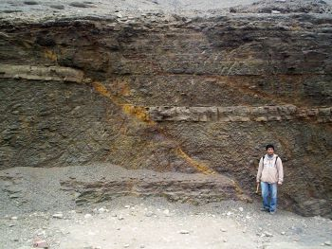
Notes:
Normal Fault

Slide 11
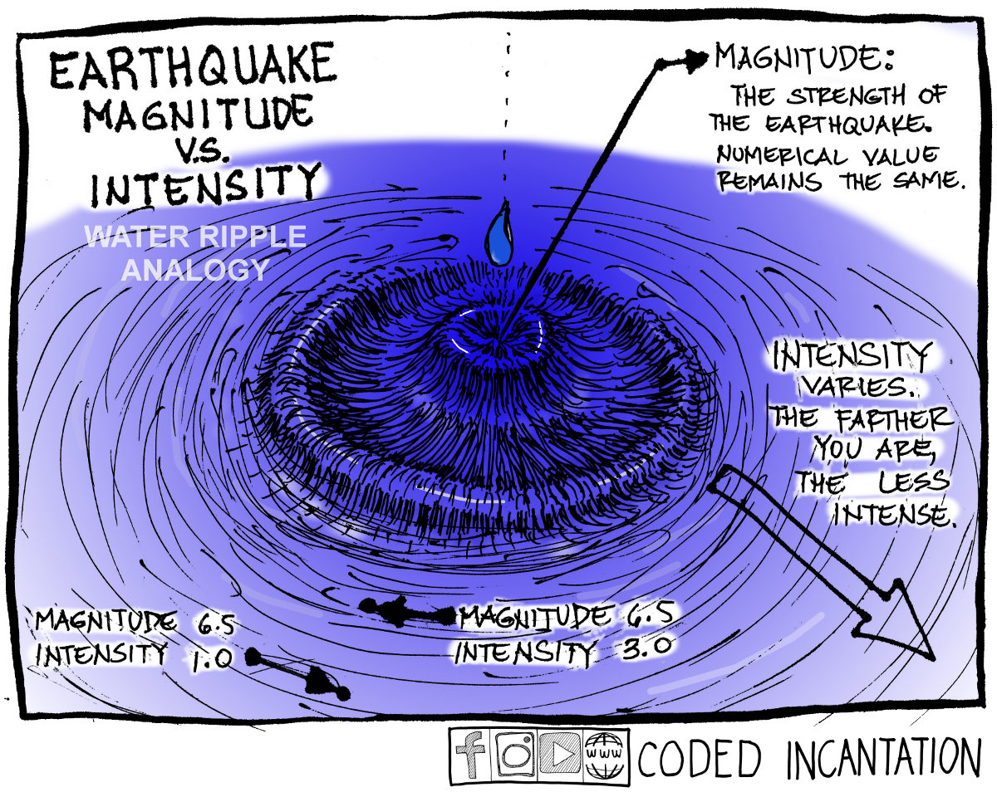

Slide 13
Notes:
Love waves are generally considered more destructive to man-made structures than Rayleigh waves. They travel faster, producing severe horizontal, side-to-side (transverse) ground shaking. This motion effectively shears the foundations of buildings, while Rayleigh waves produce a rolling, elliptical motion that is often less damaging by comparison.

Slide 14
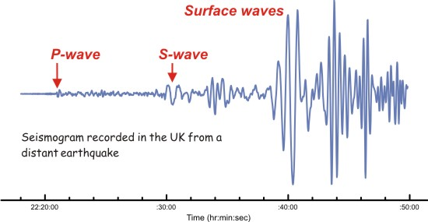
Seismograph
(primary)
(secondary)

Slide 15
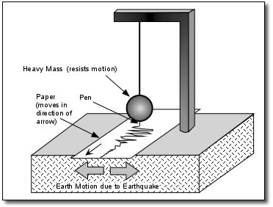
Seismograph

Slide 16
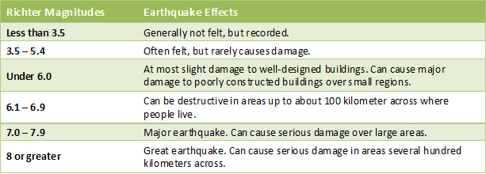
The Richter Scale
The Richter scale was invented by Charles F. Richter in 1934, in order to measure an earthquake's magnitude ( force ), calculated from the amplitude of the strongest seismic wave recorded for a specific earthquake.

Slide 17
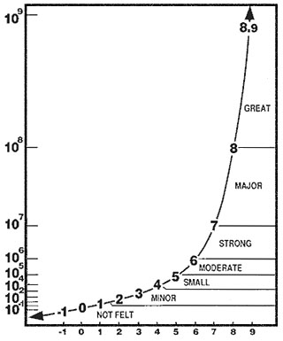
The Richter Scale
Base-10 Logarithmic Scale
Each order of magnitude is 10 times more amplified than the last one
Wave amplitude
Richter 2 is 10 times greater in amplitude than Richter 1
Richter 3 is 100 times greater than Richter 1
Notes:
Each magnitude increases by a factor of 10

