Slide 1
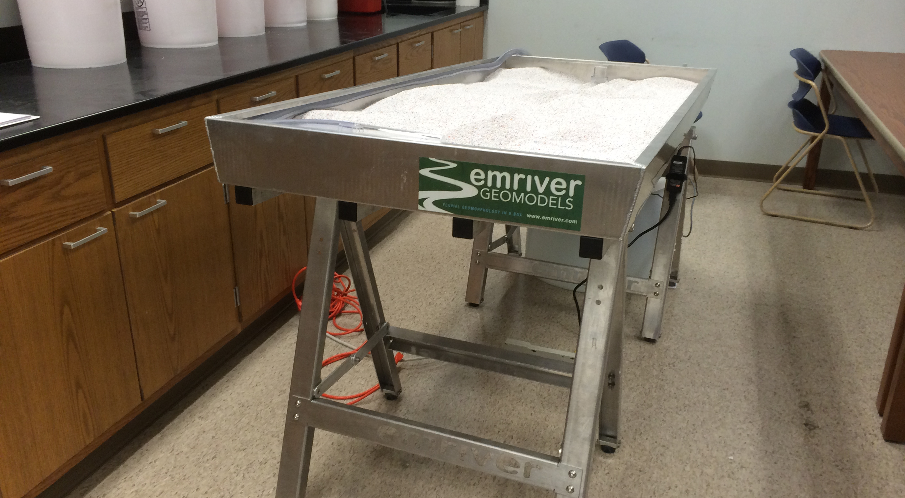
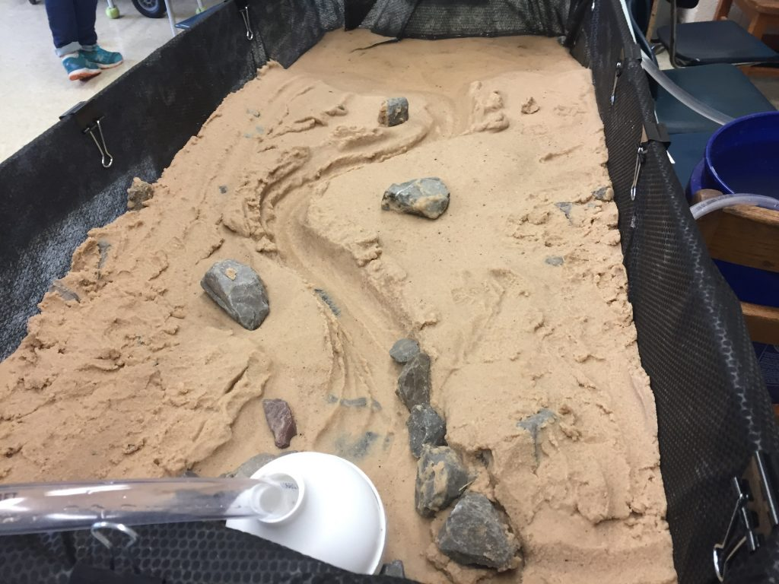
stream table

Slide 2
Why Model Rivers in the Lab?
Real rivers: large, slow, expensive, and difficult to control
Stream tables let us isolate one variable at a time
Think about:
Cost and safety vs. fieldwork
Controlling slope, discharge, and sediment independently
Compressing years of change into minutes

Slide 3
Limitations of the Model
No model perfectly replicates a natural system
What does a stream table leave out?
Scale: lab table vs. kilometer-wide floodplains
Sediment: uniform lab sand vs. natural mixed grain sizes
No vegetation, biology, or human structures

Slide 4
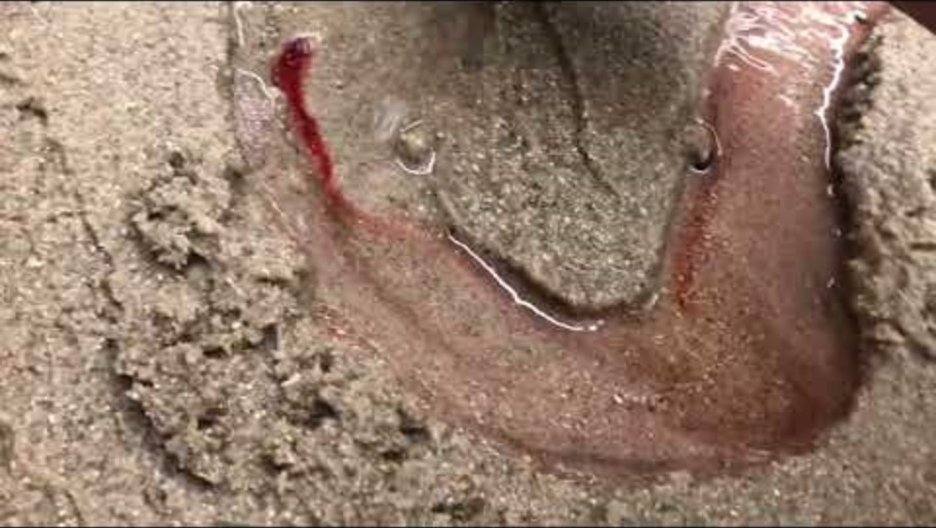
Stream Table Demonstration

Slide 5
What Makes Water Move?
Water flows from higher to lower elevation
The propping of the stream table on one side creates that elevation difference
Ask yourself:
What physical force pulls water downhill?
How does a steeper table slope affect velocity?
What happens to flow if the slope reaches zero?

Slide 6
Two Processes Shaping Every Channel
Erosion: material is detached and removed from a surface
Deposition: transported material settles and accumulates
Observed during the video demo:
Where is bank material being worn away?
Where does sediment pile up?
Can both happen at the same time in one channel?

Slide 7
Increasing Discharge: What Changes?
Discharge = volume of water passing a point per unit time
Higher discharge means more energy available to do work
the channel banks when flow increases:
Does erosion speed up or slow down?
Does the channel widen, deepen, or both?
Where does eroded sediment end up?

Slide 8
Grain Size and Flow Competence
Competence: the largest particle a flow can move
Not all grains respond to flow the same way
Watch which grains move first when flow begins:
Fine grains vs. coarse grains -- which go first?
What happens to larger particles at the same flow?
What does this predict about where different grain sizes settle along a river?

Slide 9
Velocity Patterns Across the Channel
Velocity is not uniform -- it varies with position
Friction from the bed and banks slows water near boundaries
Observed during the demo:
Channel center vs. edges: which is faster?
Inside of a bend vs. outside of a bend?
Where does erosion tend to concentrate, and why?

Slide 10
Where the River Meets Still Water
Flow velocity requires a gradient -- what if the gradient disappears?
Watch the downstream end of the stream table:
Where does sediment first start to drop out?
What shape does the deposit form?
Do coarse and fine grains settle in the same place?
This landform has a Greek letter name -- identify it from what you observe

