Slide 1
Lab 5: Watersheds

Slide 2
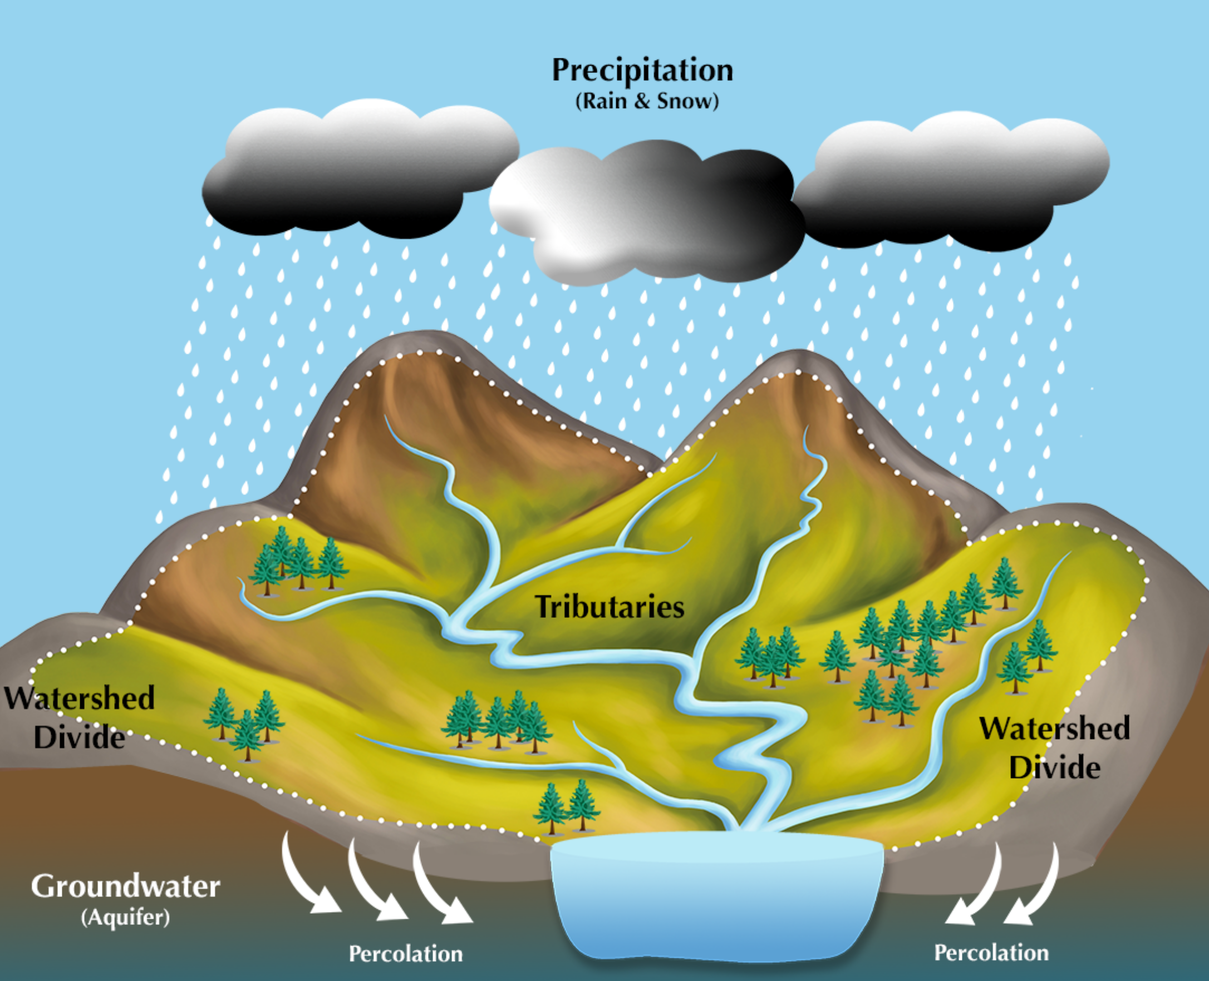
Watersheds
Define the area of land that contributes water to a stream/river
Drainage basin
Identifies highest points surrounding a river

Slide 3
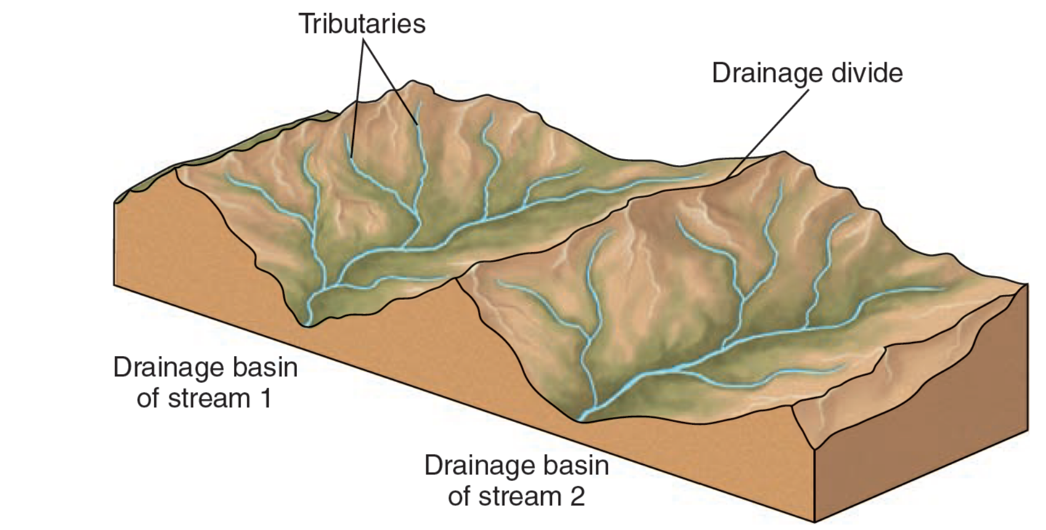

Slide 4
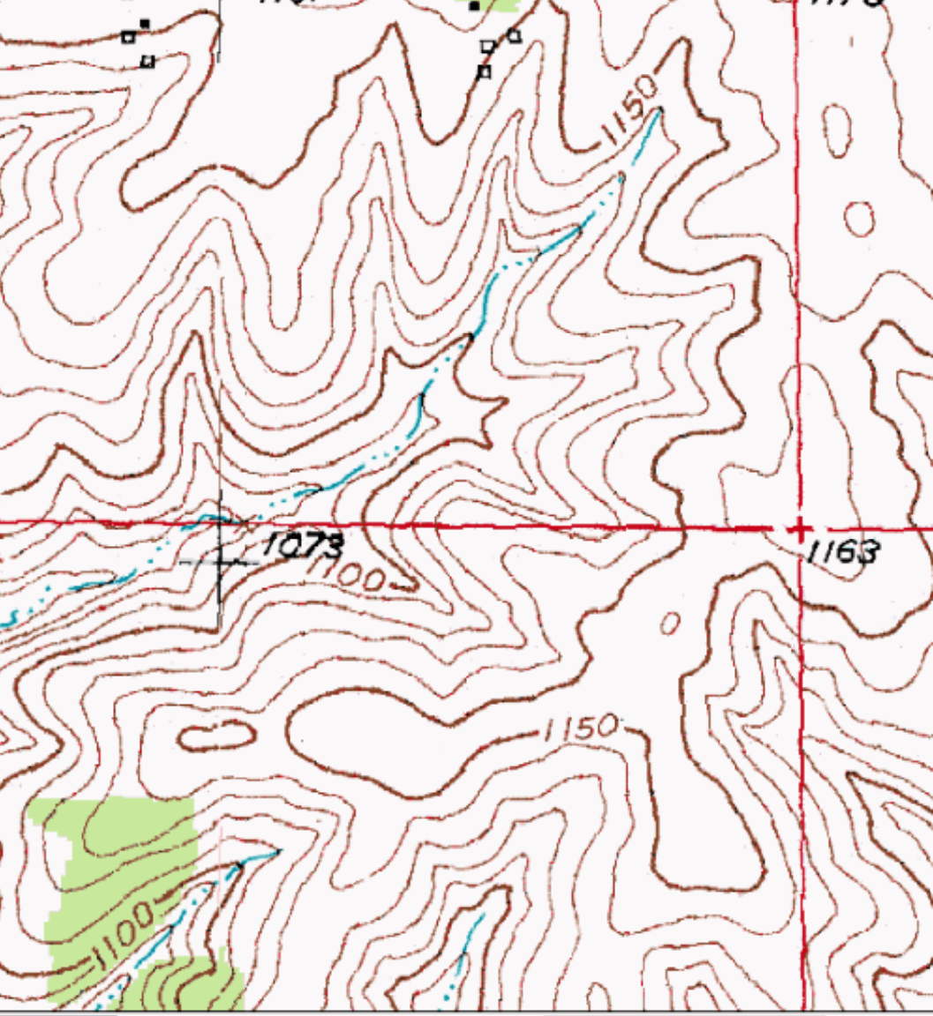
Watersheds
Topographic maps can help us delineate watershed boundaries
Review from lab 1:
Contour lines- lines connecting points of same elevation on the surface
Index contour – bold lines (every 5th line)
Contour interval

Slide 5
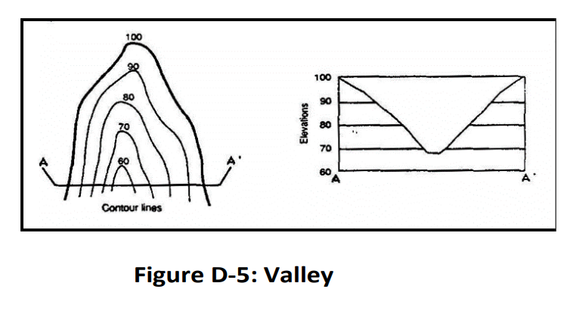
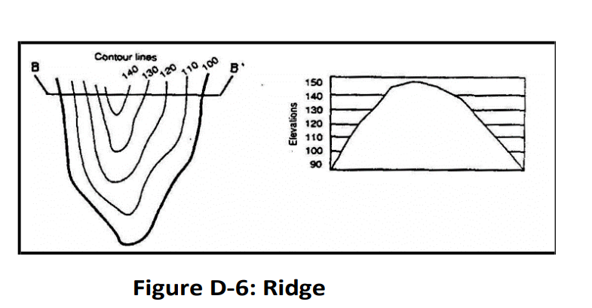
Valleys = V’s point uphill (towards high elevation)
Ridges = V’s point downhill (towards lower elevation)

Slide 6
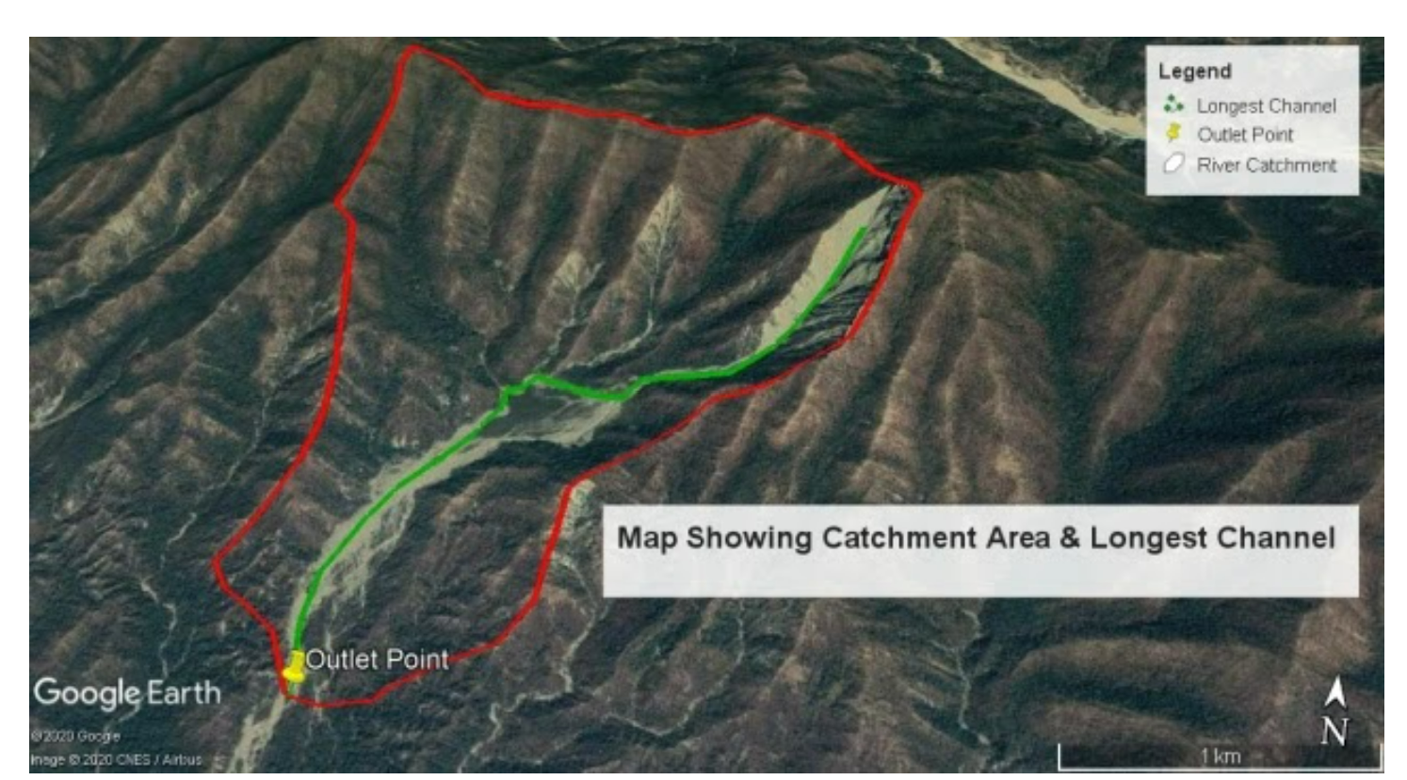
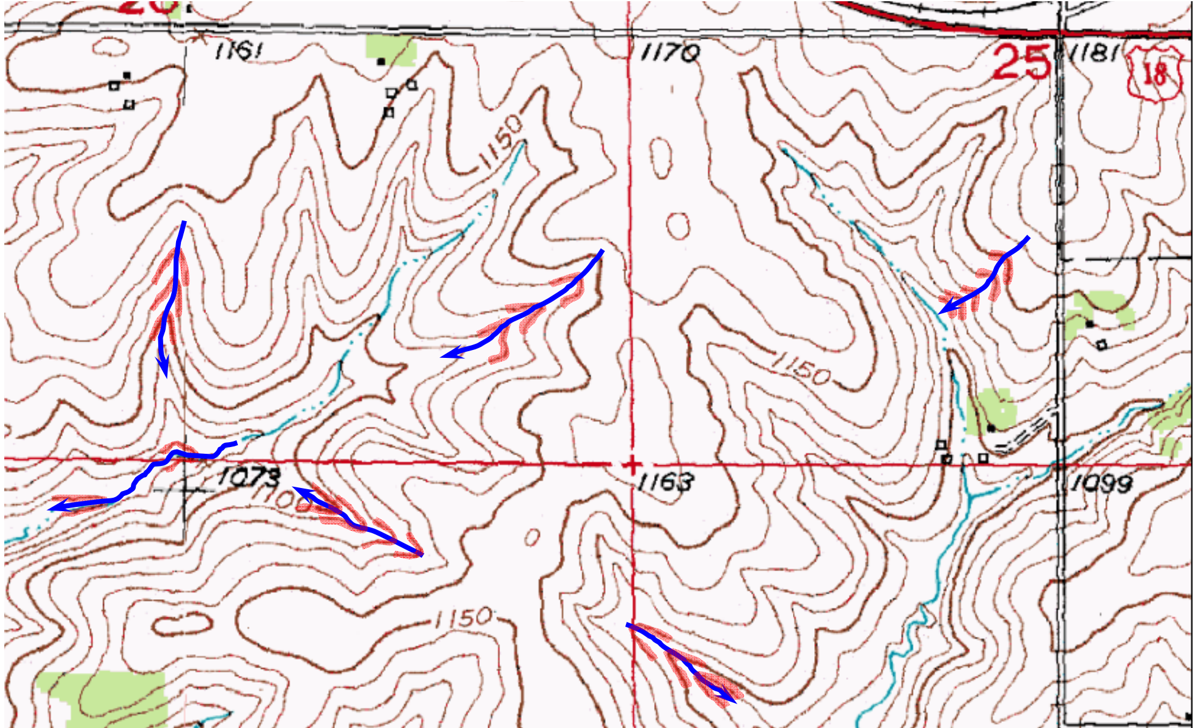
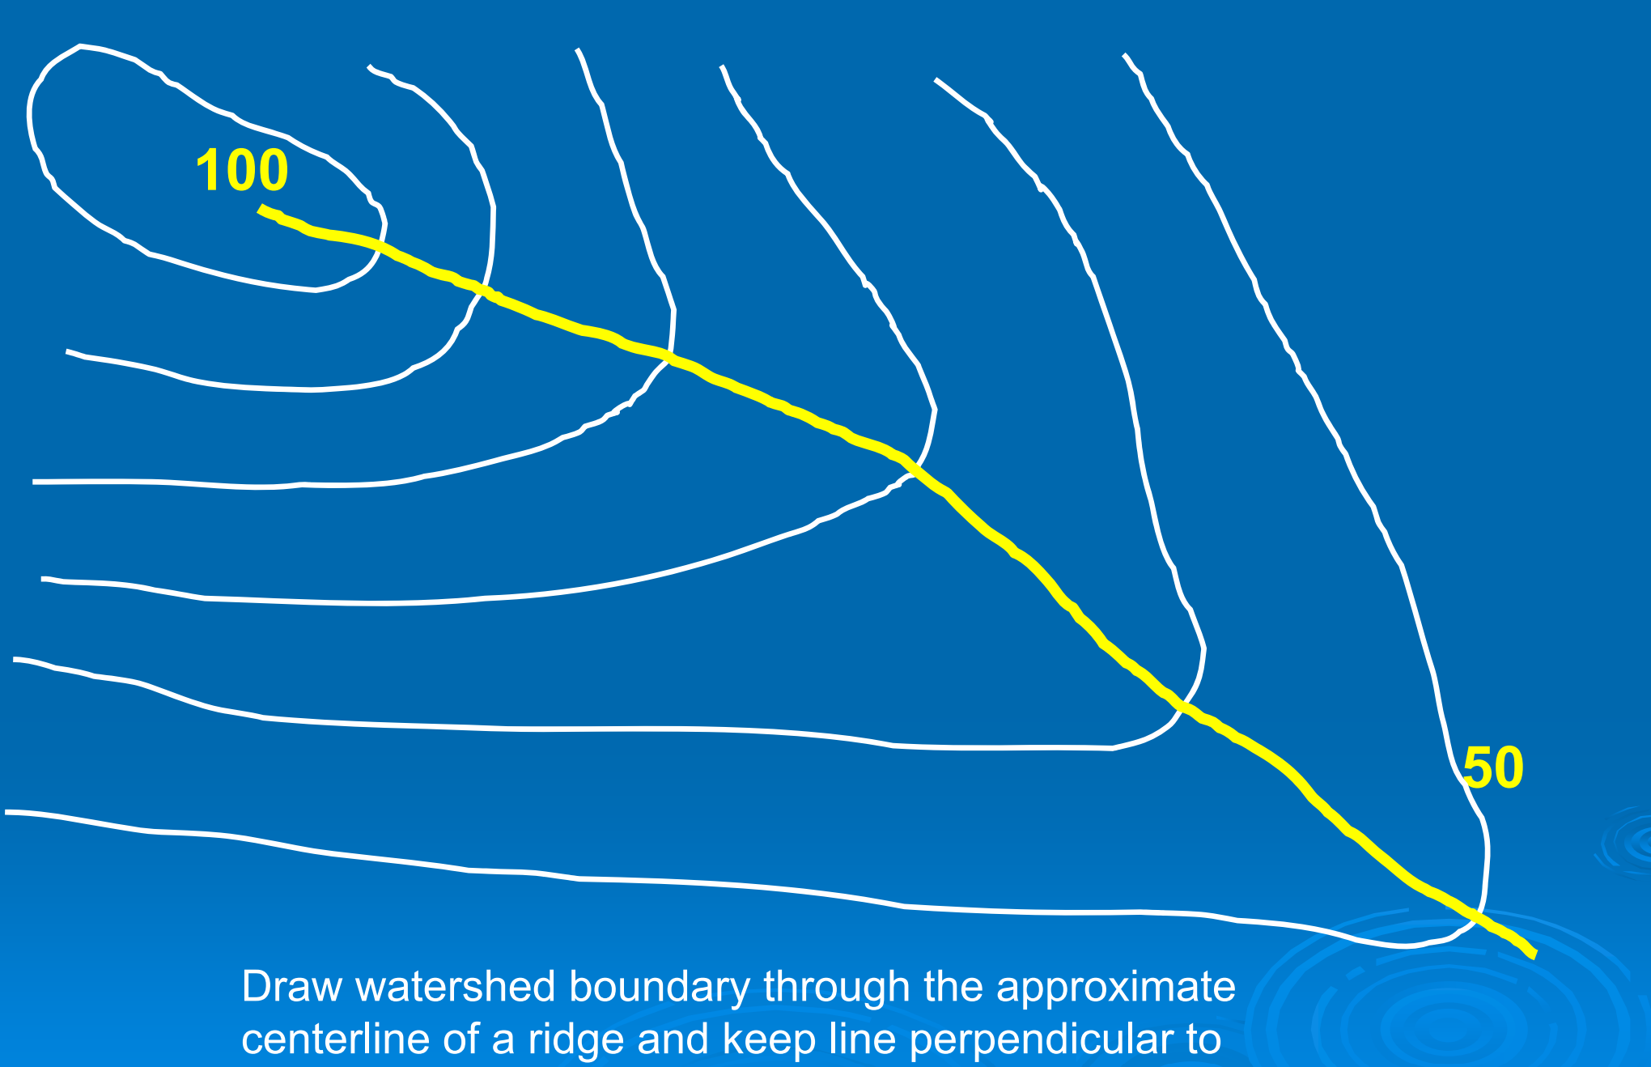
Valleys = V’s point uphill (towards high elevation)
Ridges = V’s point downhill (towards lower elevation)

Slide 7
Steps for watershed delineation:
Step 1: identify the outlet and headwater (already labelled in worksheet) **next you may want to roughly mark the high elevation (headwater) and low elevation (outlet) region
Step 2: identify the high areas (look for closed area/circle) that are close to the river
Step 3: identify valleys and ridges
Valleys = V’s point uphill (towards high elevation)
Ridges = V’s point downhill (towards lower elevation)
Step 4: draw the streams along the valleys (no need to do for now)
Step 5: connect the high points and ridges with the outlet with perpendicular line
***Watershed delineation is perpendicular to contour lines***

Slide 8
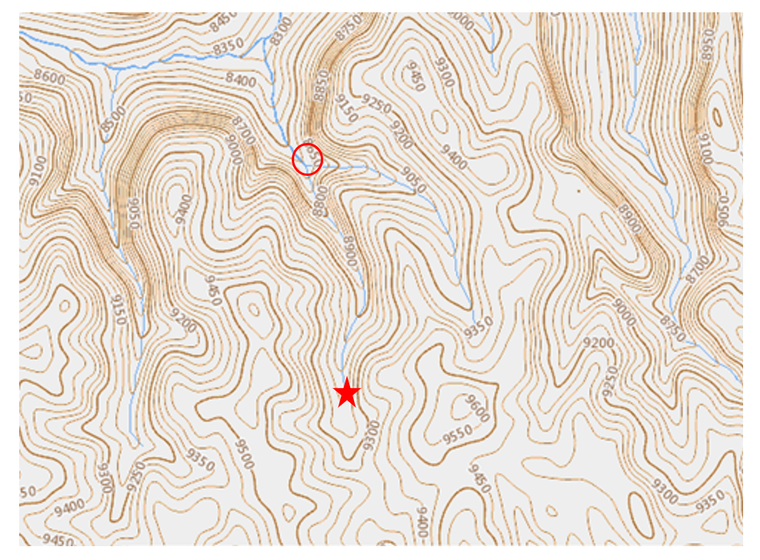

Slide 9
Water budget
A simple comparison of water supply and atmospheric demand
Water budget = Precipitation (P) − Potential evapotranspiration (PE)
Precipitation (P)
Potential ET (PE)
Water coming in
from rain or snow
compared with
How much water the air
could remove if water is available
↓
If P > PE → water surplus
If P < PE → water deficit

Slide 10
Get started with the worksheet!
Option to use Excel spreadsheet to graph for question 2
If you do this option, upload excel spreadsheet to the Canvas assignment “Lab 5”
Make sure to label axes and differentiate between P and PE
Label which graph is Champaign, and which is Austin

