Slide 1
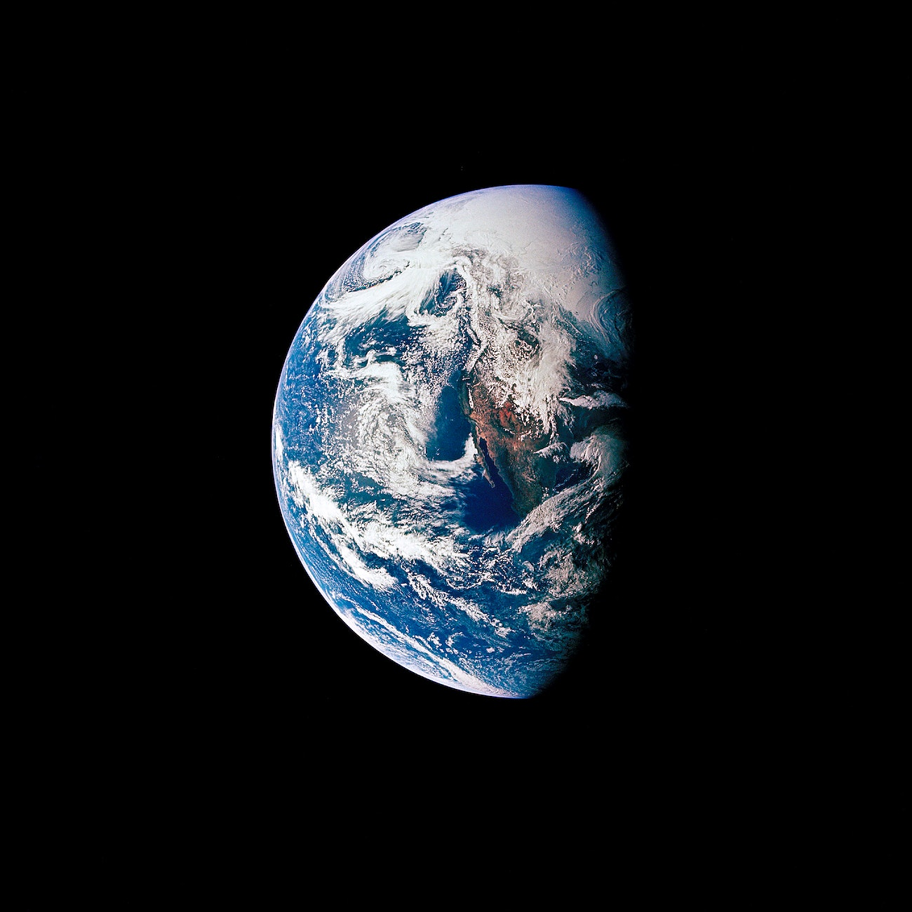
GGIS/ESE 103 Lab
Earth’s Physical Systems

Slide 2
Let’s Get to Know Each Other!!
Your name and where are you from?
What is your major? (or what are you interested in if you’re undeclared)
Why are you taking this class? (maybe your friends told you that the grading on this course is easy?!)

Slide 3
Syllabus
Week | Date | Subject
Week 1 | Jan 22/23 | Lab introduction, policies, and overview
Week 2 | Jan 29/30 | Intro to Google Earth; Topographic maps
Week 3 | Feb 5/6 | 2. Rocks
Week 4 | Feb 12/13 | 3. Plate tectonics and Volcanoes
Week 5 | Feb 19/20 | No Lab
Week 6 | Feb 26/27 | 4. Soils
Week 7 | Mar 5/6 | 5. Watersheds
Week 8 | Mar 12/13 | 6. Hillslopes and Landslides
Week 9 | Mar 19/20 | No Lab (Happy Spring Break!)
Week 10 | Mar 26/27 | 7. Stream network and stream hydrology
Week 11 | Apr 2/3 | 8. Stream Table
Week 12 | Apr 9/10 | 9. Wind and Desert Environments
Week 13 | Apr 16/17 | 10. Glaciers and Periglacial Environments
Week 14 | Nov 23/24 | 11. Coastal Systems
Week 15 | May 7/8 | 12. Biomes and Ecosystems
12 labs (10 points each)
10 best grades
35% of total course grade

Slide 4
Lab Etiquette
Can work together, but complete and turn in your own lab
Feel free to leave when after finishing lab
Turn in lab whenever you’re done during that lab period
Look at the lecture slides before you come to lab
Ask me any questions! (not that I know it all, but we can learn it together!)

Slide 5
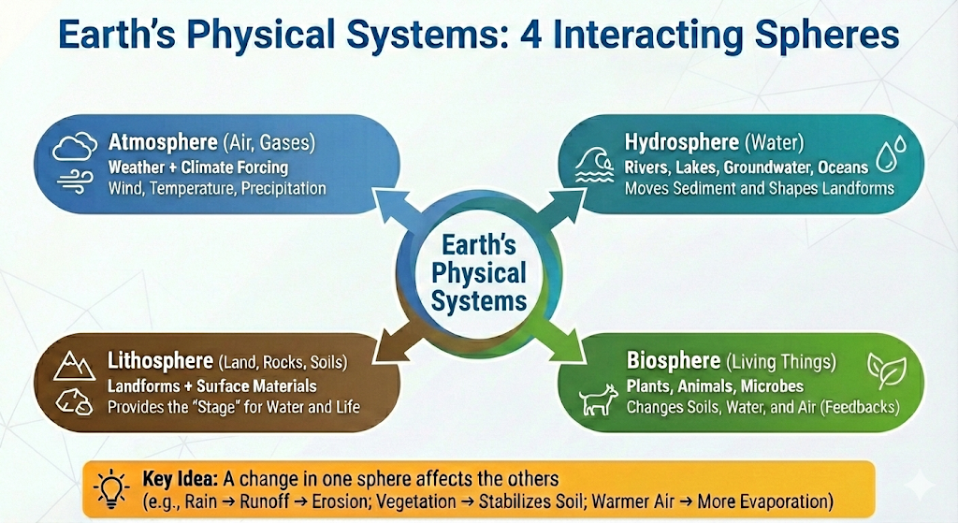

Slide 6


