Slide 1
Lab 6: Mass movement

Slide 2
Mass movement basics
We simplify the landslide into one block and use math to track how gravity turns height into motion.
Block size
length × width × height
Volume
how much space the block fills
Mass
density × volume
Potential energy
stored energy from being high on the slope
Velocity
speed after energy becomes motion
Key idea: a bigger vertical drop gives the block more gravitational energy to convert into movement.

Slide 3
How the equations connect
Q1 moves from geometry to energy to speed.
1 V = L × W × H
Use the block dimensions to get volume.
2 m = density × V
Turn volume into mass.
3 PE = mgh
Compute stored gravitational energy from the starting height.
4 PE = KE = ½mv²
Assume no losses, solve for v, then convert m/s to mph.
Real landslides lose energy to friction, roughness, and deformation, so actual speeds are lower.

Slide 4
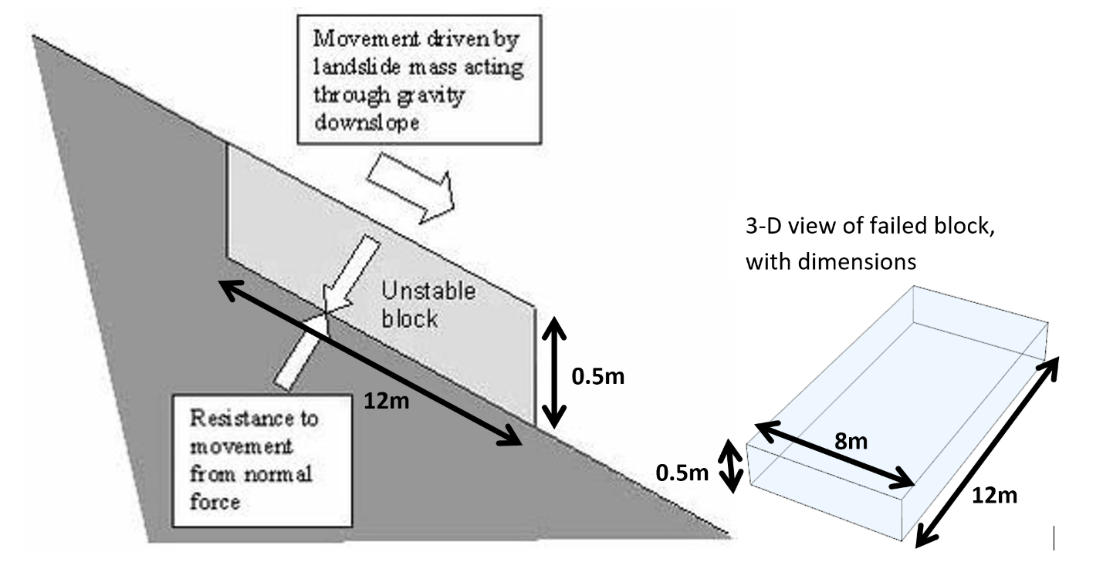
Q1
Part a
Volume = Length x width x height
Mass = Density * volume
Givens: Height = .5 m
Length = 12 m
Width = 8 m
Density of quartz = 2650 kg/m³
Step 1: l x w x h
12m *8m *0.5m = ___ cubic meters
Step 2: Mass = volume * density
__ m³ * 2650 kg/m³ = ________ kg

Slide 5
Q1 Part b
Givens:
Potential energy = mass*gravitational constant * height = ? J
Mass = (see part a) kg
Gravitational constant (g) = 9.81 m/s²
Height (h) = 500 m
Answer will be in Joules = kg*m²/s²
Notes:
h height above ground

Slide 6
Q1 Part c
Givens:
Kinetic energy = 0.5 *mass* velocity²
Mass = (see part a) kg
Height (h) = 500 m
Velocity = ?
Notes:
Ke due to motion

Slide 7
Q1 Part d
Convert m/s to mph
1 mile = 1609.34 meters
1 hour = 3600 seconds (1 hr = 60 minutes = 60 seconds)
Is this speed realistic? (Think about the arrows)
Notes:
13-mass movement lecture slide 6

Slide 8
Before Q2: soil creep
Soil creep is the very slow, downhill movement of soil and loose sediment under gravity. It is usually gradual, but over time it can reshape a slope.
qₛ how fast soil is creeping downhill
qₛ = kₑ × S
soil creep rate = diffusion constant × slope
kᵈ how easily sediment moves; vegetation usually lowers it
S slope steepness, usually rise/run
For this lab, both hills have the same slope geometry. The main change is kᵈ, which helps show why vegetation can reduce creep.

Slide 9
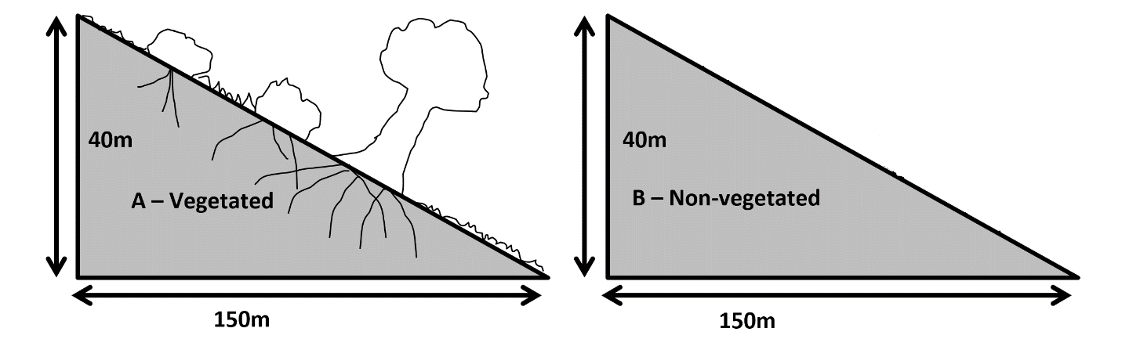
Q2
Slope – rise over run, height/length
Figure out your equation, figure out your givens, SOLVE!
Why would being vegetated make a slope less vulnerable to soil creep?
Notes:
Creep-slow downward movement of soil, low gradient, loose soil or burrowing animals could play a role
Flux diffusion- how much sediment is moving over a specific area
Roots of the vegetation hold the soil together

Slide 10
Google earth pro
Ruler- polyon
Show historical imagery (can go before April 2014 to better identify the landslide area

