Slide 1

SEMINAR ON
RIS-ASSISTED WIRELESS COMMUNICATIONS
SECOND PRESENTATION
RESEARCHER: SADJAD ALIKHANI
UNIVERSITY OF TEHRAN
FALL 2021

Slide 2


OUTLINE
1- REVIEW OF THE 1ST PRESENTATION
2- PHYSICAL LAYER SECURITY
2-1- PASSIVE EAVESDROPPING
2-2- ACTIVE EAVESDROPPING
3- SYSTEM MODEL
4- CHANNEL ESTIMATION
5- ACTIVE PILOT ATTACK
6- DOWNLINK DATA TRANSMISSION
7- ACHIEVEABLE SECRECY SUM-RATE
8- PRECODING AND PHASE-TUNING
8-1- STOCHASTIC SRZF PRECODING
8-2- ALTERNATING OPTIMIZATION
8-3- SEMIDEFINITE RELAXATION
9- ITERATIVE ALGORITHM
10- SIMULATION
11- REFERENCES
UNIVERSITY OF TEHRAN SEMINAR REASEARCH: RIS-ASSISTED WIRELESS COMMUNICATIONS 2 / 27

Slide 3
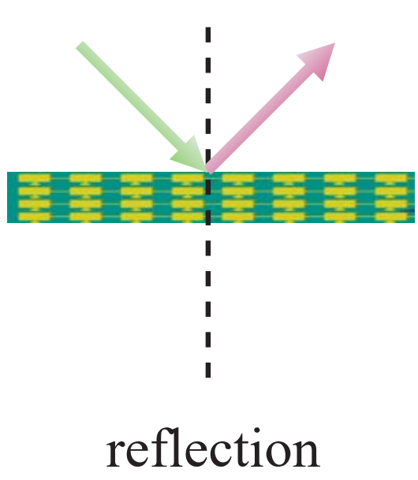
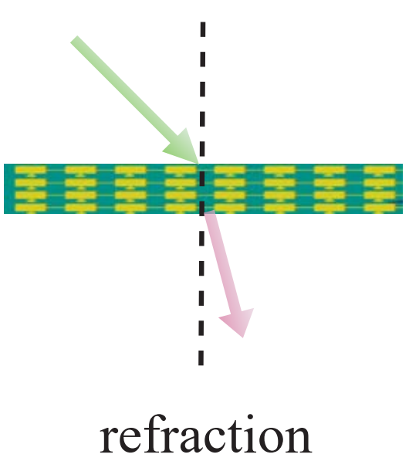
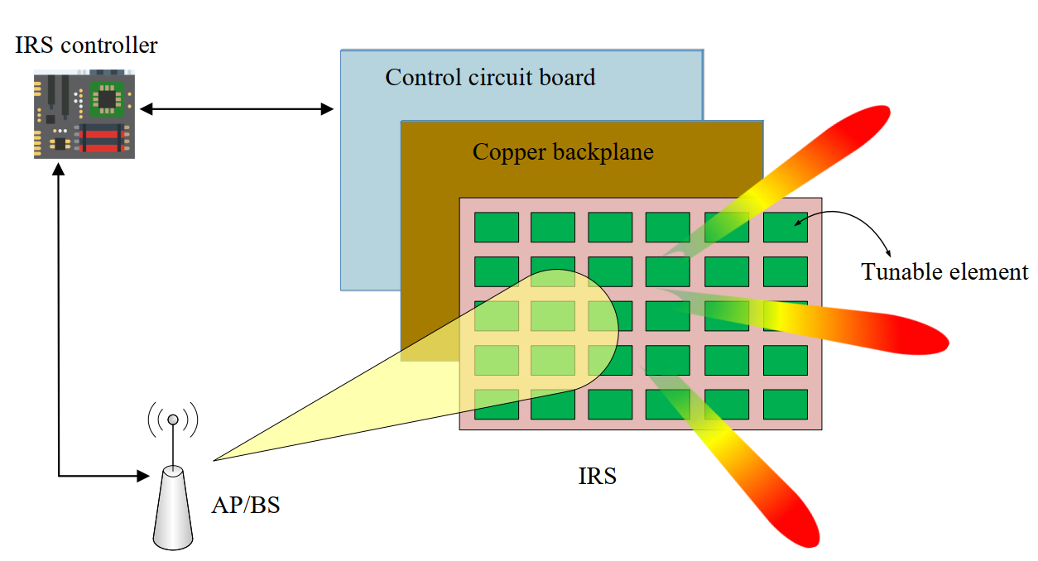
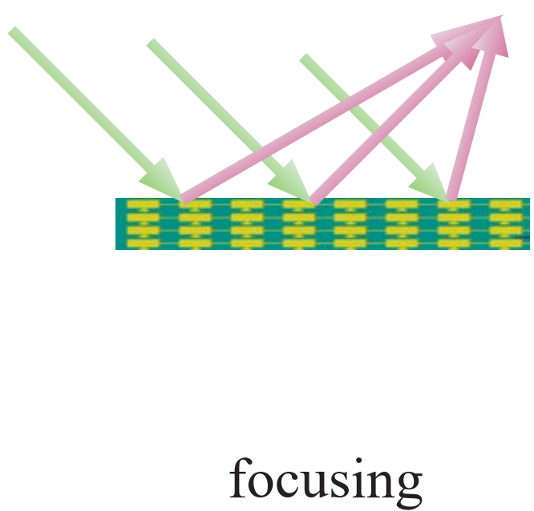
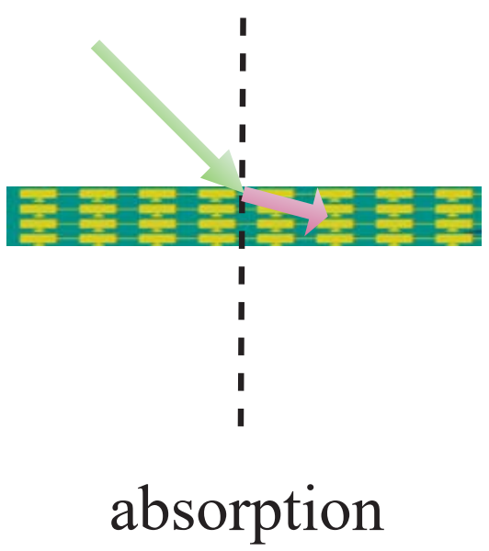
REVIEW (RECONFIGURABLE INTELLIGENT SURFACES)
Figure 1: Architecture of RIS
Figure 2: EM-based activities of RIS
[1] Wu, Qingqing et al. “Intelligent Reflecting Surface-Aided Wireless Communications: A Tutorial.” IEEE Transactions on Communications 69 (2021): 3313-3351.
[2] K. M. Faisal and W. Choi, "A Study on Machine Learning-based Approaches for Reconfigurable Intelligent Surface," 2021 International Conference on Information and Communication Technology Convergence (ICTC), 2021, pp. 227-232, doi: 10.1109/ICTC52510.2021.9620993.
UNIVERSITY OF TEHRAN SEMINAR REASEARCH: RIS-ASSISTED WIRELESS COMMUNICATIONS 3 / 27

Slide 4
REVIEW (CHALLENGES)
1
2
3
REFLECTION OPTIMIZATION
Cooperative signal focusing and/or interference cancellation in RIS’ local proximity
>>
Jointly design with the BSs’/users’ transmissions
>>
End-to-end communications optimization
CHANNEL ESTIMATION
No RF Chains
>>
Channel Estimation is essential to the RIS reflection optimization
>>
A difficult task especially with a large number of reflecting elements
DEPLOYMENT
Optimal deployment strategy of RISs
>>
Maximizing the network capacity
>>
Passive and reflecting structure of RIS ( vs active and transmit/receive ) makes it difficult
UNIVERSITY OF TEHRAN SEMINAR RESEARCH: RIS-ASSISTED WIRELESS COMMUNICATIONS 4 / 27

Slide 5
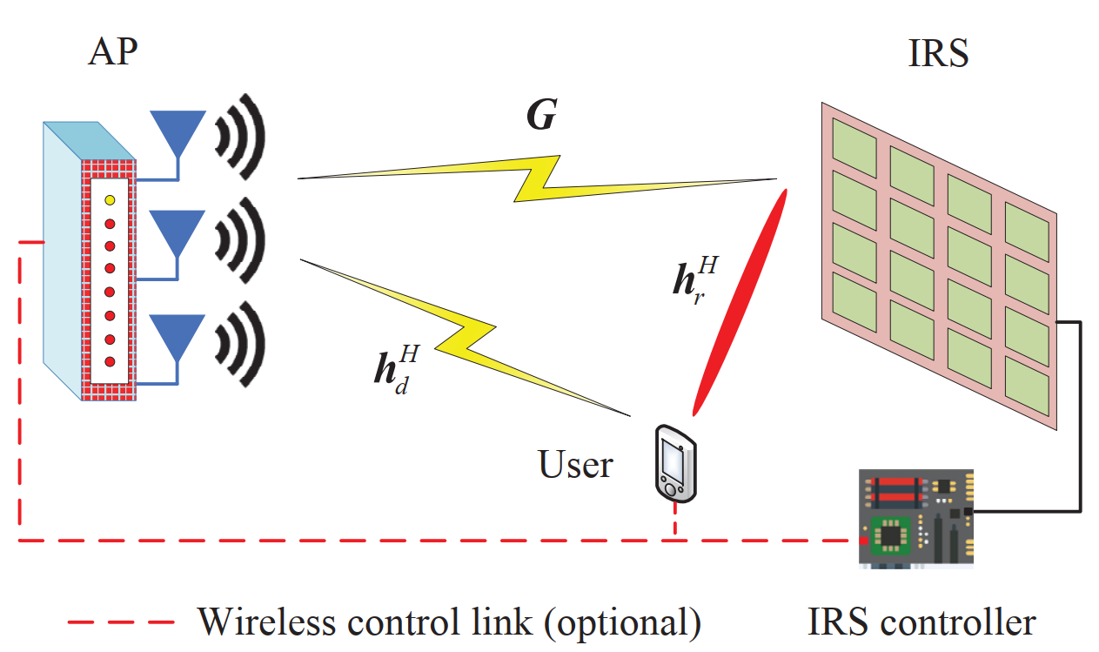
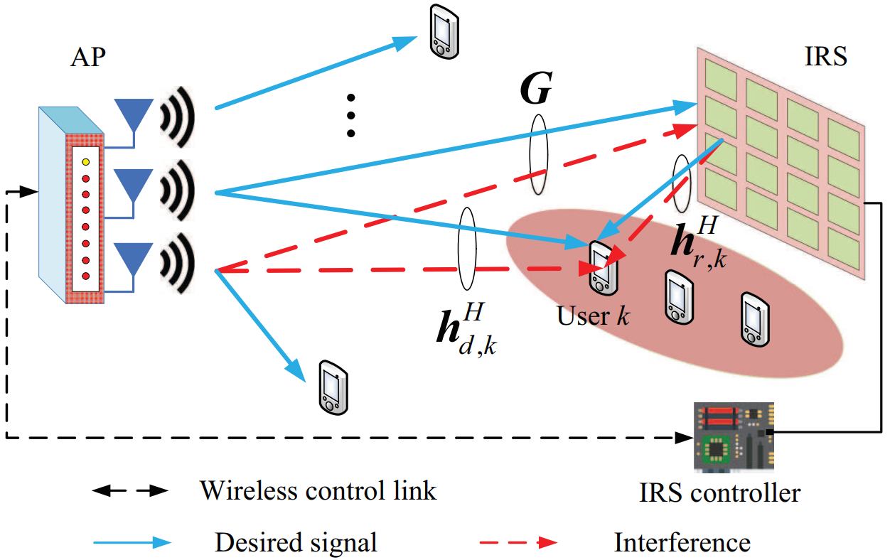
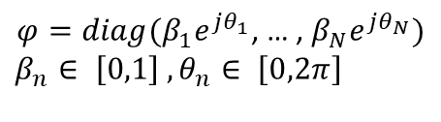
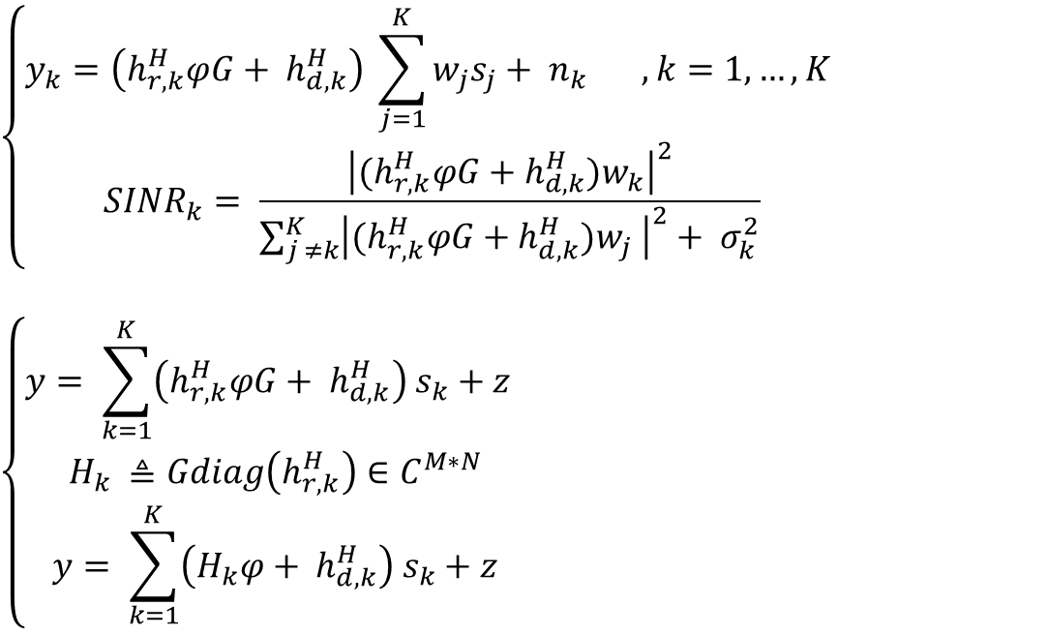
REVIEW (SYSTEM MODEL)
$$\left\{\begin{aligned}y_{k}=\left(h_{r,k}^{H}φG+ h_{d,k}^{H}\right) \sum_{j=1}^{K}{w_{j}s_{j}+ n_{k}} , k=1,…, K \\ {SINR}_{k}= \frac{{\left|(h_{r,k}^{H}φG+h_{d,k}^{H})w_{k}\right|}^{2}}{\sum_{j ≠k}^{K}{{\left|(h_{r,k}^{H}φG+h_{d,k}^{H})w_{j} \right|}^{2}+ σ_{k}^{2}}}\end{aligned}\right.$$
$$\left\{\begin{aligned}y= \sum_{k=1}^{K}{\left(h_{r,k}^{H}φG+ h_{d,k}^{H}\right) s_{k}+z} \\ H_{k} ≜Gdiag\left(h_{r,k}^{H}\right)∈C^{M∗N} \\ y= \sum_{k=1}^{K}{\left(H_{k}φ+ h_{d,k}^{H}\right) s_{k}+z}\end{aligned}\right.$$
Figure 3: MISO IRS-assisted communication system
$φ=diag(β_{1}e^{jθ_{1}}$, … , $β_{N}e^{jθ_{N}})$
$$β_{n}∈ \left[0,1\right] ,θ_{n}∈ \left[0,2π\right]$$
Figure 4: MIMO IRS-assisted communication system
UNIVERSITY OF TEHRAN SEMINAR RESEARCH: RIS-ASSISTED WIRELESS COMMUNICATIONS 5 / 27

Slide 6
REVIEW (PROBLEM FORMULATION)
PERFECT CSI
UNKNOWN CSI
Energy Efficiency:
Power Minimization [1],[2],[3],[4],[5]
Energy Efficiency Maximization [1],[2]
Harvested Power Maximization (SWIPT) [1]
SINR Maximization:
Min SINR Maximization [1],[2]
Rate Maximization:
Rate Maximization [1],[2],[3],[4],[5],[6],[7],[8]
Weighted Sum-rate Maximization [1]
Spectral Efficiency Maximization
Ergodic Capacity Maximization [1]
Security Enhancement:
Minimum-secrecy-rate Maximization [1]
Jamming Minimization (UAV) [1]
Secrecy Rate Maximization [1],[2]
Cascaded Channel Estimation Methods:
On/Off Method [1]
Discrete Fourier Transform (DFT) Protocol Based [1]
Sparse Channel Matrix Recovery [1]
Deep Denoising Convolutional Neural Network (DnCNN) [1],[2]
Generative Adversarial Network (GAN)
Deep Learning [1],[2]
Compressed Sensing [1]
Element Grouping [1],[2]
Convolutional Neural Network (CNN) [1]
UNIVERSITY OF TEHRAN SEMINAR RESEARCH: RIS-ASSISTED WIRELESS COMMUNICATIONS 6 / 27

Slide 7
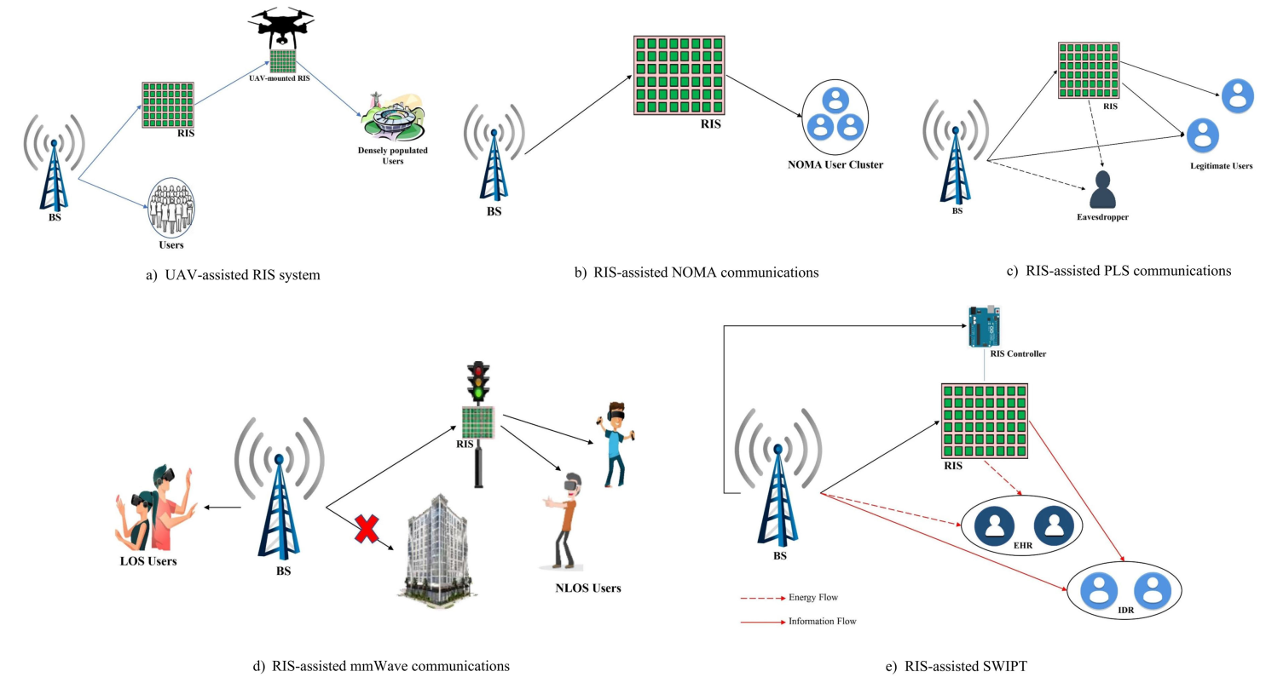
REVIEW (OTHER RESEARCH AREAS)
Figure 5: Some other applications of RIS
UNIVERSITY OF TEHRAN SEMINAR RESEARCH: RIS-ASSISTED WIRELESS COMMUNICATIONS 7 / 27

Slide 8
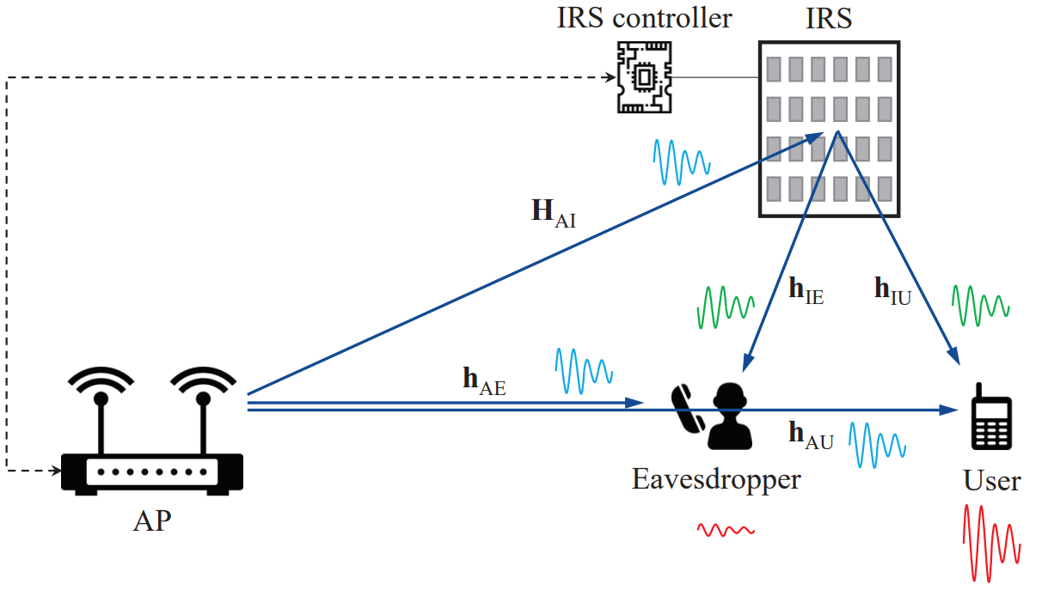
PASSIVE EAVESDROPPING
Goal
Jointly design the phase-shifts and the precoding scheme
Maximization of the achievable secrecy throughput
Figure 6 : IRS-aided secure communication from an AP to a user in the presence of an eavesdropper
M. Cui, G. Zhang and R. Zhang, "Secure Wireless Communication via Intelligent Reflecting Surface," in IEEE Wireless Communications Letters, vol. 8, no. 5, pp. 1410-1414, Oct. 2019, doi: 10.1109/LWC.2019.2919685.
UNIVERSITY OF TEHRAN SEMINAR RESEARCH: RIS-ASSISTED WIRELESS COMMUNICATIONS 8 / 27

Slide 9
ACTIVE EAVESDROPPING
PASSIVE EAVESDROPPING:
Secrecy-for-free property of MIMO systems with large antenna arrays
No need to know the presence of malicious terminals
ACTIVE EAVESDROPPING:
Active attackers are not suppressed automatically
Attackers can contaminate the estimated CSIs
Non-vanishing leakage to the eavesdroppers
Attackers’s CSI has to be known for suppression
IS THERE A TRACTABLE WAY TO MAKE ACTIVE EAVESDROPPERS PARTIALLY BLINDED?
UNIVERSITY OF TEHRAN SEMINAR RESEARCH: RIS-ASSISTED WIRELESS COMMUNICATIONS 9 / 27

Slide 10
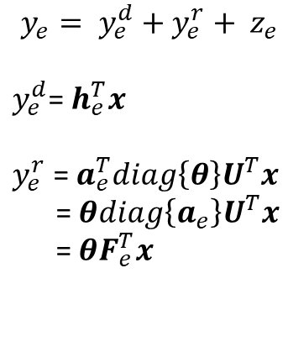
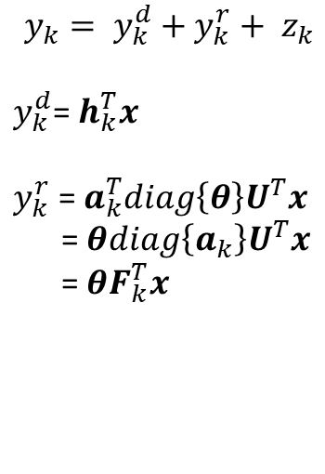
SYSTEM MODEL
DOWNLINK
Overheard by an active eavesdropper
EAVESDROPPER
UPLINK
Has access to the transmission codebooks
Active attack in transmission cycles
The received signal at UT k
The received signal at UT e (eavesdropper)
$$y_{k}= y_{k}^{d}+y_{k}^{r}+ z_{k}$$
$y_{k}^{d}$=${ h}_{k}^{T}x$
$y_{k}^{r}$ = $a_{k}^{T}diag\left\{θ\right\}U^{T}x$
= $θdiag\left\{a_{k}\right\}U^{T}x$
= $θF_{k}^{T}x$
$$y_{e}= y_{e}^{d}+y_{e}^{r}+ z_{e}$$
$y_{e}^{d}$=${ h}_{e}^{T}x$
$y_{e}^{r}$ = $a_{e}^{T}diag\left\{θ\right\}U^{T}x$
= $θdiag\left\{a_{e}\right\}U^{T}x$
= $θF_{e}^{T}x$
UNIVERSITY OF TEHRAN SEMINAR RESEARCH: RIS-ASSISTED WIRELESS COMMUNICATIONS 10 / 27

Slide 11
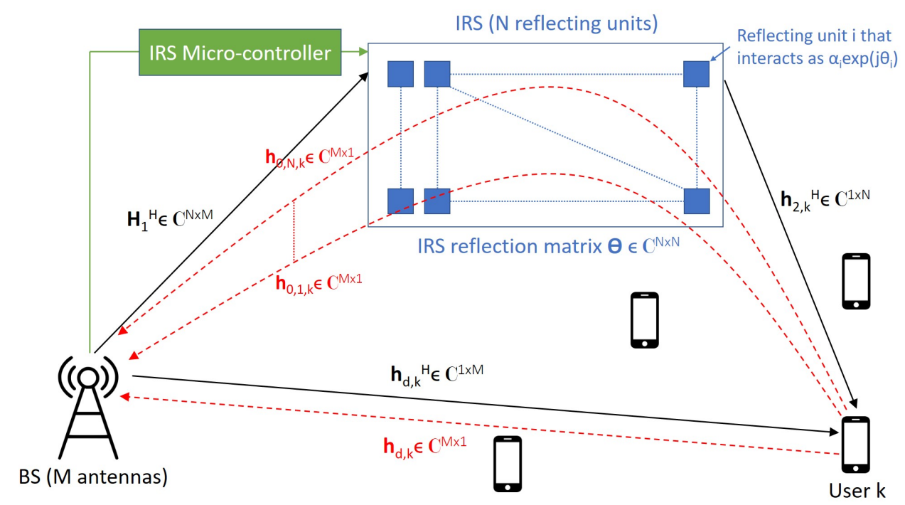
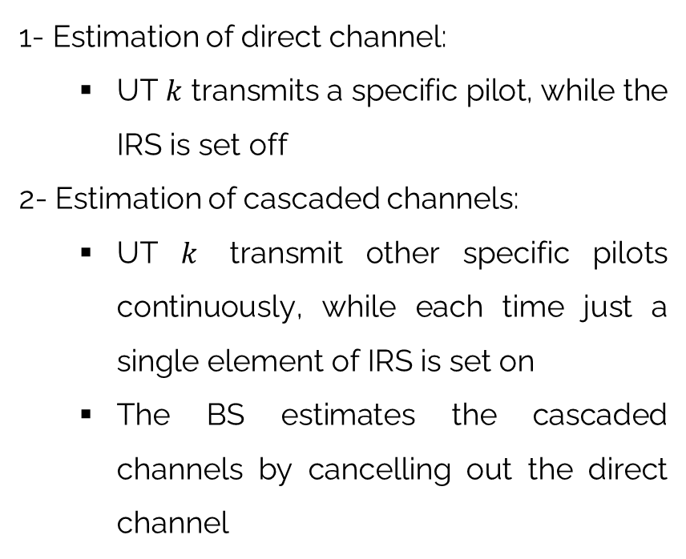
CHANNEL ESTIMATION
1- Estimation of direct channel:
UT $k$ transmits a specific pilot, while the IRS is set off
2- Estimation of cascaded channels:
UT $k$ transmit other specific pilots continuously, while each time just a single element of IRS is set on
The BS estimates the cascaded channels by cancelling out the direct channel
Figure 7: IRS-assisted multi-user MISO system. Red dashed lines represent the uplink channel vectors.
Q. -U. -A. Nadeem, H. Alwazani, A. Kammoun, A. Chaaban, M. Debbah and M. -S. Alouini, "Intelligent Reflecting Surface-Assisted Multi-User MISO Communication: Channel Estimation and Beamforming Design," in IEEE Open Journal of the Communications Society, vol. 1, pp. 661-680, 2020, doi: 10.1109/OJCOMS.2020.2992791.
UNIVERSITY OF TEHRAN SEMINAR RESEARCH: RIS-ASSISTED WIRELESS COMMUNICATIONS 11 / 27

Slide 12





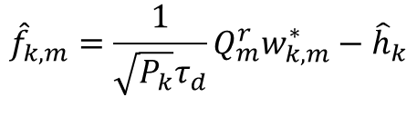
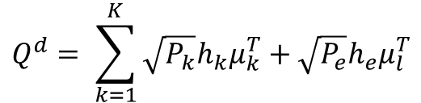
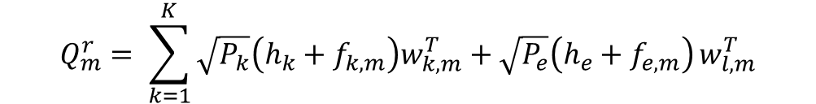
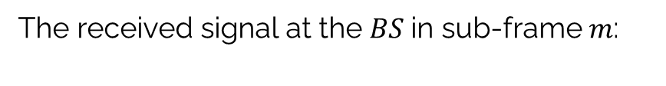
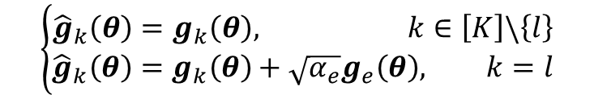
ACTIVE PILOT ATTACK
The received signals in the first $τ_{d}$ intervals:
The received signal at the $BS$in sub-frame $m$:
$$Q^{d}= \sum_{k=1}^{K}{\sqrt{P_{k}}h_{k}μ_{k}^{T}+\sqrt{P_{e}}h_{e}μ_{l}^{T}}$$
$$Q_{m}^{r}= \sum_{k=1}^{K}{\sqrt{P_{k}}\left(h_{k}+f_{k,m}\right)w_{k,m}^{T}+\sqrt{P_{e}}\left(h_{e}+f_{e,m}\right)}w_{l,m}^{T}$$
Using $Q^{d}$, the BS estimates direct channel $h_{k}$ as:
The estimated effective channel:
$${\hat{h}}_{k}=\frac{1}{\sqrt{P_{k}}τ_{d}}Q^{d}μ_{k}^{∗}$$
$${\hat{f}}_{k,m}=\frac{1}{\sqrt{P_{k}}τ_{d}}Q_{m}^{r}w_{k,m}^{∗}−{\hat{h}}_{k}$$
$${\hat{f}}_{l,m}=f_{l,m}+\sqrt{\frac{P_{e}}{P_{l}}}f_{e,m}$$
Following the orthogonality of the pilots:
$${\hat{h}}_{l}=h_{l}+\sqrt{\frac{P_{e}}{P_{l}}}h_{e}$$
$$g_{k}\left(θ\right)= h_{k}+F_{k}θ$$
$$\left\{\begin{aligned}{\hat{g}}_{k}\left(θ\right)=g_{k}\left(θ\right), k∈\left[K\right]\backslash \left\{l\right\} \\ {\hat{g}}_{k}\left(θ\right)=g_{k}\left(θ\right)+\sqrt{α_{e}}g_{e}\left(θ\right), k=l\end{aligned}\right.$$
UNIVERSITY OF TEHRAN SEMINAR RESEARCH: RIS-ASSISTED WIRELESS COMMUNICATIONS 12 / 27

Slide 13
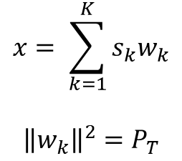
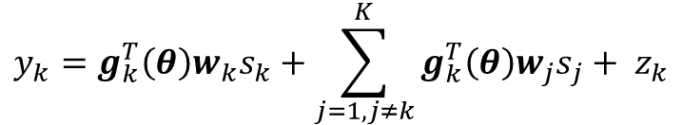

DOWNLINK DATA TRANSMISSION
Transmitted signal from BS
The received signal at UT $k∈\left[K\right]∪\left\{e\right\}$
$$x= \sum_{k=1}^{K}{s_{k}w_{k}}$$
$${\left\|w_{k}\right\|}^{2}=P_{T}$$
$$y_{k}=g_{k}^{T}\left(θ\right){w_{k}s}_{k}+\sum_{j=1,j≠k}^{K}{g_{k}^{T}\left(θ\right){w_{j}s}_{j}+ z_{k}}$$
The received signal at UT $k$
The received signal at UT 𝑘
Beamformed by $w_{k}, θ$
Beamformed by 𝒘_𝑘, 𝜽
Suppression of the eavesdropper
UNIVERSITY OF TEHRAN SEMINAR RESEARCH: RIS-ASSISTED WIRELESS COMMUNICATIONS 13 / 27

Slide 14
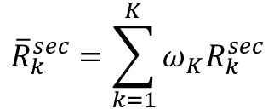
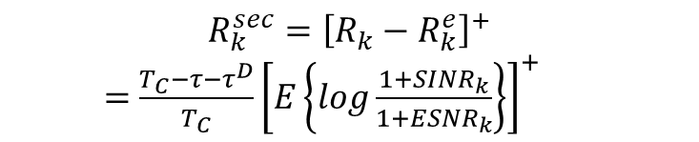
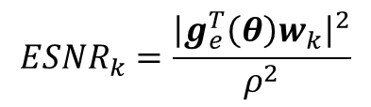


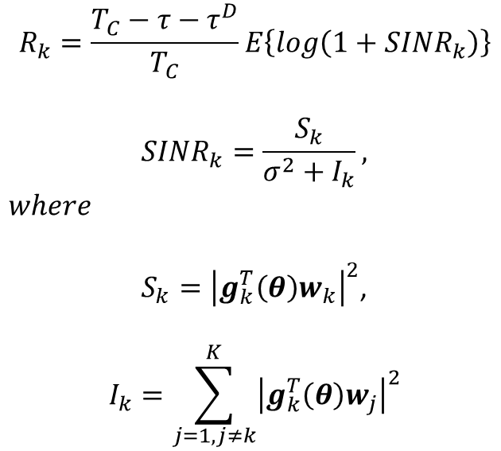

ACHEIVABLE SECRECY SUM-RATE
An achievable secrecy rate for UT $k∈[K]$ is given by subtracting the information leakage to the eavesdropper from $R_{k}$
$$R_{k}=\frac{T_{C}−τ−τ^{D}}{T_{C}}E\left\{log\left(1+{SINR}_{k}\right)\right\}$$
$${SINR}_{k}=\frac{S_{k}}{σ^{2}+I_{k}},$$
$$where$$
$S_{k}={\left|g_{k}^{T}\left(θ\right)w_{k}\right|}^{2}$,
$$I_{k}=\sum_{j=1,j≠k}^{K}{{\left|g_{k}^{T}\left(θ\right)w_{j}\right|}^{2}}$$
$$R_{k}^{e}=\frac{T_{C}−τ−τ^{D}}{T_{C}}E\left\{log\left(1+{ESNR}_{k}\right)\right\}$$
$${ESNR}_{k}=\frac{{\left|g_{e}^{T}\left(θ\right)w_{k}\right|}^{2}}{ρ^{2}}$$
Difficult to characterize the exact information leakage
$$R_{k}^{sec}={\left[R_{k}−R_{k}^{e}\right]}^{+}$$
$=$ $\frac{T_{C}−τ−τ^{D}}{T_{C}}{\left[E\left\{log\frac{1+{SINR}_{k}}{1+{ESNR}_{k}}\right\}\right]}^{+}$
upperbound
Worst-case scenario: The eavesdropper is capable of acquiring its instantaneous CSI, as well as canceling the interference of other legitimate UTs.
- Achievable weighted secrecy sum-rate:
$${\overline{R}}_{k}^{sec}=\sum_{k=1}^{K}{ω_{K}R_{k}^{sec}}$$
, where the weights model the
priority of UTs
$$ω_{1},…,ω_{K}$$
UNIVERSITY OF TEHRAN SEMINAR RESEARCH: RIS-ASSISTED WIRELESS COMMUNICATIONS 14 / 27

Slide 15
PRECODING AND PHASE-TUNING
Optimal choice
Optimal precoding vector and phase-shifts
Optimization
Maximization of${\overline{R}}^{sec}$ over $w_{1}, …, w_{K}, θ$
Maximization of 𝑅 ̅^𝑠𝑒𝑐 over 𝒘_1, …, 𝒘_𝐾, 𝜽
Drawback
NP-Hard problem
ASSUMPTIONS
Matched filtering
BS knows the existence of the active eavesdropper
No access to the active eavesdropper’s instantenous CSI
Stochastic form of secure regularized zero forcing (SRZF) precoding
UNIVERSITY OF TEHRAN SEMINAR RESEARCH: RIS-ASSISTED WIRELESS COMMUNICATIONS 15 / 27

Slide 16
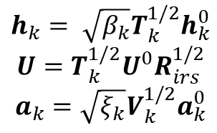
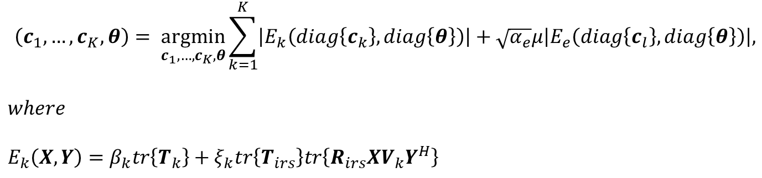
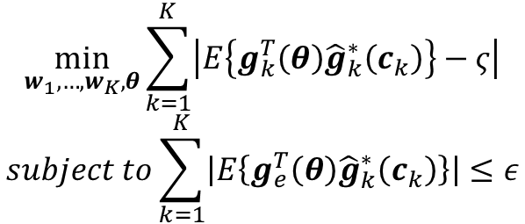
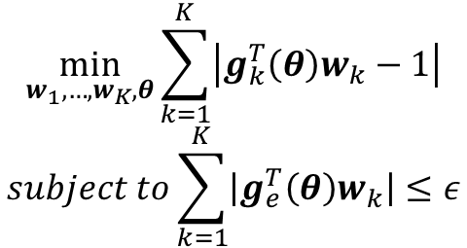
STOCHASTIC SRZF PRECODING
$$\min_{w_{1},…,w_{K},θ}{\sum_{k=1}^{K}{\left|g_{k}^{T}\left(θ\right)w_{k}−1\right|}}$$
$$subject to\sum_{k=1}^{K}{\left|g_{e}^{T}\left(θ\right)w_{k}\right|}≤ε$$
$$\min_{w_{1},…,w_{K},θ}{\sum_{k=1}^{K}{\left|E\left\{g_{k}^{T}\left(θ\right){\hat{g}}_{k}^{∗}\left(c_{k}\right)\right\}−ς\right|}}$$
$$subject to\sum_{k=1}^{K}{\left|E\left\{g_{e}^{T}\left(θ\right){\hat{g}}_{k}^{∗}\left(c_{k}\right)\right\}\right|}≤ε$$
No access to I-CSI
$$h_{k}= \sqrt{β_{k}}T_{k}^{1/2}h_{k}^{0}$$
$$U=T_{k}^{1/2}U^{0}R_{irs}^{1/2}$$
$$a_{k}=\sqrt{ξ_{k}}V_{k}^{1/2}a_{k}^{0}$$
$$\left(c_{1},…,c_{K},θ\right)= \underset{c_{1},…,c_{K},θ}{argmin}{\sum_{k=1}^{K}{\left|E_{k}\left(diag\left\{c_{k}\right\}, diag\left\{θ\right\}\right)\right|}}+\sqrt{α_{e}}μ\left|E_{e}\left(diag\left\{c_{l}\right\}, diag\left\{θ\right\}\right)\right|,$$
$$where$$
$$E_{k}\left(X,Y\right)=β_{k}tr\left\{T_{k}\right\}+ξ_{k}tr\left\{T_{irs}\right\}tr\left\{R_{irs}XV_{k}Y^{H}\right\}$$
UNIVERSITY OF TEHRAN SEMINAR RESEARCH: RIS-ASSISTED WIRELESS COMMUNICATIONS 16 / 27

Slide 17
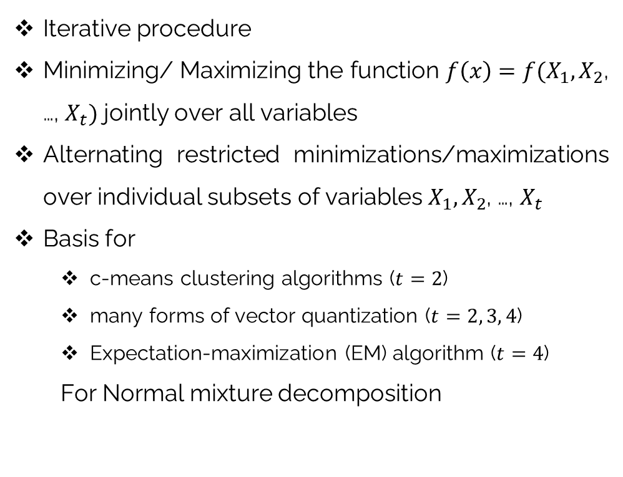
ALTERNATING OPTIMIZATION (AO)
Iterative procedure
Minimizing/ Maximizing the function $f\left(x\right)=f(X_{1},X_{2}$, …, $X_{t})$ jointly over all variables
Alternating restricted minimizations/maximizations over individual subsets of variables $X_{1},X_{2}$, …, $X_{t}$
Basis for
c-means clustering algorithms ($t=2$)
many forms of vector quantization ($t=2, 3, 4$)
Expectation-maximization (EM) algorithm ($t=4$)
For Normal mixture decomposition
Four reasons why AO may be preferable to its competitors:
Division of variables, which explicit partial minimizer formulas exist for most of the variables.
Computationally cheaper than the best standard optimization approaches in some cases.
Saving of development time, with good convergence.
More adapt at bypassing local minimizers than other approaches
UNIVERSITY OF TEHRAN SEMINAR RESEARCH: RIS-ASSISTED WIRELESS COMMUNICATIONS 17 / 27

Slide 18
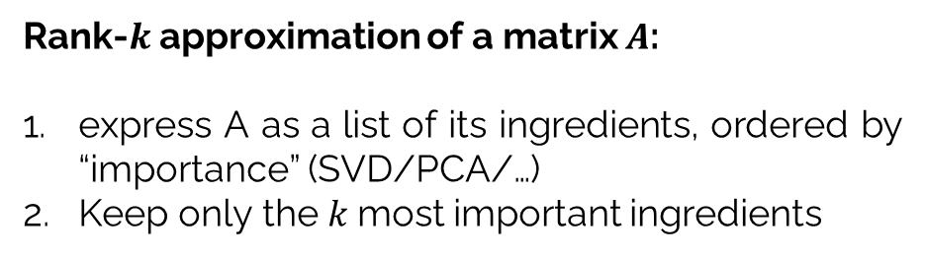
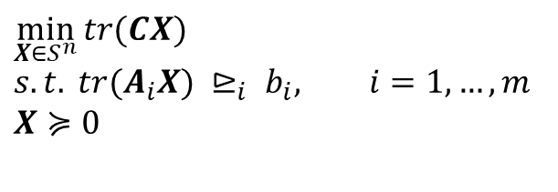
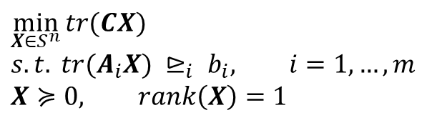
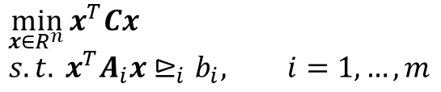
SEMI-DEFINITE RELAXATION (SDR)
Many practical experiences have already indicated that SDR is capable of providing accurate (and sometimes near optimal) approximations
What is the issue when using SDR?
Converting the global optimal solution into a feasible solution
Example:
Real-valued homogeneous QCQP
Rank-$k$ approximation of a matrix $A$:
express A as a list of its ingredients, ordered by “importance” (SVD/PCA/…)
Keep only the $k$most important ingredients
$$\min_{x∈R^{n}}{x^{T}Cx}$$
$$s.t. x^{T}A_{i}x⊵_{i}b_{i}, i=1,…,m$$
$$\min_{X∈S^{n}}{tr(CX)}$$
$$s.t. tr(A_{i}X) ⊵_{i} b_{i}, i=1,…,m$$
$$X≽0, rank\left(X\right)=1$$
non-convex
Note:
Even with a feasible extracted solution, it is not an optimal solution
+ An NP-hard problem is solved in polynomial time
$$\min_{X∈S^{n}}{tr(CX)}$$
$$s.t. tr(A_{i}X) ⊵_{i} b_{i}, i=1,…,m$$
$$X≽0$$
UNIVERSITY OF TEHRAN SEMINAR RESEARCH: RIS-ASSISTED WIRELESS COMMUNICATIONS 18 / 27

Slide 19
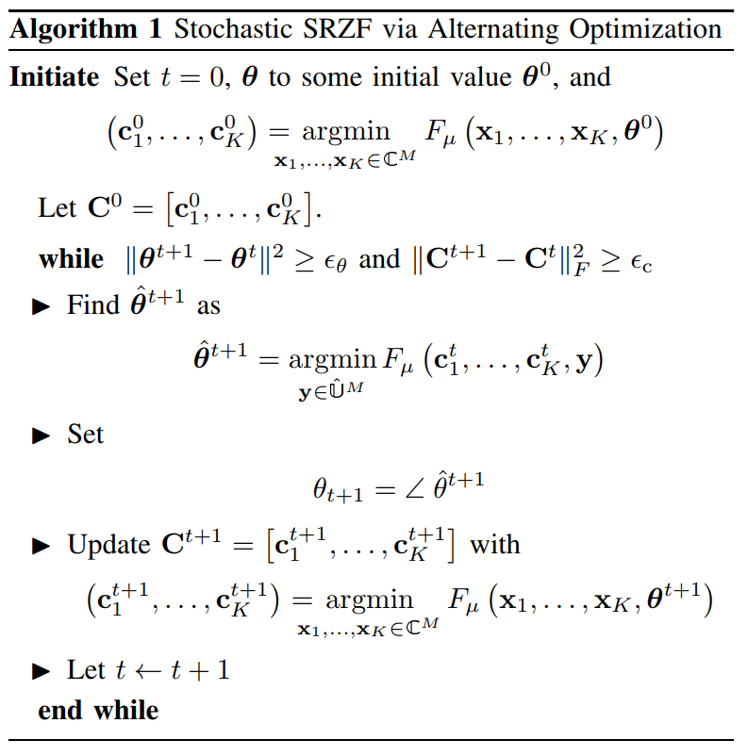
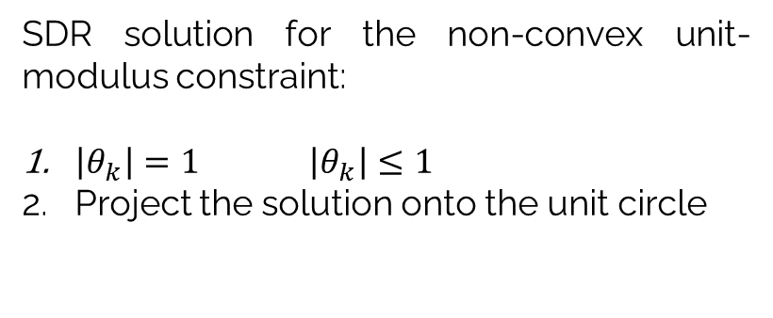
ITERATIVE ALGORITHM
INTRACTABLE OPTIMIZATION PROBLEM
The objective function is not convex
Problem 1
Unit-modulus constraint
Problem 2
SDR solution for the non-convex unit-modulus constraint:
$\left|θ_{k}\right|=1$ $\left|θ_{k}\right|≤1$
Project the solution onto the unit circle
UNIVERSITY OF TEHRAN SEMINAR RESEARCH: RIS-ASSISTED WIRELESS COMMUNICATIONS 19 / 27

Slide 20
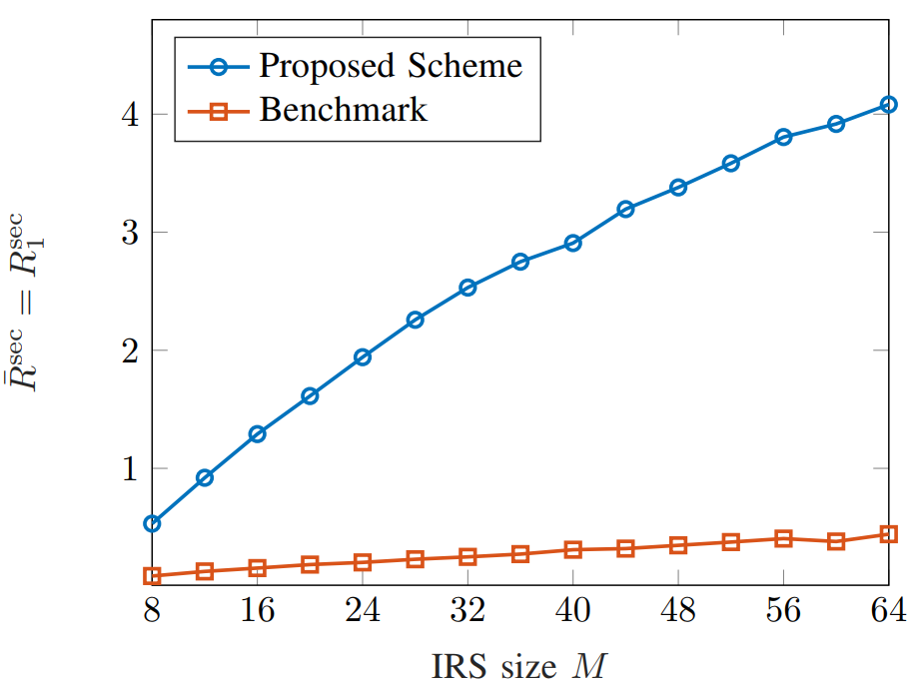
SIMULATION
Figure 8: Achievable secrecy rate vs. IRS size
Bereyhi, Ali et al. “Secure Transmission in IRS-Assisted MIMO Systems with Active Eavesdroppers.” 2020 54th Asilomar Conference on Signals, Systems, and Computers (2020): 718-725.
UNIVERSITY OF TEHRAN SEMINAR RESEARCH: RIS-ASSISTED WIRELESS COMMUNICATIONS 20 / 27

Slide 21
REFERENCES
[1] Q. Wu, S. Zhang, B. Zheng, C. You and R. Zhang, "Intelligent Reflecting Surface-Aided Wireless Communications: A Tutorial," in IEEE Transactions on Communications, vol. 69, no. 5, pp. 3313-3351, May 2021, doi: 10.1109/TCOMM.2021.3051897
[2] K. M. Faisal and W. Choi, "A Study on Machine Learning-based Approaches for Reconfigurable Intelligent Surface," 2021 International Conference on Information and Communication Technology Convergence (ICTC), 2021, pp. 227-232, doi: 10.1109/ICTC52510.2021.9620993
[3] Q. Wu and R. Zhang, "Intelligent Reflecting Surface Enhanced Wireless Network: Joint Active and Passive Beamforming Design," 2018 IEEE Global Communications Conference (GLOBECOM), 2018, pp. 1-6, doi: 10.1109/GLOCOM.2018.8647620.
[4] Q. Wu and R. Zhang, "Intelligent Reflecting Surface Enhanced Wireless Network via Joint Active and Passive Beamforming," in IEEE Transactions on Wireless Communications, vol. 18, no. 11, pp. 5394-5409, Nov. 2019, doi: 10.1109/TWC.2019.2936025.
[5] K. Feng, Q. Wang, X. Li and C. Wen, "Deep Reinforcement Learning Based Intelligent Reflecting Surface Optimization for MISO Communication Systems," in IEEE Wireless Communications Letters, vol. 9, no. 5, pp. 745-749, May 2020, doi: 10.1109/LWC.2020.2969167.
[6] Wu, Qingqing and Rui Zhang. “Joint Active and Passive Beamforming Optimization for Intelligent Reflecting Surface Assisted SWIPT Under QoS Constraints.” IEEE Journal on Selected Areas in Communications 38 (2020): 1735-1748.
UNIVERSITY OF TEHRAN SEMINAR RESEARCH: RIS-ASSISTED WIRELESS COMMUNICATIONS 21 / 27

Slide 22
REFERENCES
[7] B. Zheng, Q. Wu and R. Zhang, "Intelligent Reflecting Surface-Assisted Multiple Access With User Pairing: NOMA or OMA?," in IEEE Communications Letters, vol. 24, no. 4, pp. 753-757, April 2020, doi: 10.1109/LCOMM.2020.2969870.
[8] C. Huang, A. Zappone, G. C. Alexandropoulos, M. Debbah and C. Yuen, "Reconfigurable Intelligent Surfaces for Energy Efficiency in Wireless Communication," in IEEE Transactions on Wireless Communications, vol. 18, no. 8, pp. 4157-4170, Aug. 2019, doi: 10.1109/TWC.2019.2922609.
[9] Q. Wang, F. Zhou, R. Q. Hu and Y. Qian, "Energy Efficient Robust Beamforming and Cooperative Jamming Design for IRS-Assisted MISO Networks," in IEEE Transactions on Wireless Communications, vol. 20, no. 4, pp. 2592-2607, April 2021, doi: 10.1109/TWC.2020.3043325.
[10] W. Shi, X. Zhou, L. Jia, Y. Wu, F. Shu and J. Wang, "Enhanced Secure Wireless Information and Power Transfer via Intelligent Reflecting Surface," in IEEE Communications Letters, vol. 25, no. 4, pp. 1084-1088, April 2021, doi: 10.1109/LCOMM.2020.3043475.
[11] Y. Liu, J. Zhao, M. Li and Q. Wu, "Intelligent Reflecting Surface Aided MISO Uplink Communication Network: Feasibility and Power Minimization for Perfect and Imperfect CSI," in IEEE Transactions on Communications, vol. 69, no. 3, pp. 1975-1989, March 2021, doi: 10.1109/TCOMM.2020.3040404.
[12] Q. -U. -A. Nadeem, A. Kammoun, A. Chaaban, M. Debbah and M. -S. Alouini, "Asymptotic Max-Min SINR Analysis of Reconfigurable Intelligent Surface Assisted MISO Systems," in IEEE Transactions on Wireless Communications, vol. 19, no. 12, pp. 7748-7764, Dec. 2020, doi: 10.1109/TWC.2020.2986438.
[13] Yang, Yifei et al. “Intelligent Reflecting Surface Meets OFDM: Protocol Design and Rate Maximization.” IEEE Transactions on Communications 68 (2020): 4522-4535.
UNIVERSITY OF TEHRAN SEMINAR RESEARCH: RIS-ASSISTED WIRELESS COMMUNICATIONS 22 / 27

Slide 23
REFERENCES
[14] Yang, Yifei et al. “IRS-Enhanced OFDM: Power Allocation and Passive Array Optimization.” 2019 IEEE Global Communications Conference (GLOBECOM) (2019): 1-6.
[15] S. Zhang and R. Zhang, "Capacity Characterization for Intelligent Reflecting Surface Aided MIMO Communication," in IEEE Journal on Selected Areas in Communications, vol. 38, no. 8, pp. 1823-1838, Aug. 2020, doi: 10.1109/JSAC.2020.3000814.
[16] S. Zhang and R. Zhang, "On the Capacity of Intelligent Reflecting Surface Aided MIMO Communication," 2020 IEEE International Symposium on Information Theory (ISIT), 2020, pp. 2977-2982, doi: 10.1109/ISIT44484.2020.9174375.
[17] M. -M. Zhao, Q. Wu, M. -J. Zhao and R. Zhang, "Two-timescale Beamforming Optimization for Intelligent Reflecting Surface Enhanced Wireless Network," 2020 IEEE 11th Sensor Array and Multichannel Signal Processing Workshop (SAM), 2020, pp. 1-5, doi: 10.1109/SAM48682.2020.9104346.
[18] Pan, Cunhua et al. “Multicell MIMO Communications Relying on Intelligent Reflecting Surfaces.” IEEE Transactions on Wireless Communications 19 (2020): 5218-5233.
[19] Taha, Abdelrahman et al. “Enabling Large Intelligent Surfaces With Compressive Sensing and Deep Learning.” IEEE Access 9 (2021): 44304-44321.
[20] M. A. Aygül, M. Nazzal and H. Arslan, "Deep Learning-Based Optimal RIS Interaction Exploiting Previously Sampled Channel Correlations," 2021 IEEE Wireless Communications and Networking Conference (WCNC), 2021, pp. 1-6, doi: 10.1109/WCNC49053.2021.9417591.
UNIVERSITY OF TEHRAN SEMINAR RESEARCH: RIS-ASSISTED WIRELESS COMMUNICATIONS 23 / 27

Slide 24
REFERENCES
[21] H. Guo, Y. -C. Liang, J. Chen and E. G. Larsson, "Weighted Sum-Rate Maximization for Intelligent Reflecting Surface Enhanced Wireless Networks," 2019 IEEE Global Communications Conference (GLOBECOM), 2019, pp. 1-6, doi: 10.1109/GLOBECOM38437.2019.9013288.
[22] Y. Han, W. Tang, S. Jin, C. -K. Wen and X. Ma, "Large Intelligent Surface-Assisted Wireless Communication Exploiting Statistical CSI," in IEEE Transactions on Vehicular Technology, vol. 68, no. 8, pp. 8238-8242, Aug. 2019, doi: 10.1109/TVT.2019.2923997.
[23] J. Chen, Y. -C. Liang, Y. Pei and H. Guo, "Intelligent Reflecting Surface: A Programmable Wireless Environment for Physical Layer Security," in IEEE Access, vol. 7, pp. 82599-82612, 2019, doi: 10.1109/ACCESS.2019.2924034.
[24] X. Tang, D. Wang, R. Zhang, Z. Chu and Z. Han, "Jamming Mitigation via Aerial Reconfigurable Intelligent Surface: Passive Beamforming and Deployment Optimization," in IEEE Transactions on Vehicular Technology, vol. 70, no. 6, pp. 6232-6237, June 2021, doi: 10.1109/TVT.2021.3077662.
[25] Y. Xiu, J. Zhao, W. Sun and Z. Zhang, "Secrecy Rate Maximization for Reconfigurable Intelligent Surface Aided Millimeter Wave System With Low-Resolution DACs," in IEEE Communications Letters, vol. 25, no. 7, pp. 2166-2170, July 2021, doi: 10.1109/LCOMM.2021.3057379.
[26] D. Mishra and H. Johansson, "Channel Estimation and Low-complexity Beamforming Design for Passive Intelligent Surface Assisted MISO Wireless Energy Transfer," ICASSP 2019 - 2019 IEEE International Conference on Acoustics, Speech and Signal Processing (ICASSP), 2019, pp. 4659-4663, doi: 10.1109/ICASSP.2019.8683663.
UNIVERSITY OF TEHRAN SEMINAR RESEARCH: RIS-ASSISTED WIRELESS COMMUNICATIONS 24 / 27

Slide 25
REFERENCES
[27] Q. -U. -A. Nadeem, H. Alwazani, A. Kammoun, A. Chaaban, M. Debbah and M. -S. Alouini, "Intelligent Reflecting Surface-Assisted Multi-User MISO Communication: Channel Estimation and Beamforming Design," in IEEE Open Journal of the Communications Society, vol. 1, pp. 661-680, 2020, doi: 10.1109/OJCOMS.2020.2992791.
[28] Z. He and X. Yuan, "Cascaded Channel Estimation for Large Intelligent Metasurface Assisted Massive MIMO," in IEEE Wireless Communications Letters, vol. 9, no. 2, pp. 210-214, Feb. 2020, doi: 10.1109/LWC.2019.2948632.
[29] N. K. Kundu and M. R. McKay, "A Deep Learning-Based Channel Estimation Approach for MISO Communications with Large Intelligent Surfaces," 2020 IEEE 31st Annual International Symposium on Personal, Indoor and Mobile Radio Communications, 2020, pp. 1-6, doi: 10.1109/PIMRC48278.2020.9217359.
[30] S. Liu, Z. Gao, J. Zhang, M. D. Renzo and M. -S. Alouini, "Deep Denoising Neural Network Assisted Compressive Channel Estimation for mmWave Intelligent Reflecting Surfaces," in IEEE Transactions on Vehicular Technology, vol. 69, no. 8, pp. 9223-9228, Aug. 2020, doi: 10.1109/TVT.2020.3005402.
[31] A. M. Elbir, A. Papazafeiropoulos, P. Kourtessis and S. Chatzinotas, "Deep Channel Learning for Large Intelligent Surfaces Aided mm-Wave Massive MIMO Systems," in IEEE Wireless Communications Letters, vol. 9, no. 9, pp. 1447-1451, Sept. 2020, doi: 10.1109/LWC.2020.2993699.
[32] Khan, Saud and Soo Young Kim Shin. “Deep-Learning-aided Detection for Reconfigurable Intelligent Surfaces.” arXiv: Signal Processing (2019): n. pag.
[33] E. Balevi, A. Doshi, A. Jalal, A. Dimakis and J. G. Andrews, "High Dimensional Channel Estimation Using Deep Generative Networks," in IEEE Journal on Selected Areas in Communications, vol. 39, no. 1, pp. 18-30, Jan. 2021, doi: 10.1109/JSAC.2020.3036947.
UNIVERSITY OF TEHRAN SEMINAR RESEARCH: RIS-ASSISTED WIRELESS COMMUNICATIONS 25 / 27

Slide 26
REFERENCES
[34] C. You, B. Zheng and R. Zhang, "Channel Estimation and Passive Beamforming for Intelligent Reflecting Surface: Discrete Phase Shift and Progressive Refinement," in IEEE Journal on Selected Areas in Communications, vol. 38, no. 11, pp. 2604-2620, Nov. 2020, doi: 10.1109/JSAC.2020.3007056.
[35] E. Shtaiwi, H. Zhang, A. Abdelhadi and Z. Han, "RIS-Assisted mmWave Channel Estimation Using Convolutional Neural Networks," 2021 IEEE Wireless Communications and Networking Conference Workshops (WCNCW), 2021, pp. 1-6, doi: 10.1109/WCNCW49093.2021.9419974.
[36] Bereyhi, Ali et al. “Secure Transmission in IRS-Assisted MIMO Systems with Active Eavesdroppers.” 2020 54th Asilomar Conference on Signals, Systems, and Computers (2020): 718-725.
[37] Bezdek, James C. and Richard J. Hathaway. “Some Notes on Alternating Optimization.” AFSS (2002).
[38] Z. -q. Luo, W. -k. Ma, A. M. -c. So, Y. Ye and S. Zhang, "Semidefinite Relaxation of Quadratic Optimization Problems," in IEEE Signal Processing Magazine, vol. 27, no. 3, pp. 20-34, May 2010, doi: 10.1109/MSP.2010.936019.
[39] M. Cui, G. Zhang and R. Zhang, "Secure Wireless Communication via Intelligent Reflecting Surface," in IEEE Wireless Communications Letters, vol. 8, no. 5, pp. 1410-1414, Oct. 2019, doi: 10.1109/LWC.2019.2919685.
UNIVERSITY OF TEHRAN SEMINAR RESEARCH: RIS-ASSISTED WIRELESS COMMUNICATIONS 26 / 27

Slide 27
THANKS FOR YOUR TIME AND ATTENTION
Contact: ichbinsajadalikhani@gmail.com
UNIVERSITY OF TEHRAN SEMINAR RESEARCH: RIS-ASSISTED WIRELESS COMMUNICATIONS 27 / 27

