Slide 1
Multimodal Intelligent System Experiences (ISE)
A Privacy-First Architecture for Personalized Product Discovery
Candidate Presentation: Manager, SIML

Slide 2
1. Vision & Strategy (SIML Focus)
Goal: Deliver highly personalized, multimodal intelligent experiences natively on Apple devices.
System Intelligence: Decoupling heavy representation learning from on-device sequential modeling.
Privacy-First: User click streams remain entirely on-device.
Scalability: Designed to scale across Apple's ecosystem (iOS, iPadOS, macOS) via CoreML and the Apple Neural Engine (ANE).

Slide 3
2. Multimodal Foundation Models
Catalog Embedding Cloud: Pre-processing the product index purely offline.
Vision Backbone: ViT-B/16 (Vision Transformer) for semantic patch-level feature extraction.
Text Backbone: all-MiniLM Transformer replacing RNNs for deeply contextualized text alignment.
Result: A unified 128-dimensional multimodal item embedding representing complex semantics.

Slide 4
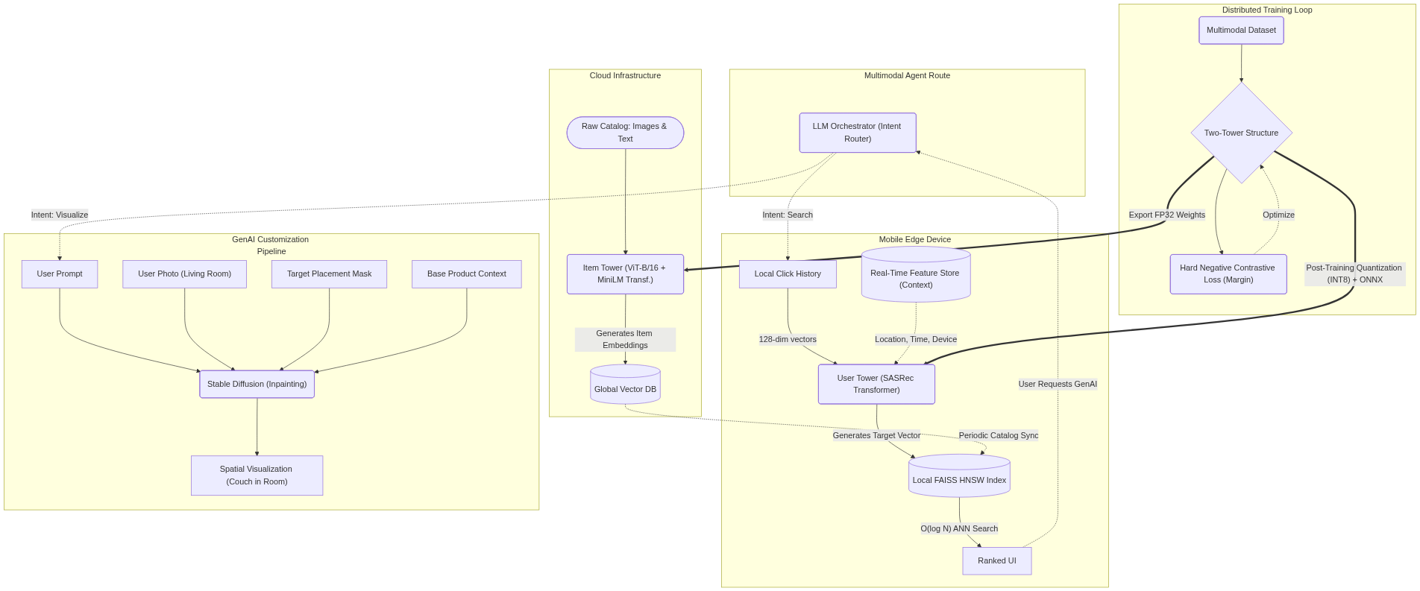
3. System Architecture Design

Slide 5
4. Efficient On-Device ML Architecture
RecSys Edge Tower: A fast SASRec (Self-Attentive) sequence Transformer processing local interaction history.
Hard Negative Contrastive Loss: Trained symmetrically using Additive Margin (CosFace) mechanics.
Feature Store Integration: Injecting real-time context (time-of-day, location) efficiently onto the edge.
Retrieval Engine: Employing FAISS HNSW for sub-millisecond Approximate Nearest Neighbor resolution natively in RAM.
Quantization: Compressing core weights to INT8 to radically minimize runtime footprint.

Slide 6
5. Agentic Generative AI (RAG + Diffusion)
Intelligent Orchestration: Multimodal LLM dynamically routes ambiguous user queries.
Spatial Inpainting: Users upload photos of their own space (e.g., Living Room) for contextualized placement.
Closed-Loop Feedback: User validations of Spatial images implicitly construct difficult hard negatives.
LoRA Fine-Tuning: Applying Low-Rank Adaptation to strictly adhere to brand guidelines and aesthetics.

Slide 7
6. End-to-End Evaluation Framework
Recommendation Quality: Driving engagement via Hit Rate (HR@10) and NDCG via dense indexing.
Generative AI Metrics: Automated CLIP Score evaluation for text-to-image alignment and prompt adherence.
Continuous Improvement: Setting up infrastructure for RLHF and online A/B testing (CTR tracking).

Slide 8
7. Team Leadership & Roadmap
Cross-Functional Execution: Bridging researchers, mobile developers, and product teams.
Infrastructure: Standardizing on scalable tools (PyTorch Lightning, Ray Serve) vs Edge deployments (CoreML).
Next Steps: Expanding pure LLM integration for conversational product search and Multimodal Foundation capabilities.

