Slide 1
ROBO CAR PROJECT
Autonomous Navigation System
Self navigating Robo Car with ultrasonic obstacle avoidance.
Arduino
Mecanum Drive
Ultrasonic Sensors
Autonomous
Badsha Munna | Sadman Showmik | Jayed Amir

Slide 2
PROJECT OVERVIEW
🎯
🤖
✅
Goal
Platform
Outcome
Build a robot that navigates autonomously detecting obstacles and planning paths.
Mecanum wheeled car on Arduino. 3 ultrasonic sensors (front, left, right). Custom motor driver over I2C.
Slow, steady navigation with obstacle detection at 50cm, and smooth turns by measuring left and right side distance.

Slide 3
HARDWARE & COMPONENTS
Controller
Front / Left / Right – HC-SR04 Sensor
Customized Arduino Board
Front: TRIG- 12 / ECHO- 13, Left: TRIG- 7 / ECHO- 6
Right: TRIG- 8 / ECHO-11
Drive System
Chassis
4x Mecanum wheels via I2C motor driver
Customized Chassis with Lego Hole
Battery
I2C Bus
18650 Li-ion Battery
SDA: Pin 3 / SCL: Pin 2

Slide 4
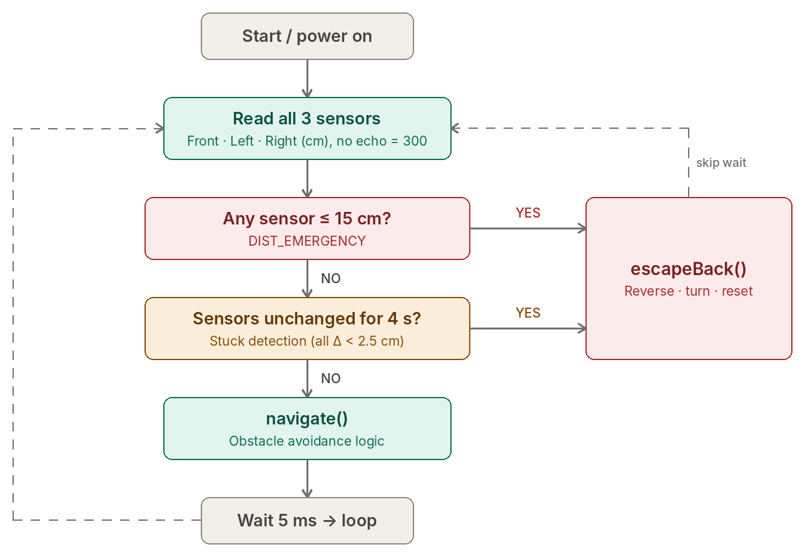
ALGORITHM
OVERVIEW

Slide 5
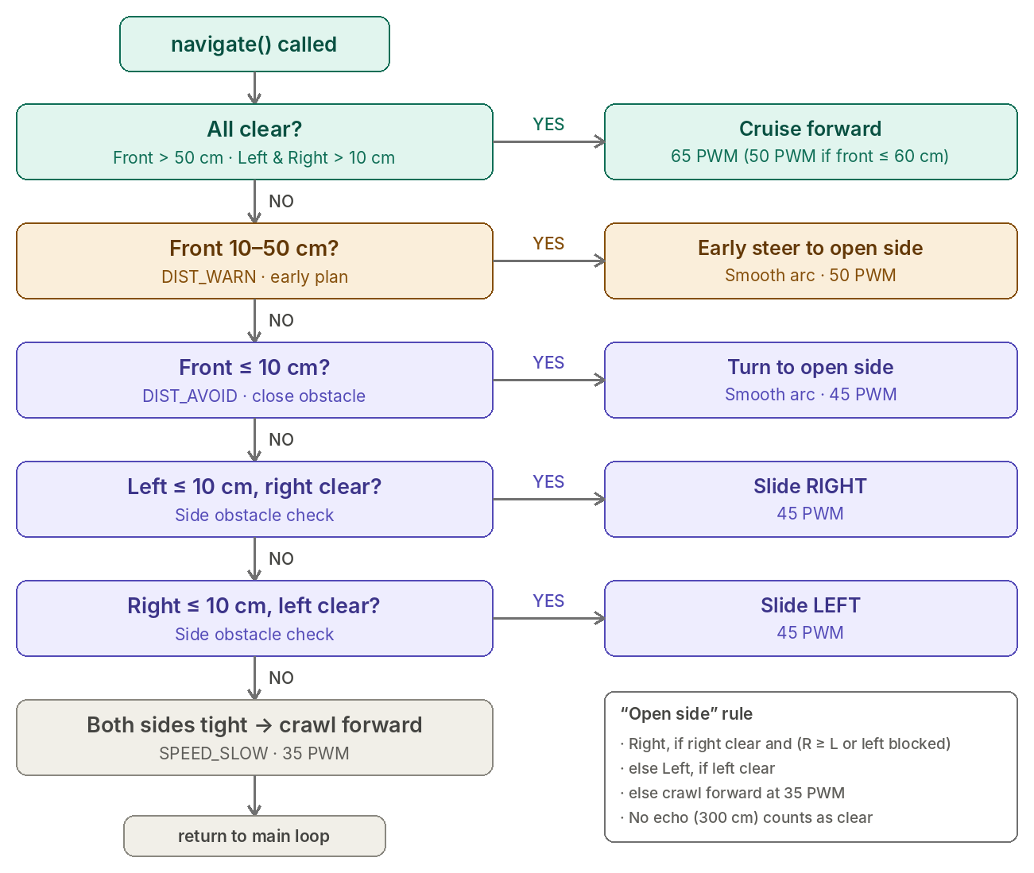
ALGORITHM
navigate();

Slide 6
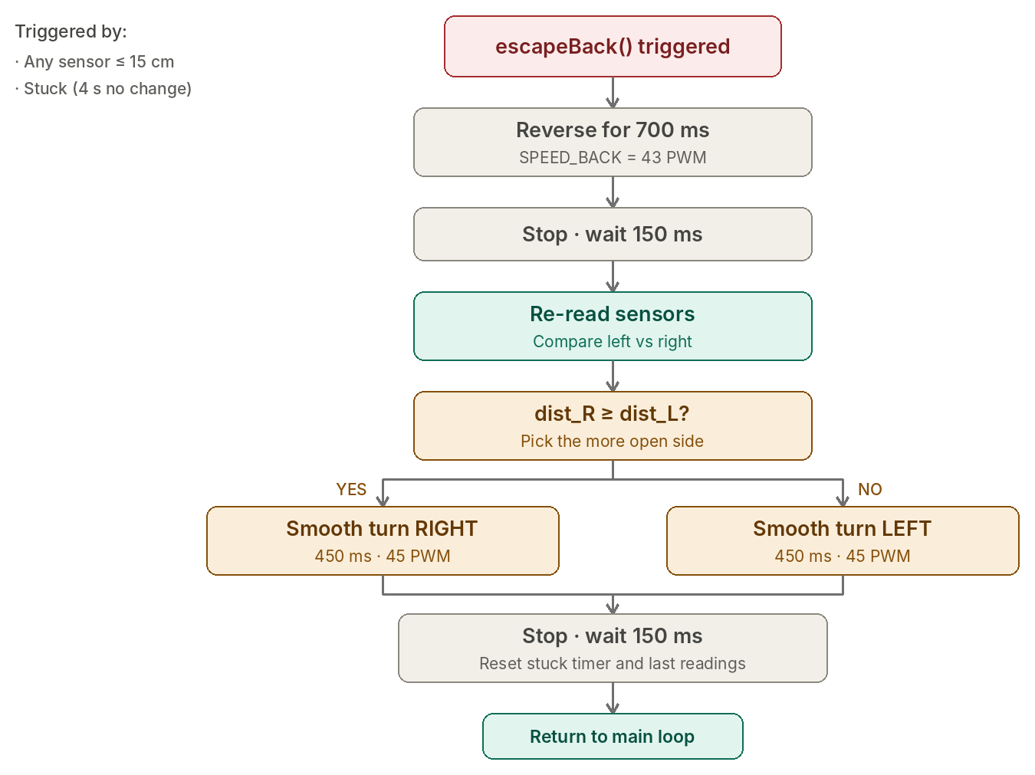
ALGORITHM
escapeBack();

Slide 7
NAVIGATION LOGIC
P1
Emergency
P2
Stuck Check
P3
Early Steer
P4
Cruise
Trigger:
Trigger:
Trigger:
Trigger:
Any sensor ≤ 15cm
No sensor change > 4s
Front 10–50cm
Front > 50cm, sides > 10cm
Action:
Action:
Action:
Action:
Reverse + turn to open side
Escape back + reset
Gentle turn at 50 PWM
Forward at 65 PWM

Slide 8
SMOOTH TURN SYSTEM
All 4 wheels always spin. Outer wheels get +18 PWM, inner wheels get −18 PWM for smooth coordinated arcs
Turn LEFT
Turn RIGHT
Right side spins faster
Left side spins faster
FL −18
FR +18
FL +18
FR −18
BL −18
BR +18
BL +18
BR −18

Slide 9
SPEED & DISTANCE SETTINGS
Speed Levels
Distance Thresholds
SPEED_CRUISE
65 PWM — Open path forward
DIST_EMERGENCY
15 cm — Immediate back-escape
SPEED_APPROACH
50 PWM — Near obstacle
DIST_AVOID
SPEED_MANEUVER
45 PWM — Turning / sliding
10 cm — Strong turn / slide
DIST_WARN
SPEED_SLOW
35 PWM — Very close
50 cm — Early gentle steer
SPEED_BACK
43 PWM — Reversing escape
DIST_CLEAR
60 cm — Full cruise speed

Slide 10
SUMMARY
⚙️
Mecanum Drive
📡
3 Ultrasonic Sensors
4 wheel independent control enables forward, backward, lateral sliding, and smooth arc turns
Front, left, right sensing with 30ms timeout and invalid reading protection
🧭
4 Priority Navigation
🔧
Self Recovery
Emergency → Stuck recovery → Early steer (50cm) → Cruise
Smooth obstacle avoidance and self recovery when stuck.

