Slide 1
CSE 402 · Numerical Analysis Sessional · BUET
Numerical Kernels for Dynamic
Homotopy Power Flow
My contribution to the team project
SADMAN
Based on: Lima-Silva & Freitas, Energies 17(18):4642, 2024
Numerical kernels · Section 4.4 · Figure 5 · Richardson control
Team: Jonayed · Apurbo · Hasbi · Sizan · Sadman

Slide 2
THE PAPER
The power flow problem and why it is hard
Lima-Silva and Freitas, Energies 17(18):4642, 2024
Power flow solves g(x) = 0. The state x holds every bus voltage angle and magnitude.
Newton-Raphson from a flat start (V = 1 pu, angle = 0) diverges on large, ill-conditioned grids.
The paper reaches the solution in two stages.
First stage. Build the homotopy G(x, t) = t g(x) + (1 - t) K (x - x0).
Integrate the path from t = 0 (flat start) to t = 1 (the real problem) with FE, RK2 or backward Euler.
Second stage. Give the endpoint to NR or FDXB for the final iterations.
The paper's headline claim
Backward Euler with only two path points makes NR converge on grids up to 109,272 buses.
What the team reproduced and improved
All nine test systems, every table and figure. Ten changes tested on 34 grids.
Sadman · Dynamic homotopy power flow
02

Slide 3
MY ROLE AT A GLANCE
What I built
Numerical kernels: linear algebra, step control, tests and tools
1
Core code
2
Paper results
3
Improvements
LU counter, result types, shared plot style
Section 4.4 pathways and Figure 5 time step
Richardson step control and scaled homotopy
linalg.py · results.py · plots.py
exp05_sec44_pathways.py · exp08_fig5.py
improvements/path.py · improvements/homotopies.py
4
From scratch
5
Command line
6
Report
Gauss elimination and LU with partial pivoting
Run the paper's method with any switch on any grid
Shared style plus four figures of the report
improvements/gauss.py
improvements/__main__.py
style.py · spy · richardson_path · sec44_grid · fig5_tradeoff
Sadman · Dynamic homotopy power flow
03

Slide 4
CORE CODE · 1 OF 3
Sparse LU factorization counter
dynhomotopy/linalg.py — the single cost metric of the project
The paper counts one LU factorization per path point.
I wrap SciPy's sparse LU (splu) in a small factorize function.
One LUCounter dataclass records every call.
Every solver in the project shares the same counter.
So the cost measure is honest and consistent across NR, FDXB and the homotopy.
A singular matrix raises SingularMatrixError. This lets adaptive rules retry.
@dataclass
class LUCounter:
factorizations: int = 0
def factorize(a, counter=None):
if counter is not None:
counter.factorizations += 1
try:
lu = spla.splu(sp.csc_matrix(a))
except RuntimeError as exc:
raise SingularMatrixError(str(exc)) from exc
return lu.solve
def solve(a, b, counter=None):
return factorize(a, counter)(b)
Sadman · Dynamic homotopy power flow
04

Slide 5
CORE CODE · 2 OF 3
One result type for every solver
dynhomotopy/results.py — SolveResult, Trajectory, HybridResult
SolveResult
Trajectory
HybridResult
method, converged, iterations
x, norms (per iteration)
factorizations, time
states (optional)
method, K
times, states, norms
factorizations, time, failed
property x_final
trajectory
refine (SolveResult or None)
property converged
property factorizations
Returned by NR, FDXB and GSH-NR.
Returned by the homotopy path followers.
Combines a Trajectory with the final refinement.
Uniform return type. So every study script can read the same fields.
Sadman · Dynamic homotopy power flow
05

Slide 6
CORE CODE · 3 OF 3
Shared plot style
experiments/plots.py and report/scripts/style.py
One place for colours, fonts and figure sizes.
Every experiment plot and every report figure imports from it.
So all figures in the report look like one document.
The report copy adds save helpers for PDF and for generated LaTeX rows.
What the style file gives
Colour cycle
One brand of blues, greens, oranges, reds
Font
Consistent size for axis labels and legends
Figure size
Fixed width for one-column and two-column plots
Grid
Thin grey grid, no top or right spines
Save helper
PDF with tight bounding box
Table helper
Writes LaTeX row files for the report
Sadman · Dynamic homotopy power flow
06

Slide 7
PAPER RESULT · SECTION 4.4
Larger first step with fewer path points
exp05_sec44_pathways.py — dt0 up to 0.1 with delta held at 0.02
The paper tries dt0 = 0.05 with K = 1e-3, then dt0 = 0.1 with K = 2e-3.
delta = K / dt0 stays at 0.02 in every run.
Nine paths with 3, 4 or 5 points. Three integrators: FE, RK2 and BE.
Every cell reports NR and FDXB iterations, or 'fail'.
Backward Euler works on almost every path, as the paper reports.
New: FE and RK2 also work on some 4-point paths.
New: BE + NR fails on case36964 with only 3 points. FDXB still converges there.
Example row: case109272
Path
FE
RK2
BE
{0, 0.05, 1}
fail
fail
5 / 3
{0, 0.05, 0.1, 1}
fail
5 / 4
4 / 3
{0, 0.05, 0.15, 1}
5 / 4
4 / 3
4 / 3
{0, 0.05, 0.1, 0.2, 1}
4 / 4
4 / 3
4 / 3
{0, 0.1, 1} K = 2e-3
fail
fail
5 / 3
Numbers: NR iterations / FDXB iterations.
Sadman · Dynamic homotopy power flow
07

Slide 8
PAPER RESULT · FIGURE 5
Effect of the time step on the 109,272-bus grid
exp08_fig5.py — BE homotopy, then NR, bus 6
Five constant time steps: dt = 1.0, 0.5, 0.25, 0.125 and 0.1.
First step is always backward Euler at t1 = 0.005, K = 1e-4.
Each run runs the homotopy, then hands the last point to NR.
Track voltage magnitude and voltage angle at bus 6 through every iteration.
NR converges to V = 1.0045 pu and angle = 21.1 degrees for every dt.
Smaller dt costs more LU factorizations without a better final answer.
So the time step is a cost knob, not an accuracy knob for the final root.
Final answer for every dt
1.0045 pu
voltage magnitude at bus 6
21.1°
voltage angle at bus 6
Matches the paper for every time step tested.
Sadman · Dynamic homotopy power flow
08

Slide 9
IMPROVEMENT · RICHARDSON STEP CONTROL
Why change the fixed step size
improvements/path.py — follow_path_richardson
The paper picks one dt0 for the whole path. This forces a hard compromise.
A small dt is safe but wastes LU factorizations.
A large dt saves LUs but can blow up on the hardest grids.
The best dt depends on the grid and even on the point along the path.
Idea: estimate the local error from a Richardson step and let it steer the step size.
Extrapolate the two half steps to gain one order for the kept point.
Stop early if the path costs more than max_lu = 150 LU factorizations.
The Richardson trick
one full step
x_full = step(x, t, dt)
two half steps
half = step(x, t, dt/2)
both = step(half, t+dt/2, dt/2)
error and update
err = ||both - full|| / (2^p - 1)
x_new = both + (both - full) / (2^p - 1)
dt_new = dt · (tol / err)^(1 / (p + 1))
Sadman · Dynamic homotopy power flow
09

Slide 10
IMPROVEMENT · RICHARDSON STEP CONTROL
The step control loop, step by step
Every attempt costs three underlying integrator calls
1
Start at t = 0.
Order p for each integrator
Take the paper's first step to t1 = dt0 with backward Euler.
Method
Order p
2
Attempt one full step of size dt.
Forward Euler
1
And two half steps of size dt / 2. Count three LUs.
Backward Euler
1
3
Estimate the error.
RK2
2
err = ||x_both - x_full|| divided by 2^p - 1, where p is the method order.
RK4
4
4
Accept if err <= tol.
Store the Richardson extrapolation x_both + (x_both - x_full) / (2^p - 1).
Fallback
5
Rescale for the next step.
If any of the three trial steps is non-finite, halve dt by four and try again.
dt_new = dt · clamp( 0.9 · (tol/err)^(1/(p+1)) , 0.1 , 4 ).
6
Stop early.
10
Sadman · Dynamic homotopy power flow
If the total LU count exceeds max_lu = 150, mark the run as failed.

Slide 11
IMPROVEMENT · RICHARDSON STEP CONTROL
What Richardson control achieves
170 runs = 34 grids × 5 settings of dt0 and K, correct root only
151 / 170
156 / 170
127 / 170
runs solved with Richardson only
with Hasbi's optimal multiplier
paper's method (baseline)
Findings unique to Richardson control
Only change that solves case6024 at the paper's own setting (dt0 = 0.005, K = 1e-4).
Solves case7092, case10595 and case12110 with a weak K where the paper's method diverges.
Under error control, backward Euler stays the cheapest integrator: 10.6 LUs per case, against FE 37, RK2 48, RK4 87.
Sadman · Dynamic homotopy power flow
11

Slide 12
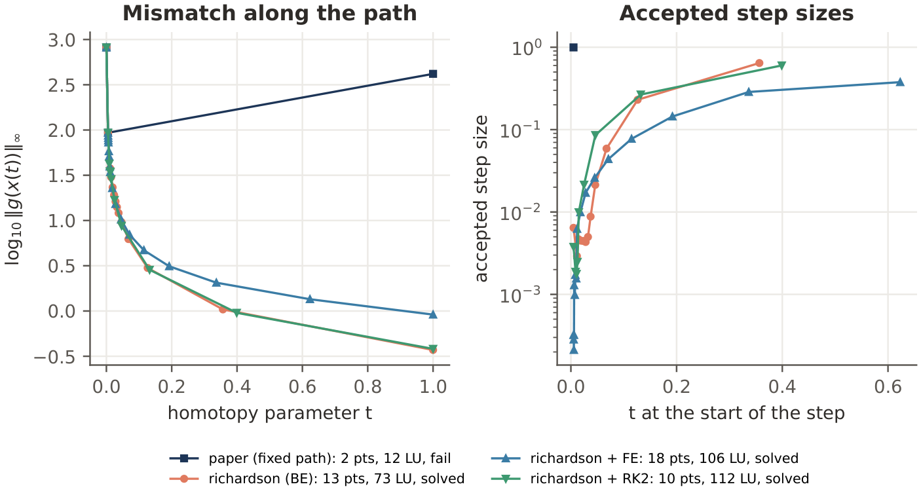
IMPROVEMENT · RICHARDSON STEP CONTROL
Richardson paths on case6024
richardson_path.pdf — mismatch and accepted step size for BE, FE, RK2
What the figure shows
Left column: paper's fixed step.
Right column: Richardson steps.
Top row: mismatch ||g|| along t.
Bottom row: accepted dt vs t.
BE runs are always safe.
FE and RK2 need small dt near t = 0.
Sadman · Dynamic homotopy power flow
12

Slide 13
IMPROVEMENT · SCALED HOMOTOPY
A second homotopy that did not help
improvements/homotopies.py — class ScaledHomotopy
The paper's easy function shifts every equation by the same K.
Idea from ref. 29: shift each equation by its own Jacobian diagonal.
Define g0(x) = K D (x - x0), where D = |diag J(x0)| scaled to mean 1.
So a strong row gets a strong shift and a weak row gets a weak shift.
Result: 129 of 170 runs solved. Almost the same as the paper's 127.
Kept in the code as a documented negative result.
class ScaledHomotopy(FixedPointHomotopy):
def __init__(self, problem, x0, K, counter=None):
super().__init__(problem, x0, K, counter)
d = np.abs(problem.jacobian(x0).diagonal())
d[d == 0] = d[d > 0].min()
self.scale = d / d.mean()
def G(self, x, t):
return (t * self.problem.g(x)
+ (1 - t) * self.K * self.scale * (x - self.x0))
def Gt(self, x):
return self.problem.g(x) - self.K*self.scale*(x - self.x0)
Sadman · Dynamic homotopy power flow
13

Slide 14
FROM SCRATCH · LINEAR ALGEBRA
Gauss elimination and LU with partial pivoting
improvements/gauss.py — dense, O(n^3), inner loops vectorised
gauss_solve does partial pivoting on each column.
The multiplier m eliminates the sub-diagonal in one row update.
back_substitution walks up the upper triangle.
lu_factor stores L (unit diagonal) and U in one packed array (Doolittle).
forward_substitution then back_substitution give lu_solve.
factorize wraps this with the same signature as dynhomotopy.linalg.factorize.
So NR and FDXB can drop it in with no other change (Hasbi's scratch.py).
Both algorithms agree with NumPy to about 1e-13.
def lu_factor(a):
lu = np.array(a, dtype=float)
n = lu.shape[0]
perm = np.arange(n)
for k in range(n - 1):
p = k + np.argmax(np.abs(lu[k:, k]))
if lu[p, k] == 0: raise SingularError(...)
if p != k:
lu[[k, p]] = lu[[p, k]]
perm[[k, p]] = perm[[p, k]]
lu[k+1:, k] /= lu[k, k]
lu[k+1:, k+1:] -= np.outer(lu[k+1:, k],
lu[k, k+1:])
return lu, perm
Sadman · Dynamic homotopy power flow
14

Slide 15
FROM SCRATCH · COST COMPARISON
Why the paper needs a sparse LU
exp15_scratch_lu.py — same iterations, very different time
0.04 s
424 s
14×
SciPy sparse LU (SuperLU)
our dense LU from scratch
faster than repeating Gauss for 20 rhs
Same numerical answer
Why FDXB factorizes only once
Solvers give the same NR and FDXB iteration counts on 69- to 2000-bus grids.
Largest difference in the returned voltages: about 5e-12.
So the from-scratch code is numerically correct.
One LU factor. Twenty right-hand sides. 14 × faster than repeating Gauss elimination.
The 424 s figure shows dense O(n^3) also ignores sparsity.
This confirms the design of the project's LU counter as the cost metric.
Sadman · Dynamic homotopy power flow
15

Slide 16
TOOLS · COMMAND-LINE RUNNER
One command to run any switch on any grid
improvements/__main__.py — python -m improvements ...
$ python -m improvements case18482 --corrector
case18482: dt0 = 0.005, K = 0.0001, refiner = NR
method outcome path steps NR its LUs
paper solved 2 3 5
corrector solved 2 3 6
$ python -m improvements case6024 --multiplier --richardson
$ python -m improvements case36964 --dt0 0.1 --K 2e-3 \
--corrector --multiplier
$ python -m improvements spectrum case18482
$ python -m improvements feasibility case6024
$ python -m improvements tune case6024
$ python -m improvements scratch case_ACTIVSg500limit \
--refiner FDXB
Switches available
--corrector: Newton corrector (Apurbo)
--multiplier: optimal step (Hasbi)
--adaptive: halve when mismatch grows
--richardson: error-controlled dt
--step: FE, RK2, RK4, BE, BE-chord
--homotopy: fpv, scaled, newton
--refiner: NR or FDXB
--dt0, --K: paper's parameters
Sadman · Dynamic homotopy power flow
16

Slide 17
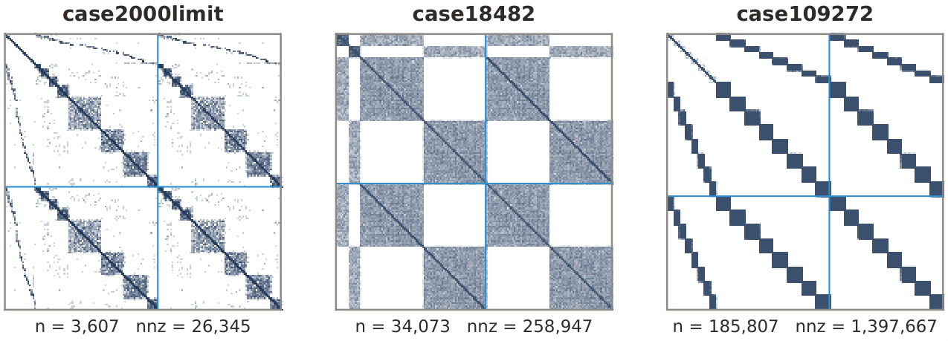
REPORT FIGURE · SPY.PDF
Sparsity of the Jacobian at three grid sizes
report/figures/spy.pdf — why sparse LU is not optional
Reading the panels
Left: 2000-bus grid.
Middle: 18,482-bus grid.
Right: 109,272-bus grid.
Each dot: one non-zero of J.
Density stays near 0.01 %.
Every column has few entries.
This is why splu is fast.
Sadman · Dynamic homotopy power flow
17

Slide 18
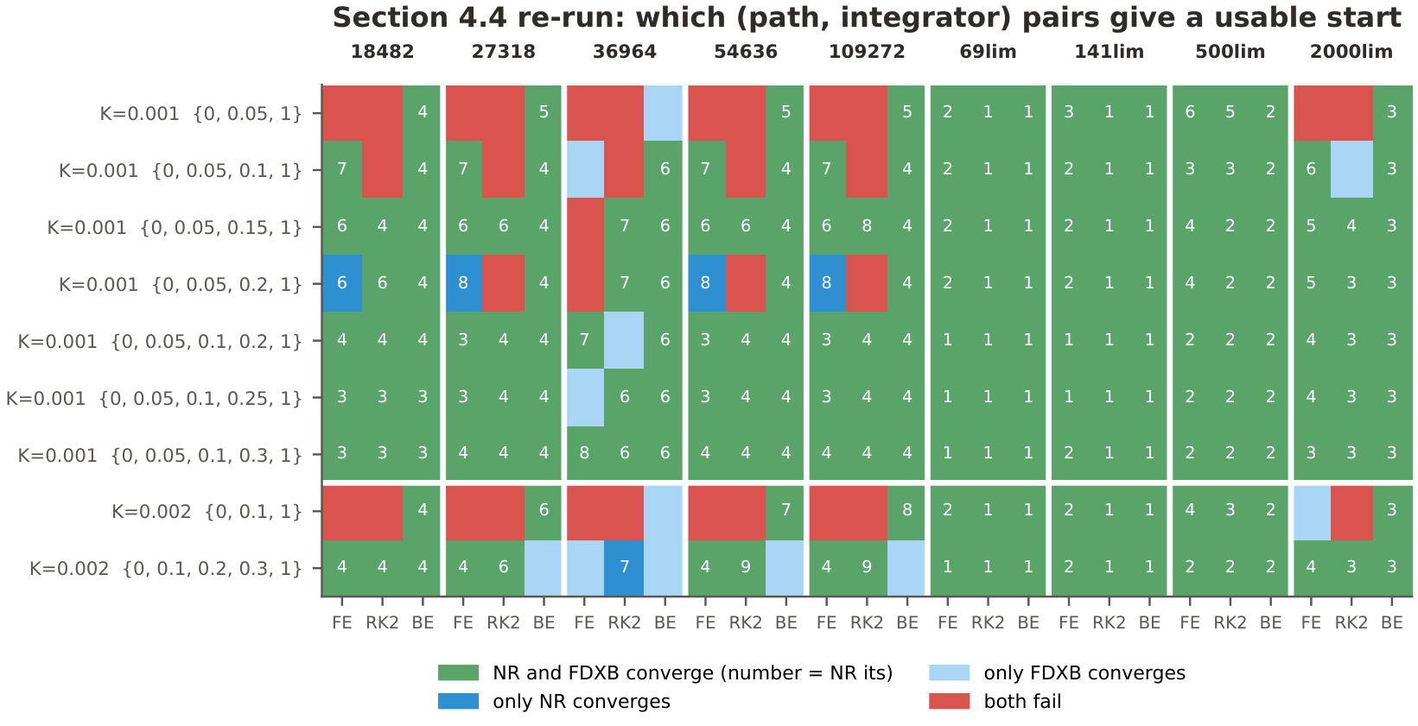
REPORT FIGURE · SEC44_GRID.PDF
Section 4.4 rerun as one grid
report/figures/sec44_grid.pdf — paths × integrators, coloured by convergence
Colour legend
NR and FDXB converge
only NR converges
only FDXB converges
neither converges
Numbers inside each cell: NR iterations. BE is the only integrator that fills the grid.
Sadman · Dynamic homotopy power flow
18

Slide 19
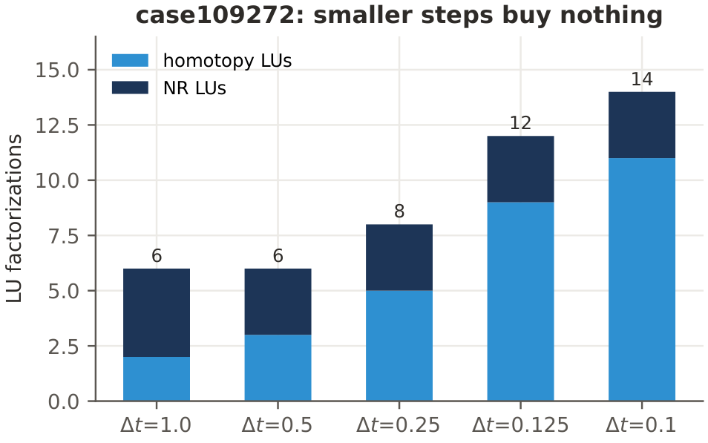
REPORT FIGURE · FIG5_TRADEOFF.PDF
Cost of a small time step on case109272
report/figures/fig5_tradeoff.pdf — homotopy vs NR LU factorizations
What the bars show
Bar height: total LUs.
Dark: homotopy LUs.
Light: NR refinement LUs.
Smaller dt: taller dark bar.
NR bar hardly changes.
Same final V and angle.
So small dt costs more for the same result.
Sadman · Dynamic homotopy power flow
19

Slide 20
VERIFICATION · TESTS
Tests I wrote
24 tests in the project. My share is below.
File
Test
tests/test_improvements.py
scaled homotopy: matches fpv when the diagonal is uniform
tests/test_improvements.py
Gauss elimination against numpy.linalg.solve
tests/test_improvements.py
LU factorization: L unit triangular, U upper triangular
tests/test_improvements.py
partial pivoting: swaps recorded in perm
tests/test_improvements.py
Richardson control: solves the 2x2 example
tests/test_cli.py
command-line tool: parses arguments and runs each study
All tests pass. Run with: pytest -q
Sadman · Dynamic homotopy power flow
20

Slide 21
Takeaways
Where my kernels moved the project forward
Honest cost. Every LU is counted through one wrapper. So the paper's cost claim can be checked.
Richardson control. Only change that solves case6024, case7092, case10595 and case12110.
From-scratch LU. 424 s vs 0.04 s proves the sparse LU is essential at 2000 buses and above.
Command-line tool. One line reproduces any experiment. Every switch is exposed.
Report figures. Sparsity, Richardson paths, Section 4.4 grid and Figure 5 tradeoff.
Thank you
Sadman · CSE 402 · 2026

