Slide 1


Welcome to our Presentation

Slide 2

Presenter
* Nurul Adnan Kamor Dipty
232-15-107
* Towhidul Islam Tarek
232-15-406
* Puja Dhar
232-15-848

Slide 3
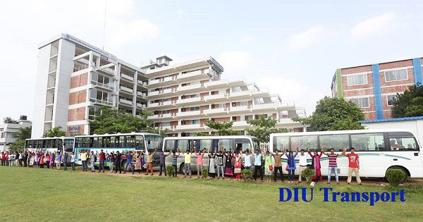
Presentation Title
DIU Bus Management System
Using C and Linked Lists

Slide 4
Introduction
•In this presentation, we'll discuss about simplifying bus operations at diu transport using C programming and linked lists.
•This system can improve the management of buses by enhancing efficiency and student satisfaction.|

Slide 5
Motivation
Efficient management of buses at diu transport is crucial for smooth transportation services.
Manual tracking of bus details, seat bookings, and cancellations can be time-consuming.
An automated system can streamline operations, improve accuracy, and enhance students experience.

Slide 6
Objective
To develop a simple yet efficient system for managing bus at diu transport.
Utilize C programming language and linked list data structure to implement essential functionalities.

Slide 7
Functions
Add_bus()
seat_booking()
cancel_seat()
bus_details()

Slide 8
Structure And Pictorial Diagram
Struct bus{
char busname[50];
int totalSeat;
int bookedSeat;
struct bus *next;
}
busname[50] | totalSeat | bookedSeat | *next

Slide 9
Conclusion
The developed Bus Management System provides a robust solution for students.
Leveraging C programming and linked lists ensures efficient memory management and scalability.
The system offers functionalities such as booking seats, canceling bookings, displaying bus details, and adding new buses.

Slide 10

Thank you

