Slide 1


Adversarial Robustness in Network Intrusion Detection Systems
via Attribution-Guided Feature Selection and Dynamic Multi-Stage Adversarial Training
CANDIDATES
Sadman Hossain Sajid
ID: 2023200000062
Redoan Islam
ID: 2023200000689
SUPERVISOR
Mahjabin Sultana
Lecturer, Department of CSE
DATE
September 10, 2026

Slide 2

Presentation Outline
Overview of the research structure and milestones.
01
Problem Statement
06
Dataset & Environment
02
Motivation & Objectives
07
Target Architecture
03
Literature Review
08
Research Timeline
04
Comparative Analysis
09
Expected Results
05
Proposed Methodology
10
Conclusion

Slide 3

Problem Statement
Modern Deep NIDS achieve >95% accuracy on normal traffic, but collapse to ~30% under tiny, undetectable packet tweaks.
System Performance
Clean vs. Robust
Gradient-Volatile Features
Fragile Features: Classifiers rely on weak traffic clues that attackers can easily disguise.
95%
CLEAN ACC
~30%
ROBUST ACC
Transient Socket Shortcuts
Shortcut Cheating: Models memorize port numbers and IP addresses instead of learning real attack behavior.
The Adversarial Evasion Mechanism
Attackers slightly alter flow timing and packet sizes.
Consequence: The AI is tricked into classifying dangerous attacks as normal benign traffic.
Defensive Hardening Trade-Offs
Stale Defenses: Existing defenses train once on old attacks, making them helpless against adaptive, modern attackers.

Slide 4




Motivation & Objectives
Building fast, accurate, and honest AI defense for live enterprise networks
01
02
03
Real-Time Speed
High-speed networks cannot wait: slow detection drops valid packets.
Goal: Keep inference under 0.05 ms per flow for line-rate speed.
Acc vs Robustness
Defending models usually causes a 2% to 6% drop in normal accuracy.
Goal: Stop attacks without hurting normal accuracy by removing noisy features.
Benchmark Hygiene
Goal: Completely remove all port and IP shortcuts so the AI learns real attack behavior.
Enforce strict partitioning and class balancing.

Slide 5
Literature Review
Survey of 40 peer-reviewed defenses spanning 2021–2026.
Macro Empirical Findings Across the Literature
Scope of Survey
40
Peer-Reviewed Publications
(2021–2026)
Comprehensive analysis spanning deep learning NIDS, adversarial hardening, and Explainable AI (SHAP).
01
Clean Accuracy Trade-Off
Adversarial training on unpruned feature spaces leads to a clean accuracy drop of 2% to 6%, reflecting Tsipras' trade-off.
02
Vulnerability of Tree Ensembles
Tree-based ensembles suffer severe degradation under iterative gradient perturbations (>80% Attack Success Rate).
03
Static Perturbation Staleness
Offline data augmentation exhibits reduced effectiveness against adaptive attacks (16% to 20% evasion reported).
04
Inference Latency Overhead
Runtime XAI verification (85–220 ms/flow) introduces substantial latency overhead relative to real-time line-rate constraints.
05
Shortcut Memorization & Clean-Only Bias
Conventional feature selection methods evaluate features solely on nominal traffic, frequently retaining port numbers that act as fragile back doors under perturbation.

Slide 6

Literature Review (Part 2)
Landmark Peer Benchmarks & Defense Paradigms
1. Static Adversarial
Holla et al., IEEE Access 2025
METHOD
3-layer MLP; clean SHAP top 8; static triad augmentation.
RESULTS
Clean 85% drops to 55% under PGD; defense restores to 88% / 84% Square.
LIMITATION
Static attack staleness & explicit port retention issues.
2. Dynamic Hardening
Olukola & Rahimi, TIFS 2026
METHOD
4-layer MLP; clean warm up + dynamic PGD with adaptive loss scheduling.
RESULTS
94.8% clean accuracy and 89.4% robust accuracy (0.08 ms latency).
LIMITATION
Operates across all 78 dimensions (+140% overhead); limited explainability.
3. Explainable AI Gate
Güvenç Paltun et al., 2025
METHOD
DNN with runtime SHAP cosine similarity vs. clean centroids.
RESULTS
95.1% clean accuracy; detects 88.5% of FGSM/PGD perturbations.
LIMITATION
High runtime latency (85–220 ms per flow); susceptible to scaffolding.
4. Graph Attention IDS
Zeng et al., IEEE IoTJ 2025
METHOD
Dual-module channel-spatial attention over dynamic host communication graphs.
RESULTS
97.4% clean accuracy; 76.2% robust accuracy under topology evasion.
LIMITATION
Window batch delay (>2.4 ms/flow); vulnerable to dummy-edge spoofing.

Slide 7
Comparative Analysis
Empirical benchmarks across 40 surveyed papers: Every best result has a limitation.
Benchmark Frontier
Published Paper
Best Result
Defense Mechanism
Limitation
Best Clean Accuracy
Roshan et al. (2023) /
Zeng et al. (2025)
98.2% Clean
Standard Deep MLP /
Graph Attention
Zero Defense: Collapses to <32% under white-box PGD attacks; or incurs 2.4 ms delay.
Best White-Box Robustness
Olukola & Rahimi
(IEEE TIFS 2026)
89.4% PGD₂₀
Multi-Stage Dynamic PGD
Clean Drop & Overhead: 2.1% clean penalty; keeps all 78 dimensions (+140% GPU).
Best Static Defense
Holla et al.
(IEEE Access 2025)
88.0% Def
Static Triad Augmentation
Staleness & Shortcuts: Offline attacks go stale (16–20% evasion); retained ports.
Best Black-Box Robustness
Ennaji et al.
(IEEE TIFS 2025)
88.6% B-Box
Query Perturbation &
Anomaly Tracking
High Complexity: Stateful query tracking; vulnerable to adaptive white-box transfer.
Best Certified Defense
Zhou et al.
(IEEE TDSC 2023)
Provable L₂
Randomized Smoothing
Severe Accuracy Crash: Clean accuracy dropped from 94.5% → 76.2% (-18.3% penalty).
The Literature Dilemma
Across 40 surveyed papers, no existing system achieves high robustness without suffering a severe penalty in clean accuracy, latency, or computational complexity.

Slide 8


Proposed Methodology
Data Sanitization and Screening
01
Sanitization
Feature Drop
02
Partitioning
Train/Val/Test
03
MI Screening
Shannon MI
04
SMOTE
Balancing
Data Sanitization
Permanently remove non-generalizable shortcuts: Src/Dst IP, Ports, Timestamp, Flow ID.
Result: 69 continuous features remain.
Strict Partitioning
80% Dev Set (5M flows) / 20% Test Set (1.2M flows) locked Day 0.
Dev split: 72% Train / 8% Val.
Parameters fitted strictly on 72% Train.
Feature Selection
Mutual Information filters 69 down to top 40 candidates.
Preserves semantics (unlike PCA).
Accelerates Shapley computation by >60%.
Oversampling
Continuous-Only SMOTE applied strictly within Dtrain (72% Train).
Balances minority attacks without interpolating discrete flags.

Slide 9
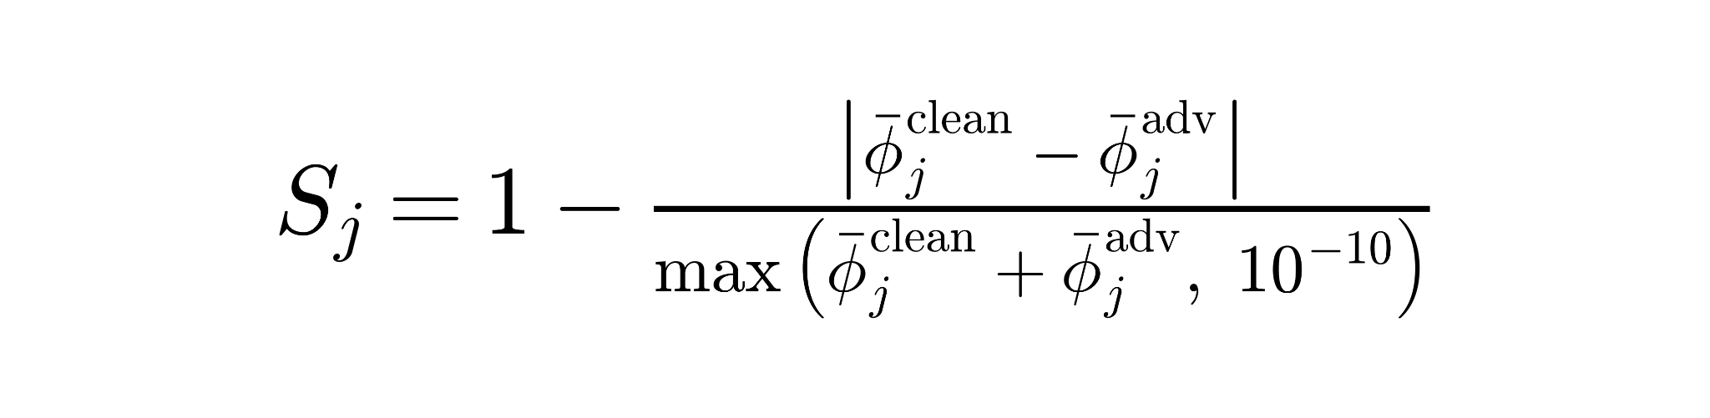
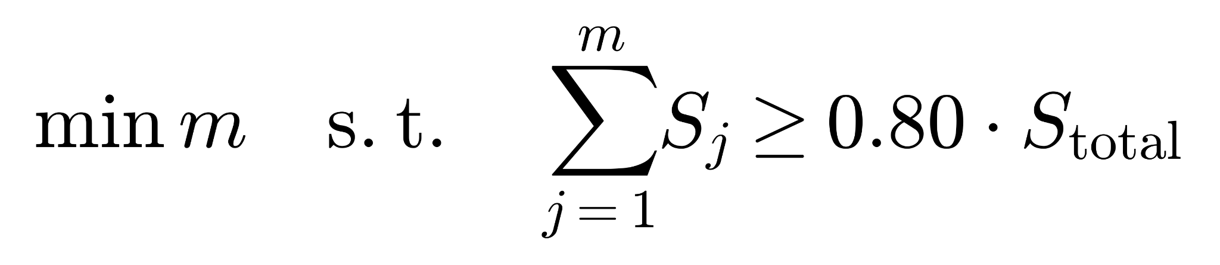
Proposed Methodology: SHAP
Our Approach: Measure feature stability under attack to keep only the 27 most reliable features.
01 Clean-Only Vulnerability
Selecting features only on normal traffic is dangerous: features that look important on clean data are often the easiest for attackers to manipulate.
02 Dual-State Attribution Auditing
Train a baseline model on 40 candidates. Attack it with 20-step PGD, then compare feature importance on normal vs. attacked traffic.
03 Exact Mathematical Stability Score (S_j)
Quantifying individual feature robustness under perturbation:
04 80% Cumulative Stability-Mass Selection
Rank features descending and select minimal subset m satisfying:
27 STABLE FEATURES SELECTED
13 VOLATILE FEATURES PRUNED

Slide 10
Proposed Methodology : Two-Phase Dynamic Training
Curriculum training to mitigate static attack staleness.
Why Two Phases?
Attacking a brand-new model from day one ruins its learning. It must learn normal traffic patterns first before facing adversarial attacks.
PHASE 1: Representation Warmup (Epochs 1–10)
Train exclusively on clean data using standard cross-entropy loss so the model builds solid, accurate classification foundations.
PHASE 2: Dynamic Online Training (Epochs 11–50)
Generate live, fresh PGD attacks for every training batch to defeat evolving attacks without hurting normal accuracy.
Joint Objective:
Defends against evolving attacks while keeping normal traffic accuracy high.

Slide 11
Dataset & Environment
Experimental configuration and technical architecture parameters
1. Benchmark Dataset
CSE-CIC-IDS 2018: from dhoogla/csecicids2018 14 attacks across 7 profiles; curated Parquet flows replace raw 250 GB dataset
Total Valid Flow Volume:
6,320,003
flows (post-sanitization).
Partition Breakdown:
72% Core Train: 4.55M flows
8% Validation: 505K flows
20% Frozen Test: 1.26M flows
2. Platform & Stack
GPU Platform:
AMD Radeon RX 7600 (8 GB VRAM, RDNA 3 architecture).
Software Stack:
Python 3.10, PyTorch, ROCm Windows, Adversarial Robustness Toolbox.
Batch Optimization:
Vectorized GPU tensor operations (Batch Size = 2048), mixed-precision (~70 min for 50 epochs).
3. Target Architecture
Topology:
4-Layer Multi-Layer Perceptron (MLP).
Layer Design:
Linear → Batch Normalization → ReLU Activation → Dropout (p = 0.30).
Complexity:
Compact feed-forward pass (~14,000 parameters) ensuring high GPU throughput.
27
→
128
→
64
→
32
→
2

Slide 12
Weekly Research Timeline & Gantt Chart
Project Execution Timeline (Weeks 1-14)
★ PRE-DEFENSE (SEP 10)
★ FINAL DEFENSE (OCT 11)
W1
W2
W3
W4
W5
W6
W7
W8
W9
W10
W11
W12
W13
W14
1. Topic Selection
2. Literature Review
3. Base Paper Selection
4. Methodology Study
5. Limitation Identify
6. Environment Setup
7. Pre-Defense Prep
8. Implementation
9. Empirical Evaluation
10. Result Analysis & Comparison
11. Thesis Manuscript Drafting
12. Supervisor Review & Revisions
13. Final Thesis Defense
Current Status (September 10, 2026)
Tasks 1 through 7 are complete (Theoretical formulation, literature audit, data ingestion pipeline, and GPU environment verified). The Pre-Defense Milestone has been successfully achieved.
Immediate Transitions & Next Steps
Immediately transitioning to multi-threat evaluation (Weeks 11–12) and final manuscript submission (Weeks 13–14).

Slide 13
Expected Results & Research Hypotheses
Comprehensive multi-threat evaluation protocol and performance targets.
Clean Accuracy
≥95%
Pruning 13 unstable features mitigates degradation.
Robust Accuracy
88.0% – 90%
PGD-100 (ε=0.05) vs. undefended baselines.
Multi-Threat Evaluation Suite
First-Order Gradient Attacks
FGSM, PGD20, PGD100, BIM
Parameter-Free & Optimization Attacks
Auto-PGD (APGD-CE), Carlini-Wagner (l∞)
Decision-Based & Black-Box Attacks
Square Attack (query-based), Surrogate Model Transferability
Attack Success Rate
< 12.0%
Under iterative white-box gradient attacks.
Inference Speed
< 0.05 ms
Amortized per flow (preliminary: <0.02 ms).
VERIFICATION
Gradient Obfuscation Safeguards
Validate that robustness is genuine and not caused by gradient masking (verifying non-zero input gradients and evaluating black-box transferability).

Slide 14
Conclusion & Immediate Next Steps
Summary of proposed contributions and immediate project execution roadmap
PROPOSED CONTRIBUTIONS
SEPT 11 – OCT 11
Summary of Key Innovations
Immediate Next Milestones
Execute 3-seed experimental runs across all 9 adversarial threat models.
Theoretical Contribution
Identifies 27 stable, attack-resistant features using our Adversarial Stability SHAP method.
01
Conduct ablation studies: (1) Full 69D vs. 40D MI vs. 27D Stable; (2) Static Triad vs. Dynamic PGD.
Architectural Contribution
Introduces two-phase dynamic training to stop attack staleness without sacrificing normal traffic accuracy.
02
Complete and submit the final B.Sc. thesis manuscript for October defense.
Methodological Hygiene
Permanently removes socket shortcut leakage and enforces strict zero-leakage 72/8/20 partitioning on 6.32M valid flows.
03

