Slide 1
CSE498R.15
Sentimental Analysis on Product Reviews and Customer interactions
Sentimental Analysis
On Product Reviews and Customer interactions
Research

Slide 2

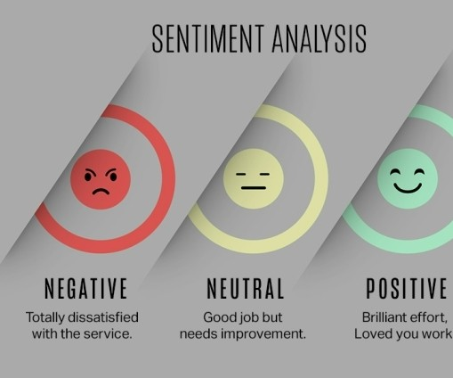

DESIGNED AND IMPLEMENTED BY:
1.Sadman Kabir (1811987042)
2. Maruf Hasan Arnob (1812701642)

Slide 3
Table of contents
Methods Used
SVC Method
01
02
The Methods that were used
SVC shows good accuracy
in this project.
scores.
DTC Method
Naive-Bayes
03
04
DTC showed the most
Naive-Bayes was less
prominent accuracy score.
accurate than the others,
Logistic Regression
Results
05
06
Accuracy was slightly less
Which method was chosen
and fitted model runtime was
and why.
slow.

Slide 4



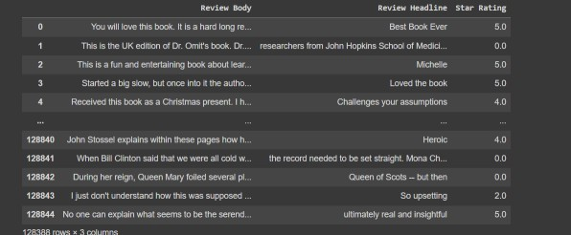
Amazon and Walmart Dataset
Cleaned the databases considering various factors.
The initial phase required the redundant fields to be dropped followed by dropping rows which had any null values.
Data removal of unnecessary words, symbols and characters was crucial.
Special characteristics like, and, (), [] {}/' are separated to eliminate inconsistencies by the function of polarity.

Slide 5
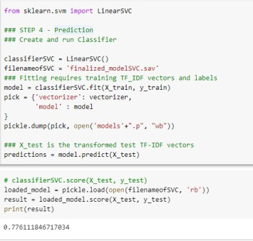
SVC was fitted and the model was saved in a file in a variable.
Loaded the model in the system to figure out the accuracy score.
0.78 was the accuracy score so we decided to try other methods.
SVC Method

Slide 6
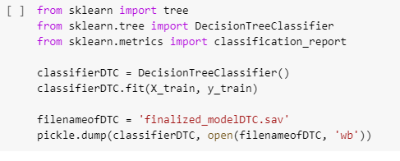
Decision Tree Classifier
Dataset was fitted and the accuracy score was measured.
0.8 was the score and showed a more accurate prediction.
DTC’s runtime was also faster with the same accuracy.
DTC was easier to visualize practically and theoretically.

Slide 7
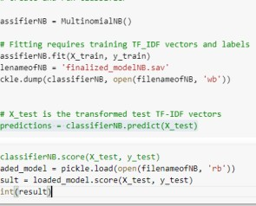
Fitted, dumped and loaded the model in the system.
Accurate score was measure from the loaded model.
0.78 was the accuracy score.
Other methods has a better accuracy solution compared to Naive-Bayes.
Naive- Bayes Method

Slide 8
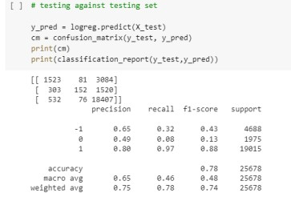
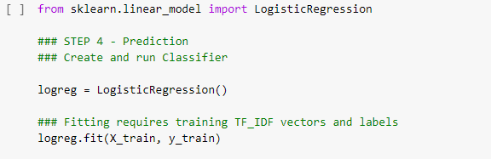
Model fitted, a confusion matrix was created along with a classification report.
Model was saved for future use so that it
Logistical Regression
doesn’t need to be fit at every runtime.
0.78 was the accuracy score.
Method
Logistic Regression may not be accurate
at times if the dataset is smaller.

Slide 9
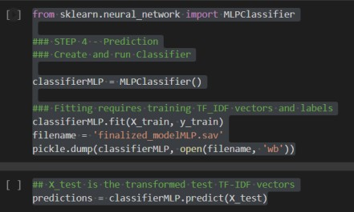
Fitted, dumped and loaded the model in the system.
Accurate score was measure from the loaded model.
0.79 was the accuracy score.
NN showed good results but the runtime using our dataset took the longest.
Neural Network Classifier

Slide 10
Why did we chose DTC for our System
DTC is non-linear. As we are working with sentimental language this fits perfectly!
Easier to understand than other models.
Runtime showed prominent results in
Results
the beginning of model training.

Slide 11


Why did we chose DTC for our System
Does not require a lot of assumptions. Not highly dependent on the dataset.
Less data preparation. DTC can make the dataset run without needing any
Results
sophistication normalization or scaling.

Slide 12
Conclusion
All of the models applied gives us a similar accuracy score. We have categorized them according to their accuracy score, time efficiency and usability. Much better cleaner dataset will provide us with a more accurate results and a more precise prediction. With more training, this model can show better accuracy score with larger and connecting sentences. Working with text objects requires a much complex speculation and calculations to predict humanly accurate results.

