Slide 1

CSE440 • Section 2
Autonomous Robot
for Indoor Navigation
Using A* Search Algorithm
Project idea and Week 1 work plan
Software-only simulation • No hardware needed

Slide 2
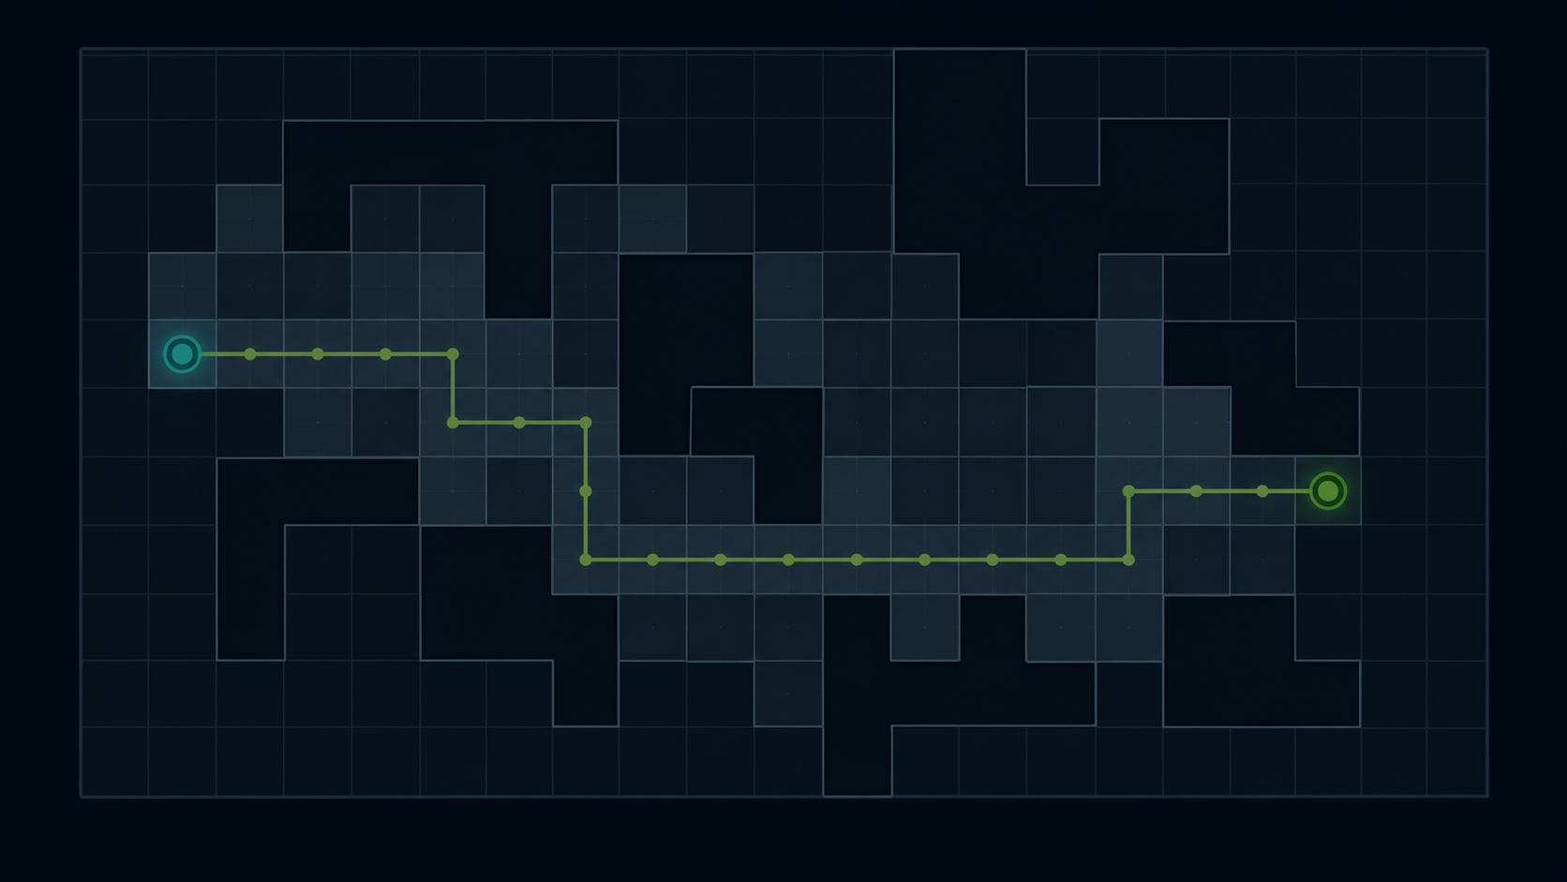
Project Idea
A simple indoor robot navigation simulator
🗺️
Indoor grid map
What we want to build
🤖
Virtual robot
•
A software map of a room or building.
•
A virtual robot that moves on the map.
✨
Shortest path
•
A* will find the shortest safe path.
🚧
Obstacle avoid
•
The robot will avoid blocked cells.
•
If a new obstacle comes, the path will update.

Slide 3
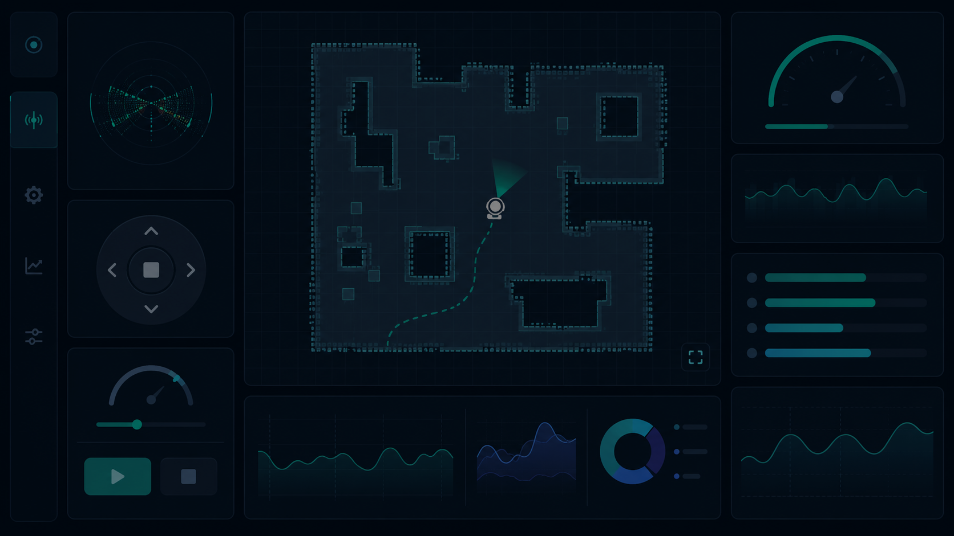
Simple System Flow
How the project will work
1
2
3
4
5
Create map
Choose points
Find path
Move robot
Replan
Make or load a grid map of the room.
Select start and destination cells.
A* calculates the best safe route.
Robot follows the route step by step.
If an obstacle appears, find a new route.
End result: user can watch the robot move and understand the path clearly.

Slide 4
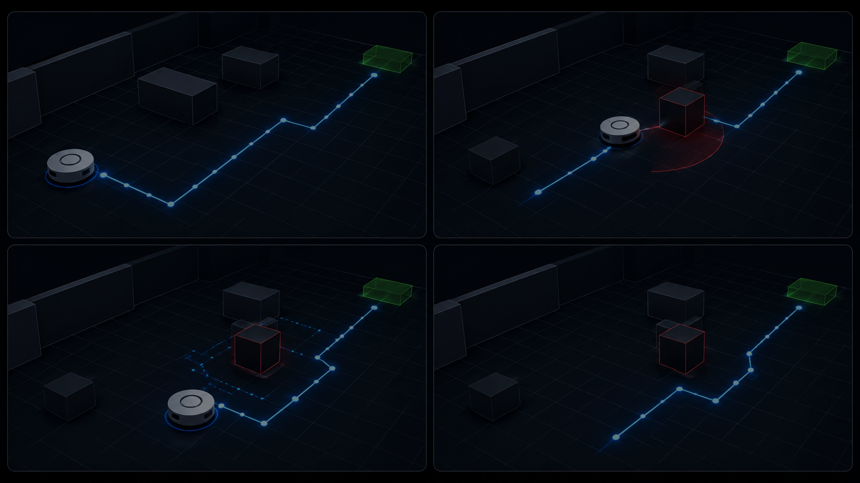
Main Features
Four parts of the complete system
1. Environment Mapping
2. A* Path Planning
3. Obstacle Avoidance
4. Simulation Dashboard
Create occupancy grid, load maps, and show the environment clearly.
Find the shortest safe route from start to destination.
Detect new obstacles, stop safely, and replan the route.
Animate robot movement and show performance values.
This is a software-focused AI/pathfinding project. It is easy to show because the output is visual.

Slide 5
Team Work Distribution
Four members will work on four connected parts
Asraful Hossain Riyan
Grid Map & Visual Map
Create the map, show cells, obstacles, start, goal, path, and robot.
Sadman Murtoza
A* Algorithm
Write A* code, find shortest path, and calculate path values.
Fahima Shameem
Robot & Replanning
Move the robot, stop before obstacles, and request a new route.
Sanjida Jaman
GUI, Testing & Docs
Build controls, test the system, and prepare screenshots and documents.

Slide 6
Week 1 Work Plan
First week tasks
Task 1: Grid Map & Visual Map
Task 2: A* Algorithm
Define grid and obstacle requirements.
Prepare map workflow.
Plan map loading and visualization.
Prepare sample grid layouts.
Define pathfinding requirements.
Plan A* module structure.
Decide inputs: grid, start, and goal.
Prepare open-node and cost logic.
Week 1 date: 11–17 July

Slide 7
Week 1 Work Plan
First week tasks for Member 3 and Member 4
Task 3: Robot & Replanning
Task 4: GUI, Testing & Docs
Define robot movement requirements.
Plan simulation module.
Plan dynamic obstacle behavior.
Decide how the robot will stop and update.
Prepare development environment.
Create project folder structure.
Plan GUI module and testing module.
Start documentation layout.
Goal of Week 1: setup, plan modules, and make the project ready for coding.

Slide 8
Expected Final Output
What we will show at the end
Final simulator will:
One-line presentation
•
Create or load an indoor map.
“Our project is a software simulator where a virtual robot finds the shortest safe path in an indoor map and changes the path if obstacles appear.”
•
Place start, destination, and obstacles.
•
Calculate a safe route using A*.
•
Move the robot on the route.
•
Update path when a new obstacle appears.
Simple • Visual • Easy to explain

