Slide 1
Composable
PPTX Viewer
Test Deck
@diceui/presentation
<Presentation.Root>
<Presentation.Toolbar />
<Presentation.Sidebar />
<Presentation.Canvas />
<Presentation.Controls />
</Presentation.Root>
A practical deck for testing parsing, layout fidelity, text rendering, images, shapes, tables, charts, hyperlinks, notes, and slide metadata.
headless
themeable
extensible
Notes:
This title slide has multi-line text, code-style text, rounded rectangles, shadows, and master footer/slide numbering.

Slide 2
TEXT FIDELITY
Rich text, bullets, alignment
Same textbox, multiple runs, inline emphasis, and symbol support: → ✓ ★ αβγ
Left aligned
with manual line breaks
and a soft gray fill.
Centered text
inside a box
Right aligned
short paragraph
for wrapping.
Rotated label
Bullets with indentation
Nested bullet approximation
Long bullet intentionally wraps to verify line-height and width calculations in the viewer
Number-like item: 01 02 03
Hyperlink to DiceUI
Speaker notes are attached to this slide.
Notes:
This slide tests rich text runs, bullets, wrapping, alignment, rotation, hyperlinks, and notes.

Slide 3
GEOMETRY
Shapes, lines, fills, transforms
Rect
Round
Oval
Tri
Hex
Cloud
Drop shadow + rounded rectangle
Arrow line
Rotated
Notes:
This slide tests native shapes, fills, transparency, lines, arrowheads, rotation, and shadows.

Slide 4
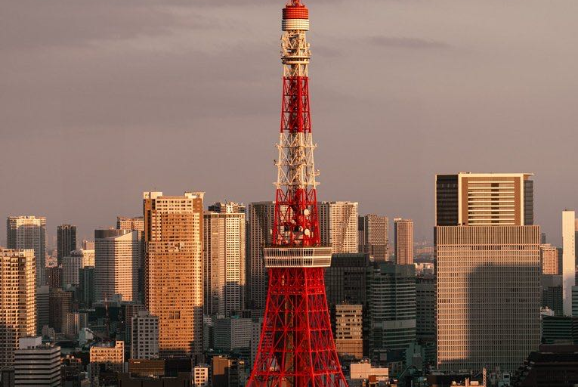

MEDIA
Raster images: crop, contain, border
Cropped cover image
Contained transparent PNG
This slide intentionally includes two different image fitting behaviors so a viewer can test cropping math and aspect-ratio preservation.
Notes:
Tests crop vs contain image sizing and transparent PNG handling.

Slide 5
DATA LAYOUT
Tables and styled cells
Feature | MVP | Advanced | Viewer risk
Text boxes | Yes | Rich runs + bullets | Medium
Images | Yes | Crop + alpha | Low
Charts | Basic | Native chart XML | High
Animations | No | Transitions/events | Very high
Overlays | Yes | Comments + AI layers | Low
Note: header fill is a separate shape behind/near the table in some renderers; useful for testing z-order edge cases.
Notes:
Tests table layout, borders, cell text, widths, and a z-order edge case.

Slide 6
CHARTS
Native PPTX charts
Native charts are important because many libraries flatten or ignore them. Your renderer can decide: parse chart XML, rasterize fallback image, or show a placeholder.
Notes:
Tests native chart objects; many browser PPTX viewers struggle here.

Slide 7
DIAGRAM
Composable viewer architecture
Parse
Normalize
Render
Compose
Unzip OOXML and relationships
Resolve theme, masters, layouts
Map slide model to DOM/SVG
Expose headless React primitives
Suggested API shape
Renderer adapters
const viewer = usePresentation();
<Presentation.Root src={file}>
<Presentation.Sidebar />
<Presentation.Canvas />
<Presentation.Controls />
</Presentation.Root>
HTML/CSS
SVG
Canvas fallback
Server raster fallback
Notes:
Tests line connectors placed behind nodes, code block rendering, and multiple grouped conceptual zones.

Slide 8
Dark slide / high contrast
Useful for checking theme color resolution, white text, transparency, and shadows on non-white backgrounds.
8
View / Present
PPTX XML
Composable
Slides
Modes
Core
UI
Large text with paragraph wrapping: a good viewer should scale the entire slide while keeping text crisp, not rasterized or blurry.
Notes:
Dark background test slide.

Slide 9
CHECKLIST
What to validate in your viewer
Parser
Relationships, layouts, masters, themes, slide order
Media
Aspect ratio, crop, transparent PNG, missing assets
Text
Font face, size, line height, bullets, rich runs, links
Data
Tables, charts, fallbacks, embedded XML objects
Geometry
Native shapes, z-order, rotations, transparency, shadows
UX
Zoom, keyboard nav, fullscreen, thumbnails, loading states
End of test deck
Notes:
Final checklist slide for viewer implementation priorities.

