Slide 1
NEWS CLASSIFICATION BASED ON SIMILARITY
GROUP 11
Name ID
Sadman Sakib 1620676042
Mazharul Alam Evan 1621460642
Ankur Saha 1620753642
Course:CSE445 ,Section :3

Slide 2
What is it? Why Needed?

Slide 3

The Growth of online news services is increasing day by day
A large amount of information is being stored in the electronic format
So, It’s necessary to categorize news so that if it could be easily reached by the users.
Solution:
classify the news articles using Machine learning approach
The new articles will be classified into predefined labels or categories such as entertainment , sports, music , education ,economy etc.

Slide 4
DATASET

Slide 5
We will use this news-category-dataset from Kaggle:
https://www.kaggle.com/rmisra/news-category-dataset
This dataset contains around 200k news headline from the year 2012 to 2020 obtained from HuffPost

Slide 6
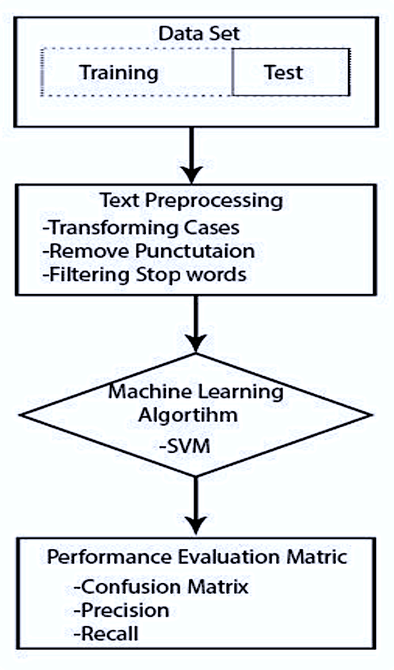
The dataset was not balanced . Most of the news are belong to the
political areas. The distribution of classes plays an important role in classification, and balanced datasets result in better learning models.
Figure 1.1: Class Workflow

Slide 7
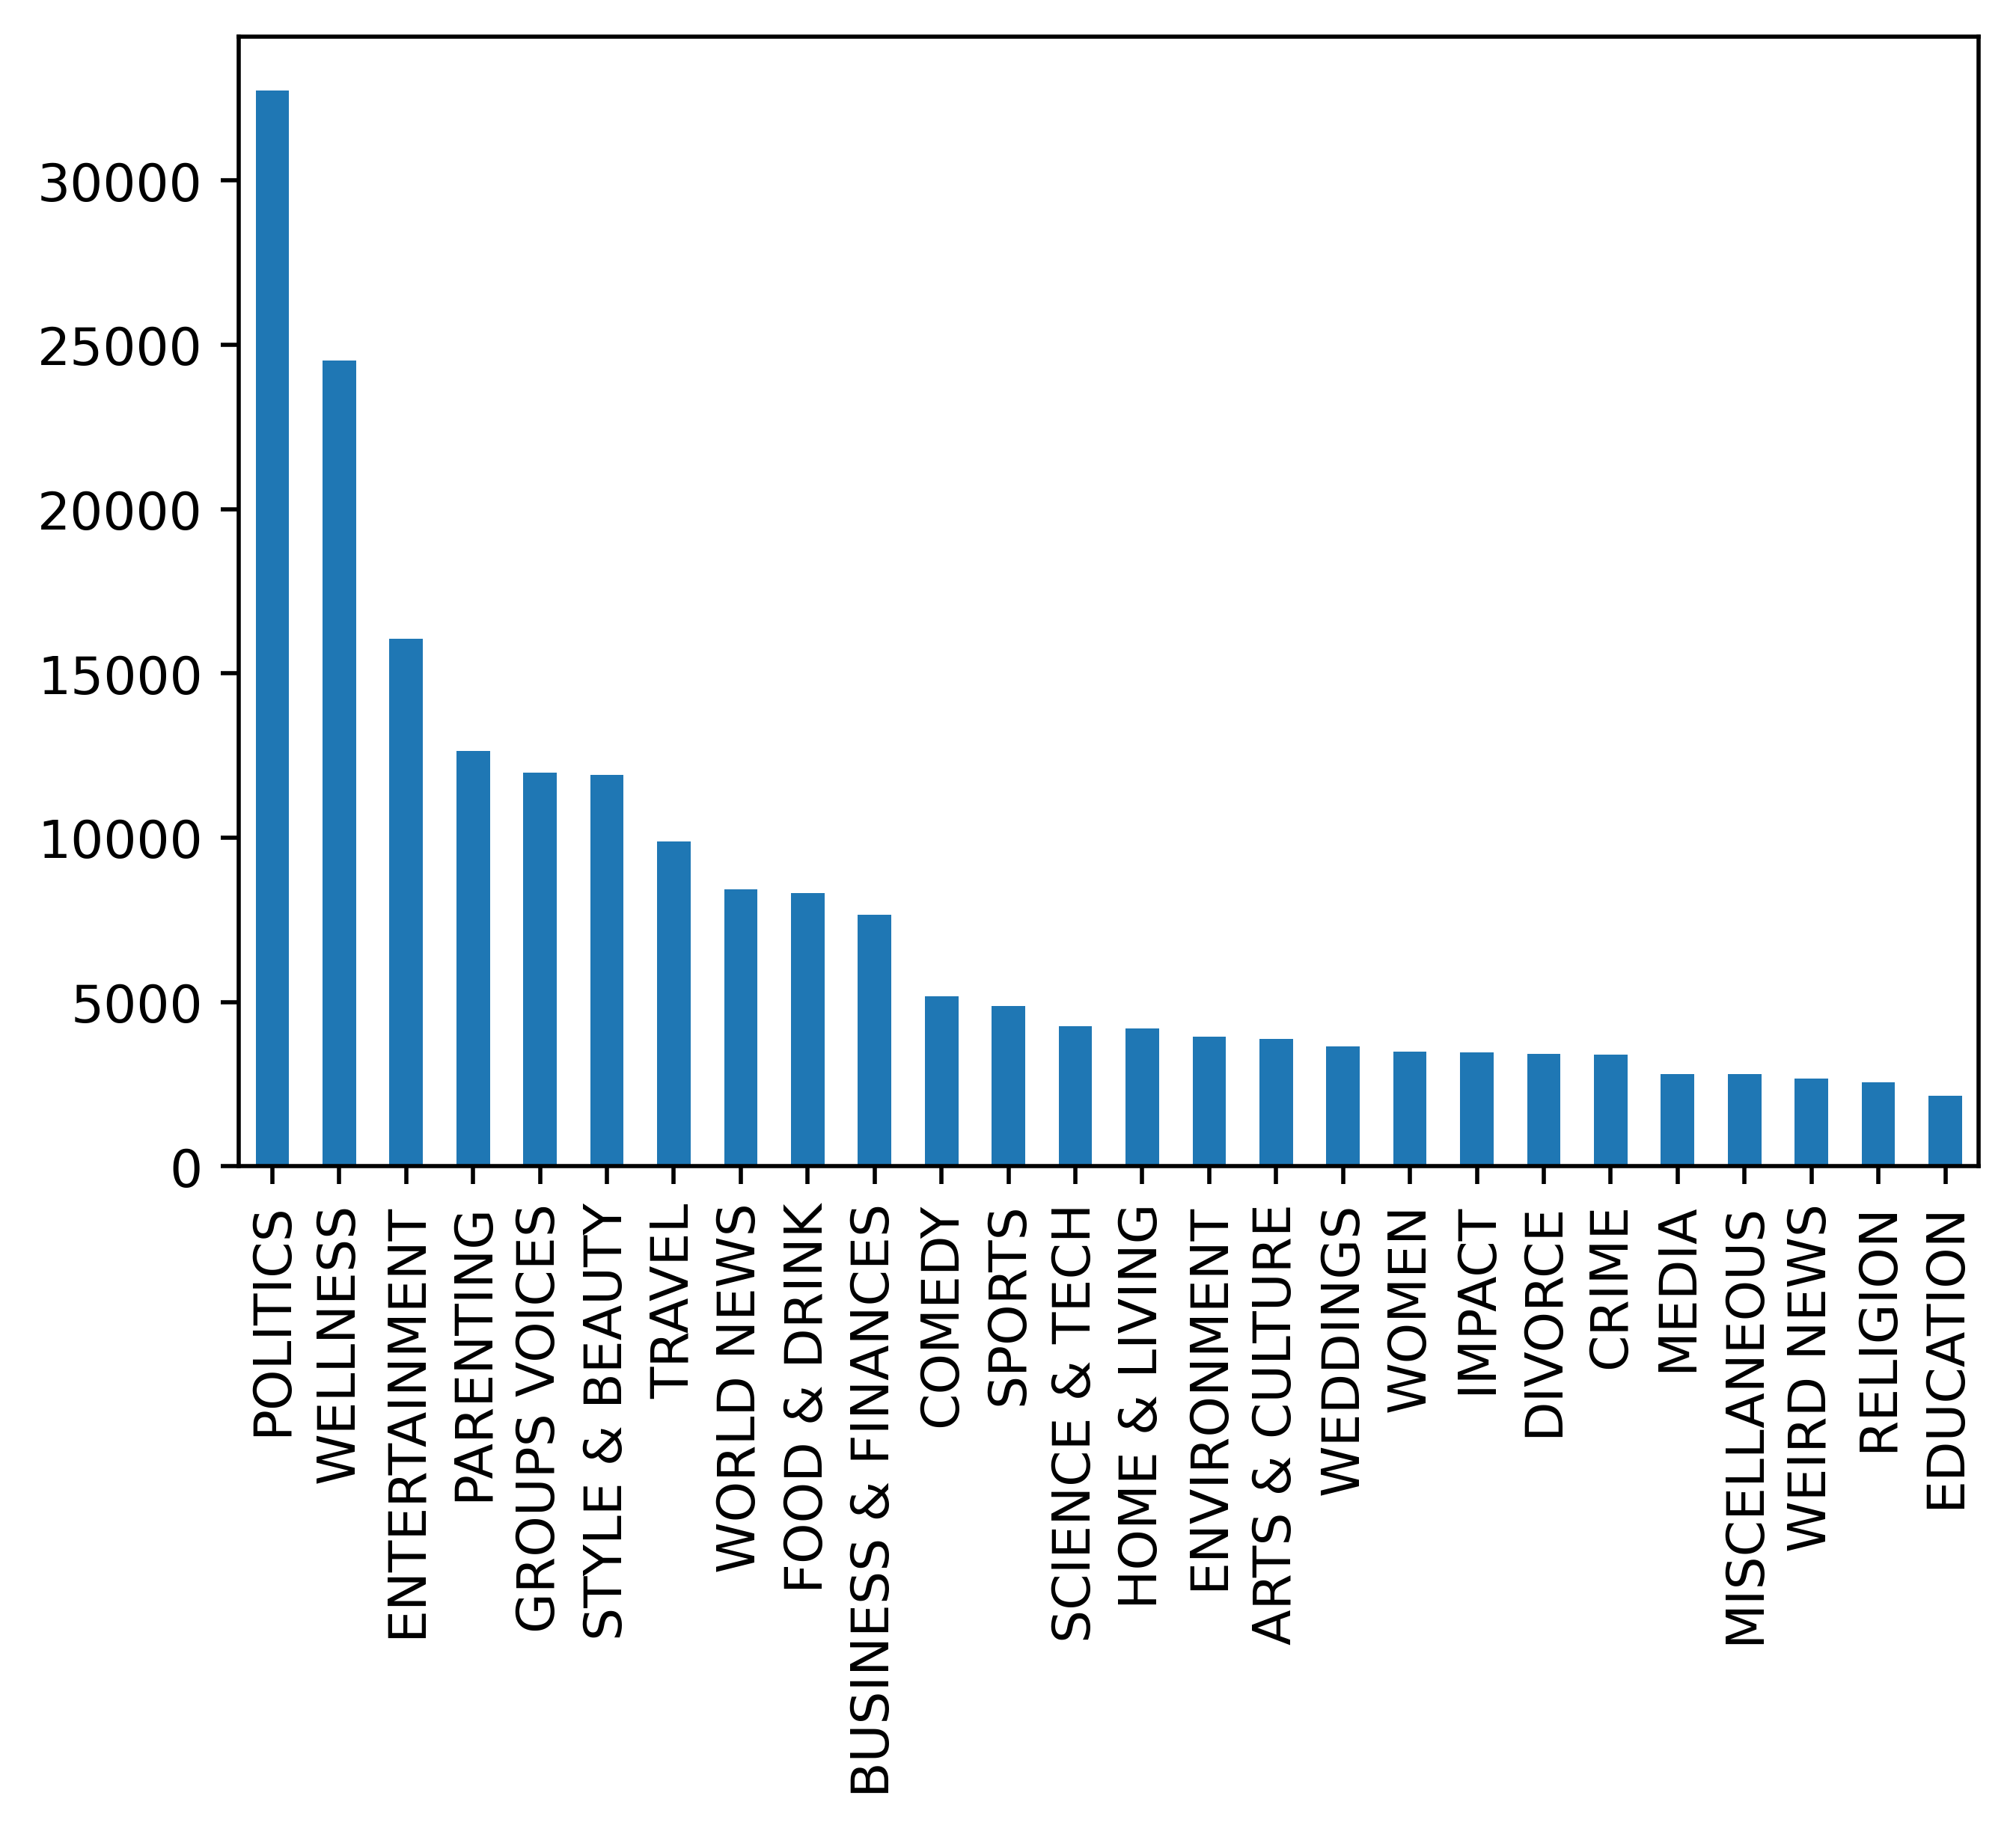
Figure 1.2: Class Distribution Bar Chart

Slide 8
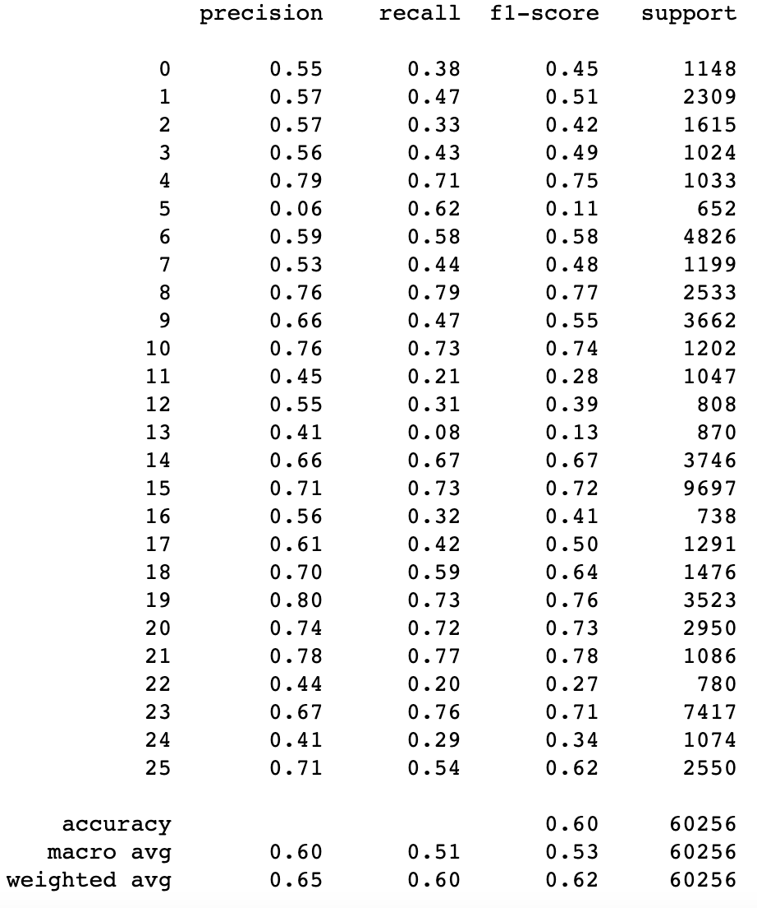
The performance results of multi-class category predictors based on different supervised learning models are evaluated and compared in this section. This study's learning model is SVM. The evaluation was done by observing each category predictor's prediction results by analysing the Confusion Matrix and quantifying Precision, Recall, and overall Accuracy.

Slide 9
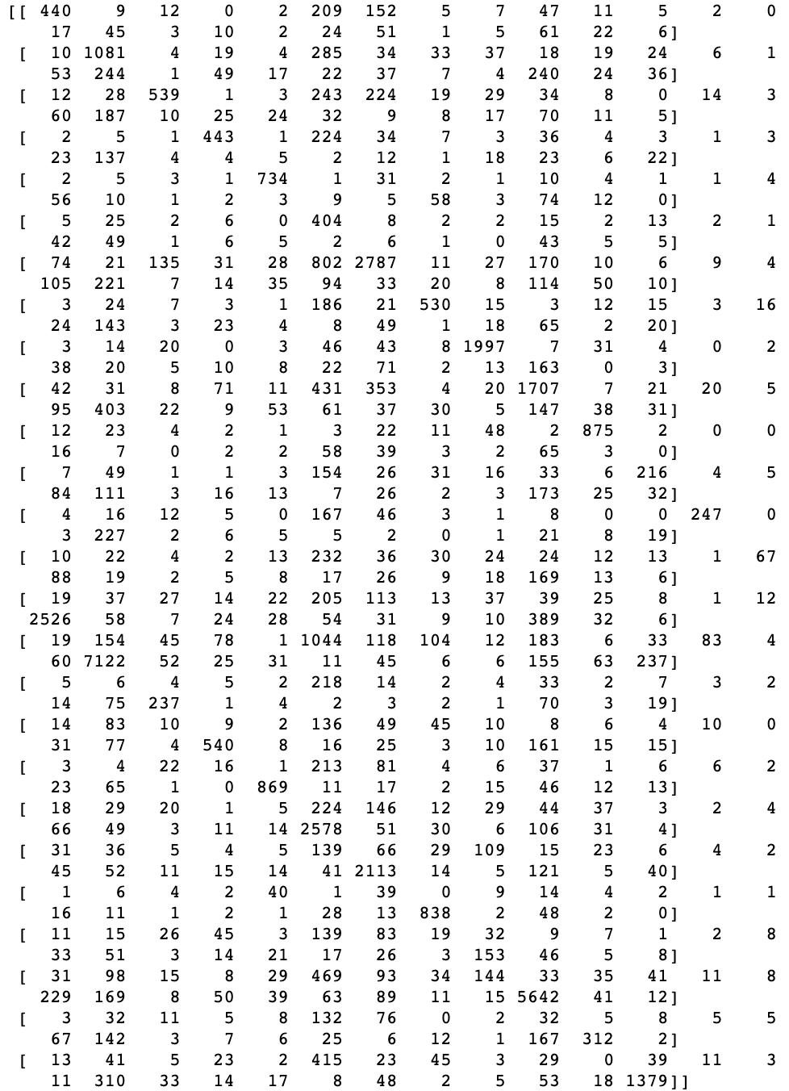
Confusion Matrix is a technique for summarizing the performance of a classification algorithm. The Confusion Matrix obtained from Support Vector Machine are described as:

Slide 10
Data Training & Testing

Slide 11
we analyse the category predictor model based on SVM algorithm, the prediction performance needs to be more satisfactory. As we get ,

Slide 12
Conclusion and Future works

Slide 13
The prediction performance of the multi-class category predictor is presented in this work. Well- known machine learning methods SVM was used to construct news category predictors. We next evaluated the Confusion Matrix and assessed the test dataset's Precision, Recall, and overall Accuracy using performance assessment criteria. We used the SVM algorithm to get correctly categorizing news to get the accuracy. For Future works, we can add recommended news features.

