Slide 1
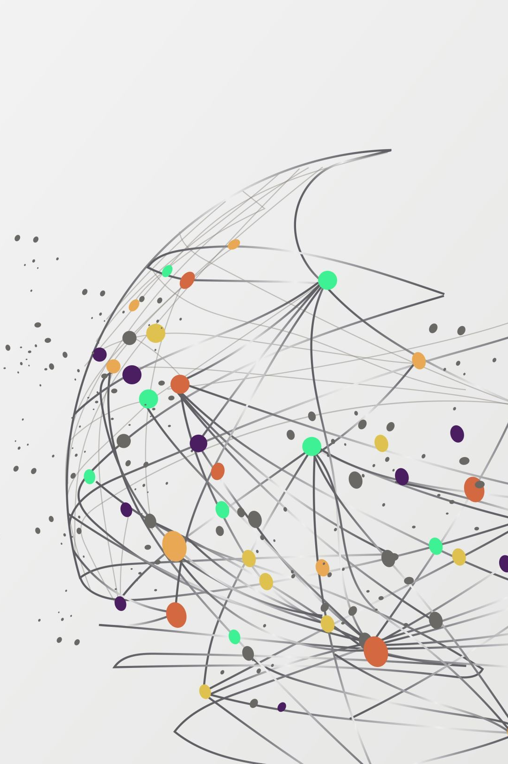

Vehicle Tracking using IOV
Presented By:
Group 2:
Anik Das
510819023
Amit Kumar Shaw
510819012
Soham Pal
510819035
Guided By:
Prof(Dr.) Tuhina Samanta
Associate Professor
Department of Information Technology
IIESTS

Slide 2
Introduction
Vehicle tracking using Internet of Vehicle – network of vehicles and roadside units
On the fly network formed, called ad-hoc network
This ad-hoc network of vehicles is called VANET

Slide 3

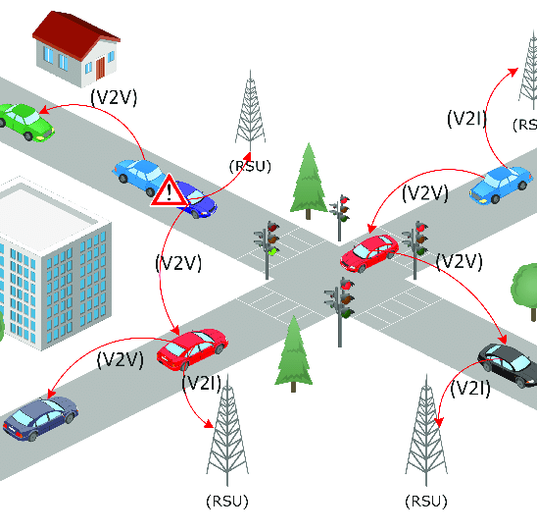
What is vanet?
Wireless multi-hop network
Has a constraint of fast topology changes due to the high node mobility.
Enables a wide range of applications, such as congestion detection, prevention of collisions, safety, blind crossing, dynamic route scheduling, real-time traffic condition monitoring, etc.

Slide 4
The Problem
Need of a system which tracks traffic and detects congestion in road
Current centralized solution has many drawbacks
Build an efficient system for this task

Slide 5
Solution
Distributed system
V2V communication
Traffic congestion detection

Slide 6
Implementation
Congestion Detection Algorithm with Adaptive Broadcasting

Slide 7
Steps
Speed Monitoring
Congestion Detection
Localization
Aggregation
Broadcasting

Slide 8
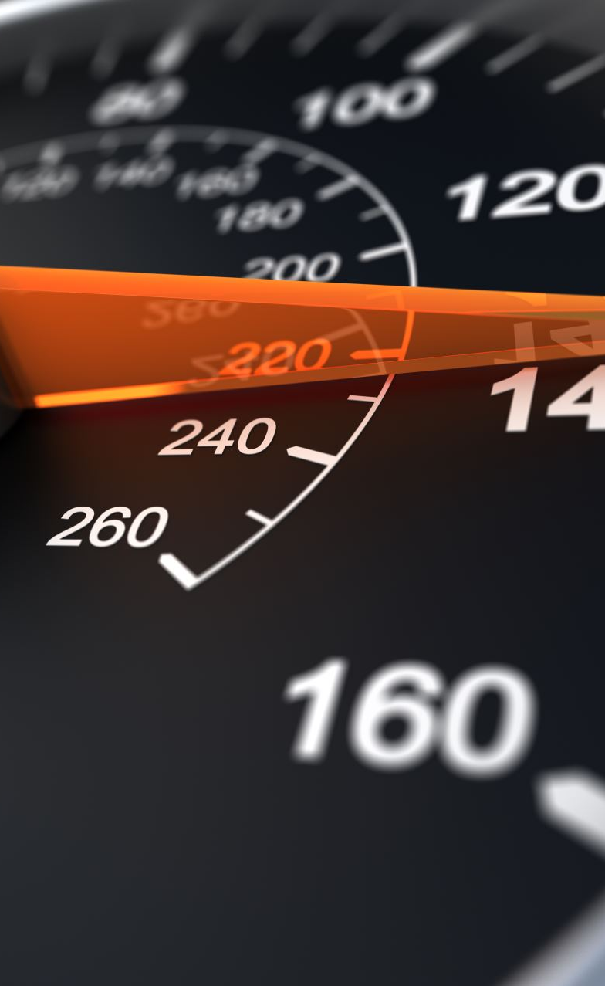
Speed Monitoring
Use speed as an indicator of congestion
Concept of threshold speed

Slide 9
Congestion Detection
Calculation of Congestion Parameter, C_{p} = η * π
π = 0 if V_{c} > V_{t} or 1 if V_{c} < V_{t}
η = {1, 2, 3, 4, 5} depending on time interval
Congestion parameter value from vehicle's database is C_{d}

Slide 10
Localization
Each street section has unique identification parameter A_{id}
This process retrieves the identification of the node’s current location and sets A_{id} parameter to this value
Included in BSM message with C_{p} and is used to store received data in vehicle's database

Slide 11

Aggregation
Responsible for the adaptation of broadcast intervals
In case V_{c} < V_{t} : broadcast only if C_{p} > C_{d}
In case V_{c} > V_{t} : broadcast only if C_{p} ≠ C_{d}

Slide 12

Broadcasting
Broadcast the message containing C_{p} and A_{id} parameters
All nodes who receive this message will know about traffic situation in A_{id} area
Following the previous steps, they can broadcast when necessary instead of doing it periodically

Slide 13
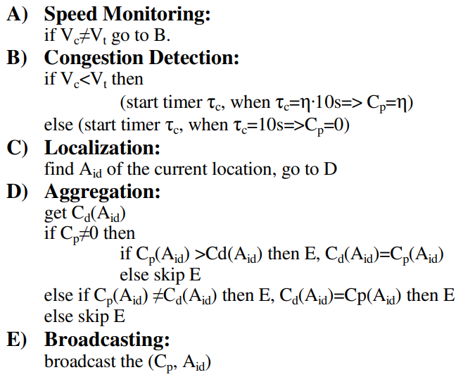
Overall Algorithm At a glance

Slide 14
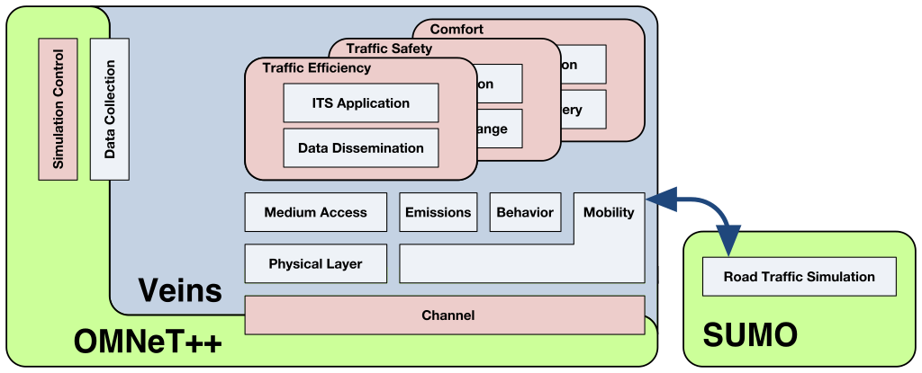
Simulation Setup

Slide 15
Recording of a congested street

Slide 16
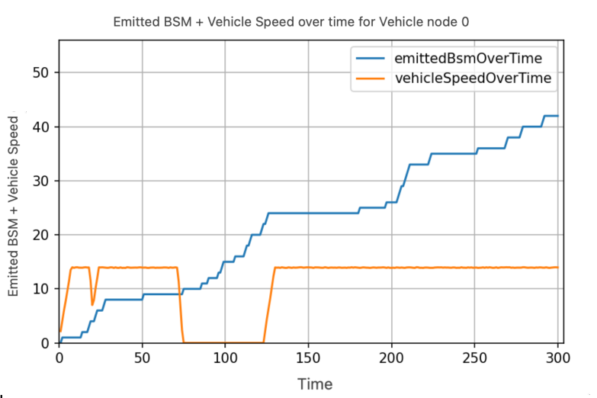
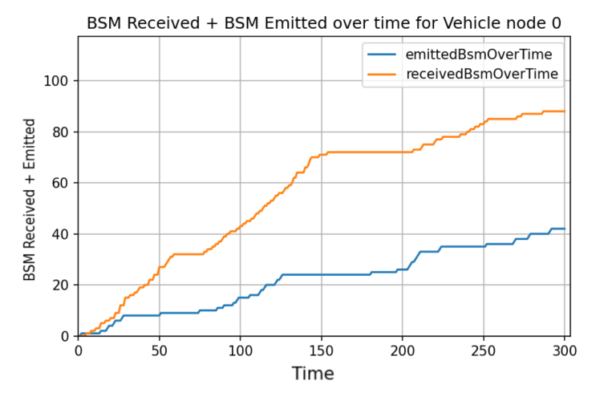
Metrics

Slide 17
Drawbacks of current Implementation
Directional flow of traffic not considered
Possibility to optimize the number of emitted beacons

Slide 18
Future Scope
Taking the directionality of traffic into account
01
Checking if the use of RSUs can reduce the load on the network traffic, shifting towards a hybrid (centralized + distributed) architecture
02

Slide 19
conclusion
Investigated the effectiveness of VANET in capturing vehicle congestion.
Results showed the ability of the system to relay congestion data to all vehicles.
Simulation revealed that the VANET system was able to adapt to changing traffic conditions and maintain high performance.

Slide 20
Thank you

