Slide 1
Dementia and its treatments
UoM Psychology Undergraduate Lecture — April 2026 (PowerPoint handout) Dr. Ross A. Dunne

Slide 2
Outline
20 minutes on “Dementia”: a modern framework for understanding
20 minutes on the development of symptomatic treatments
5 minute break
20 minutes on disease-modifying treatments
5 minutes for questions on the material
10–20 minutes for Q&A with our trial participant
10 minutes for student questions

Slide 3
Part 1 — Dementia: a modern framework
This part covers the terminology, the biological versus clinical definition of Alzheimer’s disease, the AT(N)(X) biomarker framework, and the clinical assessment workflow.

Slide 4
Audience poll
The interactive Slido poll used during the live lecture is not reproduced here. Students were invited to scan a QR code to join.

Slide 5
Alzheimer’s disease is not synonymous with dementia
Dementia is an umbrella term used to describe a state where an individual has lost the ability to carry out daily life activities independently because of cognitive impairment.
There are many types and causes of dementia. The most common ones are:
Alzheimer’s disease (AD) — pathological definition
Vascular dementia — aetiological definition
Dementia with Lewy bodies — molecular definition
Frontotemporal dementia — anatomical definition

Slide 6
Nature Neuroscience overview
A short Nature Neuroscience overview video was shown at this point.
Video: https://youtu.be/zTd0-A5yDZI

Slide 7
Alzheimer’s disease is a disease like any other
AD refers to the abnormal presence of Aβ and tau proteins which define AD among many other neurodegenerative diseases
Some individuals may have dementia without Aβ or tau pathology
Others (rarely) may have no clinical symptoms even in the presence of Aβ pathology

Slide 8
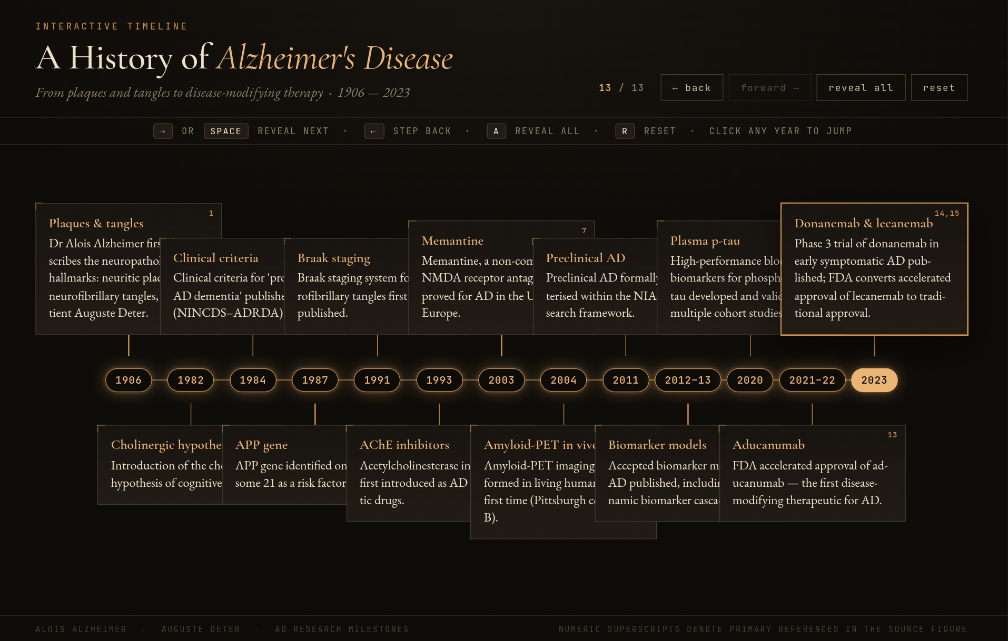
Alzheimer’s disease timeline
Timeline of Alzheimer’s disease pathology and clinical milestones, from Alzheimer’s 1907 case description through to disease-modifying antibody approvals in 2023–2024.
Notes:
This figure shows the historical and biological development of Alzheimer’s disease. It walks through the original 1907 case description by Alois Alzheimer, the cholinergic hypothesis of the 1970s, the amyloid cascade hypothesis of 1992, the discovery of presenilin and APP mutations, the introduction of PET amyloid imaging in the 2000s, the 2018 NIA-AA biological framework, and the 2023 to 2024 disease-modifying antibody approvals.

Slide 9
Biological vs clinical definition
The old way (pre-2010)
Clinical syndrome → “probable AD”
Pathology only confirmed at post-mortem
Heterogeneous cohorts in trials
“Dementia of the Alzheimer type”
The modern way (2018 NIA-AA, 2024 revised criteria)
Biology defines the disease (Aβ + tau)
Clinical stage is described separately
Biomarkers in life: CSF, plasma, PET
Allows pre-symptomatic diagnosis

Slide 10
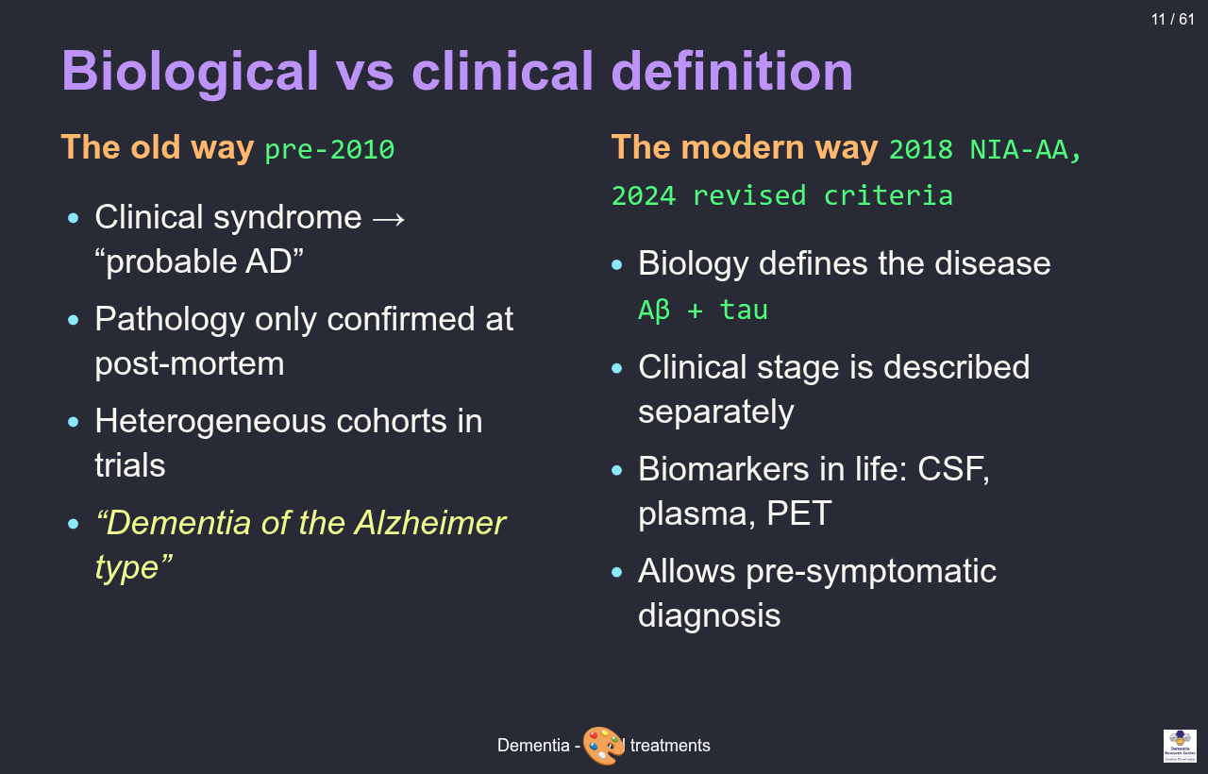
The biomarker cascade
Jack 2010/2013 biomarker cascade model: Aβ becomes abnormal earliest, then tau, neurodegeneration, cognition, and finally function. Pathology precedes symptoms by 15–20 years.
Notes:
Interactive model based on Jack and colleagues, Lancet Neurology 2010 and 2013. The horizontal axis represents the AD continuum from cognitively normal through preclinical AD, subjective cognitive decline, mild cognitive impairment, mild dementia, to moderate-severe dementia. Five sigmoid curves rise across the axis showing biomarker abnormality: amyloid beta becomes abnormal earliest, then phosphorylated tau, then neurodegeneration on MRI and FDG-PET, then cognition on neuropsychological testing, and finally function on activities of daily living. Pathology precedes clinical symptoms by 15 to 20 years, which is the rationale for early biomarker-based diagnosis and for prevention efforts.

Slide 11
Audience poll: higher or lower?
Interactive Slido poll on prevalence estimates. Not reproduced in the handout.

Slide 12
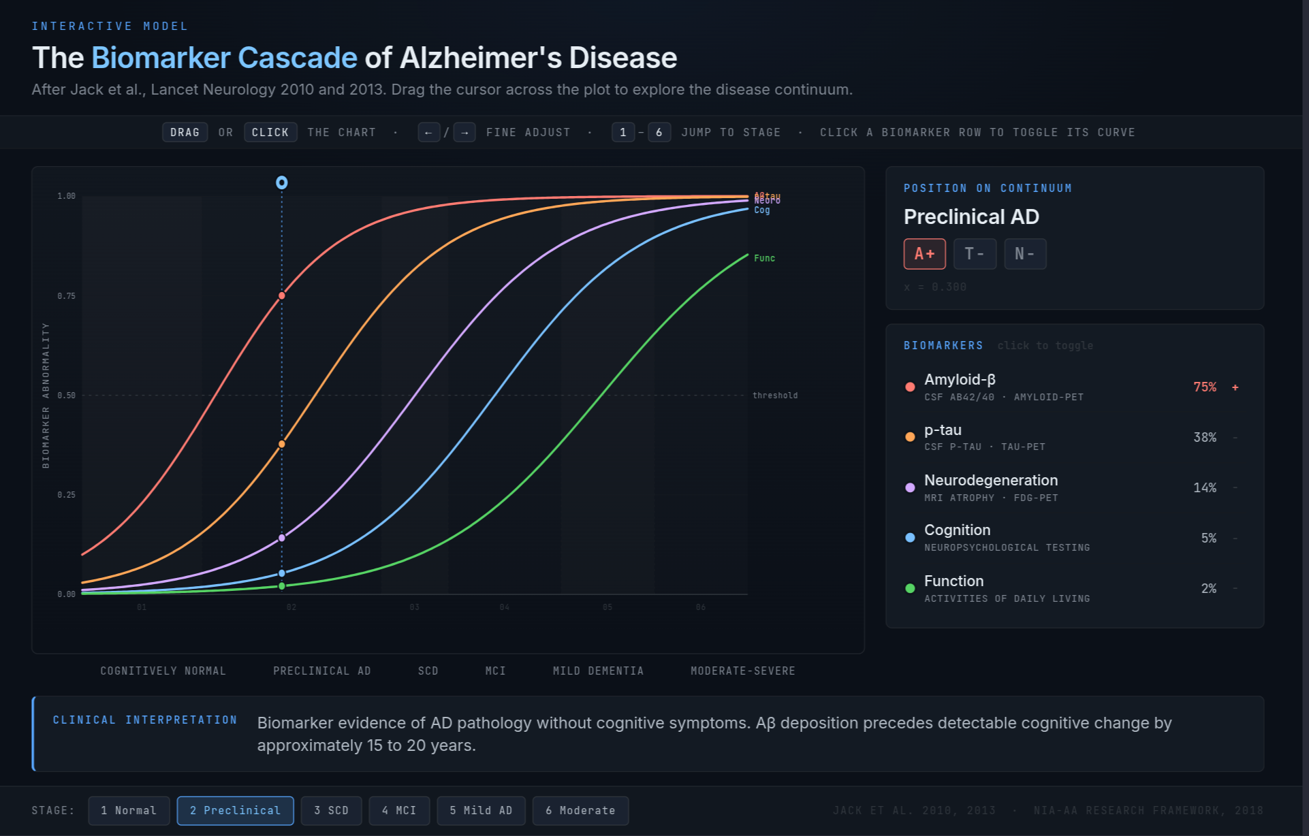


Slide 13
The AT(N)(X) framework
The modern biomarker classification, used to characterise patients independently of clinical stage. Each axis captures a different category of pathology.

Slide 14
AT(N)(X): A — Amyloid
What it measures: cerebral Aβ pathology.
CSF Aβ42/40 ratio (low = abnormal)
Plasma Aβ42/40 (replaces some lumbar punctures)
Amyloid-PET (florbetapir, flutemetamol)

Slide 15
AT(N)(X): T — Tau
What it measures: tau pathology.
CSF p-tau181, p-tau217
Plasma p-tau217
Tau-PET (flortaucipir, tracks Braak staging)

Slide 16
AT(N)(X): N — Neurodegeneration
What it measures: downstream injury, not specific to AD.
Structural MRI atrophy (MTA score)
FDG-PET (temporo-parietal hypometabolism)
CSF total tau

Slide 17
AT(N)(X): X — Other
What it measures: vascular, inflammatory, and synaptic axes added in 2024.
Vascular markers (WMH, infarcts)
Inflammatory (GFAP, astrocyte activation)
Synaptic (neurogranin, SNAP-25)

Slide 18
Audience poll: question 3
Interactive Slido poll. Not reproduced in the handout.

Slide 19
The global prevalence of dementia is increasing
AD is the most common cause of dementia in individuals older than 65 years of age
In 2020, over 55 million people worldwide were living with neurodegenerative disease at the dementia stage
The number is set to rise to 139 million by 2050, with the most significant increases in lower-middle-income (LMIC) countries
Prevalence is likely underestimated because of underdiagnosis and misdiagnosis
Up to three-quarters of those with dementia worldwide have not received a diagnosis

Slide 20
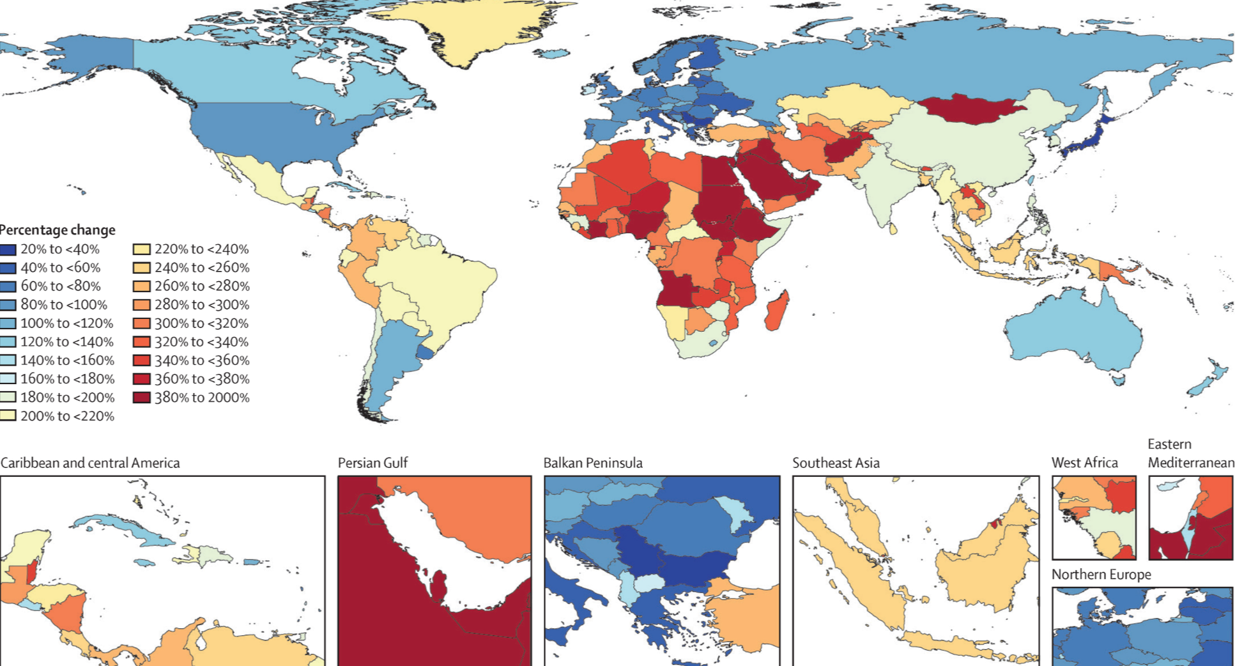
57.4M to 153M by 2050
Global dementia prevalence 2020 (~55–57M) versus projected 2050 figure (~139–153M), with the largest growth in LMIC countries.
Notes:
The chart shows two bars: the 2020 figure of approximately 55 to 57 million people living with dementia worldwide, and the 2050 projection of approximately 139 to 153 million. The growth differential is greatest in low- and middle-income countries, which are estimated to bear three quarters of the increase. Approximately 75 percent of people living with dementia worldwide remain undiagnosed today.

Slide 21
Regions of greatest change
The largest projected increases are in:
North Africa and the Middle East
Sub-Saharan Africa
South Asia
Latin America
This reflects ageing populations in regions with limited diagnostic infrastructure.

Slide 22
Historical development of AD diagnostic criteria
The 2023 revised criteria emphasises that AD is defined by its biology
Only biomarkers proven to be accurate against an accepted reference standard should be used for diagnosis
Biomarker tests should always be interpreted with clinical judgment
The clinician’s expertise is crucial in three situations:
When the biomarker test result contradicts the clinical presentation
When evaluating the probable contribution of AD versus other pathologies
When assessing how other medical conditions could impact the biomarker results

Slide 23
AD diagnostic biomarkers
Core 1 (currently accepted for diagnosis)
CSF Aβ42/40
CSF p-tau181/Aβ42
CSF t-tau/Aβ42
Accurate plasma assays
Amyloid-PET
Core 2 (emerging / research-grade)
Plasma p-tau217 (near-CSF accuracy)
Plasma MTBR-tau243
GFAP (astrocyte activation)
NfL (non-specific neurodegeneration)
Tau-PET (Braak staging in life)

Slide 24
Differential diagnosis
In the rest of this section: the four most common dementia subtypes side by side. The handout shows one slide per subtype.

Slide 25
Differential diagnosis: AD
Onset: insidious, episodic memory first
Signature: temporo-parietal cognition; language; getting lost
Imaging: medial temporal and parietal atrophy
Treatment cue: AChEi and memantine; now anti-amyloid eligible

Slide 26
Differential diagnosis: DLB
Onset: fluctuating cognition, visual hallucinations, REM sleep behaviour disorder, parkinsonism
Signature: attention/executive > memory early; very neuroleptic-sensitive
Imaging: relatively preserved MTL; DAT scan abnormal
Treatment cue: rivastigmine often helpful; avoid antipsychotics

Slide 27
Differential diagnosis: FTD
Onset: typically <65 y; behavioural variant or primary progressive aphasia
Signature: disinhibition, apathy, loss of empathy, dietary change (bvFTD)
Imaging: frontal / anterior temporal atrophy
Treatment cue: AChEi unhelpful or may worsen behaviour; SSRIs and environmental management

Slide 28
Differential diagnosis: VaD
Onset: stepwise, after vascular events
Signature: executive dysfunction, slowed processing, focal neurology
Imaging: infarcts, white matter hyperintensities, microbleeds
Treatment cue: aggressive vascular risk control; modest AChEi benefit

Slide 29
Reversible mimics
Always rule out treatable contributors to cognitive impairment:
B12 / folate deficiency
Hypothyroidism
Depression (pseudo-dementia)
Normal pressure hydrocephalus (gait, urinary, cognitive)
Drug effects (anticholinergics, benzodiazepines, opioids)
Delirium (often superimposed)
Obstructive sleep apnoea
Subdural haematoma
Alcohol misuse

Slide 30
Assessment
The full assessment in the live deck is a tabset; the handout shows one slide per assessment domain.

Slide 31
Assessment: Clinical history
Medical history from the patient and collateral history from an appropriate informant.
Background factors
Educational attainment — quantitative and qualitative
Occupational attainment — manual / skilled / professional
Head injury or contact sports (rugby, boxing)
Lifetime alcohol and substance use — peak and sustained
Smoking history
Cognitive features
Rapid forgetfulness, repetitive questioning
Loss of recent memory with relative preservation of remote
Functional decline (IADLs first, then ADLs)
BPSD (agitation, depression, sleep)

Slide 32
Assessment: Cognitive examination
A cognitive, functional, behavioural and mental state examination, preferably using validated assessment scales.
RBANS — sensitive to different sorts of decline
Addenbrookes’ Cognitive Evaluation (III) — used in 90% of UK memory clinics
Mini Mental State Examination — insensitive to early decline
Montreal Cognitive Assessment — better than MMSE, retains ceiling effects

Slide 33
Assessment: Examination
Physical examination, laboratory tests (to exclude comorbid conditions that may be impairing cognitive function), and review of medication (to identify drugs that may be impairing cognitive function).

Slide 34
Assessment: Neuroimaging
Structural MRI (first-line): medial temporal atrophy (MTA score), parietal atrophy (Koedam), white-matter disease, microbleeds
FDG-PET: temporo-parietal hypometabolism in AD; frontal in FTD
Amyloid-PET: confirms or excludes Aβ pathology in life
Tau-PET: research and disease-modifying treatment selection
DAT scan: supports DLB when uncertain

Slide 35
Assessment: Biomarkers
CSF panel: Aβ42/40, p-tau181, t-tau (requires lumbar puncture)
Plasma p-tau217: near-CSF accuracy, primary care feasible
Plasma Aβ42/40, GFAP, NfL: pre-screening tools
APOE genotyping: risk stratification; mandatory before anti-amyloid antibodies
Genetic testing: APP, PSEN1, PSEN2 in early-onset / familial cases

Slide 36
Part 2 — Symptomatic treatments
The development of a field over fifty years, from the cholinergic hypothesis to brexpiprazole.

Slide 37
The cholinergic hypothesis (1976)
Bowen, Davies, Perry independently observed loss of choline acetyltransferase in post-mortem AD brain
Source: degenerating cholinergic projections from the nucleus basalis of Meynert
Implication: boost acetylcholine, improve cognition

Slide 38
AChE inhibitor mechanism
Cholinergic synapse cartoon
Presynaptic ACh release → AChE breaking ACh in cleft → AChEi blocking AChE → more ACh available at post-synaptic receptors.
Clinical implications
AD brains have loss of cortical and hippocampal ACh
AChEi inhibit synaptic breakdown, increasing transmitter availability
Effect is presynaptic compensation; does not modify disease
Side-effects from cholinergic excess: ↑ vagal tone, GI cramping, bradycardia, vivid dreams

Slide 39
AChE inhibitors: clinical use
The three approved AChE inhibitors are presented one per slide.

Slide 40
AChEi: Donepezil
Once daily, oral; 5 mg → 10 mg after 4 weeks
Most common UK first-line agent
Long half-life
Side effects: GI upset, vivid dreams, bradycardia
Cardiac history → ECG before starting

Slide 41
AChEi: Rivastigmine
BD oral or transdermal patch
Patch useful when swallowing or compliance issues
Inhibits both AChE and butyrylcholinesterase
Patch reduces GI side-effects substantially
Drug of choice in DLB and PDD

Slide 42
AChEi: Galantamine
BD oral; also a nicotinic allosteric modulator
Cardiac caution (rare reports of bradyarrhythmia)
Less commonly used in UK

Slide 43
Memantine: NMDA receptor antagonism
Mechanism
Glutamatergic synapse → NMDA receptor channel → excess glutamate driving pathological tonic activation → memantine sits in the channel as an uncompetitive, low-affinity antagonist.
Clinical use
Memantine sits in the channel only when pathologically open (voltage-dependent)
Strong physiological NMDA bursts displace it, preserving learning
Indication: moderate to severe AD, or AChEi-intolerant
Often combined with donepezil

Slide 44
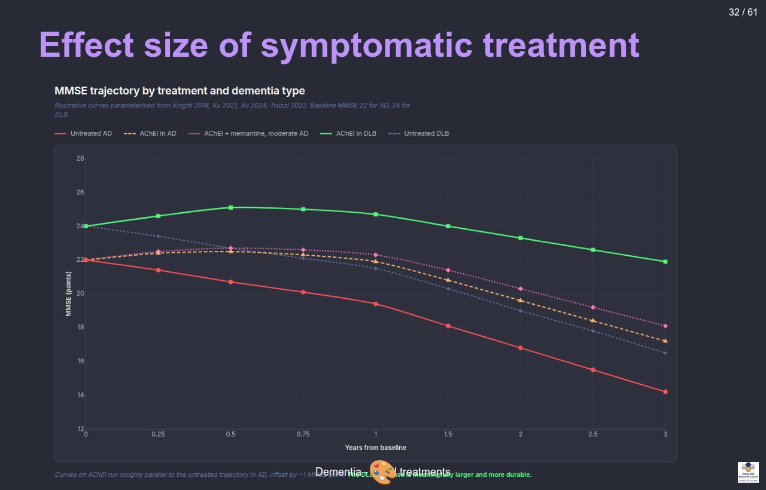
MMSE trajectory over 3 years: untreated AD declines about 2.5 points per year. AChEi shifts the curve up by ~1 point but the trajectory is unchanged. The DLB response to AChEi is much larger.
Notes:
This chart shows MMSE trajectories for five groups over three years. Untreated AD starts at MMSE 22 and declines to about 14 — roughly 2.5 points per year. AChEi treatment in AD shifts the curve up by about 1 MMSE point and the curves run in parallel: the disease trajectory is unchanged but patients are about 6 months ahead. AChEi plus memantine in moderate AD adds a small further offset. The DLB curves are the striking comparison: AChEi-treated DLB shows an early bump in cognition above baseline and a much slower trajectory of decline. Curves illustrative, parameterised from Knight 2018, Xu 2021 and 2024, and Truzzi 2022.

Slide 45
Differential responsiveness across subtypes
Helpful in
AD (modest, all severities)
DLB (often substantial; rivastigmine first choice)
PDD (cholinergic deficit prominent)
VaD (mixed disease often benefits)
Limited or harmful in
bvFTD (no benefit, may worsen agitation)
Pure VaD (inconsistent)
Severe AD (memantine takes over)

Slide 46
BPSD
Behavioural and Psychological Symptoms of Dementia
Up to 90% of patients experience at least one over the course of illness
Drives caregiver burden, institutionalisation, and mortality
Five clusters:
Agitation / aggression
Psychosis (delusions, hallucinations)
Depression / anxiety
Apathy
Sleep disturbance

Slide 47
Non-pharmacological management of BPSD
Always rule out a precipitant: pain, infection (UTI, chest), constipation, drug effect, sensory deprivation
Cognitive Stimulation Therapy (NICE-recommended, group-based)
Exercise (aerobic and resistance)
Music therapy: strong evidence in agitation
Environmental modification: light, routine, signage, familiar objects
Caregiver education and support: often high-yield

Slide 48
Pharmacological management of BPSD
Antipsychotics are last-resort
↑ stroke and all-cause mortality (CATIE-AD, FDA black box)
Severe sensitivity in DLB: can cause irreversible parkinsonism / NMS
Use only when behaviour endangers patient or others, lowest dose, short duration, regular review
SSRIs for depression (citalopram has agitation evidence, but QTc concern)
Brexpiprazole: first FDA approval for agitation in AD, 2023 (not yet NICE-approved on NHS)
Trazodone: sleep, agitation; mostly off-label
Avoid benzodiazepines: falls, paradoxical agitation, dependence

Slide 49
Limits of symptomatic treatment
They do not slow neuronal loss
They do not clear Aβ or tau
They do not change underlying trajectory
A patient on AChEi 5 years from diagnosis has the same brain pathology as one untreated

Slide 50
Audience poll: what is important in clinical trials?
Interactive Slido poll. Not reproduced in the handout.

Slide 51
5 minute break

Slide 52
Part 3 — Disease-modifying treatments
Anti-amyloid antibodies enter the clinic.

Slide 53
The amyloid hypothesis (Hardy & Higgins, 1992)
Aβ accumulation is the upstream driver of AD
Genetic anchor: every gene mutation that causes autosomal-dominant AD (APP, PSEN1, PSEN2) alters Aβ production or clearance
Down syndrome (trisomy 21 → 3 copies of APP) → near-universal AD pathology by age 50
Tau pathology, inflammation, neurodegeneration: downstream
Predicted: lower Aβ → less downstream damage → better outcome

Slide 54
Failed anti-amyloid trials
Solanezumab: Eli Lilly; failed Phase 3 in mild AD (2014, 2016)
Bapineuzumab: Pfizer/J&J; failed (2012); high rate of vasogenic edema
Crenezumab: Roche; failed (2019)
Gantenerumab: Roche; first GRADUATE trials negative (2022); reformulated for prevention
Lessons learned:
Treating too late (pathology has spread for 15+ years)
Targeting the wrong species (monomer vs oligomer vs plaque)
Insufficient brain penetration / dosing
Endpoint too noisy in mild populations

Slide 55
Aducanumab (2021)
Two Phase 3 trials (EMERGE, ENGAGE): discordant; pre-specified analysis was negative
Post-hoc reanalysis at high dose suggested cognitive benefit on EMERGE
FDA accelerated approval June 2021, over near-unanimous advisory panel objection
EMA refused authorisation
NHS / NICE: not commissioned
Eli Lilly withdrew it from market 2024

Slide 56
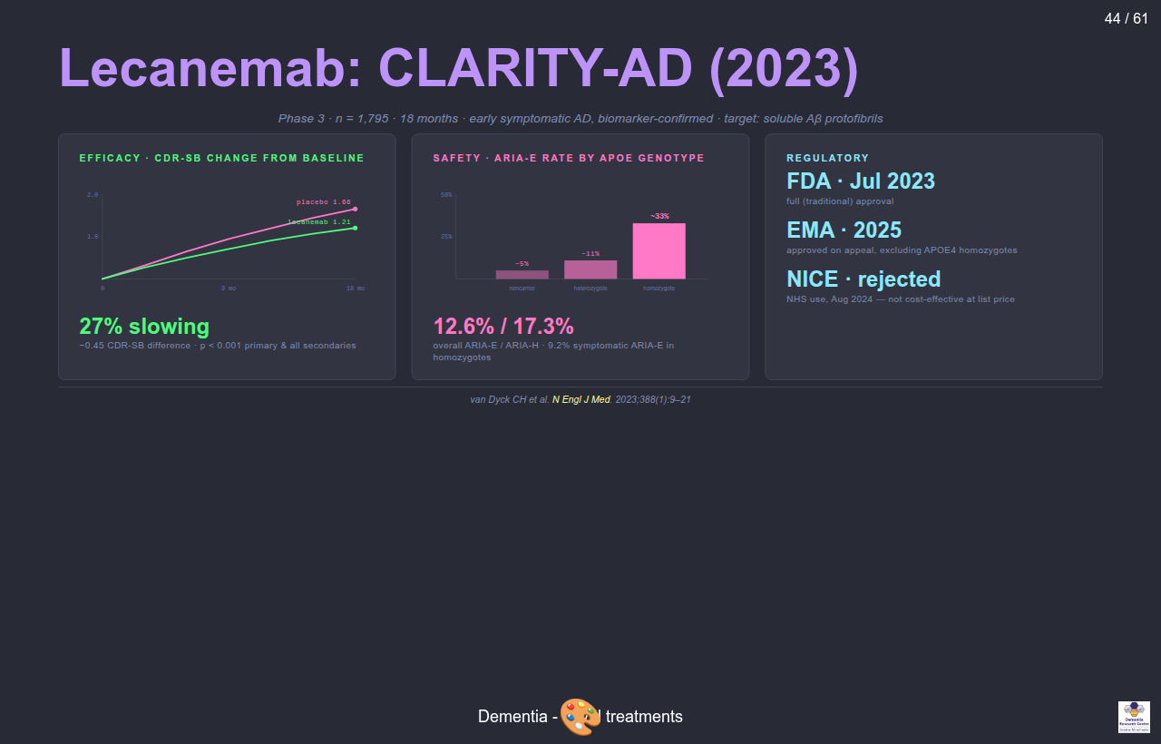
Lecanemab: CLARITY-AD (2023)
Lecanemab CLARITY-AD trial summary: efficacy (CDR-SB curves), safety (ARIA by APOE genotype), and regulatory status.
Notes:
CLARITY-AD trial of lecanemab (van Dyck and colleagues, NEJM 2023). 1,795 participants with biomarker-confirmed early symptomatic Alzheimer’s disease, randomised to lecanemab or placebo for 18 months. Efficacy: 27 percent slowing of decline on CDR Sum of Boxes, with the placebo group ending at 1.66 points worse than baseline and the lecanemab group at 1.21, a difference of minus 0.45 points, p less than 0.001. Safety: ARIA-E rates by APOE genotype: about 5 percent in non-carriers, about 11 percent in heterozygotes, about 33 percent in homozygotes. Overall ARIA-E was 12.6 percent and ARIA-H 17.3 percent. Symptomatic ARIA-E in homozygotes was 9.2 percent. Regulatory: FDA full approval July 2023, EMA approved on appeal in 2025 excluding APOE4 homozygotes, NICE rejected for NHS use August 2024 on cost-effectiveness grounds.

Slide 57
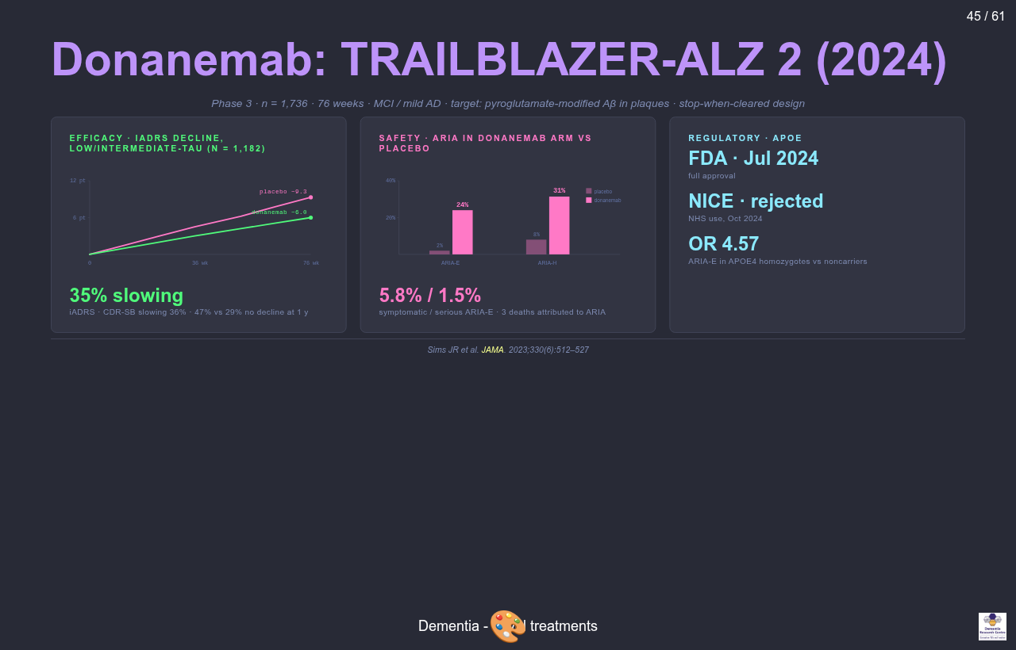
Donanemab: TRAILBLAZER-ALZ 2 (2024)
Donanemab TRAILBLAZER-ALZ 2 trial summary: efficacy (iADRS curves and CDR-SB), safety (ARIA-E and ARIA-H vs placebo), and regulatory.
Notes:
TRAILBLAZER-ALZ 2 trial of donanemab (Sims and colleagues, JAMA 2023). 1,736 participants with MCI or mild AD over 76 weeks; primary analysis population was 1,182 with low or intermediate tau burden. Donanemab targets pyroglutamate-modified Aβ found only in established plaques; stop-when-cleared design meant patients with negative amyloid PET stopped treatment. Efficacy: 35 percent slowing on iADRS, 36 percent on CDR-SB. 47 percent of donanemab participants had no decline at 1 year versus 29 percent on placebo. Safety: ARIA-E 24 percent (vs 2 percent placebo), ARIA-H 31 percent (vs ~8 percent placebo). Symptomatic ARIA-E 5.8 percent, serious ARIA-E 1.5 percent. Three deaths in donanemab arm attributed to serious ARIA. APOE4 homozygotes had odds ratio 4.57 for ARIA-E versus non-carriers. Regulatory: FDA full approval July 2024, NICE rejected October 2024.

Slide 58
Antibody specificity
The three anti-amyloid antibodies target different Aβ species along the aggregation pathway:
Aducanumab: oligomers + fibrils
Lecanemab: protofibrils selectively
Donanemab: pyroglutamate-modified plaques only
The aggregation pathway runs: monomer → oligomer → protofibril → plaque.

Slide 59
Patient selection
Confirmed Aβ pathology: amyloid-PET or CSF Aβ42/40
Disease stage: MCI or mild AD dementia (not moderate or severe)
MRI suitable: no severe cerebral amyloid angiopathy, ≤4 microbleeds, no superficial siderosis
Anticoagulation: caution or contraindication
APOE4 genotyping: needed for ARIA risk counselling
Capable of attending infusions every 2–4 weeks for 18+ months
Capacity to consent

Slide 60
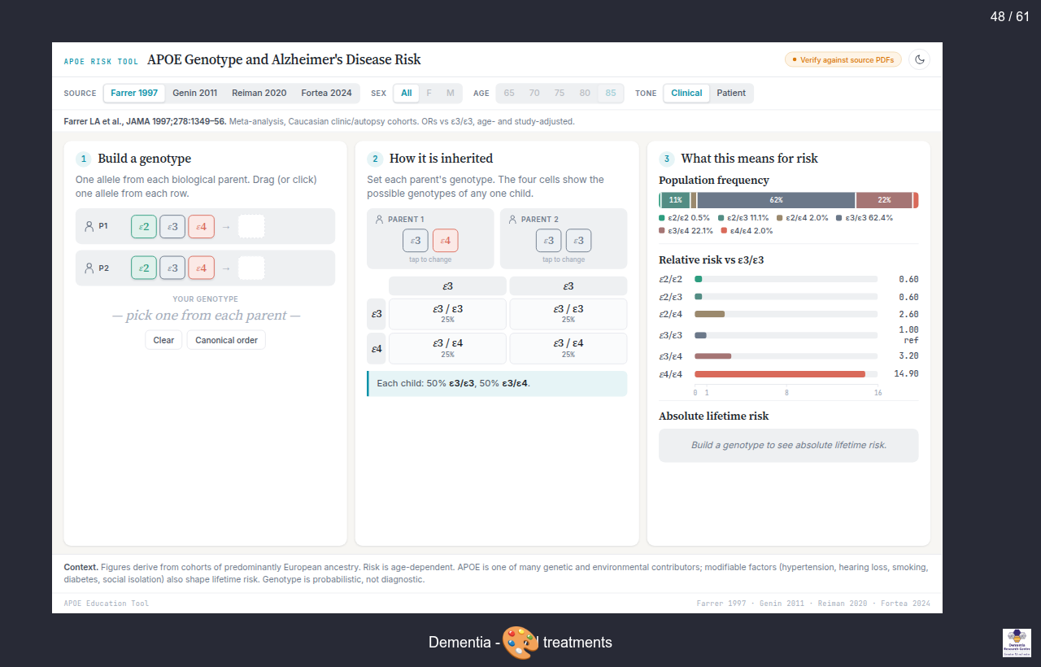
APOE genotype and ARIA-E risk
ARIA-E risk by APOE genotype for lecanemab and donanemab. Risk rises sharply in heterozygotes and is highest in homozygotes for both drugs.
Notes:
ARIA-E risk by APOE genotype. Lecanemab in CLARITY-AD: non-carriers about 5 percent, heterozygotes about 11 percent, homozygotes about 33 percent. Symptomatic ARIA-E rises from 1.4 percent in non-carriers to 9.2 percent in homozygotes. Donanemab in TRAILBLAZER-ALZ 2: non-carriers about 16 percent, heterozygotes about 23 percent, homozygotes about 41 percent. APOE4 homozygotes are about 2 percent of the population but bear most of the treatment-attributable ARIA risk.

Slide 61
ARIA
ARIA-E (oedema, effusion)
Vasogenic oedema, leptomeningeal effusion
Best seen on FLAIR
Most asymptomatic; caught on surveillance MRI
Can present with headache, confusion, focal symptoms, seizures
ARIA-H (haemorrhage)
Microbleeds, superficial siderosis
Best seen on SWI / GRE
Usually asymptomatic; persists indefinitely after resolution
Severity and surveillance
Mostly mild; ~3% serious; rare deaths reported
Surveillance MRI before infusions 5, 7, 14 (lecanemab) or 2, 3, 4, 7 (donanemab)

Slide 62
APOE4 and ARIA risk
APOE genotype | Lecanemab ARIA-E | Donanemab ARIA-E
Non-carrier | ~5% | ~16%
Heterozygote | ~11% | ~23%
Homozygote | ~33% | ~41%
Notes:
ε4 homozygotes are about 2 percent of the population but bear most of the treatment-attributable ARIA risk. Genotype results have implications beyond the individual: family members may infer their own risk, and there are life insurance considerations. The donanemab US label restricts use in homozygotes; the EMA mandates discussion of relative risk. Patients can decline genotyping but must be counselled to the higher-risk assumption.

Slide 63
UK implementation
Drug cost: £20–25k per patient per year (lecanemab list)
Infrastructure: infusion suite every 2 (lecanemab) or 4 (donanemab) weeks
Surveillance MRI: 4–7 scans per patient course
Workforce: trained nurses, neurologists, neuroradiologists
NICE August 2024: rejected lecanemab for NHS commissioning; benefit too small at price
Currently available only privately in the UK; major equity concern
Open question whether amyloid lowering alone is sufficient or whether combinations will be needed

Slide 64
Other approaches
Anti-tau antibodies: E2814, JNJ-2056 (Phase 2; zagotenemab discontinued 2023)
Tau ASOs: intrathecal antisense oligonucleotides, e.g. BIIB080
Inflammation: TREM2 agonists in early trials
Vaccines: UB-311, ABvac40 (Phase 2)
Prevention trials in pre-symptomatic carriers:
DIAN-TU: autosomal-dominant AD families
AHEAD 3-45: sporadic, plasma p-tau217 stratified
A4 closed early; solanezumab failed

Slide 65
Current state
The first disease-modifying drugs exist. Their effect size is modest. ARIA limits use. Access in the UK is restricted.
Diagnosis: plasma p-tau217 may make primary-care testing feasible.
Prevention may matter more than any antibody:
Lancet Commission 2024: 14 modifiable risk factors account for ~45% of dementia risk
Hearing, education, BP, smoking, obesity, depression, physical inactivity, diabetes, alcohol, social isolation, air pollution, head injury, vision, cholesterol

Slide 66
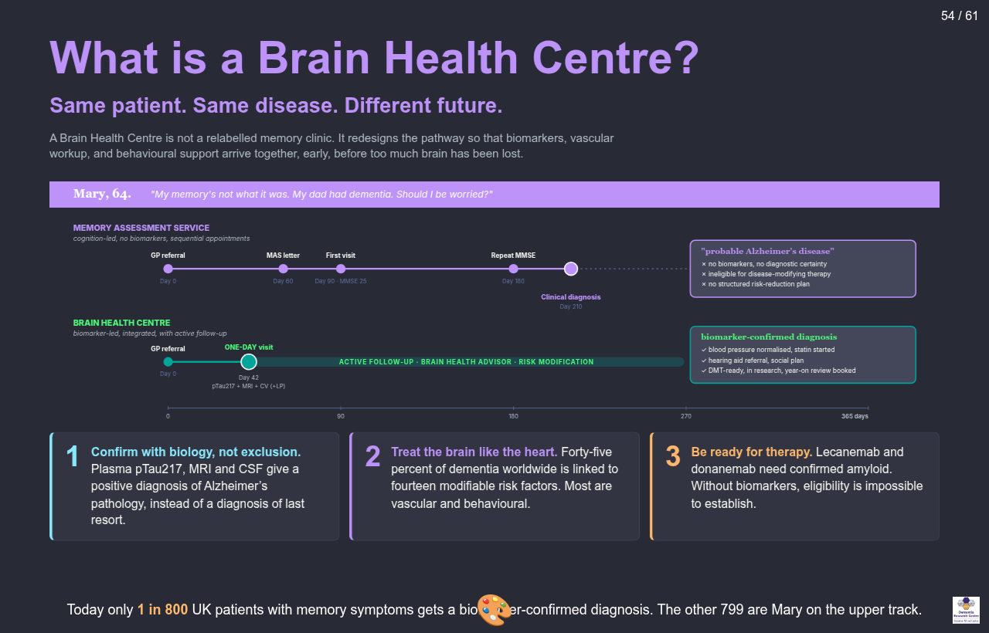
What is a Brain Health Centre?
Two parallel pathways for the same hypothetical patient (Mary, 64, presenting with memory concern). The Memory Assessment Service track produces a clinical “probable AD” diagnosis after 210 days, with no biomarkers. The Brain Health Centre track produces a biomarker-confirmed diagnosis in 42 days with a structured risk-reduction plan.
Notes:
Two-track timeline comparing pathways for Mary, 64, presenting with memory concern and a family history of dementia. Memory Assessment Service track: GP referral on day zero, MAS letter day 60, first visit day 90 with MMSE 25, repeat MMSE day 180, clinical diagnosis day 210. Outcome: probable Alzheimer’s disease, no biomarkers, ineligible for disease-modifying therapy, no structured risk-reduction plan. Brain Health Centre track: GP referral day zero, single one-day visit day 42 combining plasma p-tau217, MRI, cardiovascular workup, and lumbar puncture if needed, then active follow-up out to day 365 with a Brain Health Advisor and risk modification. Outcome: biomarker-confirmed diagnosis, blood pressure normalised and statin started, hearing aid referral, social plan, DMT-ready, in research, year-on review booked. Three principles: confirm with biology not exclusion; treat the brain like the heart; be ready for therapy. Footnote: today only one in 800 UK patients with memory symptoms gets a biomarker-confirmed diagnosis.

Slide 67
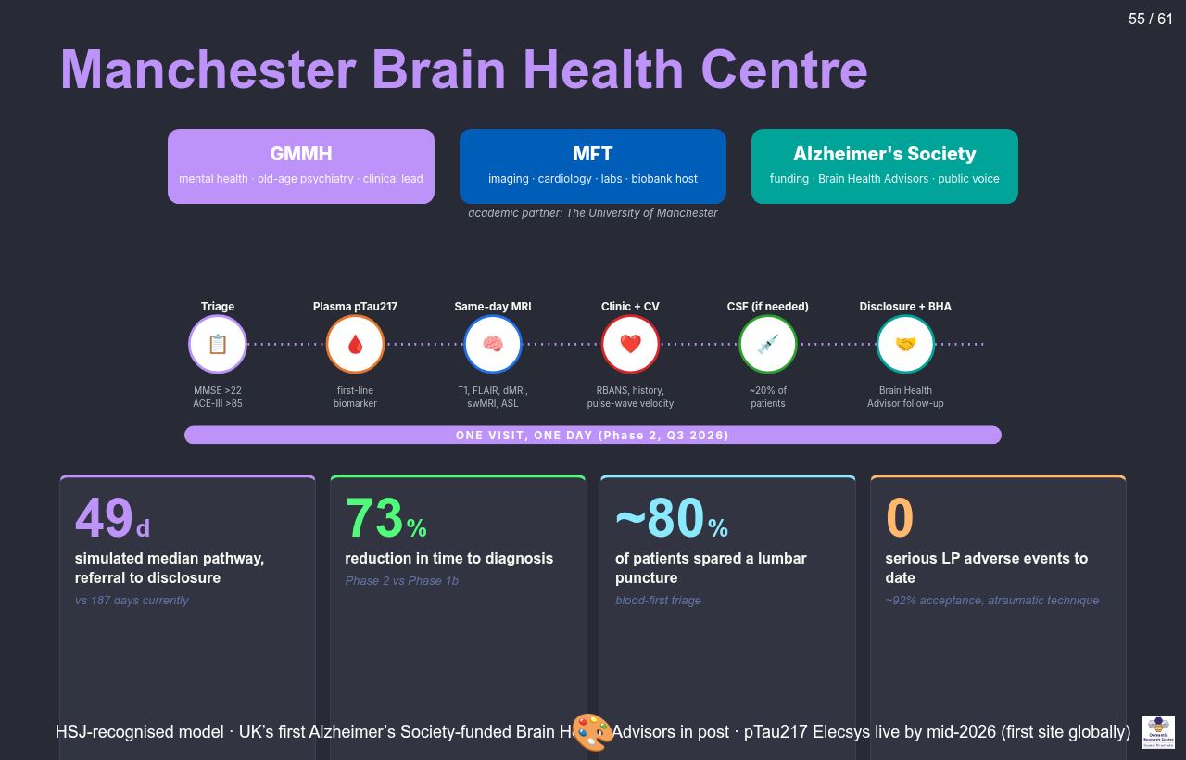
Manchester Brain Health Centre
Three core partners (GMMH, MFT, Alzheimer’s Society) plus the University of Manchester. One-day pathway across six stations: triage, plasma p-tau217, same-day MRI, clinic with cardiovascular check, CSF if needed, disclosure with Brain Health Advisor follow-up. Headline KPIs: 49 days median pathway, 73% reduction in time to diagnosis, ~80% spared a lumbar puncture, 0 serious LP adverse events.
Notes:
Three core partners shown as coloured blocks: Greater Manchester Mental Health NHS Foundation Trust as clinical lead in old-age psychiatry, Manchester University NHS Foundation Trust providing imaging, cardiology, labs and the biobank, and the Alzheimer’s Society providing funding and Brain Health Advisor training. Academic partner: University of Manchester. Six-station one-day pathway: triage with MMSE above 22 and ACE-III above 85, plasma p-tau217 first-line biomarker, same-day MRI, clinic plus cardiovascular check including pulse-wave velocity, CSF if needed (about 20 percent), disclosure with Brain Health Advisor. Phase 2 model goes live Q3 2026. KPIs: 49 days simulated median pathway versus 187 currently, 73 percent reduction in time to diagnosis, about 80 percent spared a lumbar puncture, zero serious LP adverse events to date with about 92 percent acceptance.

Slide 68
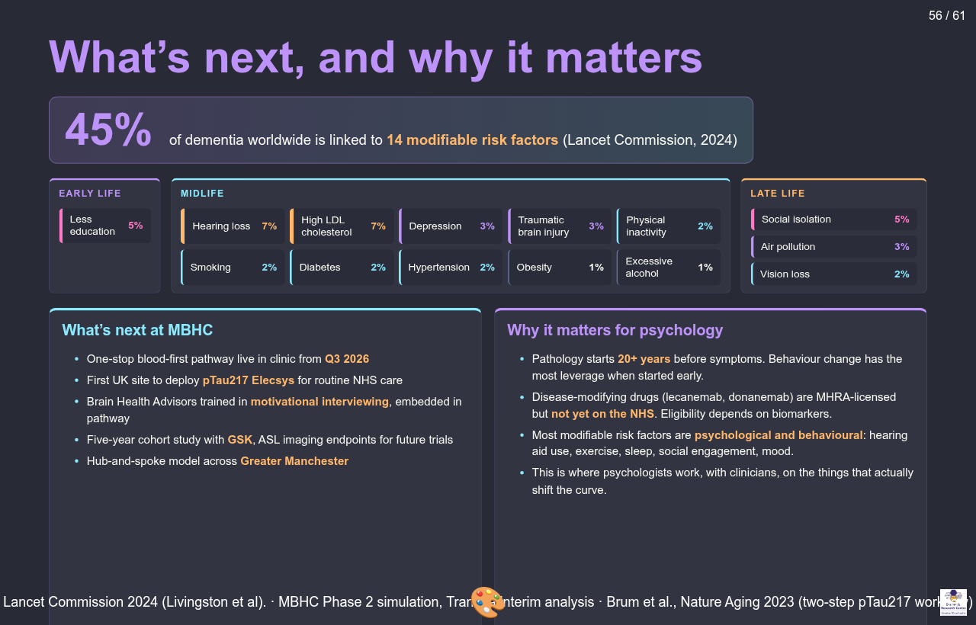
What’s next, and why it matters
Headline statistic from Lancet Commission 2024: 45% of dementia worldwide is linked to 14 modifiable risk factors. Risk factors arranged by life stage. Two columns at the bottom: what’s next at MBHC, and why this matters for psychology.
Notes:
Headline: 45 percent of dementia worldwide is linked to 14 modifiable risk factors (Lancet Commission 2024, Livingston et al). Risk factors organised by life stage with population attributable fractions. Early life: less education, 5 percent. Midlife: hearing loss 7 percent, high LDL cholesterol 7 percent, depression 3 percent, traumatic brain injury 3 percent, physical inactivity 2 percent, smoking 2 percent, diabetes 2 percent, hypertension 2 percent, obesity 1 percent, excessive alcohol 1 percent. Late life: social isolation 5 percent, air pollution 3 percent, vision loss 2 percent. What’s next at MBHC: one-stop blood-first pathway live Q3 2026, first UK site to deploy p-tau217 Elecsys for routine NHS care, Brain Health Advisors trained in motivational interviewing, five-year cohort study with GSK, hub-and-spoke model across Greater Manchester. Why it matters for psychology: pathology starts 20+ years before symptoms; disease-modifying drugs are MHRA-licensed but not yet on NHS, eligibility depends on biomarkers; most modifiable risk factors are psychological and behavioural — hearing aid use, exercise, sleep, social engagement, mood; this is where psychologists work alongside clinicians on the things that actually shift the curve.

Slide 69
Questions on the material (5 minutes)
Open floor.

Slide 70
Q&A with our trial participant (10–20 minutes)
Welcome.

Slide 71
Student questions (10 minutes)
Over to you.

Slide 72
Summary
Dementia is a syndrome; AD is defined biologically. Aβ and tau can be detected in life via CSF, plasma p-tau217, or PET.
Symptomatic treatments help modestly and do not change disease course. AChEi and memantine offer about a 6-month delay. Non-pharmacological BPSD interventions are first-line. Antipsychotics carry mortality risk.
Anti-amyloid antibodies are the first disease-modifying drugs. Effect size is modest. ARIA limits use. NICE has rejected them for the NHS. Prevention may matter more.

Slide 73
References (1/2)
Bowen DM, Smith CB, White P, Davison AN. Neurotransmitter-related enzymes and indices of hypoxia in senile dementia and other abiotrophies. Brain 1976; 99(3): 459–96.
Hardy JA, Higgins GA. Alzheimer’s disease: the amyloid cascade hypothesis. Science 1992; 256(5054): 184–5.
Jack CR Jr, Bennett DA, Blennow K, et al. NIA-AA Research Framework: Toward a biological definition of Alzheimer’s disease. Alzheimer’s & Dementia 2018; 14(4): 535–62.
Livingston G, Huntley J, Liu KY, et al. Dementia prevention, intervention, and care: 2024 report of the Lancet standing Commission. The Lancet 2024; 404(10452): 572–628.

Slide 74
References (2/2)
Palmqvist S, Tideman P, Mattsson-Carlgren N, et al. Blood biomarkers to detect Alzheimer disease in primary care and secondary care. JAMA 2024; 332(15): 1245–57.
Sims JR, Zimmer JA, Evans CD, et al. Donanemab in early symptomatic Alzheimer’s disease: the TRAILBLAZER-ALZ 2 randomized clinical trial. JAMA 2023; 330(6): 512–27.
van Dyck CH, Swanson CJ, Aisen P, et al. Lecanemab in early Alzheimer’s disease. New England Journal of Medicine 2023; 388(1): 9–21.

