Slide 1
IaC

Slide 2

What is Infrastructure as Code?
Infrastructure as Code (IaC) - is the management and provisioning of IT infrastructure (networks, servers, databases) using machine-readable definition files (code) rather than manual, physical configuration. It enables consistent, rapid, and automated deployment of environments, preventing configuration drift and reducing human error through version-controlled scripts. IaC is a foundational practice in DevOps, allowing developers and operations teams to automate infrastructure similarly to software application code.

Slide 3
Key Aspects of IaC
Automation: Replaces manual setup with automated scripts, allowing for fast, repeatable, and consistent environment provisioning.
Version Control: IaC files are stored in code repositories (like Git), enabling tracking, collaboration, and auditing of infrastructure changes.
Idempotency: A core principle ensuring that running the same IaC code multiple times produces the same result without unintended changes.

Slide 4
Primary Benefits
Speed & Efficiency: Environments can be deployed in minutes, speeding up development and testing pipelines.
Consistency & Stability: Eliminates configuration drift differences between environments which reduces errors and bugs.
Cost Efficiency: Allows easy scaling and tearing down of resources to optimize cloud spending.

Slide 5
Common IaC Tools
Terraform: Popular declarative tool for infrastructure orchestration across cloud providers.
Ansible: Popular for configuration management.
AWS CloudFormation/Azure Resource Manager (ARM): Cloud-native, vendor-specific tools.
And many others …

Slide 6
What is Terraform?
Terraform - is an open-source "Infrastructure as Code" (IaC) tool created by HashiCorp that allows developers to define, provision, and manage cloud and on-premises infrastructure using human-readable configuration files. It uses a declarative approach, meaning you define the desired end state, and Terraform handles the creation, updates, and deletion of resources across providers like AWS, Azure, and Google Cloud. It is widely used for creating, updating, and destroying infrastructure predictably.

Slide 7
Key features of Terraform
Declarative Language: You define what the infrastructure should look like using HashiCorp Configuration Language (HCL), rather than how to build it.
Multi-Cloud Support: It works with over 170 official and verified providers to manage diverse services (e.g., Kubernetes, DNS, database systems).
State Management: Terraform maps real-world resources to your configuration via a "state file," allowing it to track changes and manage lifecycles efficiently.
Automation & Consistency: It ensures consistent environments by treating infrastructure as software code, enabling version control and automating deployment.

Slide 8
How it Works
Write:
Define resources in .tf files.
1
Init:
Run “terraform init” to initialize a working directory containing Terraform configuration files.
2
Plan:
Run “terraform plan” to preview changes before they are applied.
3
Apply:
Run “terraform apply” to execute the changes.
4

Slide 9
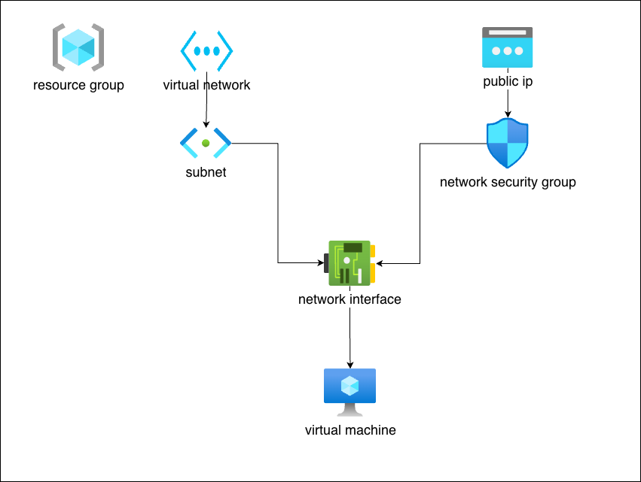
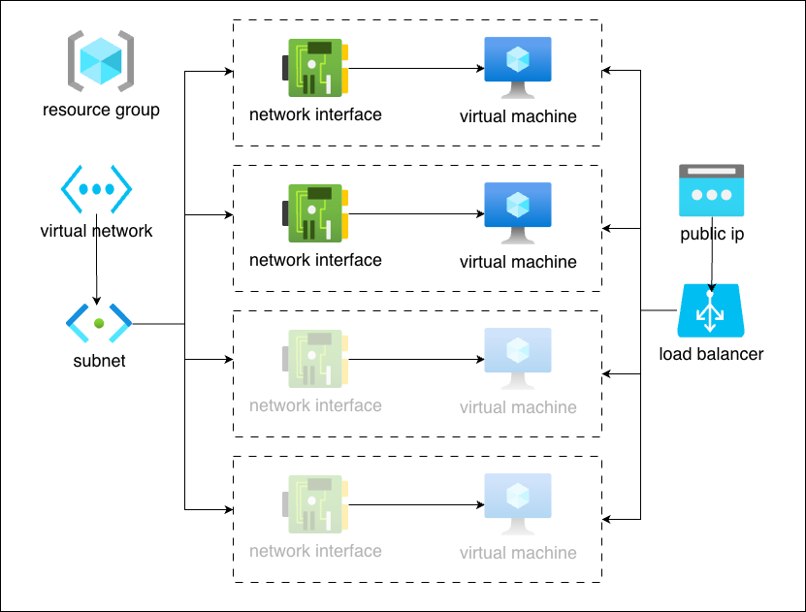
Terraform directory layout
Terraform directory layouts vary by project size, but they generally follow standardized patterns to ensure scalability and maintainability.

Slide 10
Basic Structure (Small Projects)
For simple configurations, all files reside in a single root module directory. This layout separates logic into functional files.
main.tf: The primary entry point containing resource definitions.
variables.tf: Declarations for all input variables.
outputs.tf: Definitions for data to be returned after an apply.
providers.tf: Configuration for cloud providers (e.g., Azure, AWS).
terraform.tfvars: (Optional) File containing actual values for the defined variables.
backend.tf: Configuration for remote state storage (e.g., Azure Blob Storage, S3, Terraform Cloud).

Slide 11
Environment - Based Structure
To manage multiple environments (Dev, Test, Prod) and minimize the blast radius of changes, use separate directories for each.
project-root/
├ modules/ # Reusable, versioned infrastructure components
│ ├ network / # e.g., Networking module
│ └ virtual-machine / # e.g., Compute module
├ environments/ # Environment-specific configurations
│ ├ dev/ # Development environment
│ │ ├ main.tf # Calls modules with dev parameters
│ │ ├ outputs.tf
│ │ ├ variables.tf # Unique state file for Dev
│ │ └ providers.tf # Unique state file for Dev
│ └ prod/ # Production environment
│ │ ├ main.tf # Calls modules with prod parameters
│ │ ├ outputs.tf
│ │ ├ variables.tf # Unique state file for Prod
│ │ └ providers.tf # Unique state file for Prod
└ global/ # Shared resources (e.g., Azure Blob Storage, IAM roles, S3 for state)

Slide 12
Standard Module Structure
Root directory: Contains main.tf, variables.tf, and outputs.tf.
README.md: Essential documentation for the module.
LICENSE: (Optional) Legal terms for module usage.
examples/: (Optional) Subdirectories with sample configurations showing how to use the module.
modules/: (Optional) Internal sub-modules used only by the parent module.

Slide 13
Important Operational Files
.terraform/: A hidden directory created during ”terraform init” to store cached providers and modules. Never commit this to version control.
terraform.tfstate: Tracks the current state of your managed infrastructure. Use a remote backend to avoid keeping this locally. Storing the terraform.tfstate file in Azure Blob Storage is a production best practice that enables team collaboration, provides secure encryption, and prevents state corruption through built-in locking.

Slide 14
Thank You! Q&A andrii.sadovskyi@gmail.com

