Slide 1


Slide 2
Intro
Literature Review Framework: Systematic Mapping Study (SMS)
Words
Screening (inclusion/exclusion)
Knowledge
Research Topic
Translate Knowledge into a modeling language
Number
Code
Diagram
Pool of Information

Slide 3
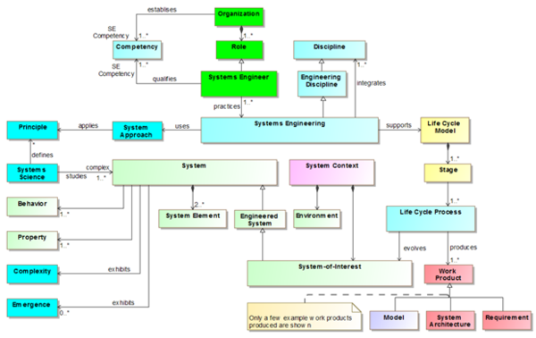

An Example
Literature Review for SysML V2 (Starting in 2015)
Research Question (RQ)
Interpretation
Pool of Information
Systems Engineering Concept Model (SECM) Working Group

Slide 4
Systematic Mapping Study (SMS)
Using the problem to understand the problem.
Problem: Large amount of data, not linked to descriptive models
Screening (inclusion/exclusion)
Build a SysML V2 Diagram
(Descriptive Model)
Research Question (RQ)
Interpretation
No Link!
Pool of Information

Slide 5
Different MBSE Approaches
Descriptive Model
Descriptive Model
Descriptive Modeling with Analytical Features
Descriptive Model
Analytic Model
OR
As the Link
As the Link
Analytical Modeling with Descriptive Features
Analytical Model
Analytical Model
Goal: developing a universal descriptive interface, to enable compatibility with various analytical modeling tools (similar to MP3 codec for music)
Ref:
Goal: Processing the descriptive model to enable APIs to ensure compatibility with other analytical modeling tools
Ref:
Goal: Provide a modeling environment for both descriptive and analytical modeling
Ref:

Slide 6
Descriptive Model as the Link
This is the common approach in SE literature
Main purpose of sysml-v2 textual notation
Similar efforts by SERC
Descriptive Model
Descriptive Model
As the Link
Caveats | Benefits
Hard to adopt, takes time | No tool needed (theoretically)
Legacy models need to be translated | Textual and Graphical modeling
IP issues (similar to MP3) | Link is permanent
Analytical Model

Slide 7
Analytical Model as the Link
This is the most practical approach
Processing the descriptive model as image, or XML file, and offer APIs
Descriptive Model
Analytic Model
As the Link
Caveats | Benefits
Hard to process (information loss) | Highly practical and intuitive
Very tool dependent (Link not permanent) | Can process legacy models (theoretically)
Cybersecurity threats | Saves money
Analytical Model

Slide 8
No link, Mix them both
Most modern approach (sysml-v2 based)
Depending on the tool, they are either focused on descriptive OR analytical, with features
Descriptive Modeling with Analytical Features
OR
Analytical Modeling with Descriptive Features
Caveats | Benefits
Analytical / Descriptive features are limited | Extremely efficient in what they do
Legacy models need redefinition | One main platform needed
Very difficult to work with (either for non technical users or technical ones) | Cost effective

Slide 9
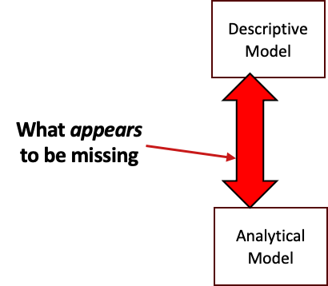
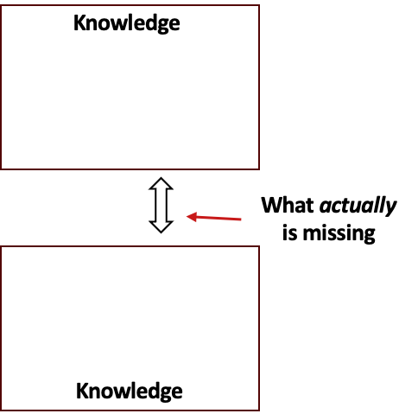

The Hidden Aspects
Knowledge
Descriptive Model
What appears to be missing
What actually is missing
Analytical Model
Knowledge

Slide 10
Research Hypothesis
Human brain should never be used as a storage for knowledge
Due to a large variety of model types, notations, use cases, audience, etc, it is IMPOSSIBLE to link them all, unless…
Models are linked with a shared knowledge repository
Knowledge repository should be able to generate both descriptive and analytical models using standard notations

Slide 11
Knowledge-Based Systems Engineering
Knowledge Receival
Knowledge Retrieval
Encoding
Knowledge Repository
Decoding

Slide 12
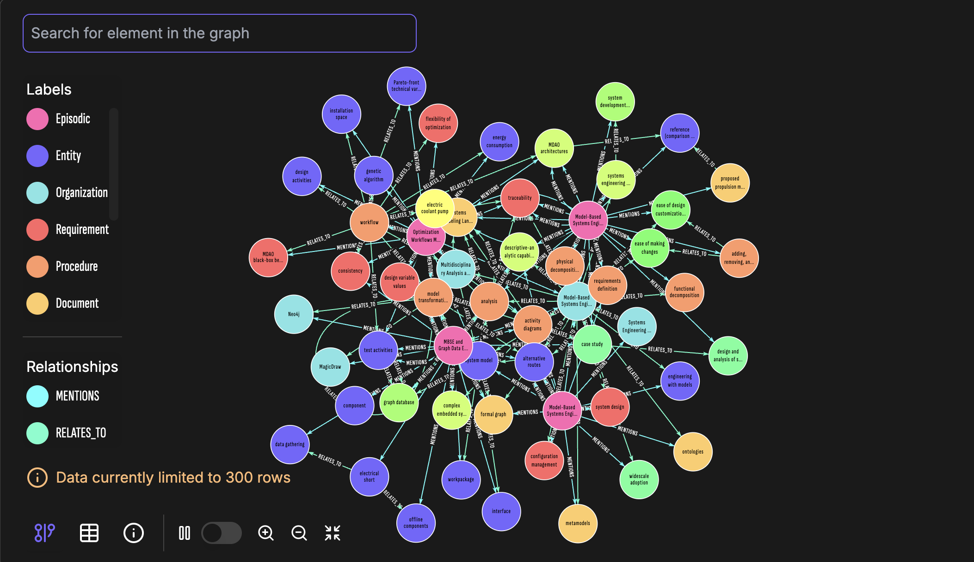
Knowledge Graph

Slide 13
Knowledge Management
Models are linked to humans
Humans are linked to Knowledge areas
As long as knowledge areas are not integrated, models will remain unlinked

Slide 14
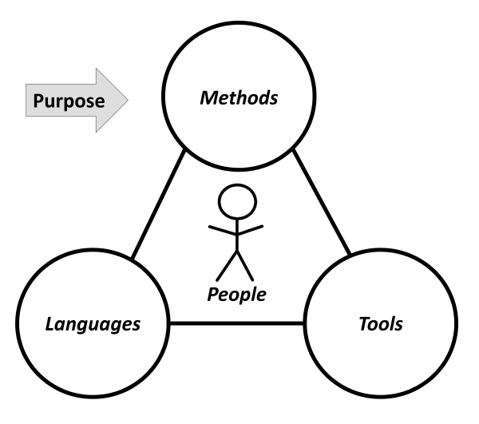
Identified Challenges
AI is not an option, it’s the only way

