Slide 1
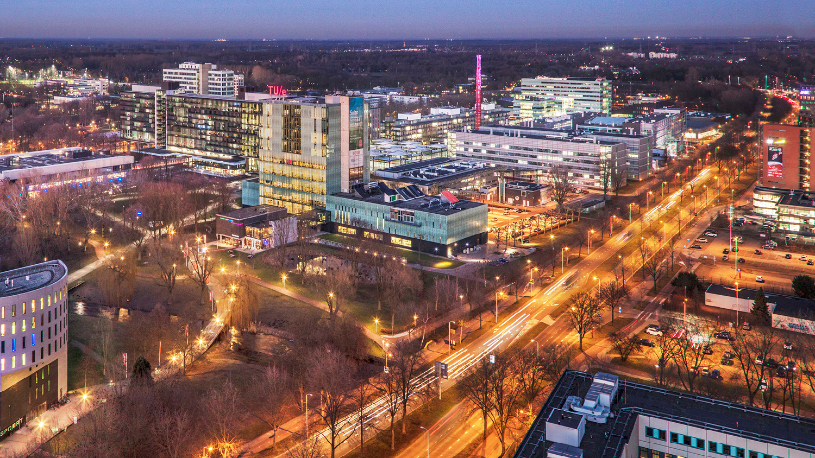

Slide 2
Evolution of Systems Engineering
Systems Engineering
Model Based Systems Engineering (MBSE)
Digital Engineering
1940
1990
2013

Slide 3
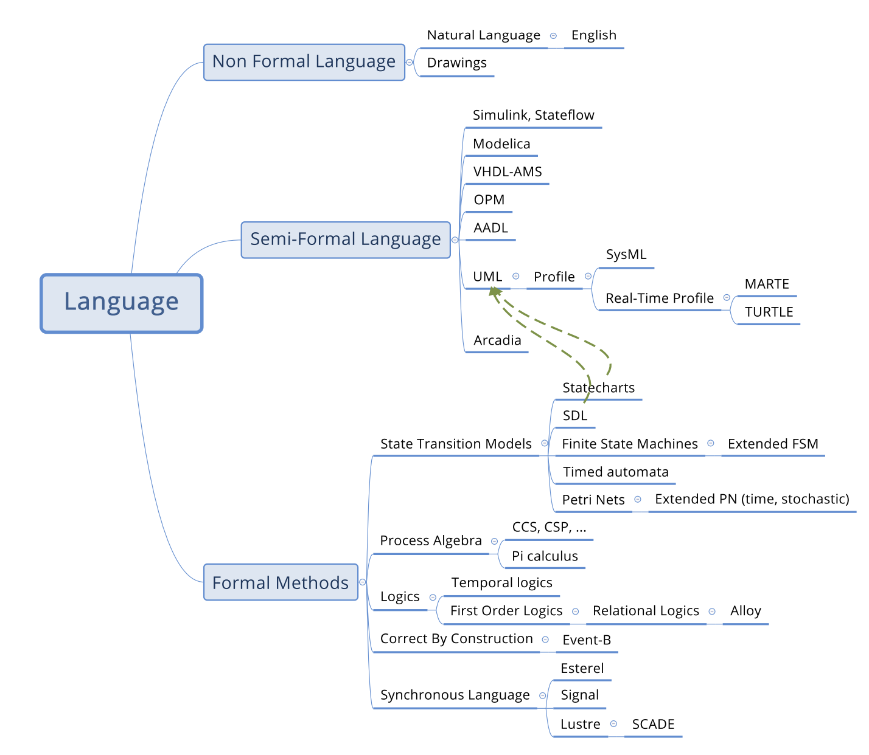
MBSE Languages
Non‑formal: natural language + drawings (good for early ideas)
Semi‑formal: diagrammatic languages (e.g., UML/SysML, AADL, Arcadia/Capella, Simulink)
Formal methods: mathematically defined semantics → proofs/model checking (e.g., Petri nets, timed automata, CSP/CCS, temporal logic, Event‑B, Lustre/SCADE)

Slide 4
In 2013 NAVAIR Asked: the most advanced and holistic approach to MCE you use or have seen used?
Model-based engineering (MBE),
Model Centric Engineering (MCE),
Integrated model-centric engineering (IMCE),
Interactive model-centric systems engineering (IMCSE),
Model-driven development (MDD),
Model-driven engineering (MDE),
Model-based enterprise (MBE)

Slide 5
DoDs Digital Engineering 5 Strategic Goals
Formalize development, integration, and use of models to inform enterprise and program decision making
Provide an enduring, authoritative source of truth (ASoT)
Incorporate technological innovation to improve the engineering practice
Establish a supporting infrastructure and environments to perform activities and communicate across stakeholders
Transform the culture and workforce to adopt and support digital engineering across the lifecycle

Slide 6
MBSE in Healthcare
Adoption is accelerating
Most used languages: SysML (most common), then UML, plus a few others (e.g., BPMN, OPM, RAAML)
SysML popularity reason (practical):
Requirement diagrams → traceability
Parametric diagrams → quantitative trade-offs (cost/quality/constraints) ￼
MBSE is often combined with analytics like: Simulation, co-simulation, and hybrid simulation (DES is most common)

Slide 7



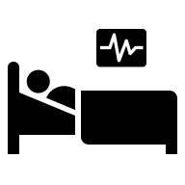

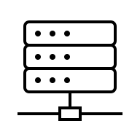

Descriptive Models
Medical History
Complaints & Symptoms
Etc.
Analytical Models
Test Results
Real time monitoring
Etc.
What will happen if this patient, take X mg of Drug Y for Z weeks?

Slide 8
Justification of MBSE Healthcare
Global Decision Making (rather than greedy treatment plans which are dependent on historical data)
Why Greedy Treatment no longer works:
New Challenges (conflicts, pandemic, mental health)
Information Sharing (e.g. Black box in aircrafts)

Slide 9
Where MBSE is used (and gaps)
IoT-enabled smart healthcare (largest cluster)
Clinical medicine (disease management, care models)
Medical device development
Healthcare process improvement (e.g., ED flow, waiting times)
Facilities / hospital information systems (EHR/EMR, billing, BIM) ￼
Two research gaps:
Stronger integration with data-driven methods e.g., agent-based / hybrid simulation, AI/LLMs, digital twins for richer uncertainty + real-time support ￼
Model the human-in-the-loop better Current models are often patient-centric but under-model clinicians’ cognitive work (decision-making, workload, burnout dynamics) ￼

