Slide 1
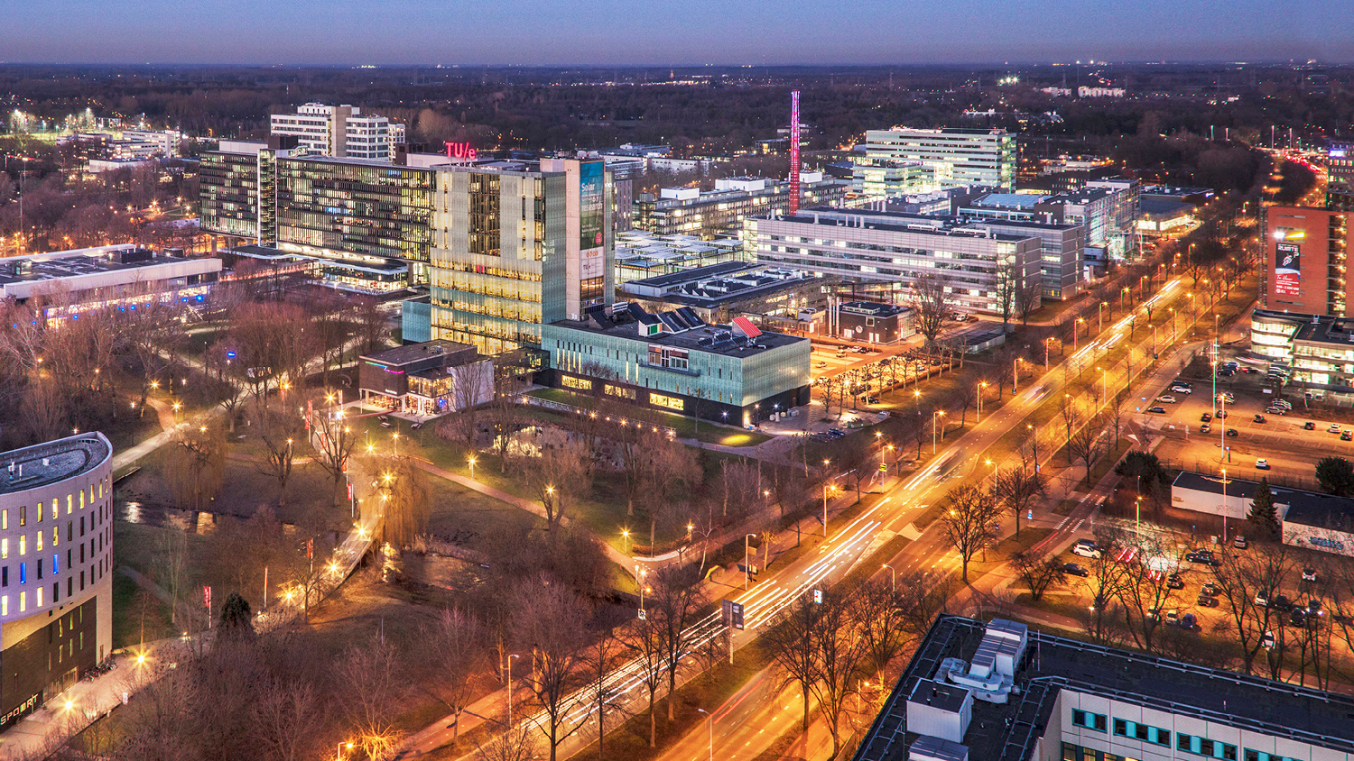

Slide 2
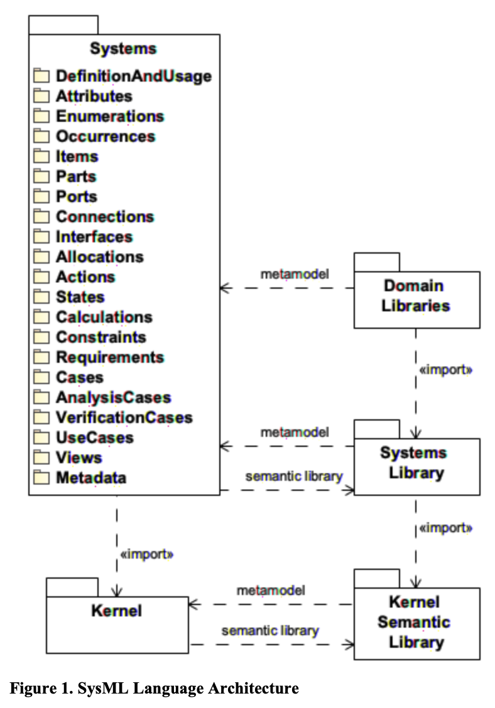
Understanding SysML V2 Language Architecture
Main References:
Almeida, J. P. A., Ferreira Pires, L., Guizzardi, G., & Wagner, G. (2024). An analysis of the semantic foundation of KerML and SysML v2.
Bajaj, M., Friedenthal, S., & Seidewitz, E. (2022). Systems Modeling Language (SysML v2) support for digital engineering. INCOSE Systems Engineering, 25(1).
Object Management Group. (2024). Systems Modeling Language (SysML®) v2 Specification. Object Management Group.

