Slide 1
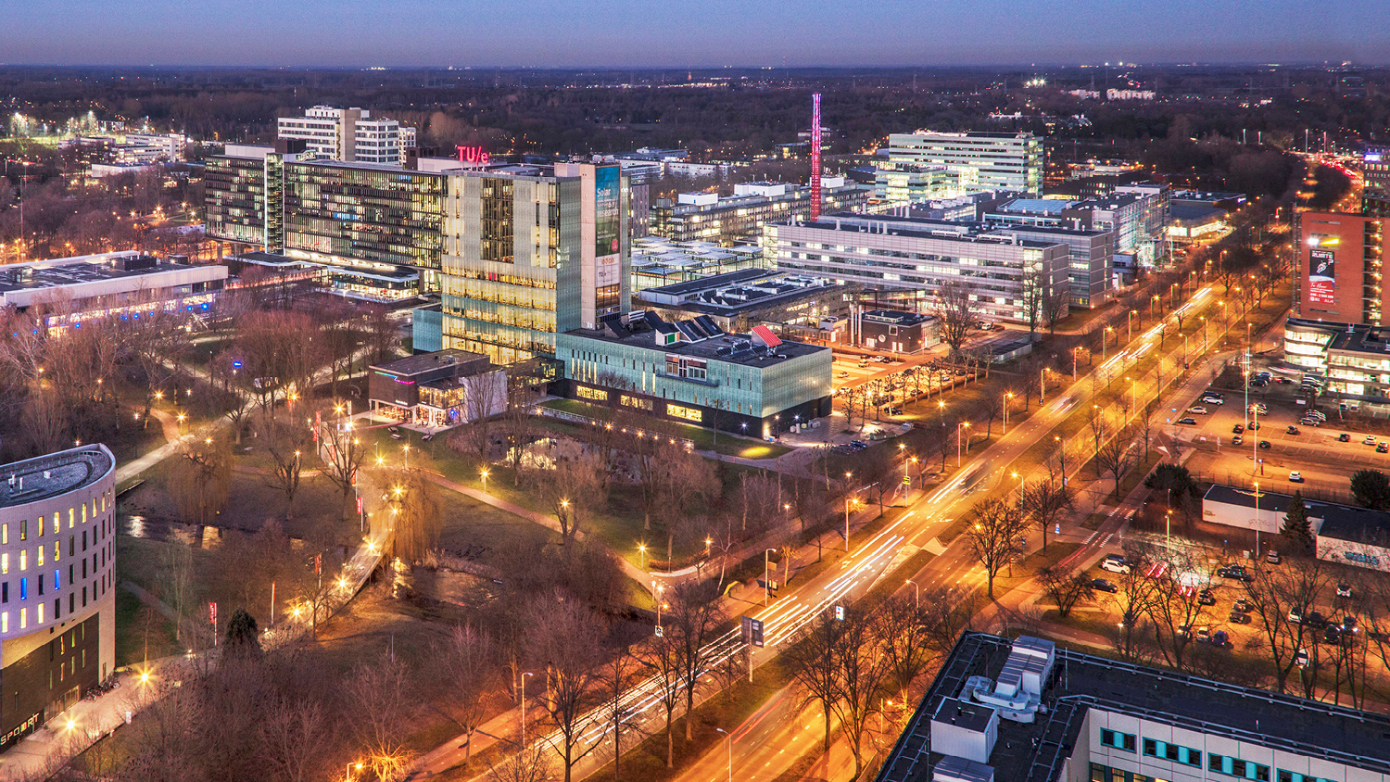

Slide 2
Context of the problem (in my view)
World X
Managers, CEOs, …
+50 years old
Too Slow to decide, High Impact
Experienced, outdated knowledge
Losing the ability to learn
Governments, Large corporations
Resistant to adopt new tech
World Y
System developers, engineers
18 to 35 years old
Too Fast to act, Low Impact
Updated Knowledge, no experience
Passionate to learn and grow
new companies, startups
Too keen on adopting new tech

Slide 3
Context of the problem (in my view)
World X
Managers, CEOs, …
+50 years old
Too Slow to decide, High Impact
Experienced, outdated knowledge
Losing the ability to learn
Governments, Large corporations
Resistant to adopt new tech
World Y
System developers, engineers
18 to 35 years old
Too Fast to act, Low Impact
Updated Knowledge, no experience
Passionate to learn and grow
new companies, startups
Too keen on adopting new tech
Systems Engineers
Connecting the two worlds
(speed matching the two gears)

Slide 4
Context of the problem (in my view)
World X
Managers, CEOs, …
+50 years old
Too Slow to decide, High Impact
Experienced, outdated knowledge
Losing the ability to learn
Governments, Large corporations
Resistant to adopt new tech
World Y
System developers, engineers
18 to 35 years old
Too Fast to act, Low Impact
Updated Knowledge, no experience
Passionate to learn and grow
new companies, startups
Too keen on adopting new tech
Systems Engineers
Connecting the two worlds
(speed matching the two gears)
The Gap is getting larger!

Slide 5
Context of the problem (in my view)
Systems Engineers are getting
Older
Slower to learn
Slower to decide but higher influence
Less updated on new technology
More involved in regulatory
Less able to learn new concepts
Etc.

Slide 6
Context of the problem (in my view)
Why Systems Engineers are getting
Older : Because SE jobs are not being opened
Slower to learn : Because systems are getting more and more complex
Slower to decide but higher influence : Because they don’t want to take risks
Less updated on new technology : Because Technology is quickly growing
More involved in regulatory : Because less risks means more compliance
Less able to learn new concepts : Because they’re getting older
Etc.

Slide 7
Context of the problem (in my view)
World X
Managers, CEOs, …
+50 years old
Too Slow to decide, High Impact
Experienced, outdated knowledge
Losing the ability to learn
Governments, Large corporations
Resistant to adopt new tech
World Y
System developers, engineers
18 to 35 years old
Too Fast to act, Low Impact
Updated Knowledge, no experience
Passionate to learn and grow
new companies, startups
Too keen on adopting new tech
Analytical Models
Systems Engineers
Connecting the two worlds
(speed matching the two gears)
The Gap is getting larger!
Descriptive Models

Slide 8
Why I chose this approach?
With a high-level overview, I can explore parallel research questions (topics) and ultimately design a better solution space:
Mapping data to models (e.g. current SERC’s MISD) > more diagrams!
AI (e.g. Anthropic’s MCP) > more data!
Address the SE and SWE gap
SE Education (for Young SE)
Human Aspects (Forgetting the KISS)
And maybe other research questions?

Slide 9
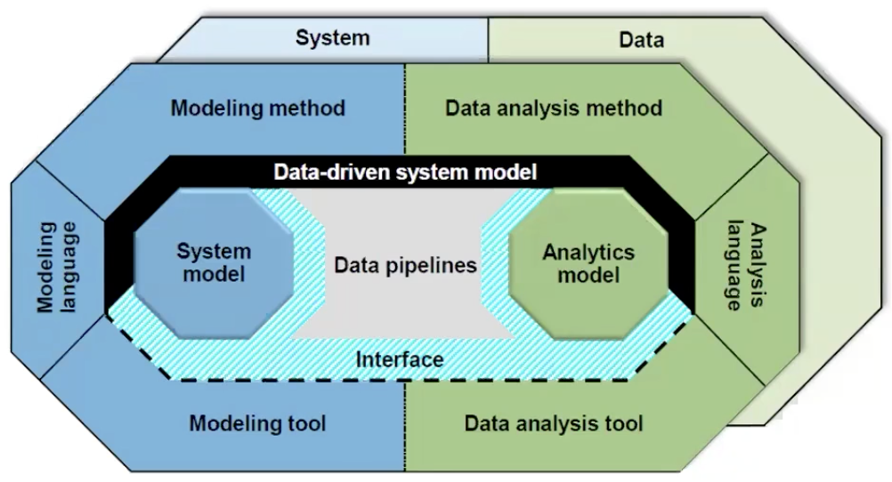
Literature Review
IEEE Systems Council
Tom McDermott (SERC)
Search Path:

