Slide 1
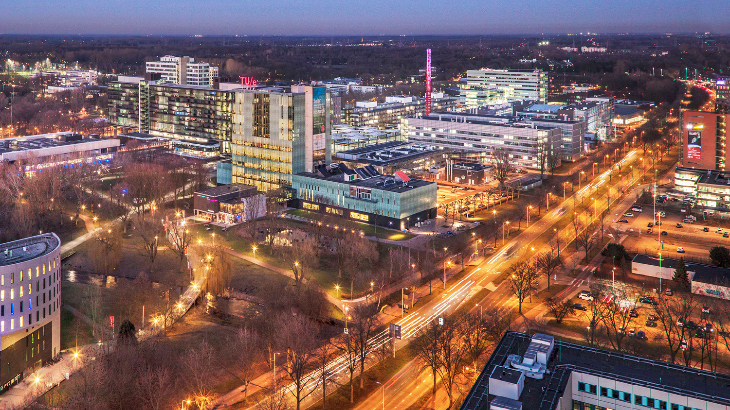

Slide 2
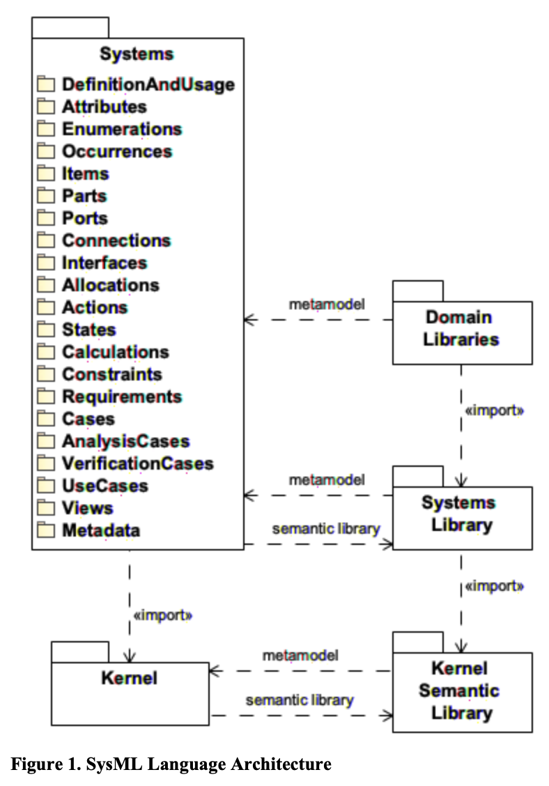
Understanding SysML V2 Language Architecture
Main References:
Almeida, J. P. A., Ferreira Pires, L., Guizzardi, G., & Wagner, G. (2024). An analysis of the semantic foundation of KerML and SysML v2.
Bajaj, M., Friedenthal, S., & Seidewitz, E. (2022). Systems Modeling Language (SysML v2) support for digital engineering. INCOSE Systems Engineering, 25(1).
Object Management Group. (2024). Systems Modeling Language (SysML®) v2 Specification. Object Management Group.

Slide 3
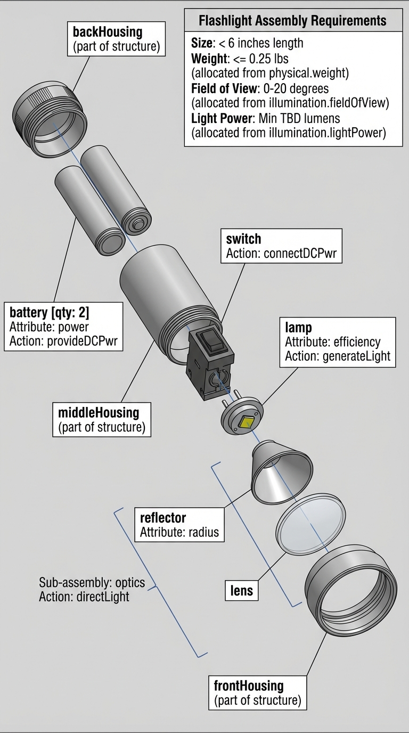
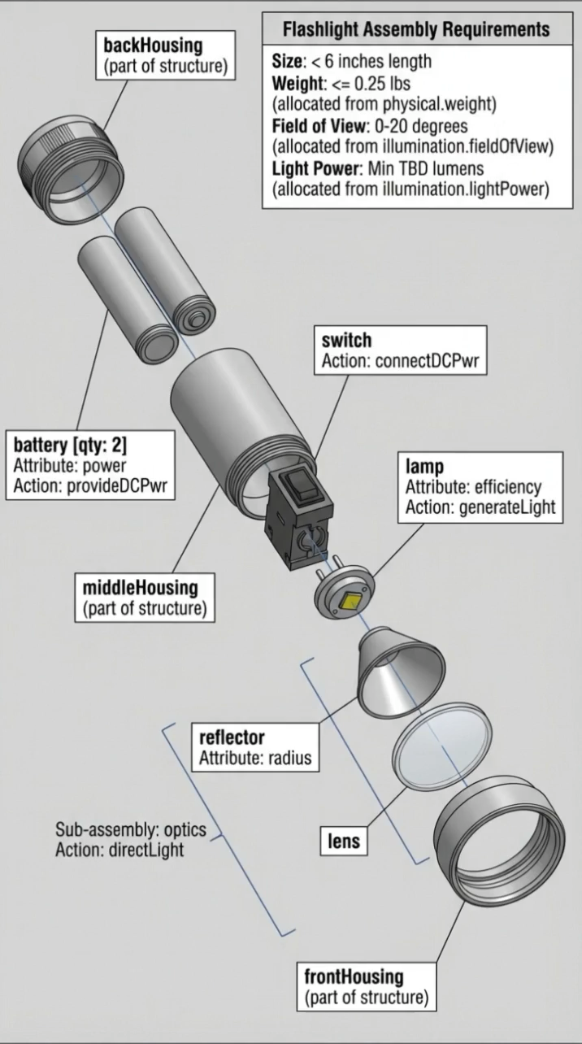
package FlashlightSpecificationAndDesign {
public import ScalarValues::*;
public import SI::*;
public import USCustomaryUnits::*;
// create a Requirements package that contains the hierarchy of requirements that compose the flashlight specification
package Requirements{
requirement flashlightSpecification{
requirement userInterface;
requirement illumination{
// the following is a simple text-based requirement
requirement fieldOfView{
doc /* The flashlight field of view shall be 0 - 20 degrees.*/
}
requirement lightPower{
doc /* The light power shall be a minumum of TBD lumens.*/
}
}
requirement physical{
requirement portability;
requirement size{
doc /* The flashlight shall be less than 6 inches in length.*/
}
// the following is a more precisely specified requirement using constraints
requirement weight{
doc /* The weight shall be less than 0.25 lbs.*/
attribute actualWeight :> ISQ::mass;
require constraint {actualWeight <= 0.25 [lb]}
}
}
requirement reliability;
requirement cost;
}
}
// create a package called ActionTree that contains the actions and flows to produceDirectedLight
package ActionTree{
action produceDirectedLight{
in item onOffCmd; //input

Slide 4
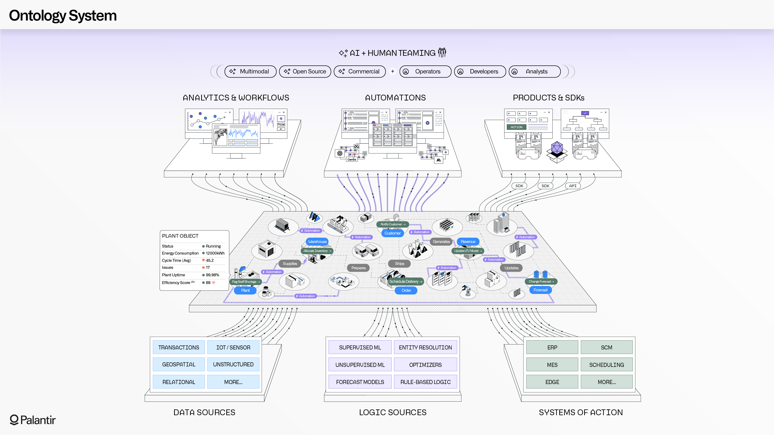
Plantir as

Slide 5
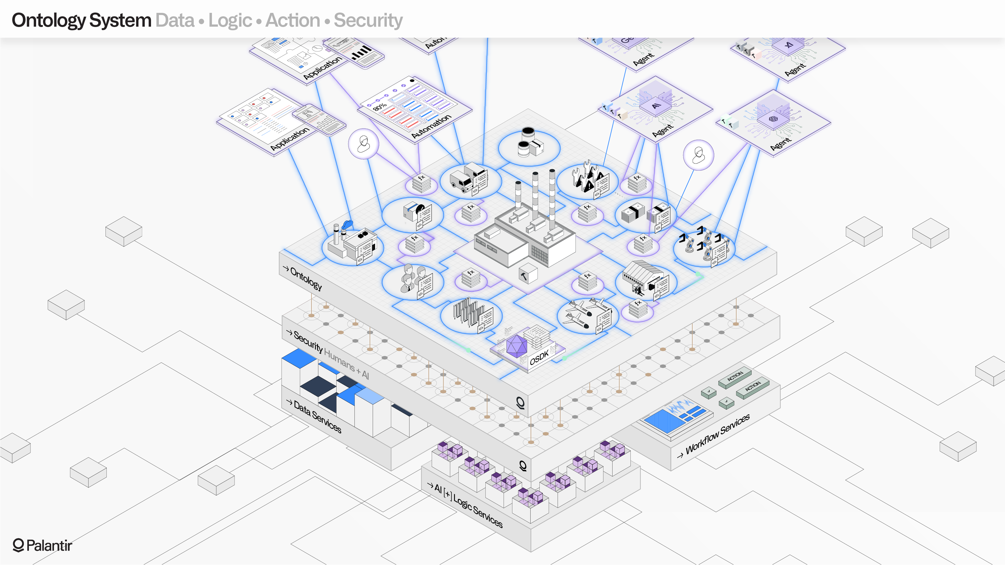

Slide 6
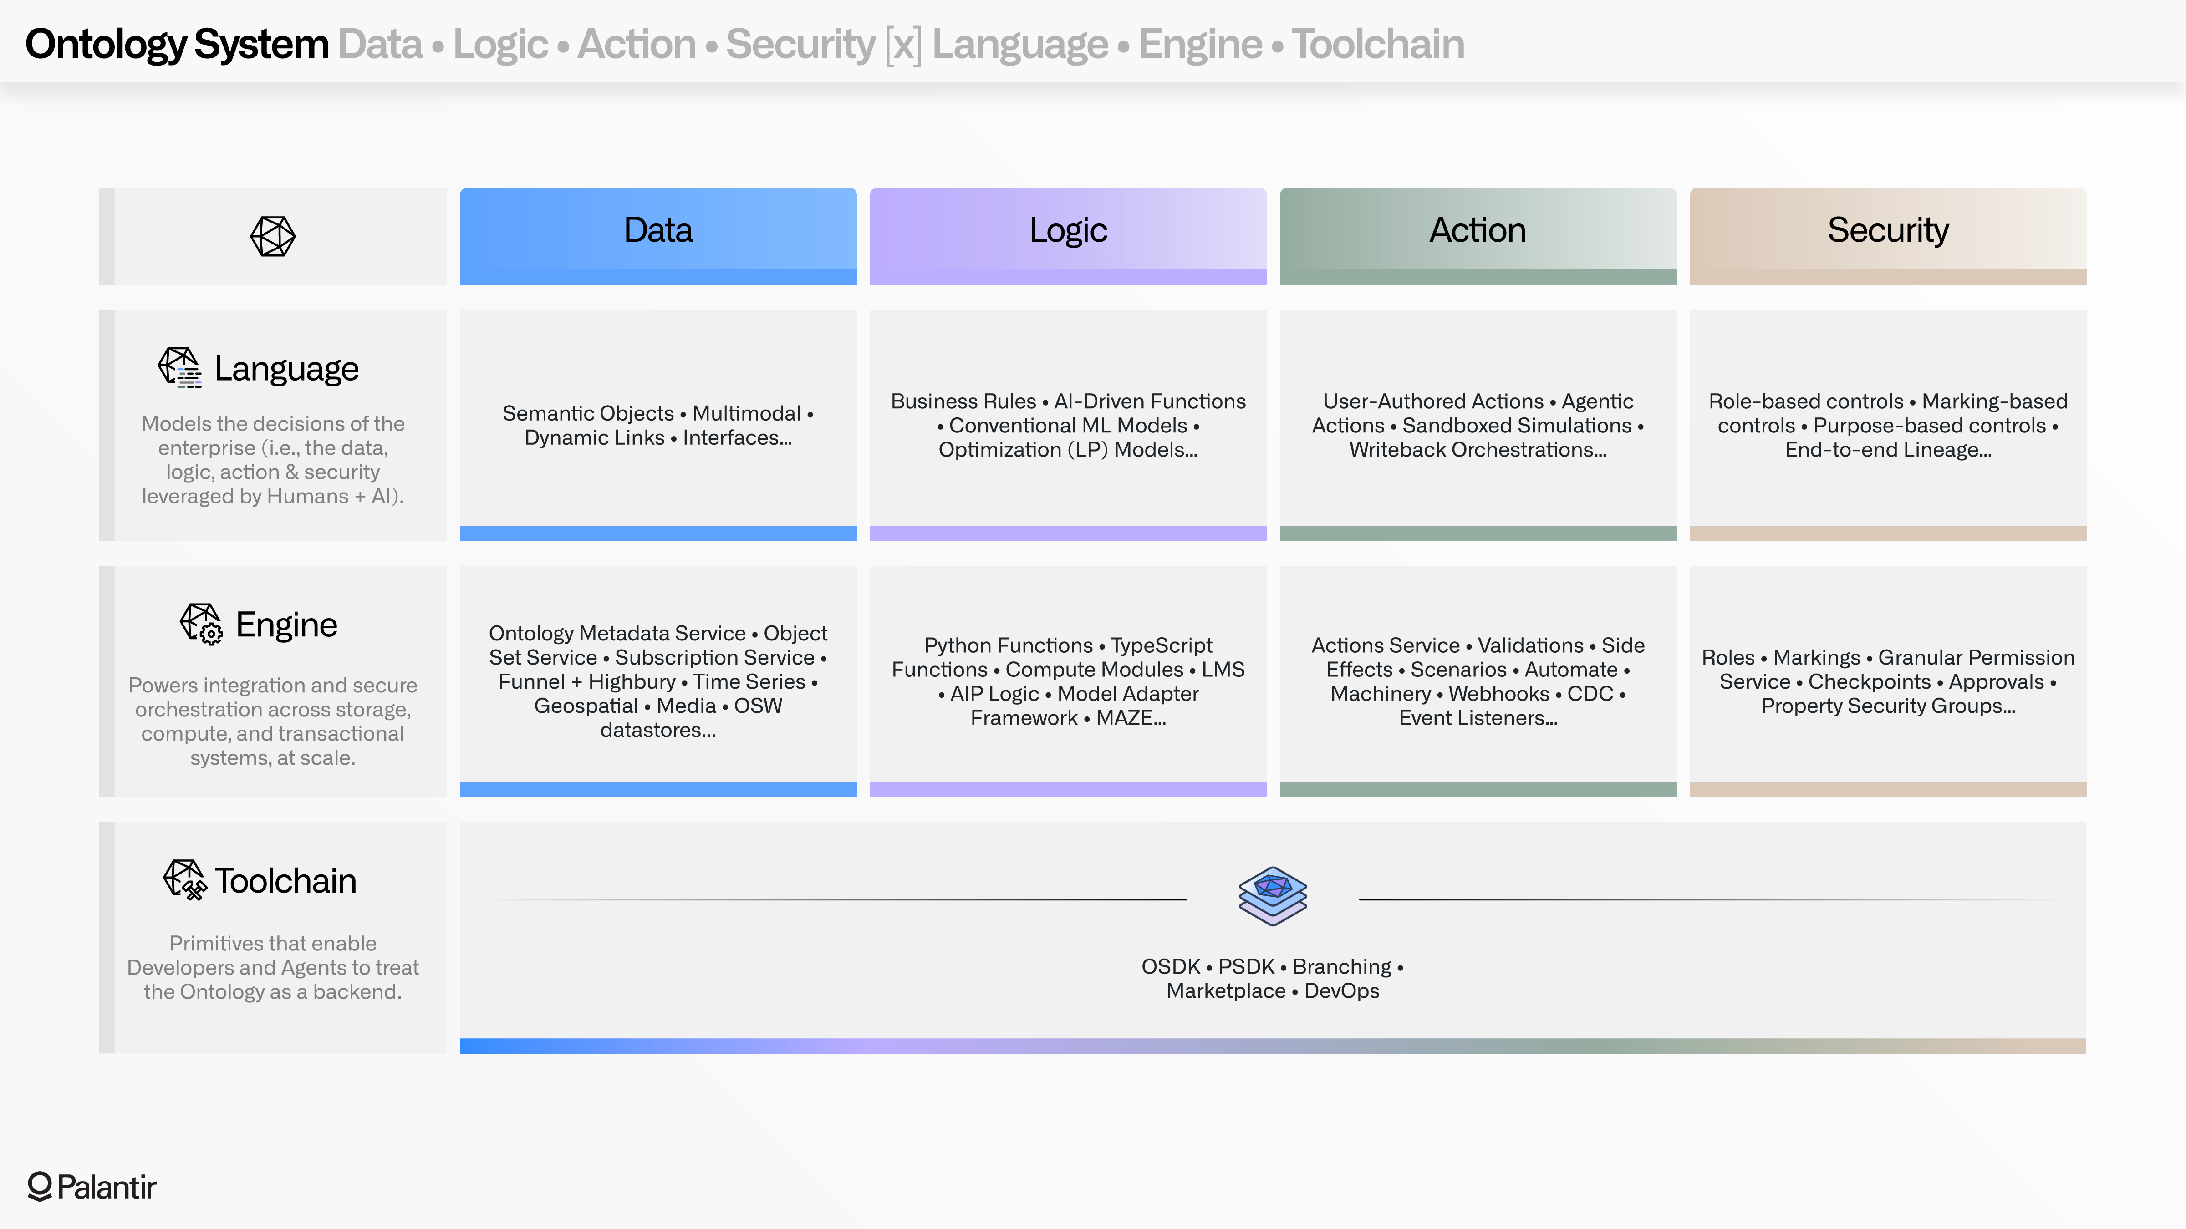

Slide 7
