Slide 1


Slide 2
Research Plan
Background
Project Goal
Research Method (means, steps, results)
Project Planning

Slide 3
Background (based on Digital Engineering HandBk)
Digital Engineering (DE) is an engineering approach centered on integrated digital models, data, and simulations across the lifecycle.
Core idea
Replace document-centric engineering with model-centric engineering
Enable continuous digital integration across:
Mission → System → Subsystem → Components
Support decision-making via linked digital artifacts
Key characteristics
Model-based lifecycle management
Integrated simulation and analytics
Cross-discipline collaboration
Authoritative Source of Truth (ASOT)
👉 DE acts as an umbrella domain connecting engineering models, data, and simulations.
Blackburn, M. R., Dunbar, D., Hagedorn, T., Hespelt, S., Collard, C., Jenkins, J. S., & contributors. (2025). Handbook on digital engineering with ontologies (Version 2.0). Systems Engineering Research Center, Stevens Institute of Technology.

Slide 4
Background (History)
Traditional Systems Engineering
Document-centric
Manual integration
Limited traceability
Model-Based Systems Engineering (MBSE)
Structured modeling languages (SysML)
Improved traceability and architecture modeling
Digital Engineering (Current Stage)
Fully digital ecosystem:
Models
Simulations
Data repositories
Analytics dashboards

Slide 5
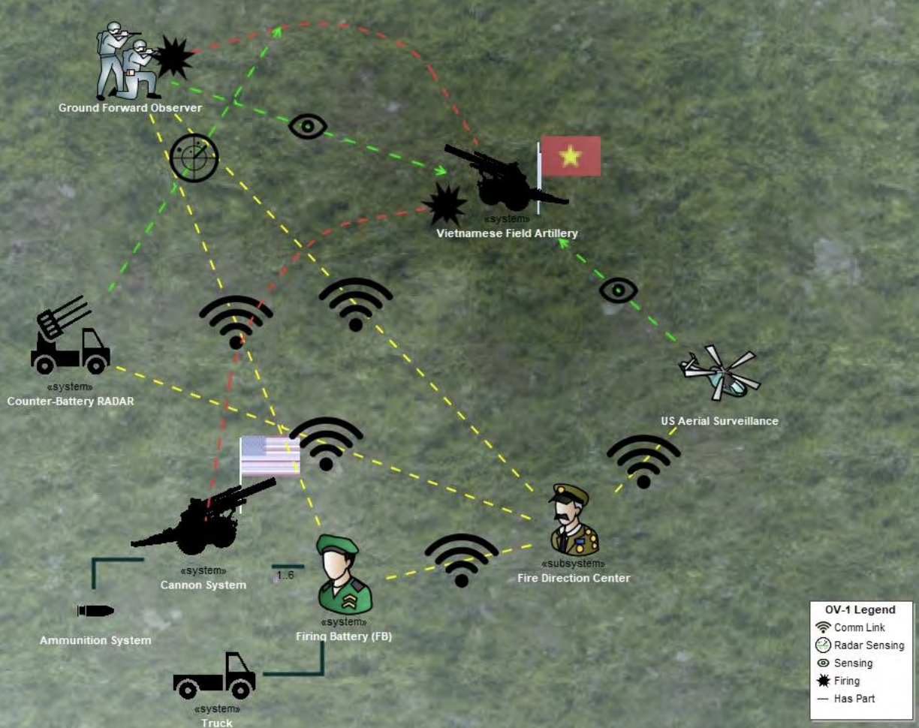
Background (Problem)
Core Problem
Engineering data exist in isolated domains:
Mechanical models
Electrical models
Software models
Operational models
Result:
Fragmented information
Poor decision visibility
Manual integration
Solution Direction:
Ontologies
Semantic technologies
Integration frameworks (IoIF)

Slide 6
Background (Ontologies)
What is an ontology?
A formal description of:
Concepts
Relationships
Domain knowledge
Why ontologies matter in DE
Enable semantic interoperability
Allow automated reasoning
Support model consistency checking
Technologies used
OWL (Web Ontology Language)
Semantic Web tools
Knowledge graphs
Blackburn, M. (2024, November 12). A digital engineering methodology and framework for interoperability using ontologies. Systems Engineering Research Center Research Review.

Slide 7
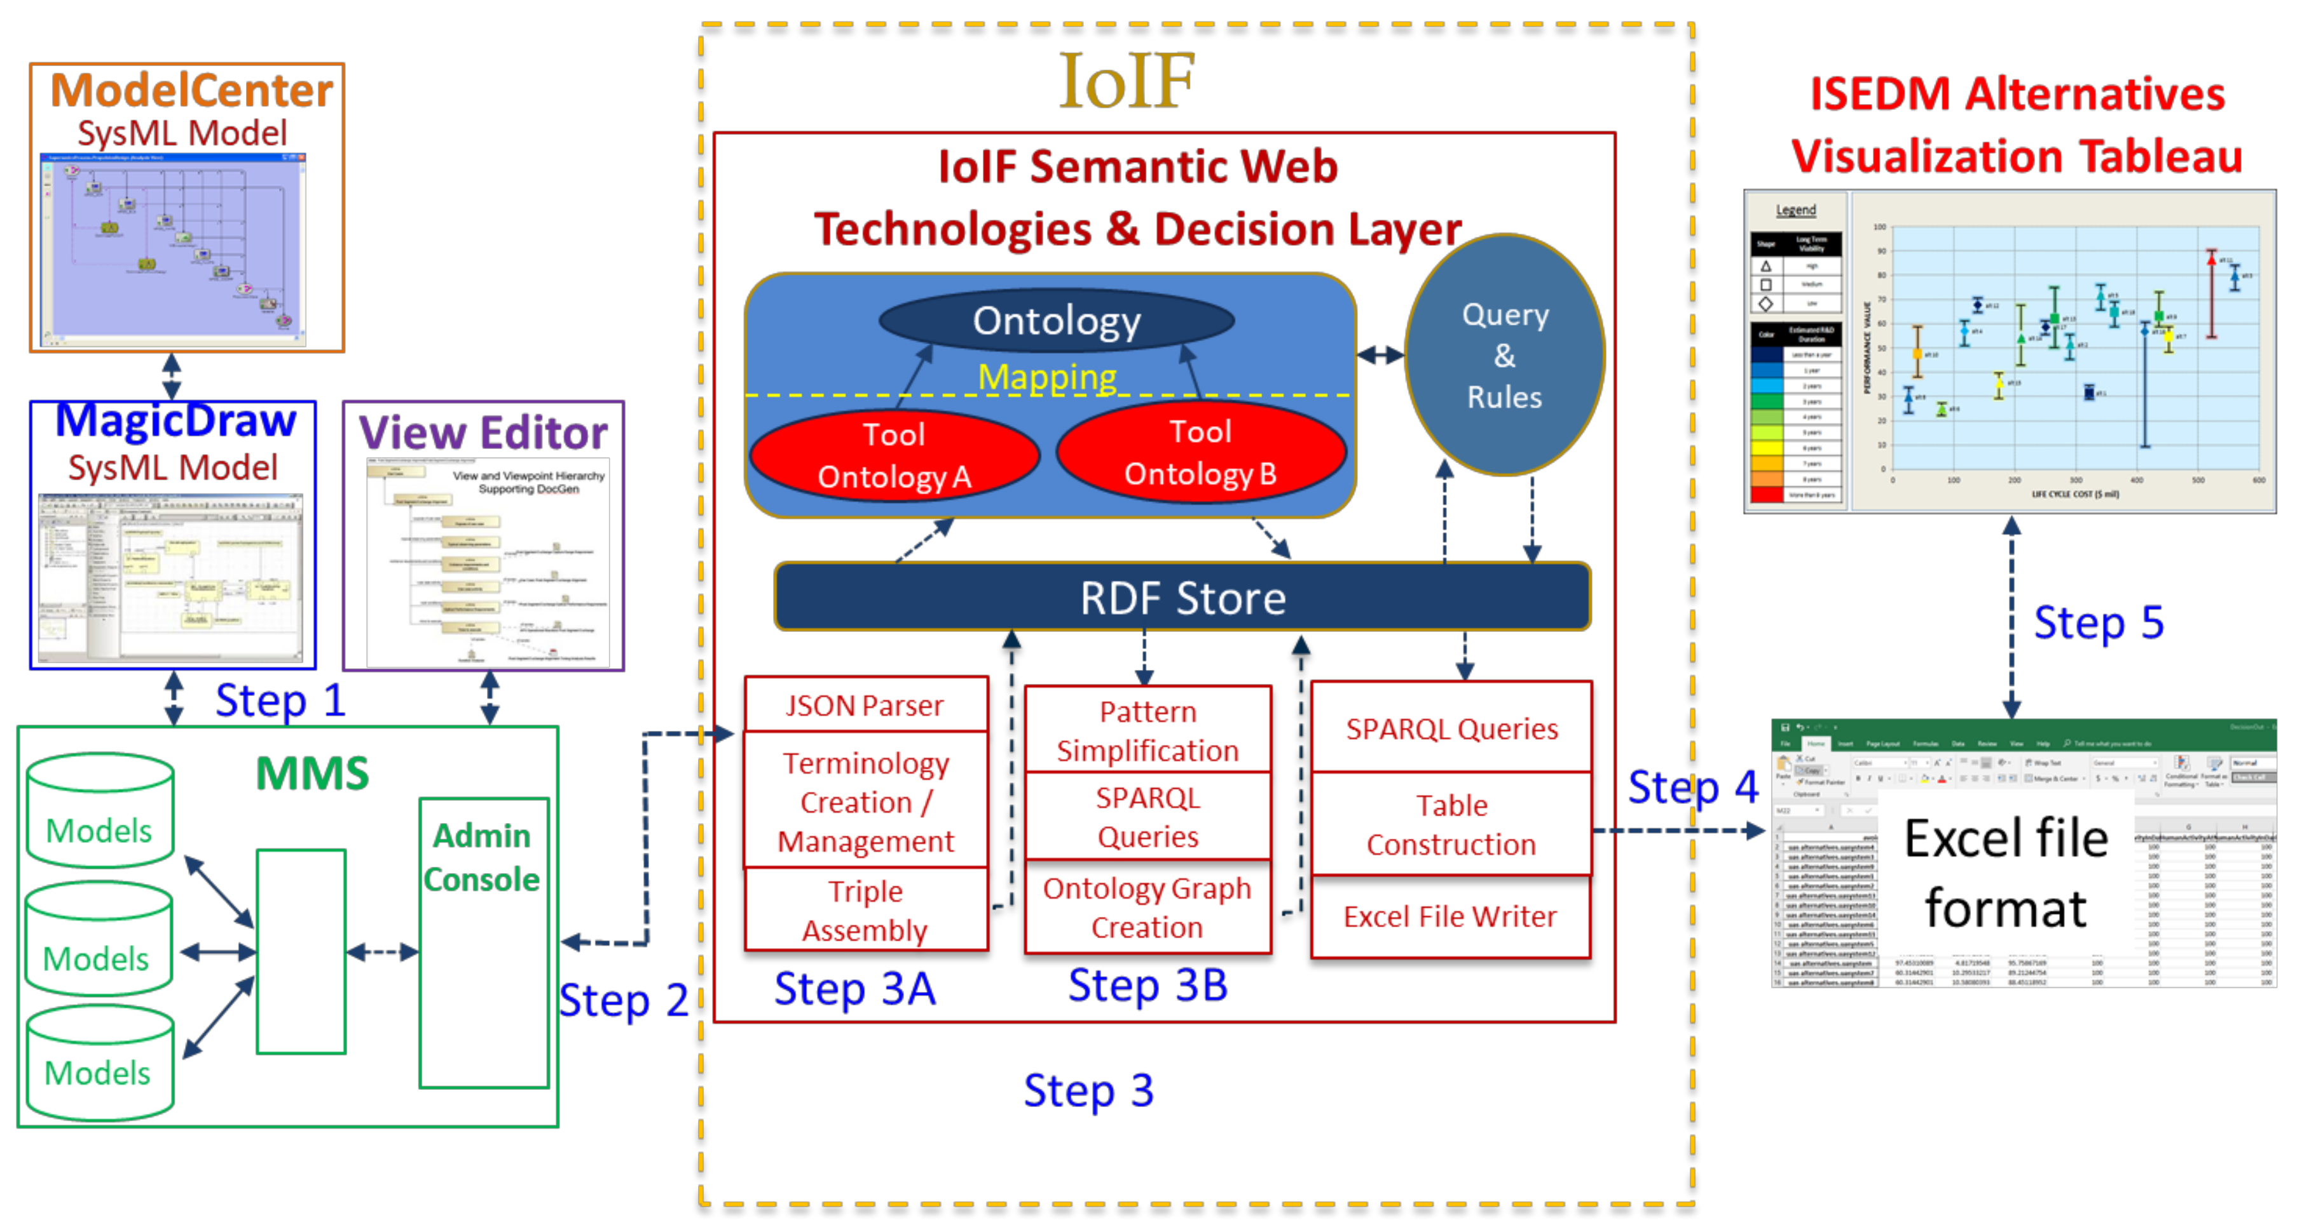
Interoperability & Integration Framework (IoIF)
Purpose:
Integrate models, data, and simulations
Enable cross-domain decision support
Functions
Data acquisition and aggregation
Semantic querying and reasoning
Workflow coordination
Outputs
Decision dashboards
Digital thread visualization
Impact analysis tools
Bone, M., Blackburn, M., Kruse, B., Dzielski, J., Hagedorn, T., & Grosse, I. (2018). Toward an interoperability and integration framework to enable the digital thread. Systems, 6(4), 46. https://doi.org/10.3390/systems6040046

Slide 8
The Catapult Example

Slide 9
Research Questions
How can AI be introduced into Digital Engineering tool-chains to improve model integrity by enabling systematic model interrogation (for FMEA) that supports ASoT use (consistency, traceability, interoperability, explainability)?
What model representation and reasoning stack (SysML v2/KerML + ontology/knowledge graph + deterministic checks + LLM assistance) yields the best integrity outcomes (to support FMEA) with controlled hallucination risk?
To what extent can an AI-assisted interrogation pipeline generate a useful, traceable FMEA for the catapult(?) system-of-interest/system-of-analysis, compared to a human-only baseline (quality, coverage, time)?
Is it “Green”: How much can token usage (and therefore compute cost) be reduced through retrieval/graph-slicing and deterministic computations without materially degrading FMEA quality or integrity findings?

