Slide 1
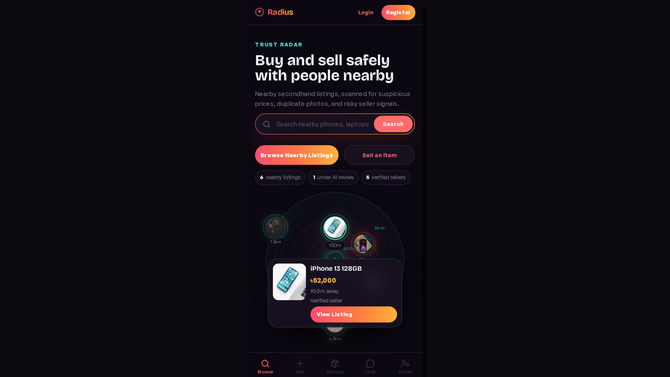
Radius
AI Assisted Hyperlocal Marketplace
Buy and sell safely with people nearby.
Trust Radar + explainable fraud detection + admin moderation.
Presented by
[Team Name]
[Names and IDs]

Slide 2
Problem
Secondhand marketplaces are useful, but trust is weak.
Fake listings
Copied photos
Scammers post attractive products that do not exist.
Old or stolen product images mislead buyers.
Suspicious prices
Off-platform pressure
Very low prices are used as bait.
Users are pushed to WhatsApp, deposits, or token money.

Slide 3
Solution
Radius combines local discovery with AI trust screening.
Browse nearby products
Sell with secure photo metadata
Chat inside the platform
Implemented in the current full-stack system.
Implemented in the current full-stack system.
Implemented in the current full-stack system.
Report suspicious listings
Admin reviews AI flags
ML log explains predictions
Implemented in the current full-stack system.
Implemented in the current full-stack system.
Implemented in the current full-stack system.

Slide 4
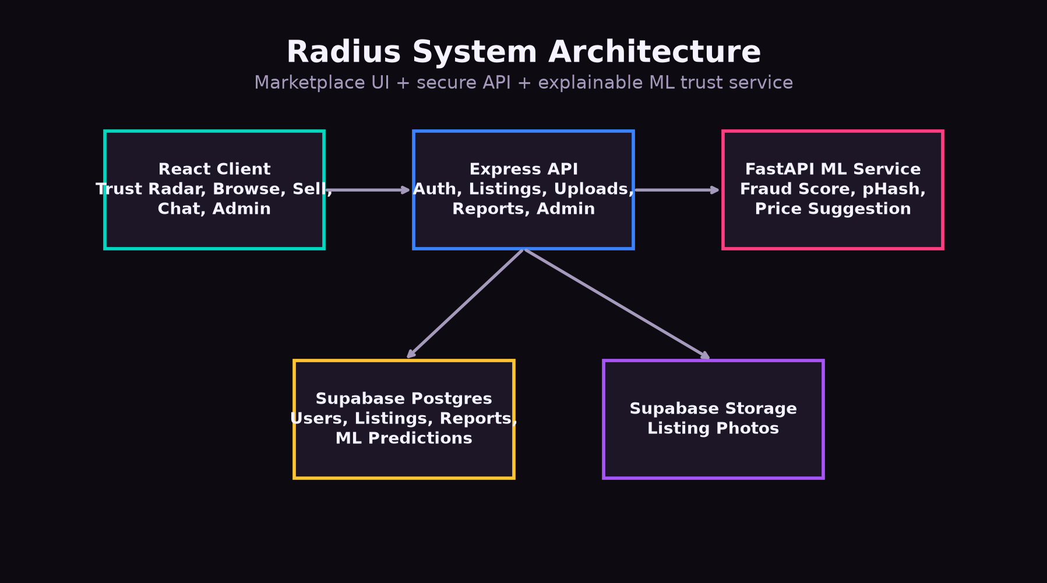
Architecture

Slide 5
User Roles
Guest
Registered User
Admin
Browse listings
Search and filter
View listing details
Cannot sell/chat/report
Create listings
Upload photos
Chat with sellers
Report suspicious items
Review after completed trade
Review fraud queue
Resolve reports
Manage users
Inspect ML prediction log

Slide 6
Trust Radar
The radar is a live discovery feature, not decoration.
Distance
The center is the user; nodes are nearby products.
Trust
Node color shows verified, review, or flagged state.
Interaction
Selecting a node opens a mini listing preview card.

Slide 7
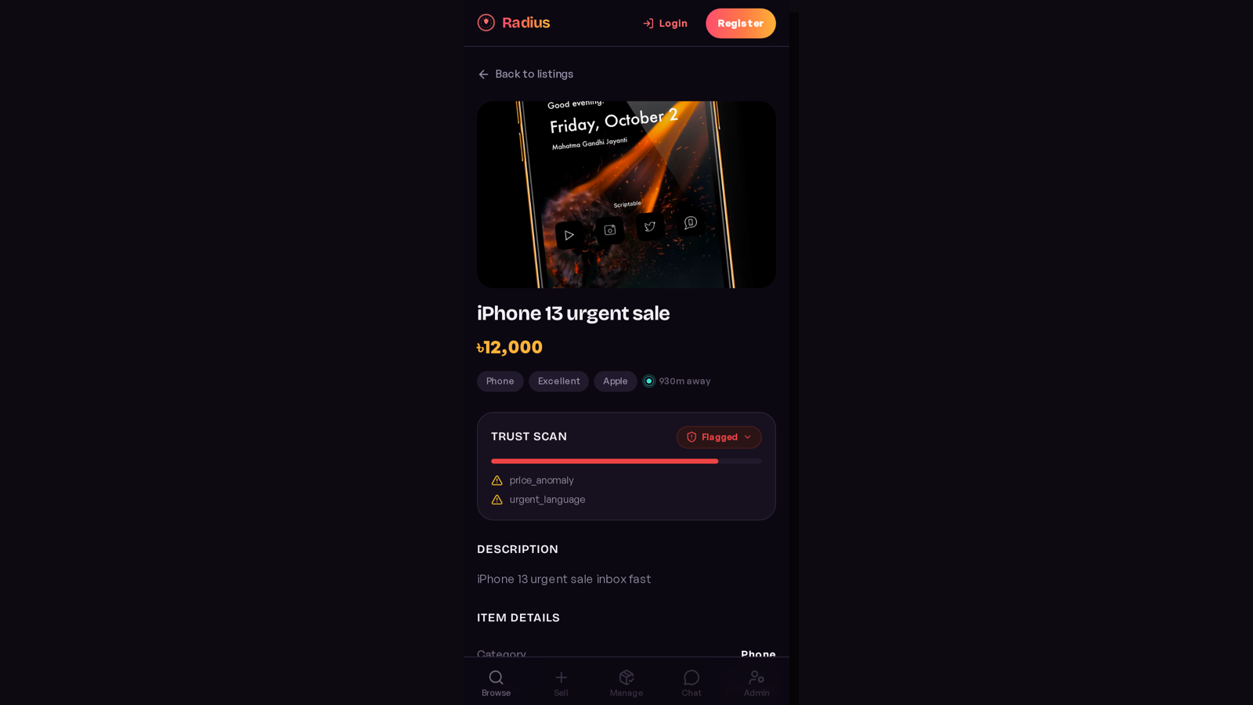
Product Detail
Trust Scan
Shows fraud score, signals, explanations, and visual risk bar.
Price Radar
Compares listing price against similar nearby products.
Seller Safety
Seller reputation and report workflow support safer decisions.

Slide 8
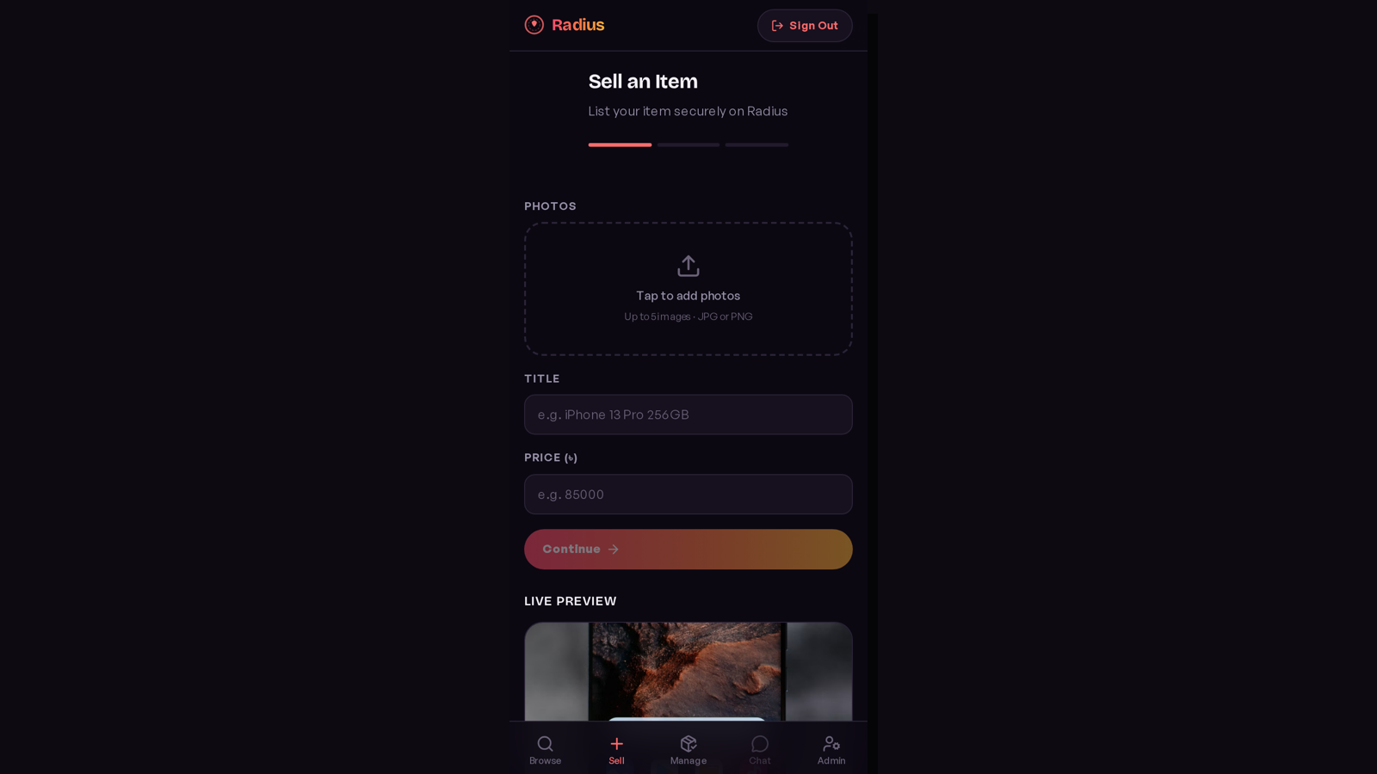
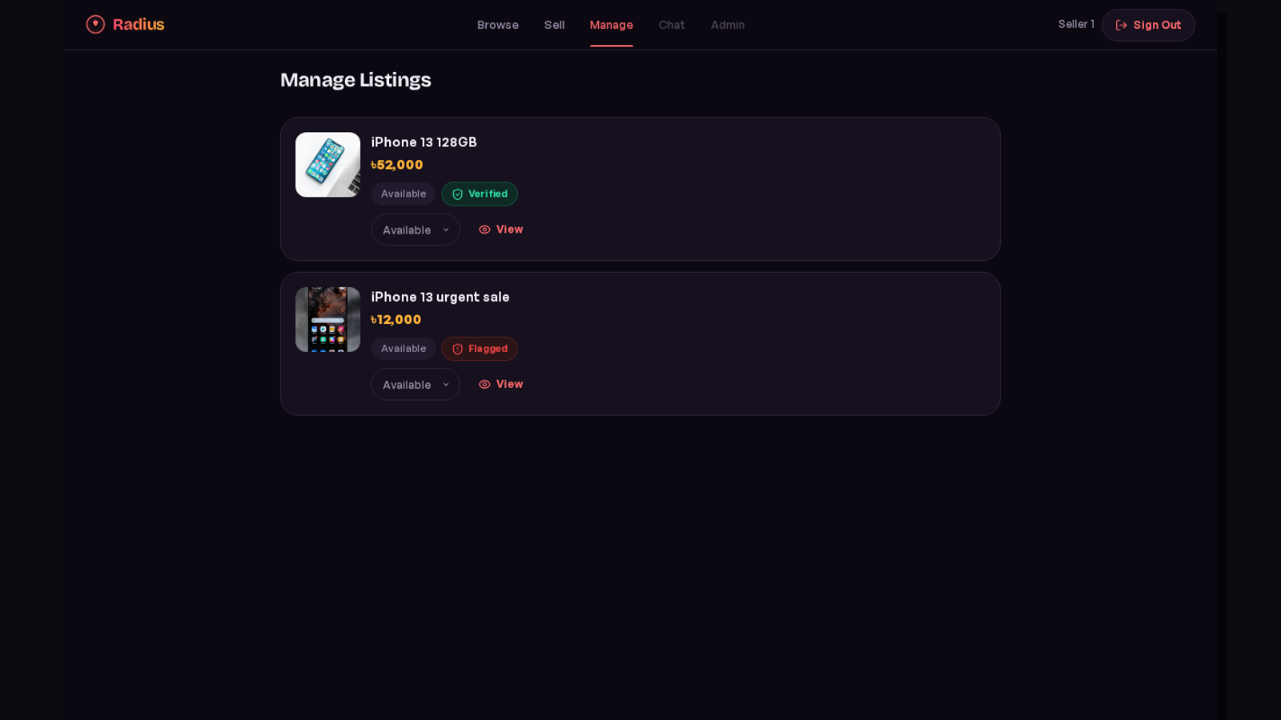
Sell and Manage
Sell flow triggers ML scoring. Manage tab focuses on seller operations.

Slide 9
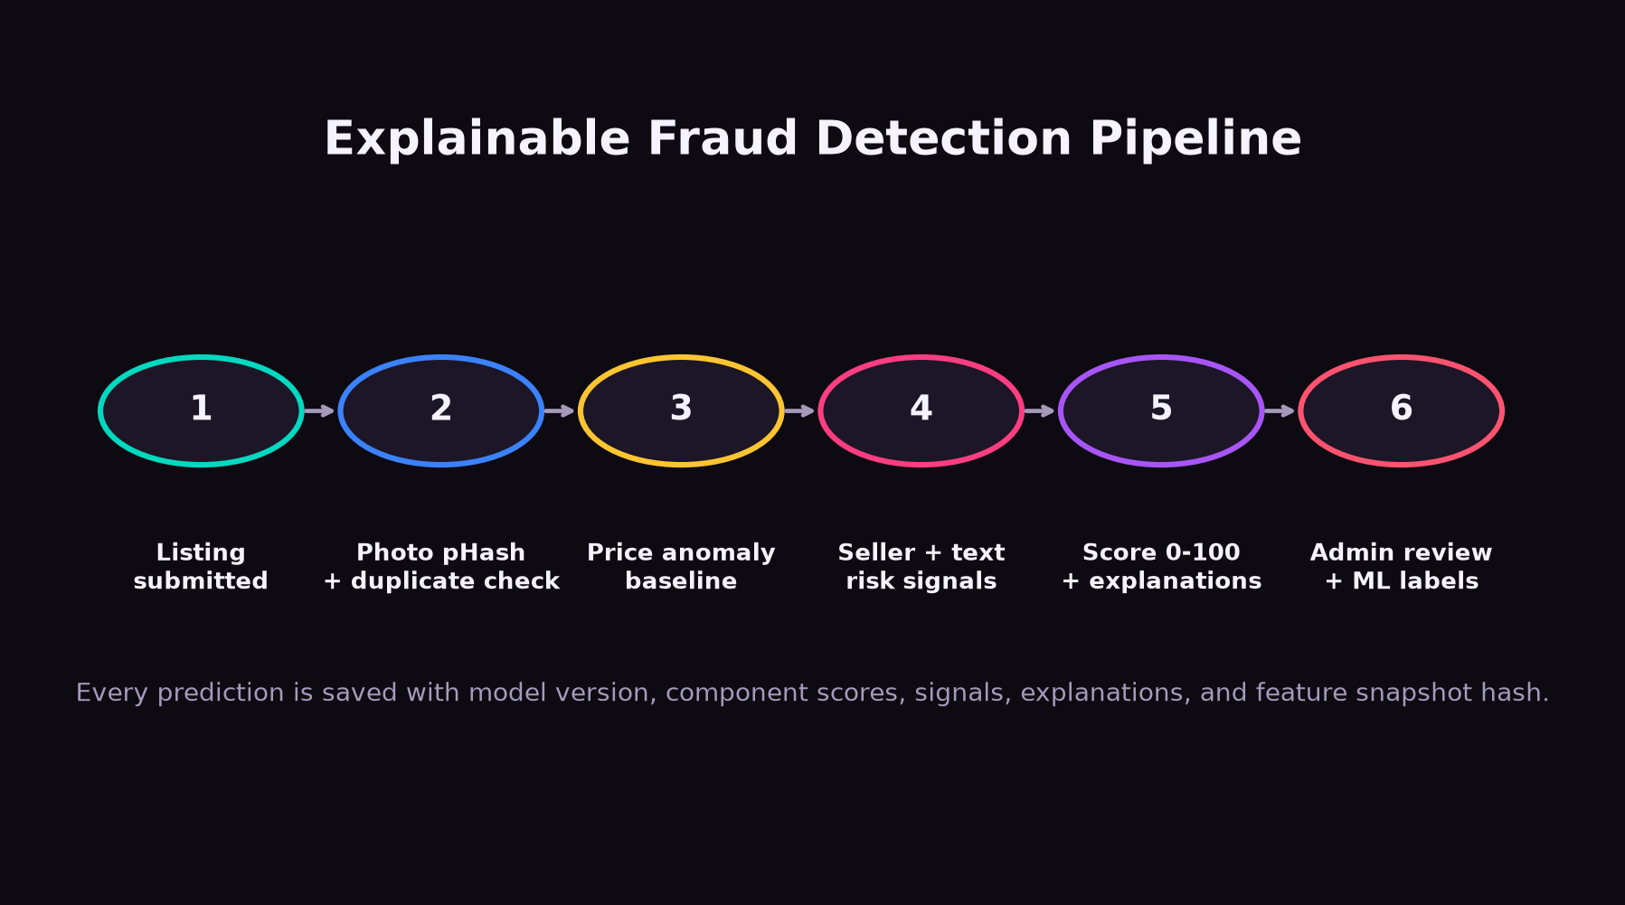
Fraud Detection Engine

Slide 10
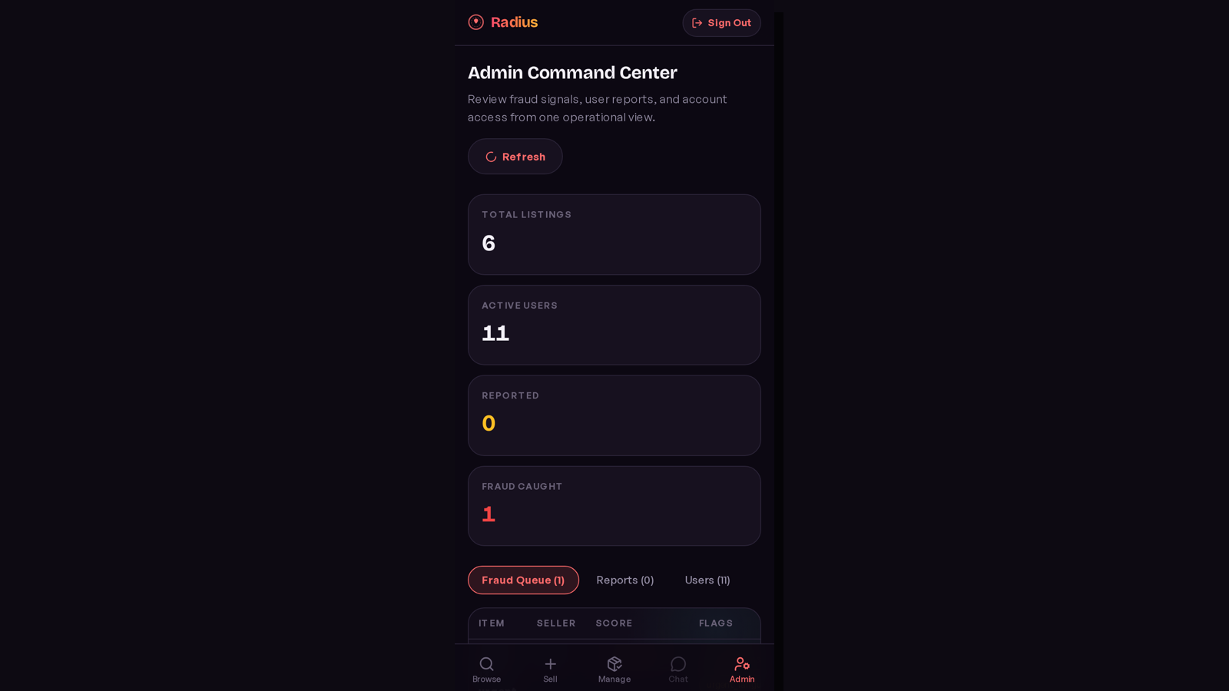
Admin Moderation
Fraud Queue
Approve or remove high-risk listings.
Reports
Resolve user-submitted suspicious listing reports.
Users
Suspend or reactivate accounts.
ML Log
Audit model version, score, signals, and feature snapshot.

Slide 11
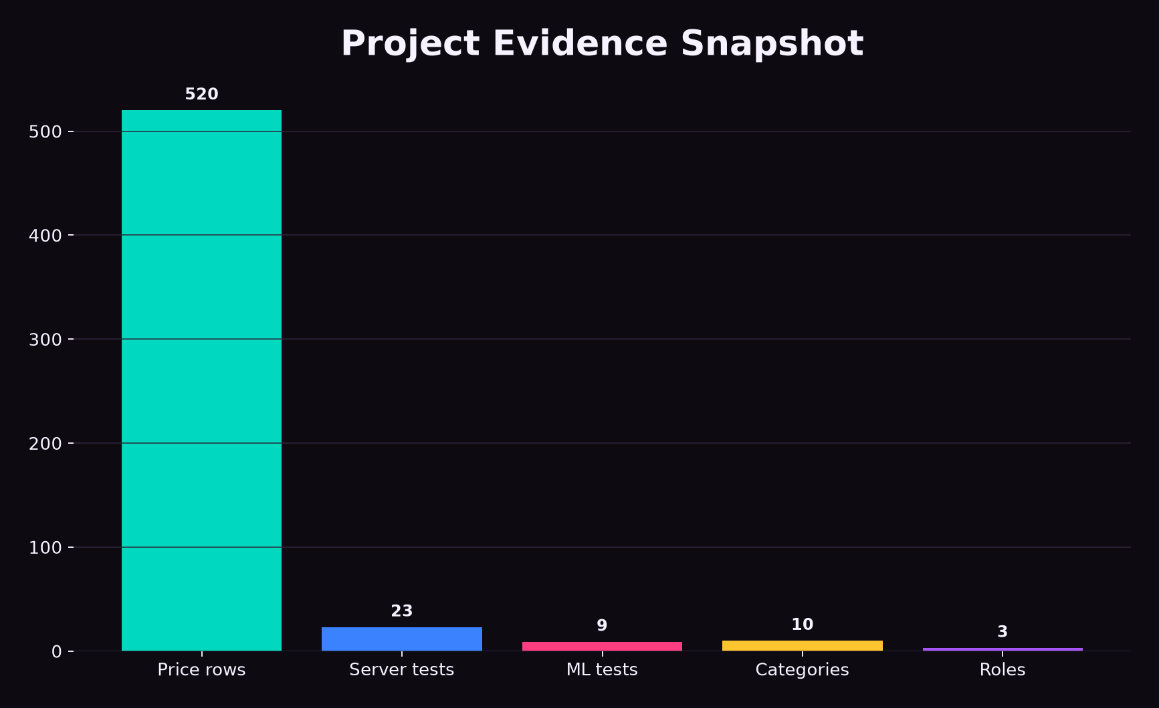
Dataset and Evaluation
Price Dataset
520+ market price rows across 10 product categories.
Fraud Labels
Admin decisions, reports, and manual CSV imports become labels.
Metrics
Precision, recall, F1 score, and false positive rate.

Slide 12
Testing and Result
Verified implementation
ML Service
Server
Client
9 pytest tests passed
23 Vitest tests passed
Production Vite build passed
The project satisfies the academic requirements and is structured as a portfolio-ready full-stack product.

Slide 13
Conclusion
Radius is more than a product selling system.
It combines role-based marketplace workflows with nearby discovery, real-time chat, admin moderation, and explainable AI/ML trust scoring.
Local
Safe
Explainable
Products near the user.
Fraud signals are visible.
Admins see reasons, not just scores.
Thank you

