Slide 1
Illumination Variation
(0.833, 0.792)
Fast Motion
(0.802, 0.760)
Out-of-Plane Rotation
(0.840, 0.762)
In-Plane Rotation
(0.801, 0.716)
Scale Variation
(0.830, 0.745)
Out of View
(0.825, 0.780)
Occlusion
(0.855, 0.815)
Background Clutter
(0.869, 0.821)
Deformation
(0.841, 0.748)
Low Resolution
(0.756, 0.825)
Motion Blur
(0.866, 0.852)

Slide 2
(1)
(2)
(3)

Slide 3

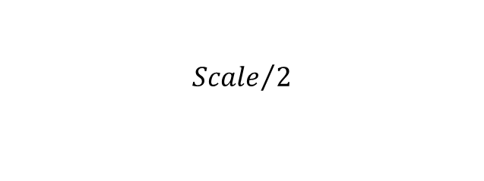





$θ_{k}^{∗}$ centered coarse-to-fine orientation update
$$θ_{2}^{∗}={87}^{°}$$
$$θ_{1}^{∗}={85}^{°}$$
$$θ_{3}^{∗}={87.9}^{°}$$
$${Scale}/2$$
Original $θ_{k}^{∗}$
Updated $θ_{k+1}^{∗}$

Slide 4
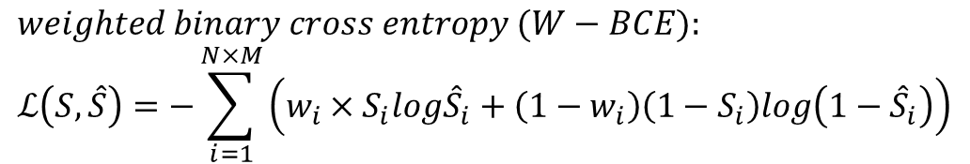
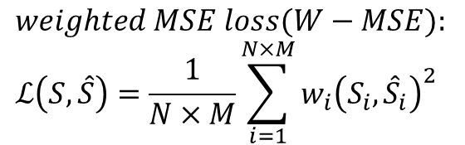
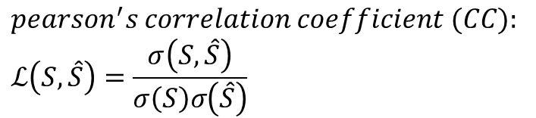
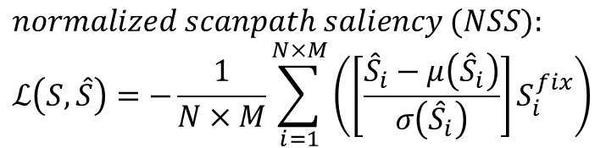
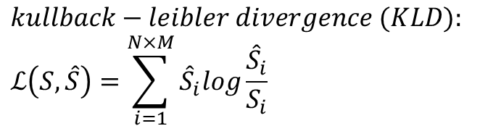
$$weighted MSE loss(W−MSE):$$
$$ℒ\left(S,\hat{S}\right)=\frac{1}{N×M}\sum_{i=1}^{N×M}{w_{i}{\left(S_{i},{\hat{S}}_{i}\right)}^{2}}$$
$$weighted binary cross entropy (W−BCE):$$
$$ℒ\left(S,\hat{S}\right)=−\sum_{i=1}^{N×M}{\left(w_{i}×S_{i}log{\hat{S}}_{i}+\left(1−w_{i}\right)\left(1−S_{i}\right)log\left(1−{\hat{S}}_{i}\right)\right)}$$
$$kullback−leibler divergence (KLD):$$
$$ℒ\left(S,\hat{S}\right)=\sum_{i=1}^{N×M}{{\hat{S}}_{i}log\frac{{\hat{S}}_{i}}{S_{i}}}$$
$$normalized scanpath saliency (NSS):$$
$$ℒ\left(S,\hat{S}\right)=−\frac{1}{N×M}\sum_{i=1}^{N×M}{\left(\left[\frac{{\hat{S}}_{i}−μ\left({\hat{S}}_{i}\right)}{σ\left({\hat{S}}_{i}\right)}\right]S_{i}^{fix}\right)}$$
$$pearson^{′}s correlation coefficient (CC):$$
$$ℒ\left(S,\hat{S}\right)=\frac{σ\left(S,\hat{S}\right)}{σ\left(S\right)σ\left(\hat{S}\right)}$$

Slide 6
0.0
0.2
-0.8
0.9
0.4
0.6
0.8

