Slide 1
Face Recognition System Based on Four State Hidden Markov Model
1
Sad Md. Tafhim
23141086

Slide 2
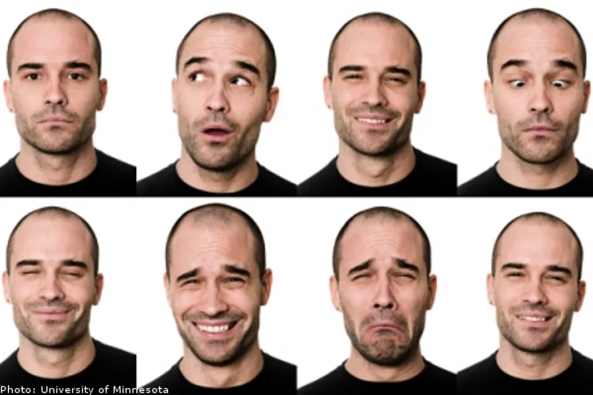
Introduction
Face recognition is a challenging task due to variations in pose, illumination, and facial expressions.
Hidden Markov models (HMMs) are a powerful tool for pattern recognition tasks.
The authors propose a method to reduce the computational complexity of face recognition using a four-state HMM.
2

Slide 3
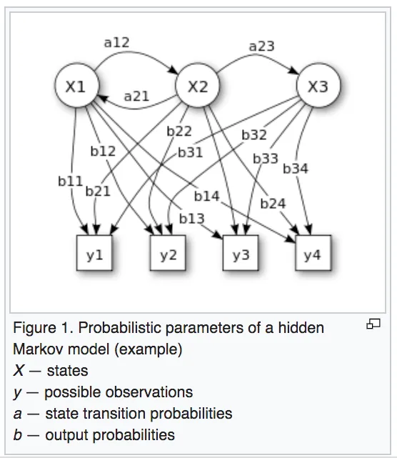
Proposed Method
The authors divide face images into overlapping blocks.
The coefficients of eigenvalues and eigenvectors are used to train the HMM.
Singular value decomposition is used to reject or accept test images.
Principal component analysis is used for feature extraction.
3

Slide 4
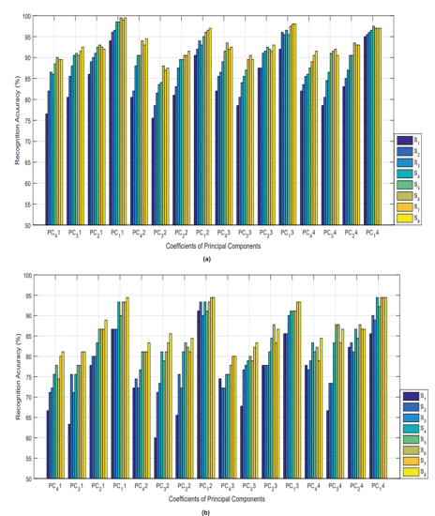
Experimental Results
The proposed method is comparable to existing techniques with reduced computational cost.
The authors achieve a recognition rate of 95% on a dataset of 1000 images.
4

Slide 5
Future Work
Investigate the use of other HMMs for face recognition.
Apply the proposed method to other image recognition tasks.
Develop a real-time face recognition system.
5

Slide 6
Conclusion
The proposed method is a promising approach for face recognition.
The method reduces computational complexity without sacrificing accuracy.
The method has the potential to be used in real-time applications.
6

