Slide 1

UE22CS252A – Mini Project
SEMESTER - III
Project Title :Airline Management System
Project Guide : Jayapriya Ma’am
Project Team :
Prasad Ishwar PES1UG22CS440
Priyanshu Chaudhary PES1UG22CS455
Pranavasurya Prakash PES1UG22CS435
Praneel Patel GM PES1UG22CS437

Slide 2
Outline
Title of the Project
Problem Statement
Introduction
Features
Functions
DS Used
Sample Code / Algo
Input & Output Screenshots
And Concluding Remarks

Slide 3
Introduction and scope
Title of the Project
Problem Statement:
Current airline management systems face technical challenges, including complexities in ticket booking, flight route planning,and resource management. These challenges hinder seamless operations and data-driven decision-making, impacting the customer experience. Our project seeks to address these technical hurdles by applying relevant algorithms and data structures, aiming to enhance understanding, technical skills, and problem-solving capabilities within the realm of airline management systems.
Prasad Ishwar_Priyanshu Chaudhary_Pranavasurya Prakash_Praneel Patel GM

Slide 4
Introduction and Scope
Title of the Project
Our project simulates a real time airline management system with features such as ticket booking, user registration, flight route planning, flight schedule generation,Admin management,etc
We use algorithms to find the cheapest cost and shortest time between the source and destination.
Prasad Ishwar_Priyanshu Chaudhary_Pranavasurya Prakash_Praneel Patel GM

Slide 5
Features and functions
Title of the Project
User registration-This information typically includes personal details, contact information, and login credentials. Registered users gain access to features such as ticket booking, flight information,ticket cancellation.
Login page-Validates the username and password
Flight scheduling-Flight scheduling involves the creation and management of a timetable for flights operated by the airline. It includes details such as departure and arrival times, flight codes, aircraft assignments, and the days of the week on which flights are available.
Flight Booking-Uses Dijkstra's algorithm to find flights by cost and by the fastest route(time).
Ticket booking-Ticket booking allows users to reserve seats on flights. Users can select their preferred flights based on factors such as departure time, destination, and class of service.
Prasad Ishwar_Priyanshu Chaudhary_Pranavasurya Prakash_Praneel Patel GM

Slide 6
Features and functions
Title of the Project
Using random generator to generate unique PNR
Admin Features: Flight scheduling,flight management , customer profile management.
Prasad Ishwar_Priyanshu Chaudhary_Pranavasurya Prakash_Praneel Patel GM

Slide 7
DS Used
Title of the Project
What data structures you plan to use? and why?
Graphs:
Usage: Representing flight routes and connections between airports.
Why: Graphs provide a natural way to model the complex network of flight paths between different locations. Algorithms like Dijkstra’s can be applied to find shortest routes.
Linked Lists:
Usage: Storing information about flights and their details.
Why: Linked lists to form adjacency list in a graph
Prasad Ishwar_Priyanshu Chaudhary_Pranavasurya Prakash_Praneel Patel GM

Slide 8
DS Used
Title of the Project
Queues:
Usage: Implementing features like ticket booking queues or processing tasks in a first-come, first-served manner.
Why: Queues are fundamental for managing processes in a sequential order, such as handling ticket reservations or processing tasks in the order they are received.
Priority Queues:
Usage: Managing tasks with different priorities, e.g., For implementing Dijkstra’s algorithm.
Why: Priority queues ensure that tasks are processed based on their urgency or importance, a crucial aspect in managing dynamic events within the airline system.
Arrays:
Usage: Storing fixed-size data structures, like arrays of flights.
Why: Arrays offer constant-time access to elements, making them suitable for managing fixed-size structures like flights.
Prasad Ishwar_Priyanshu Chaudhary_Pranavasurya Prakash_Praneel Patel GM

Slide 9
Sample code/Algorithm
Title of the Project
Dijkstra's algorithm guarantees the shortest path in non-negative weighted graphs.
It uses a priority queue or a min-heap to implement the Dijkstra’s algorithm
Prasad Ishwar_Priyanshu Chaudhary_Pranavasurya Prakash_Praneel Patel GM

Slide 10
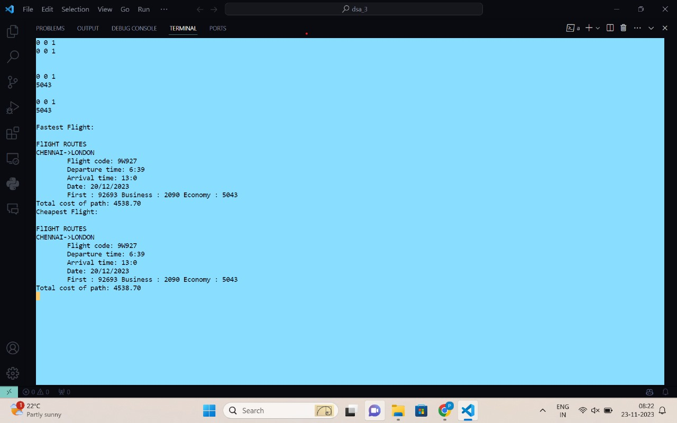
Sample Input and Output screenshots
Title of the Project
Prasad Ishwar_Priyanshu Chaudhary_Pranavasurya Prakash_Praneel Patel GM

Slide 11
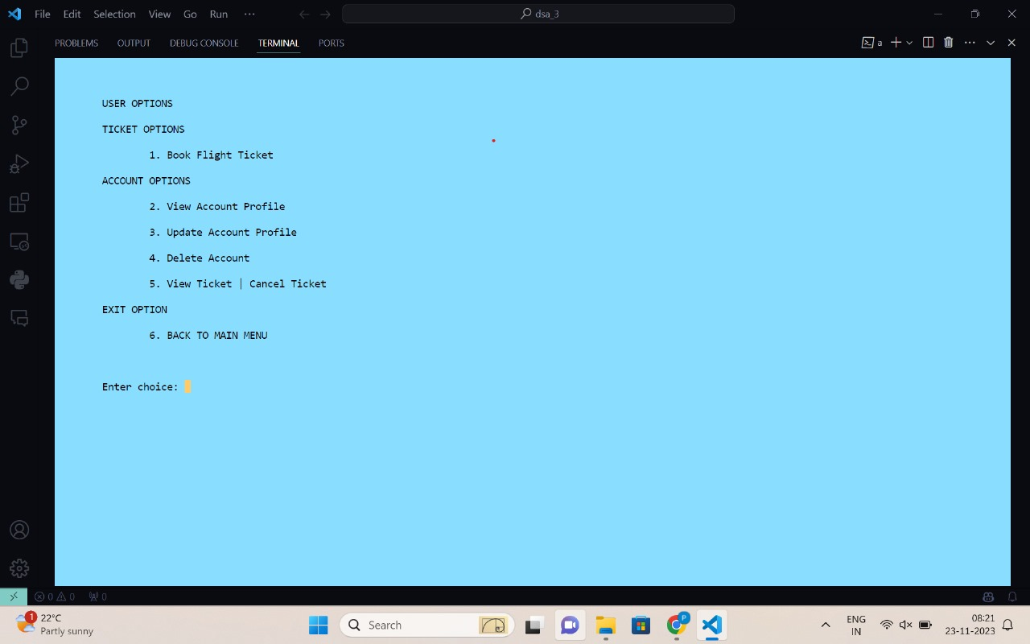
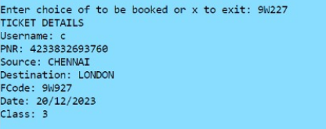
Sample Input and Output screenshots
Title of the Project
Prasad Ishwar_Priyanshu Chaudhary_Pranavasurya Prakash_Praneel Patel GM

Slide 12
Summary of work done in Mini Project
Title of the Project
Definitions for various data structures
Various ADT implementation such as GraphADT,Datetime ADT, Booking etc
Generating flight schedule from given flight details.
Implementation of various algorithms to produce route,fare and ticket.
Integration of all features into the main file
Prasad Ishwar_Priyanshu Chaudhary_Pranavasurya Prakash_Praneel Patel GM

Slide 13
Title of the Project
Thank You

