Slide 1
Analyses des données de système éducatif
ALI JAFFAR
10/09/2021

Slide 2
Strategy Analysis
Problem to solve is in expanding
DATA:
CountrySeries, Country ,Data FootNote
Series

Slide 3
STRATEGY IMPLEMENTATION
STEPS:
Step 1: prepare the environment:
Installation of Anaconda , Python, Numpy,Panda, Seaborn, and Matplot
Importation of data
Step 2: Pre-analyse of data
Quality of data
Cleaning data and Filling up NA
Analyse the content see what are the most relevant content
Find Patterns and find a strategy to tell a story
Step 3: Establishing calculations
Find countries with high potentials
Step 4: implementing Graphs
Step 5 : Analyse the results
Step 6: Conclusion on findings

Slide 4
01
SECTION
Cleaning data

Slide 5
Preparation enviroment
STEPS:
Installation I have done
Installation of anaconda
Install the editor jupyter
Installation of python
Package libraries are the following.
Nympa, library for the Python programming language, adding support for large, multi-dimensional arrays and matrices, along with a large collection of high-level mathematical functions to operate on these arrays.
Panda, data manipulation and analysis
Seaborn:data visualization library built on top of matplotlib
Matplot :plotting library for the Python programming language and its numerical mathematics extension NumPy
Importing the Data:

Slide 6
Data shapes and details
Show shapes and details of the data:
Country shape: (241, 32)
Country Code: 241
Special Notes: 131
Income Group: 5
array(['High income: nonOECD', 'Low income', 'Upper middle income', nan,
'Lower middle income', 'High income: OECD'], dtype=object)
CountrySeries = (613, 4)
Data = (886930, 70)
FootNote = (643638, 5)
Series = (3665, 21)

Slide 7
Cleaning and Selecting data
We discover that Series and Footnote, didn’t have any relevant data and I decided to remove it from the process and make a cleaner Presentation

Slide 8


Unique Variable in Country
Country code 241
Special Notes 131
Income groupe 5
seeing on dataframe index something called income group I felt this data could be usefull for my analysis on countries that could have enough income to purchase the services that openclassroom requires.

Slide 9
Selected the Unique Variable
Income groupe 5
'High income: nonOECD', 'Low income', 'Upper middle income', nan,
'Lower middle income', 'High income: OECD
saw the unique variables and discovered that the there's 5 useful variable and one to remove or just ignore it on the other process

Slide 10
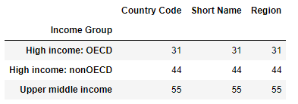
Selected the Unique Variable
Income groupe :
I did a presumption that will be confirmed at the end where Low income and low middle income will not be relevant for us. I have removed them and did try to have an idea what reagion those countries are located and if we desire to make a longer project

Slide 11
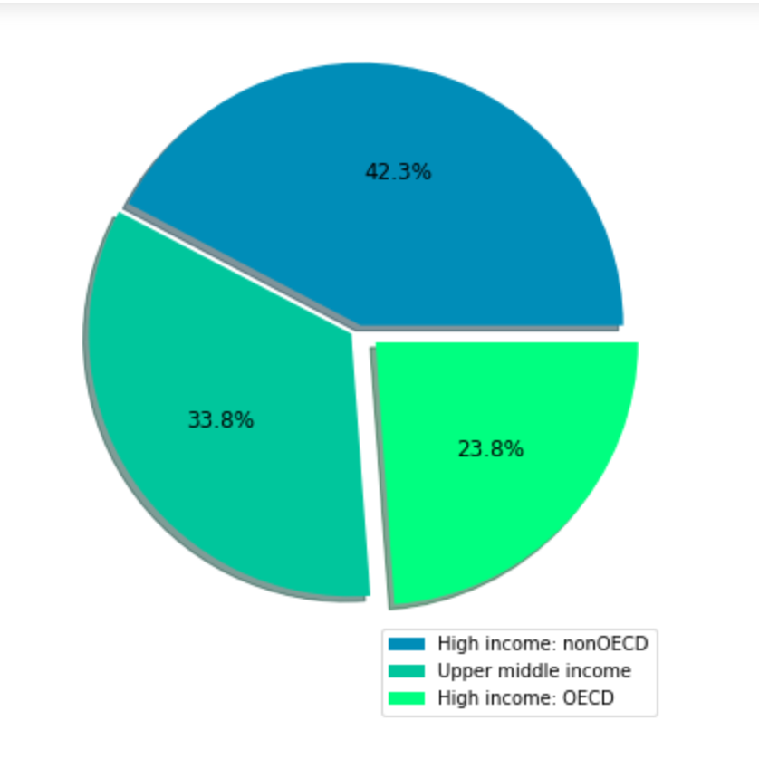
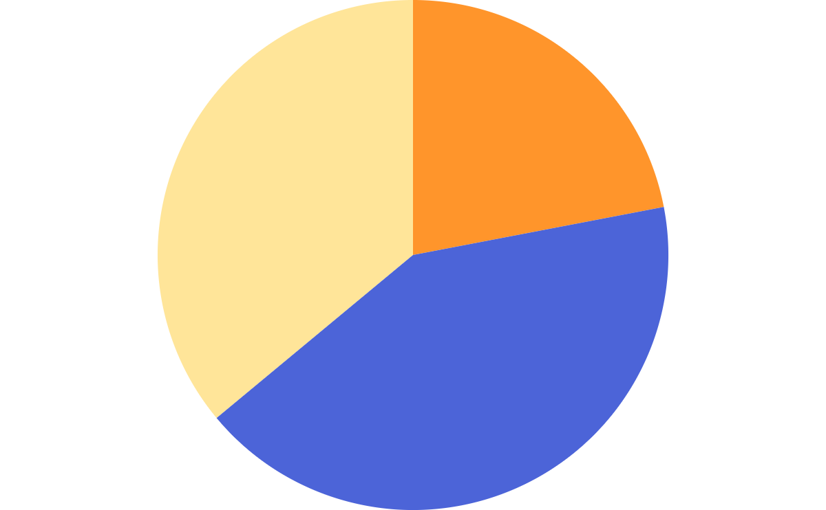
Region groups %
High Income Non OECD
42.3%
Neptune is the farthest planet from the Sun
23.8%
High Income OECD
Venus has a beautiful name, but it’s hot
33.8%
Upper Middle Income
Mercury is the closest planet to the Sun
To modify this graph, click on it, follow the link, change the data and paste the new graph here

Slide 12
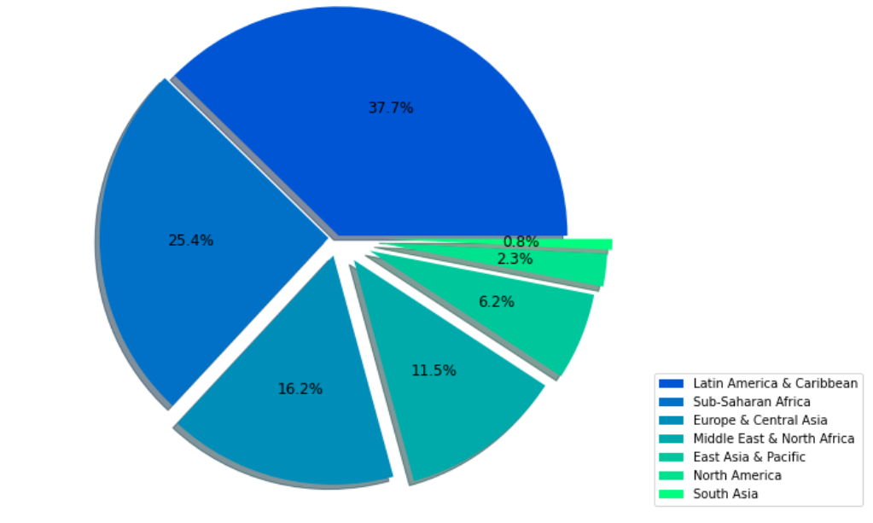
Regions of the Income Groups
NEPTUNE
45%
Neptune is the farthest planet from the Sun
15%
VENUS
Venus has a beautiful name, but it’s hot
40%
MERCURY
Mercury is the closest planet to the Sun
To modify this graph, click on it, follow the link, change the data and paste the new graph here

Slide 13
those do pie chart shows the location and see what is the best location to expand to neighboring countries for further projects

Slide 14
03
SECTION
Information from the data

Slide 15
Issues and Solution of the Data
To much NA
Find useful data
To Many Rows
Merge 2 datas

Slide 16
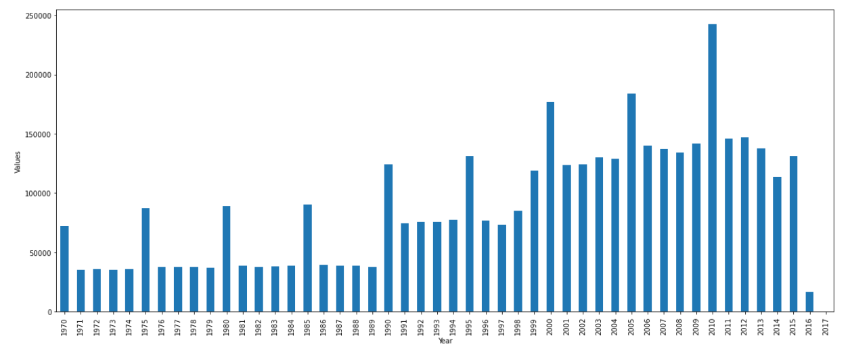
Data content
01
02
03
04
OVERVIEW
FEATURES OF THE TOPIC
You could describe the topic of the section here
You could describe the topic of the section here
ASSIGNMENT
ABOUT THE TOPIC
You could describe the topic of the section here
You could describe the topic of the section here

Slide 17
PROBLEM
SOLUTION
Not all the years will be usefull and 2016 is empty and may not be saved
We cut from 2000 to 2016. columbus . we used kept all row that has at least 75% of content so we can use the the mean option to feel up the 2016

Slide 18
04
SECTION
Merging datas, and use another variable to thin out the result

Slide 19
We are merging the clean version of Data and of country, and removing any Rows that has any NA’s.
Whit this new data, we are selection our second factor that will help us find our county and it’s internet usage. And the correlation it has with income income countries.
New jobs are digital skills an IOT ( internet of things)

Slide 20
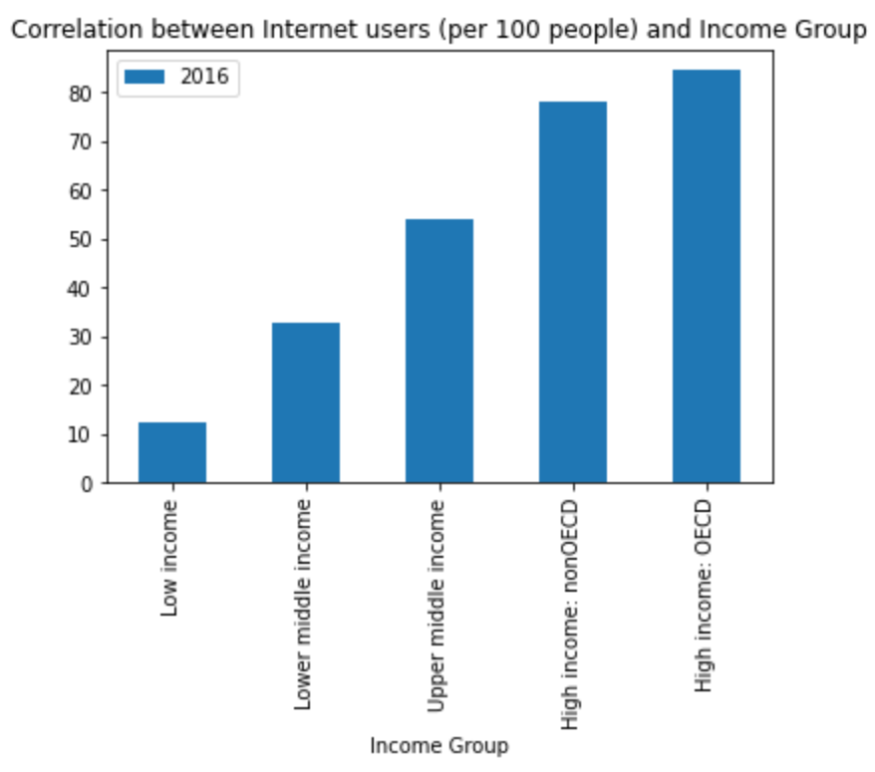
Correlation between internet and income
01
01
03
02
OVERVIEW
High Income = high usage
You could describe the topic of the section here
This shows that the higher the income the higher the usage of internet
ASSIGNMENT
Top 50% usage
You could describe the topic of the section here
Taking internet user that are less than 50% could be not wise

Slide 21
05
SECTION
Unemployment the third variable

Slide 22
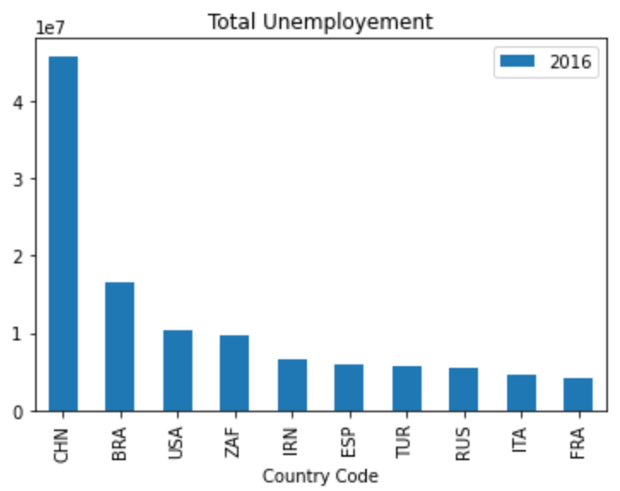
Total Unemployement
01
01
03
Unemployed
OVERVIEW
This show the those income region with high internet user still has a high unemployment that could show a higt possibility in clients but we do need to know if the country is actively hiring or if the country is in depression and it’s better to avoid
You could describe the topic of the section here
ASSIGNMENT
You could describe the topic of the section here

Slide 23
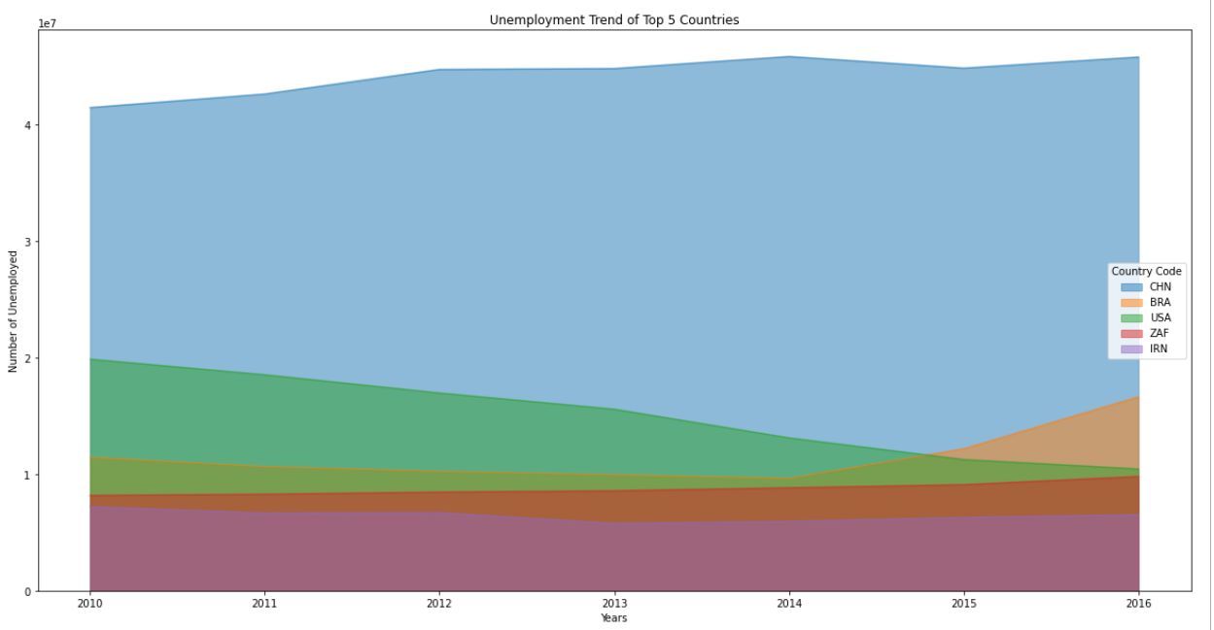
TOP 5 Unemployement Countries

Slide 24
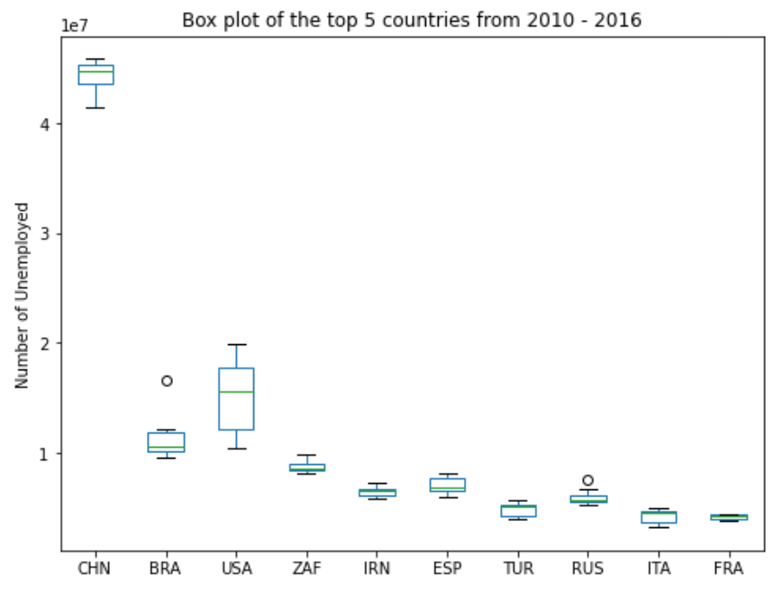
Box plote of the top 10 countries

Slide 25
06
SECTION
Leaner regression from the top 5

Slide 26
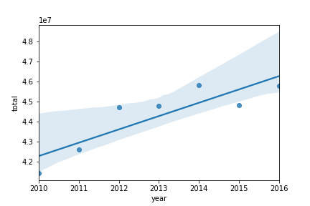
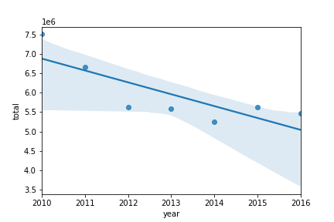
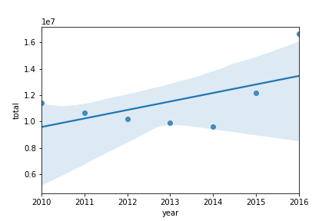
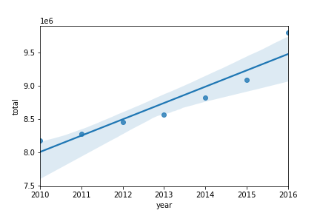
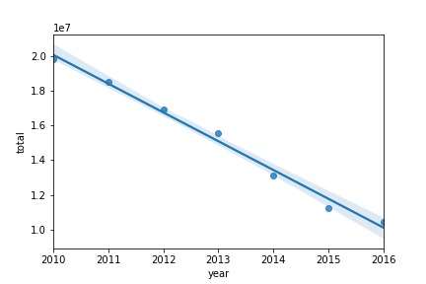
Top 5 country linear regression
CHN
RUS
RUS
BRA
ZAF
BRA
USA

Slide 27
07
SECTION
Conclusion

Slide 28
USA
10,000,000
80%
High income country
Perfect Negative correlation
Unemployed
Internet Usage
That shows that they have the income to finance there educatioan
That means every years that passes the unemployment will be going down

