Slide 1
Implement a scoring model
ALI JAFFAR
10/07/2022

Slide 2
problematic
Analyse the data
Cleaning
exploratory data analysis
Grouping CCB
Remove high correlation
Preparing data
Merging
Finding the perfect model
Do hyper parameter
LGBM Classifier
Standard testing
Sampling
Over sampling
Under sampling
Feature importance
API
Conception of website
Analyse the data
dashboard
website
Plan

Slide 3

Problematic
problematic
Context: “Prêt à dépenser” offers consumer credits for people with little or no loan history.
Mission
Build a scoring model that will give a prediction on the probability of bankruptcy of a customer automatically.
Build an interactive dashboard for relationship managers customer to interpret the predictions made by the model.
Transparency and interpretability are essential.
Notes:
Modifie le contex a partir de open class room

Slide 4

Analyse the data
01

Slide 5
Description
Data Presentation
Home Credit Group data available on Kaggle:
1. Main table → Table with a line by loan + info on the loan and the customer.
2. Historical tables → data on previous loans of customers and their reimbursement habits. Not used in this project for the sake of simplicity.
3. Description of features → used during the interpretation of predictions
Main table: 307,000 observations on 122 columns

Slide 6
Analyse the data
Cleaning
exploratory data analysis
Grouping CCB
Remove high correlation

Slide 7
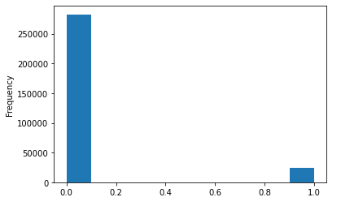
Cleaning
Analys Data
Exploratory data analysis
Created function
To all datas:
Remove columns then rows that have more than 25% NAN
Removing columns with over 95% correlation with others
Converting columns that have 2 options into binary
Seeing the frequency of accepted : 0 and default :0
We see that we have more accepted than default that could cause a on sided analysis
Training Features shape: (307511, 68)
Testing Features shape: (48744, 68)

Slide 8
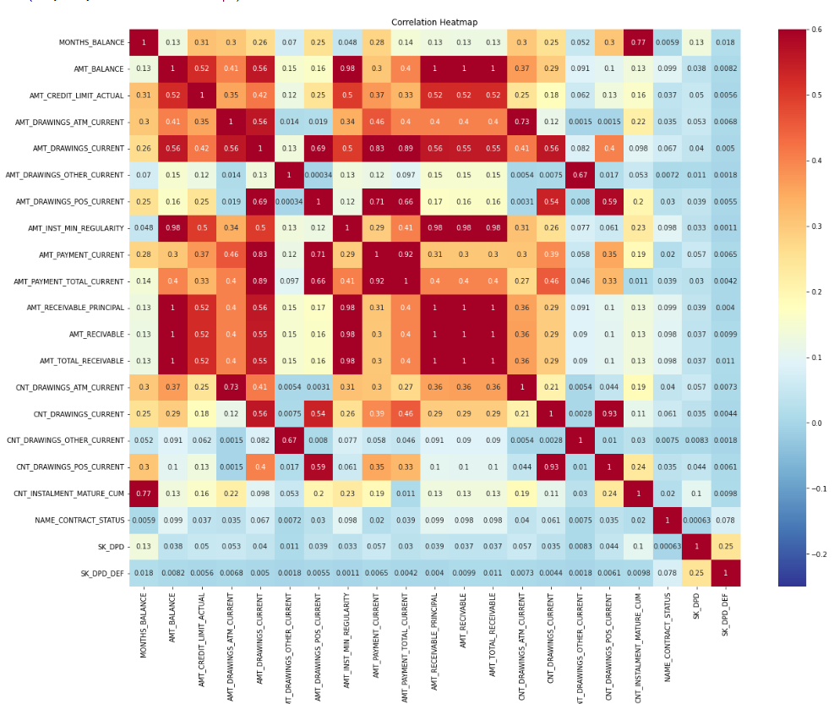
Cleaning CCB
Analys Data
Removing columns with over 95% correlation with others
Remove the SK_ID_CURR
Group by SK_ID_CURR
Fill NAN with Mean based on the SK_ID_CURR

Slide 9
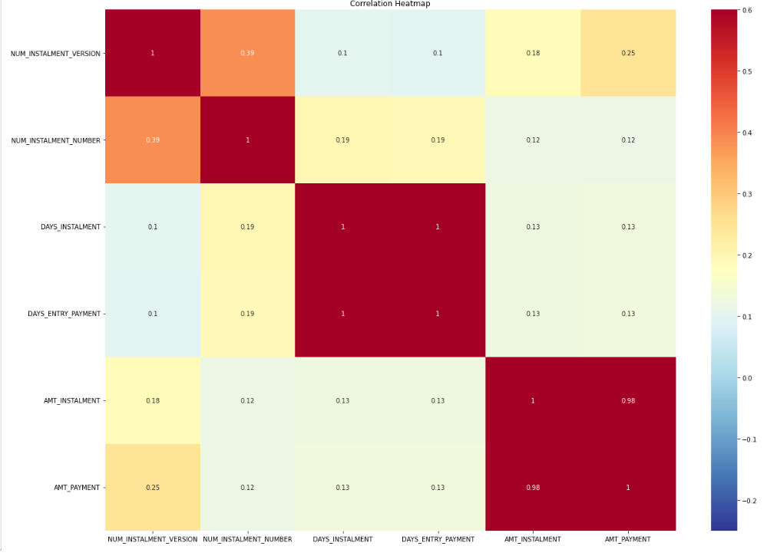
Cleaning IP
Analys Data
Removing columns with over 95% correlation with others

Slide 10
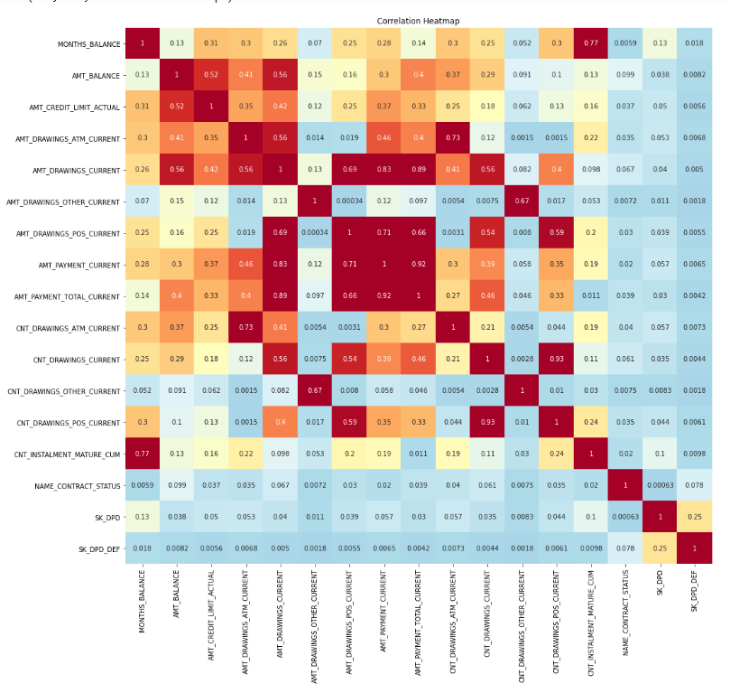
Cleaning Previous Application
Analys Data
Removing columns with over 95% correlation with others

Slide 11
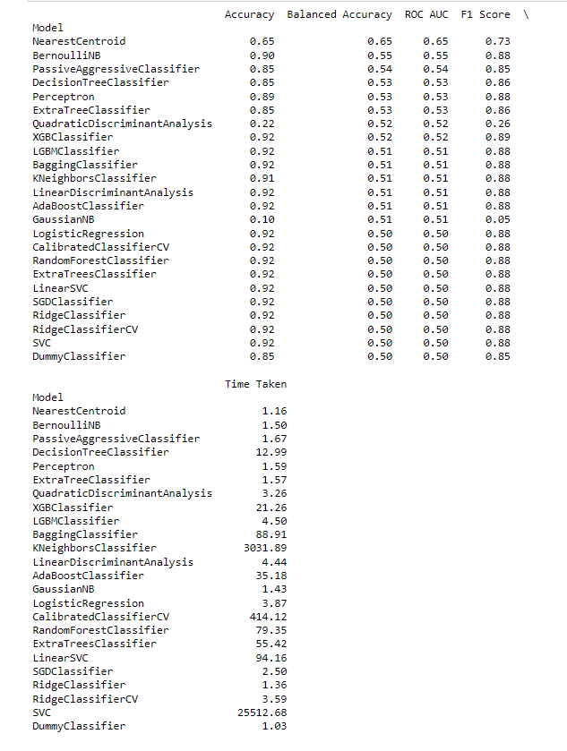
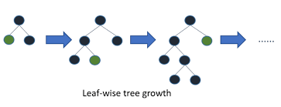
Lazy classifier
Analyze Data
With Lazy classifier we were able to find that
LGBMCLASSIFER is an good option with an accuracy of
92%
LGMCLASSIFER
Fast , distributed , High performance Gradient Boosting framework based on decision tree algorithm.
It splits the tree leef wise ( others do tree wise or level wise)
Ref: https://www.youtube.com/watch?v=n_ZMQj09S6w
https://www.youtube.com/watch?v=3CC4N4z3GJc

Slide 12
Testing Model Classification
01

Slide 13
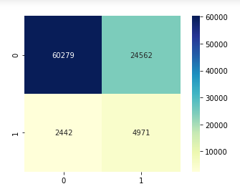
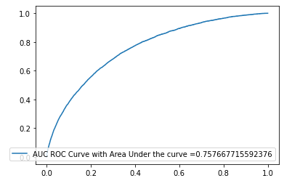
Standard sampling
Testing Model of Classification
We have selected LGBMClassifier and we decided to use balanced weight based on all the data,
It cleary shows that the accuracy isn’t as desirable we would like it to be.
Model accuracy score on test data: 0.7073
Model accuracy score on train data: 0.7184

Slide 14
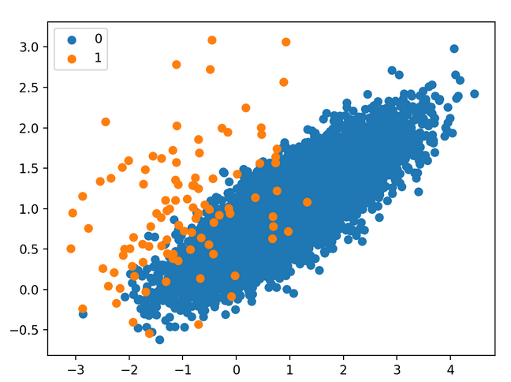
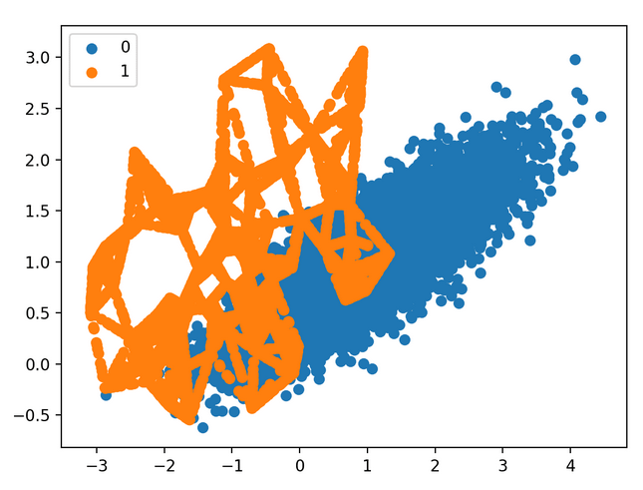
LGBMClassifier Over sampling
Testing Model of Classification
We decided then to try over sampling. It’s to create new data that follow the patch of the current data.
Example: of standard sampling VS Over sampling

Slide 15
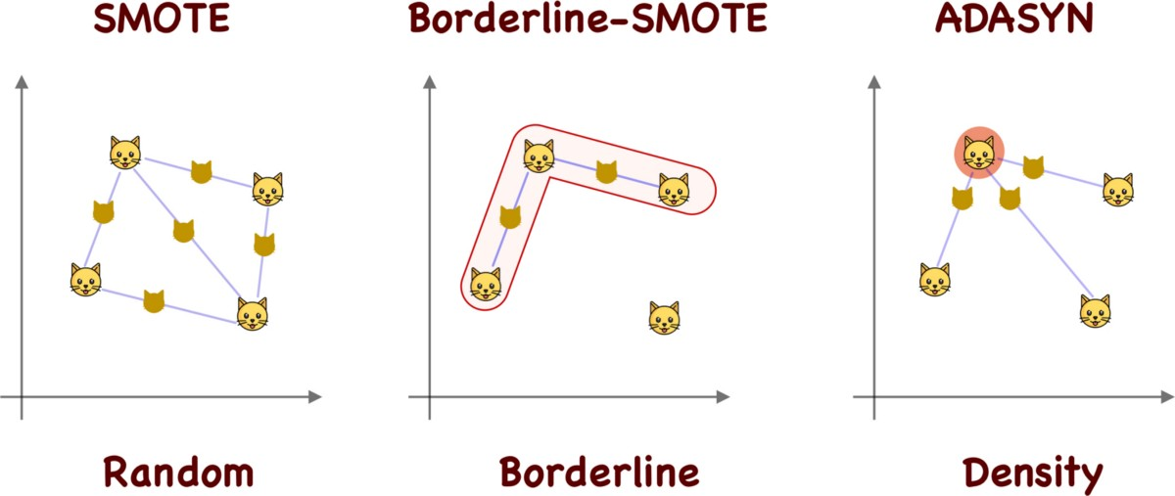
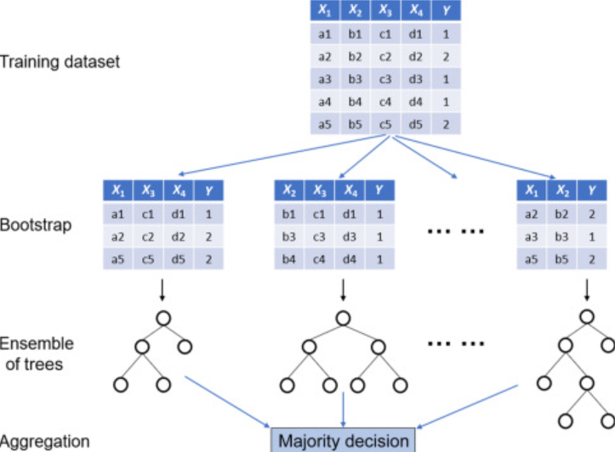
LGBMClassifier Over sampling
Testing Model of Classification
Random forest

Slide 16

LGBMClassifier Under sampling
Testing Model of Classification
Tomek links
Near Miss :https://www.youtube.com/watch?v=kZNkaNATmd8
NearMiss from the imblearn library uses the KNN (K Nearest Neighbors) to do under sampling.
There are three versions of NearMiss algorithms. Based on the documentation of the imblearn library, here are the differences of the three versions:
"NearMiss-1 selects the positive samples for which the average distance to the N closest samples of the negative class is the smallest."
"NearMiss-2 selects the positive samples for which the average distance to the N farthest samples of the negative class is the smallest."
"NearMiss-3 is a 2-steps algorithm. First, for each negative sample, their M nearest-neighbors will be kept. Then, the positive samples selected are the one for which the average distance to the N nearest-neighbors is the largest."
Random Undersampling it select randomly points across the data to reduce the size of the sampling

Slide 17

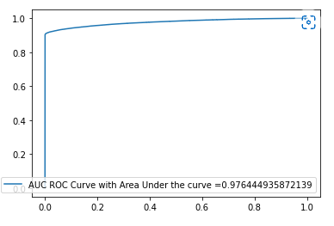
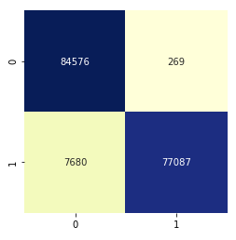
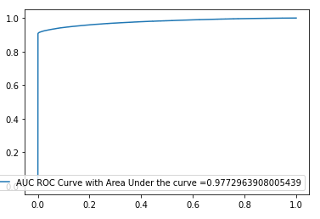
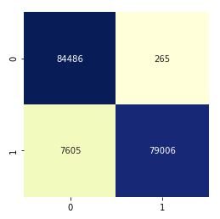
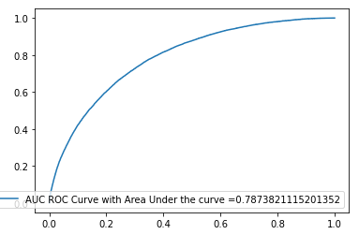
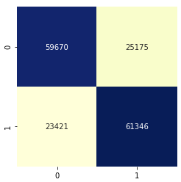
LGBMClassifier Over sampling
Testing Model of Classification
SMOTE
Model accuracy score on test data: 0.9528
Model accuracy score on train data: 0.9533
ADASYN
Model accuracy score on test data: 0.9536
Model accuracy score on train data: 0.9535
Random Forest
Model accuracy score on test data: 0.7125
Model accuracy score on train data: 0.7212
https://machinelearningmastery.com/smote-oversampling-for-imbalanced-classification/

Slide 18
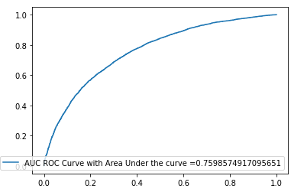
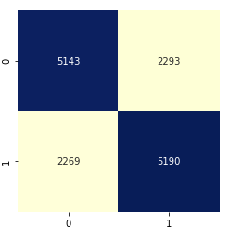
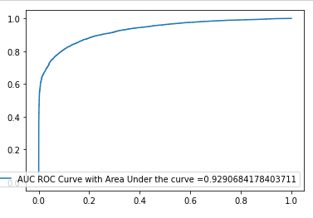
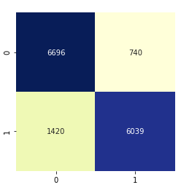
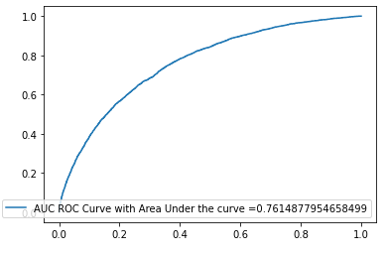
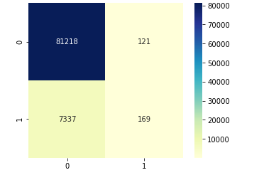
LGBMClassifier Under sampling
Testing Model of Classification
RandomUnderSampler Counter({0: 24825, 1: 24825})
Model accuracy score on test data: 0.6957
Model accuracy score on train data: 0.7496
Near Miss Counter({0: 24825, 1: 24825})
Model accuracy score on test data: 0.8563
Model accuracy score on train data: 0.8836
Tomeklinks Counter({1: 24825, 0: 271324})
Model accuracy score on test data: 0.9161
Model accuracy score on train data: 0.9181
https://github.com/ronanb95/AlgorithmBias/blob/main/AlgorithmicBiasCore.ipynb/AlgorithmicBiasCore.ipynb
https://www.youtube.com/watch?v=8_4Ls7k1wyw
https://www.youtube.com/watch?v=J4Wdy0Wc_xQ&t=270s

Slide 19
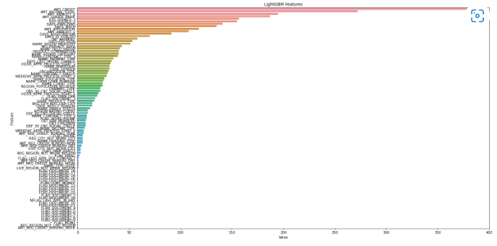
Modelisation
Feature Importance
We decided to take ADASYN because the accuracy in train is slightly higher than the SMOTE.
From this point we see the feature importance and selected all that are above 100 to show on the website to explain the main reason why if the client will be have a default of not

Slide 20
Website building
03

Slide 21
Website
Flask Part
Python Part
Heroku
Website: https://jamesholow.herokuapp.com/

Slide 22
Flask
Data Presentation
HTML: to create a structure of a web page
Python to communicate with the web server ( also known as back end)
CSS: to style the structure and to make it aesthetically ally prettier
JAVA SCRIPT: to interact with different elements on the page
Ref: https://www.youtube.com/watch?v=6plVs_ytIH8

Slide 23
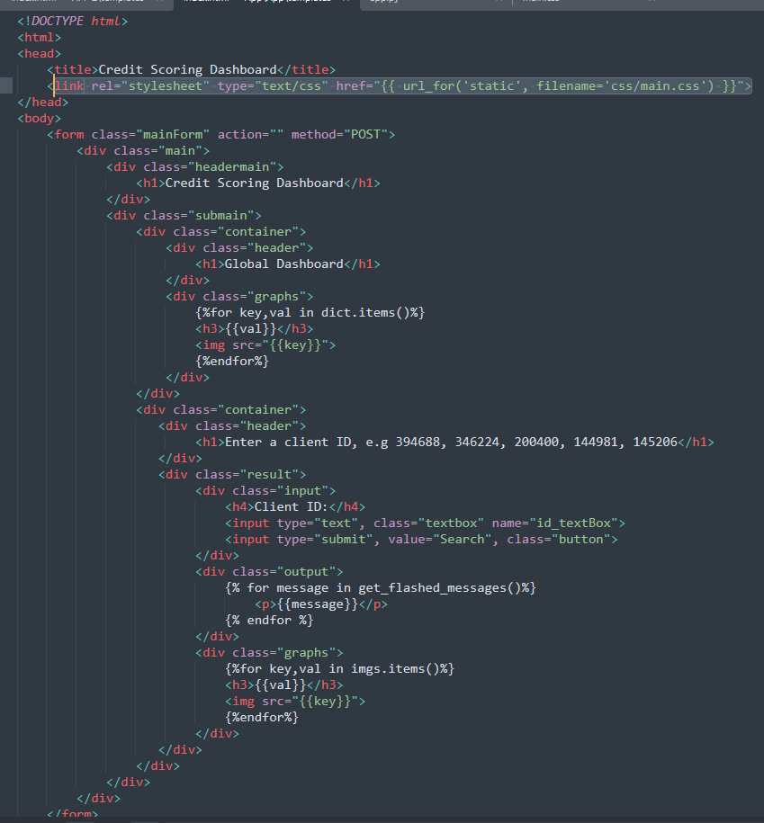
HTML
Text processing
LINK to the css

Slide 24
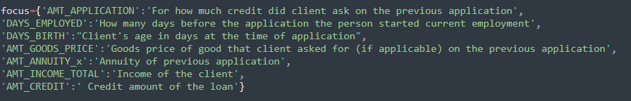
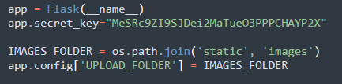
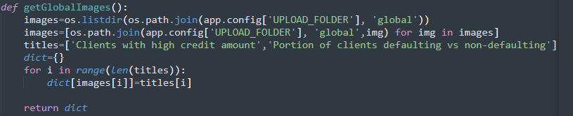
PYTHON processing
Text processing
To show the images that are already saved in the the in the static directory

Slide 25
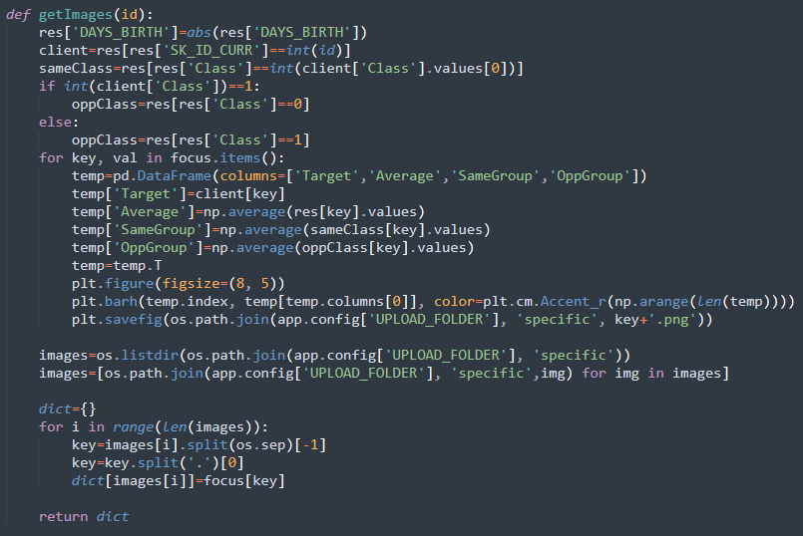
PYTHON processing
Text processing

Slide 26
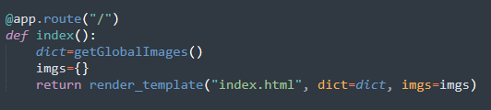
PYTHON processing
Text processing
@app.route("/") : when initial app is start this is the function that will be called first when we open the app

Slide 27
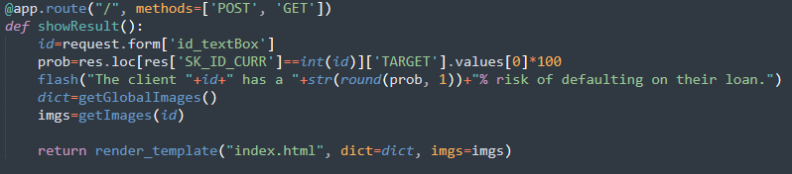

PYTHON processing
Text processing

Slide 28
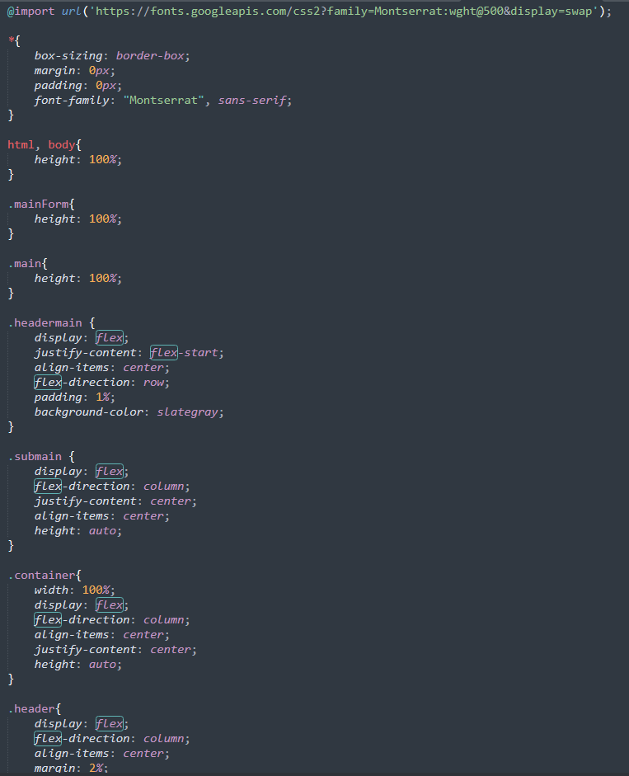
CSS
Text Data Processing

Slide 29
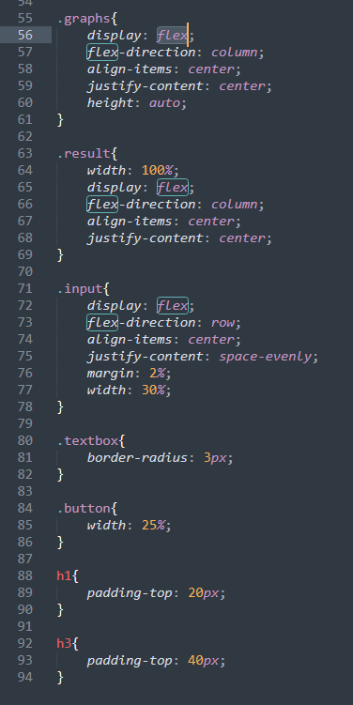
CSS
Text Data Processing

Slide 30
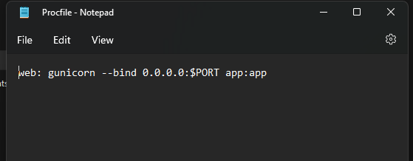
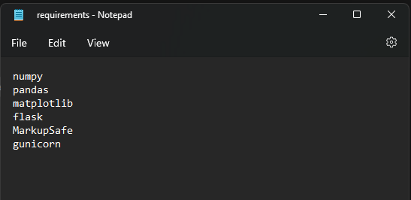
Application that will run automatically
Text Data Processing

Slide 31
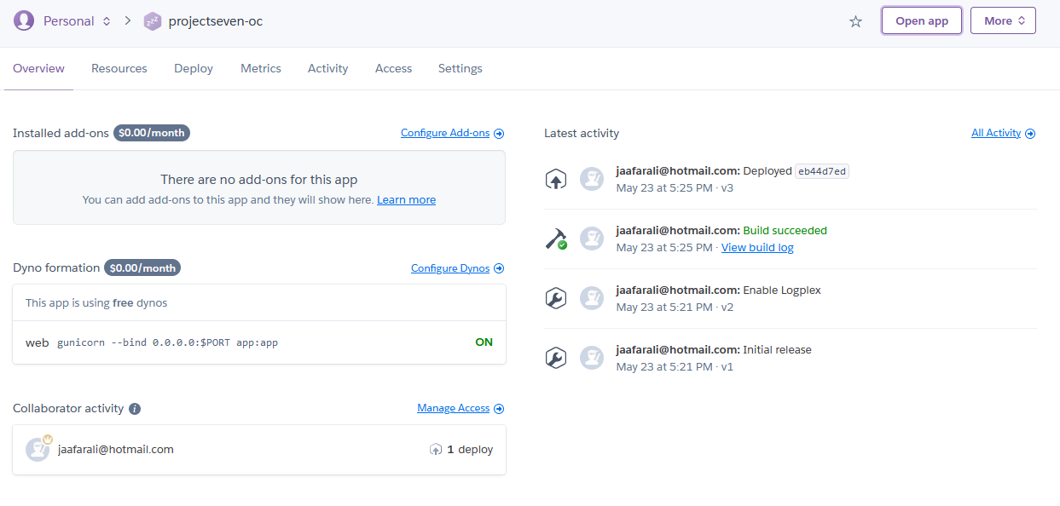
Heroku connection with the PC https://projectseven-oc.herokuapp.com
Text processing

Slide 32
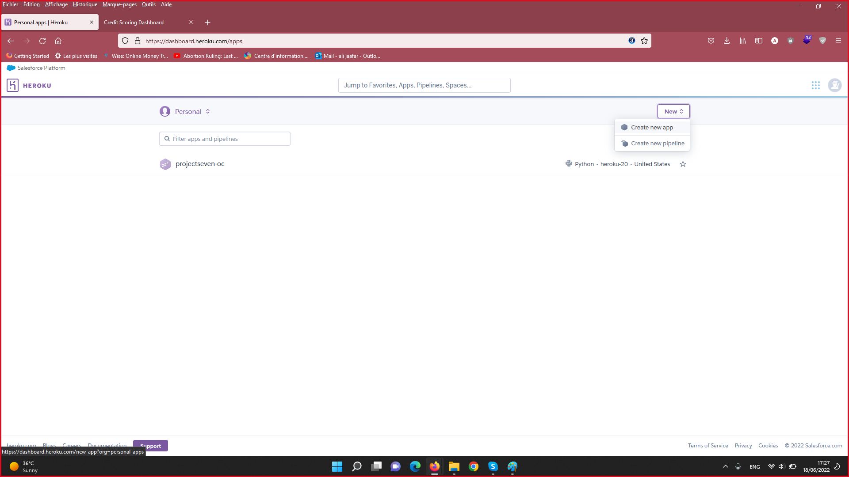
Heroku connection with the PC
https://projectseven-oc.herokuapp.com
Text processing

Slide 33
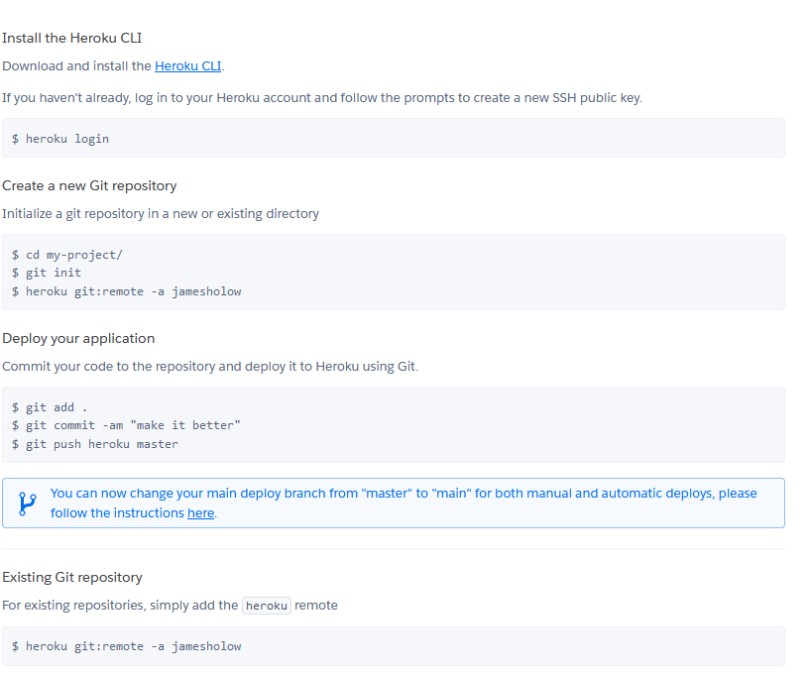
Heroku connection with the PC
Text Data Processing

Slide 34
Website display
03

Slide 35
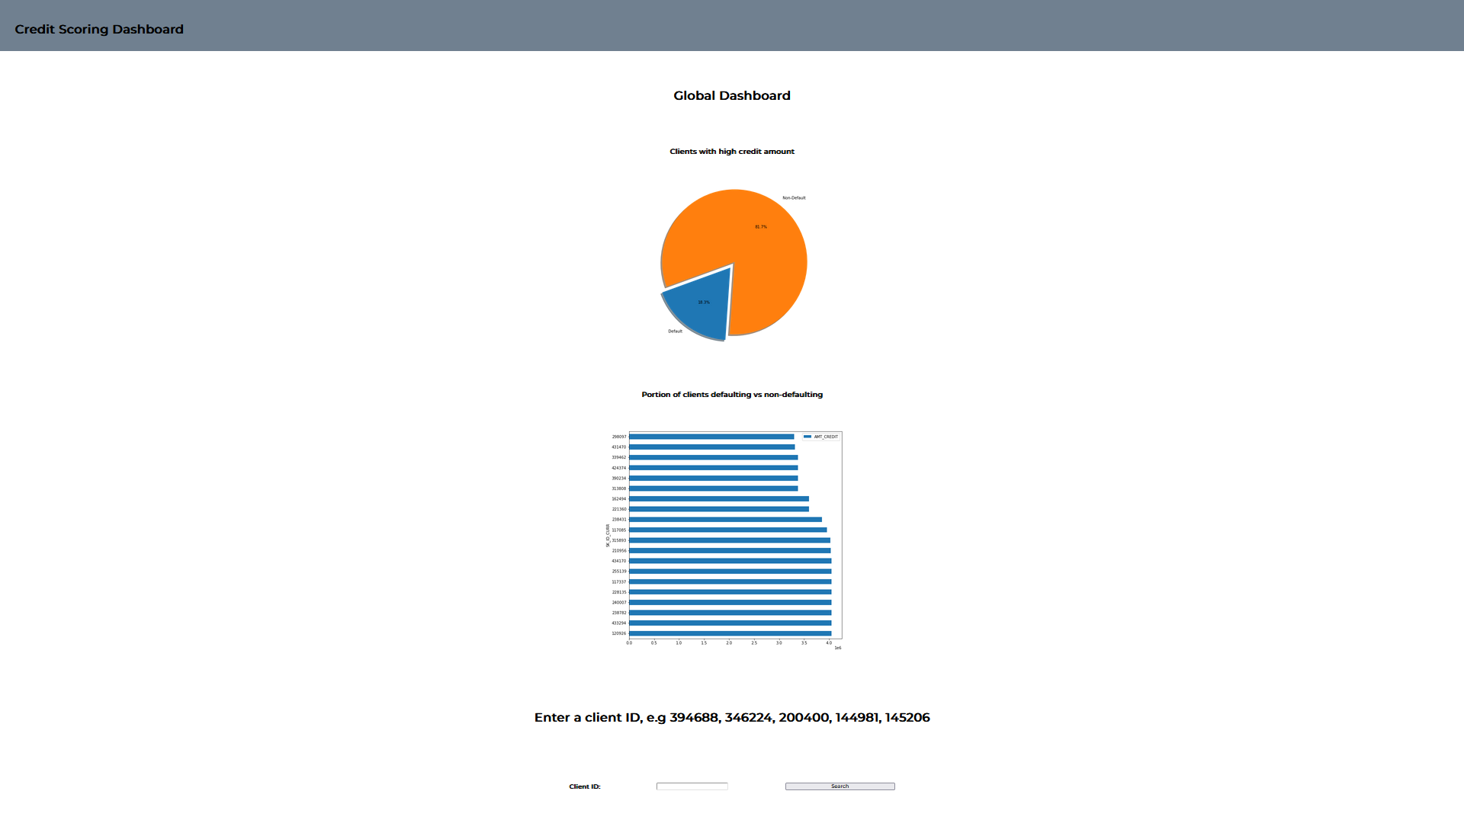
Heroku connection with the PC
Text Data Processing

Slide 36
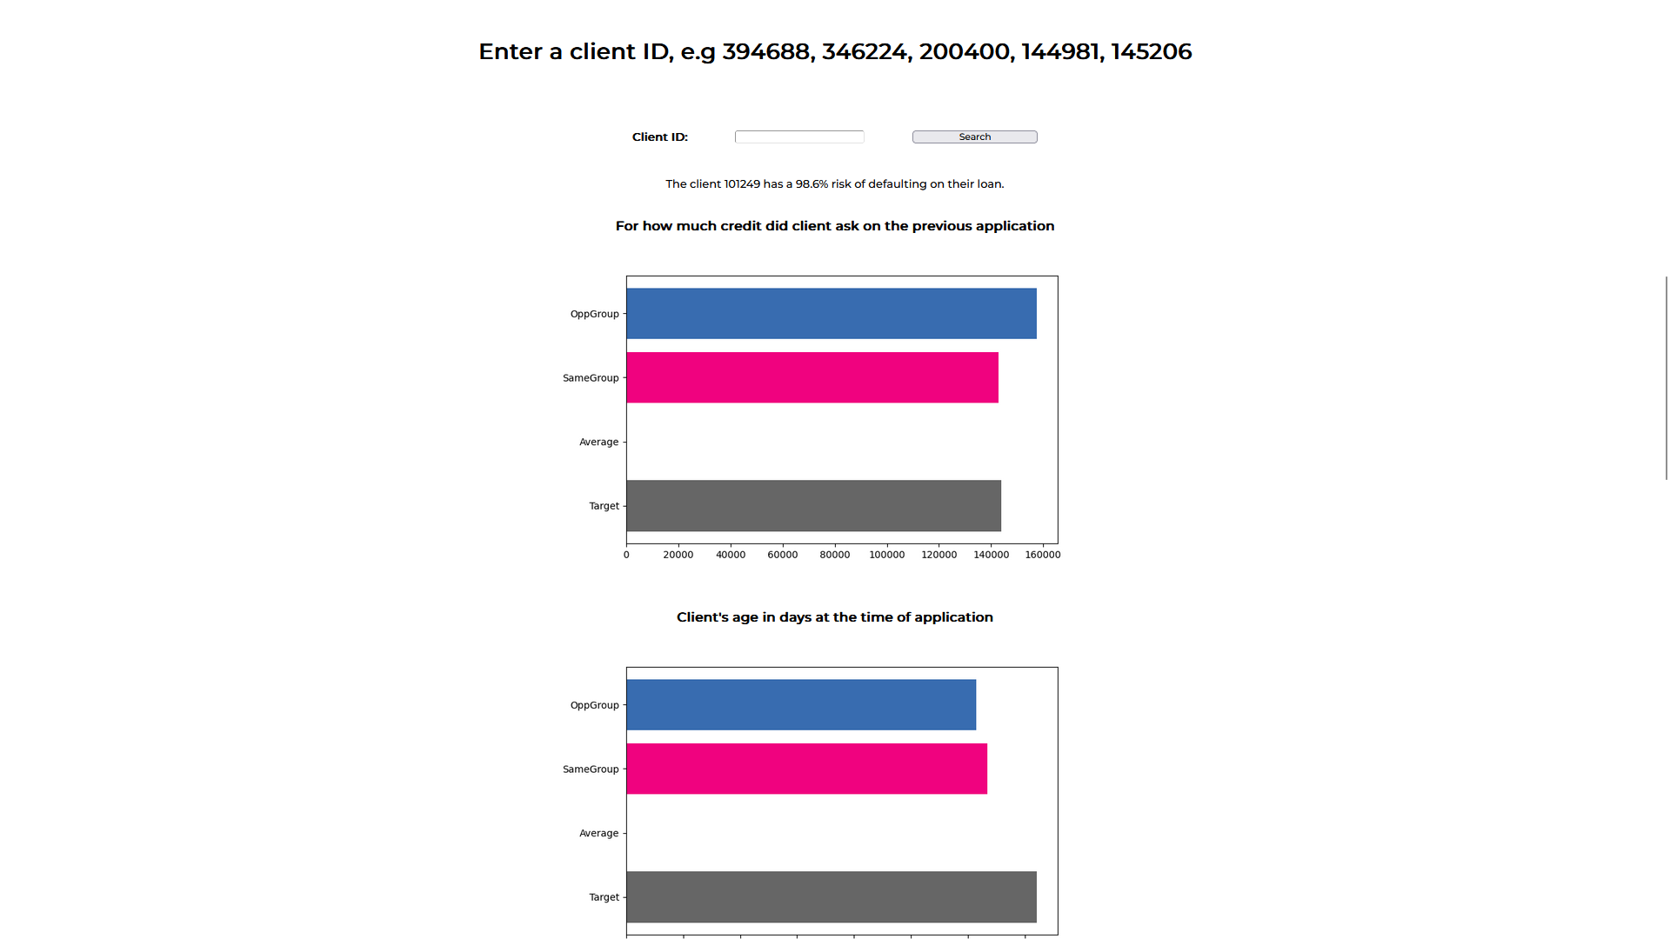
Heroku connection with the PC
Text Data Processing

Slide 37
END
Notes:
Hyper parameter of all model

