Slide 1



PROJECT – II ADVENTUROUS FROG
CME1251 Project Based Learnıng-I
BY
2017510054 KEREM KIRGÖZ
2018510016 SADULLAH CİHAN
2019510062 BATUHAN METİN

Slide 2

OUTLINE
INTRODUCTION
PROGRESS SUMMARY
Requirements
Task Sharing, Scheduling
Completed Tasks
Incomplete Tasks: Reasons, Explanations
Additional Improvements
Problems Encountered
Algorithms and Solution Strategies
Screeshots
Conclusion, References

Slide 3
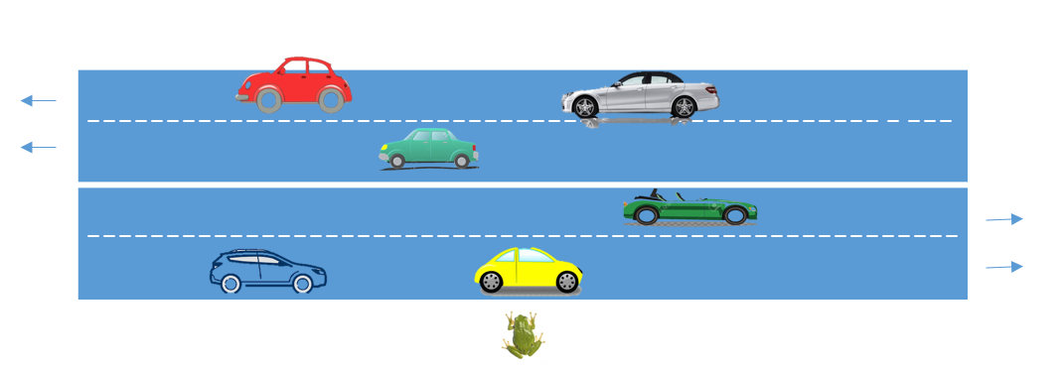
INTRODUCTION
Single-player game.
The frog wants to cross over the road.
4 distinct roads (50 units)
24 cars
6 levels
Score depends on time

Slide 4



PROGRESS SUMMARY
REQUIREMENTS
C# knowledge
Visual Studio
Teamwork
Trello
Canva

Slide 5

PROGRESS SUMMARY
Task Sharing
Sadullah Cihan :
Frog motion
Coding
Testing
Poster
PowerPoint
Reports
Kerem Kırgöz :
Randomly placing cars
Coding
Arranging car speeds
Adding comment lines
PowerPoint
Testing
Batuhan Metin :
Frog life/Game over
Coding
Arranging cars motion
Testing
Analyzing
Debugging

Slide 6

PROGRESS SUMMARY
Scheduling
First Week
Meeting with project partners.
Analyzing the game and discussing solution alternatives.
Starting to code with creating necessary variables/structures.
Second Week
Designing the road.
Moving the frog.

Slide 7

PROGRESS SUMMARY
Scheduling
Third Week
Creating the cars.
Placing the cars to road randomly.
Fourth Week
Moving the cars according to rules.
Levels.
Writing the final report.
Designing a poster.
Preparing for the presentation.

Slide 8

PROGRESS SUMMARY
Completed Tasks
Creating necessary variables.
Designing the road.
Moving the frog on array.
Creating the cars randomly.
Levels
Error checks

Slide 9

PROGRESS SUMMARY
Incomplete Tasks
There are no incomplete tasks.
We have finished the project completely.

Slide 10

PROGRESS SUMMARY
Additional Improvements
Background color
We have accomplished our mission

Slide 11

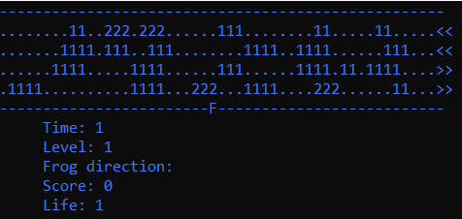
PROGRESS SUMMARY
Background color

Slide 12

PROBLEMS ENCOUNTERED
Insufficient knowledge ‘Arrays’
Tough project
Designing algorithm
Midterm week
‘Console.SetCursorPositions’ or Array?

Slide 13

ALGORITHM AND SOLUTION STRATEGIES
Efficient
Maintainable
Different

Slide 14

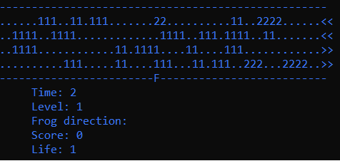
SCREENSHOTS
Main game screen

Slide 15
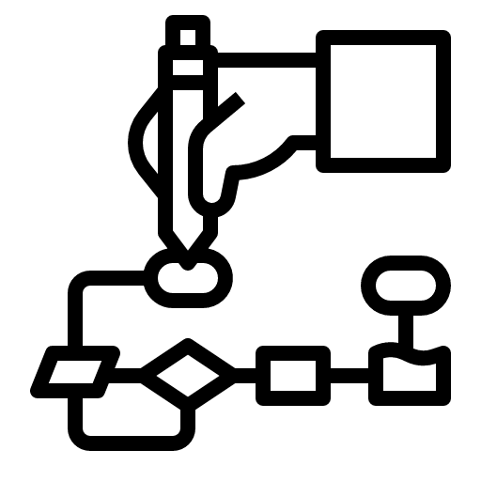
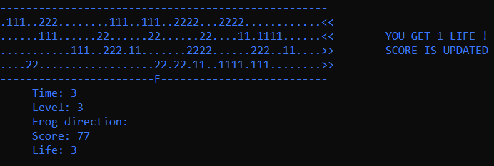
SCREENSHOTS
Meaningful user interface messages

Slide 16

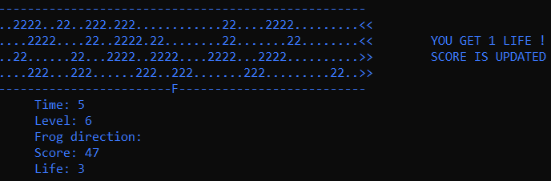
SCREENSHOTS
The hardest level…

Slide 17
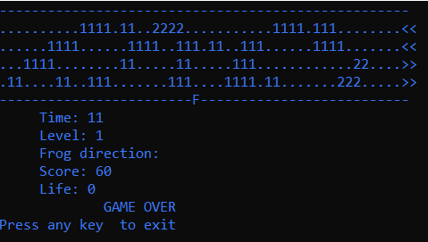
SCREENSHOTS
Game is over message

Slide 18



CONCLUSION
We have learned:
Usage of “One-Dimensional Arrays”
Team work
New functions such as,
The project has been successfully finished on time

Slide 19

REFERENCES
https://docs.microsoft.com/tr-tr/dotnet/csharp/programming-guide/arrays/single-dimensional-arrays
https://www.kodevreni.com
https://www.canva.com

Slide 20
THE END

