Slide 1



PROJECT – II POST-FIXER
CME1252 Project Based Learnıng-II
BY
2018510016 SADULLAH CİHAN
2019510018 SİMAY AYBERİK
2019510056 SAMET KERVAN
April, 2020
İZMİR
Notes:
Hello everyone. I’m Sadullah.
(herkes adını söyler)
We’re gonna present our project
that name is POST-FIXER

Slide 2
OUTLINE
Code
Sleep
Eat
INTRODUCTION
PROGRESS SUMMARY
Requirements
Task Sharing, Scheduling
Completed Tasks
Incomplete Tasks: Reasons, Explanations
Additional Improvements
Problems Encountered
Algorithms and Solution Strategies
Screenshots
Conclusion, References
Notes:
This is our OUTLINE.
We’re gonna follow these titles.

Slide 3
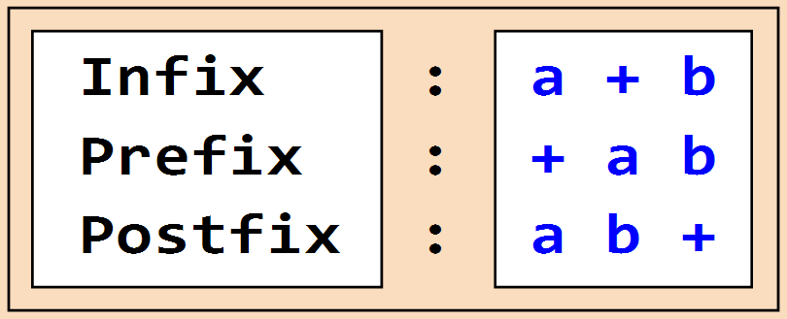
INTRODUCTION
Post-Fixer is a one-player game
Player generates a proper post-fix expression by using symbols from a dynamic board with considering post-fix rules.
Notes:
Post-Fixer is a one-player game that a player generates a proper post-fix expression by using symbols from a dynamic board and collects points bound to the expression’s symbol sequence with considering post-fix rules.

Slide 4
Introductıon
Showing expression.
The program gives penalty points according to given post-fix expression.
The aim of the game is getting the highest points as possible.
Notes:
The program checks the expression we created step by step and does calculations with opeations numerically.
If the post-fix expression is not proper the program gives penalty points to the player’s total score by controlling it.

Slide 5



PROGRESS SUMMARY
REQUIREMENTS
Java knowledge
Eclipse IDE
Enigma Library
Trello
Canva
Notes:
Requirements is Java knowledge absolutely.
Enigma library …
Also trello for communication.
Canva to make a poster.

Slide 6
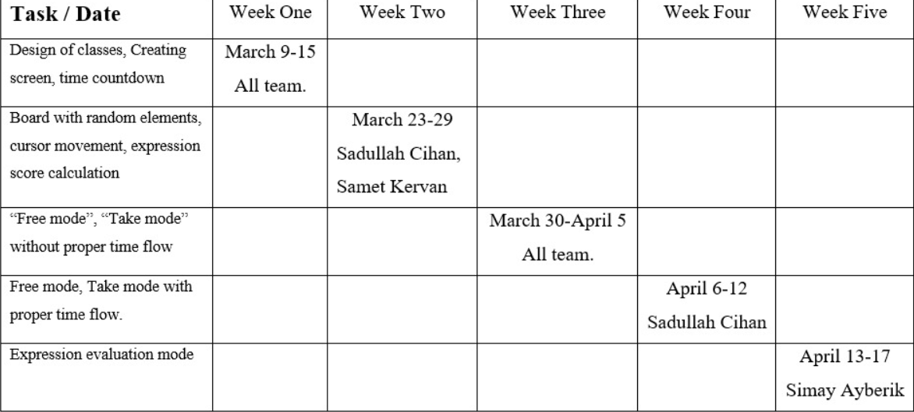
PROGRESS sUMMARY
TASK SHARING AND SCHEDULING
Notes:
The first column represents the whole task that will be accomplished. The first row represents the project’s weeks. The diagonal informs dates, shows who worked on the planned work until the end of the project. Cause of postponing the second week of the project will be explained in problems encountered.

Slide 7

PROGRESS SUMMARY
Completed Tasks
Console screen and cursor movements with using Enigma Library
Board with random elements and updating the board filling with new elements
Free mode
Take mode with time flow
Expression score calculation of the post-fix expression
Evaluation mode with checking the sequence of expression and giving penalty points if the expression is not proper
Transmissions between modes with using controllers
Notes:
We have done everything that wanted from us.

Slide 8

PROGRESS SUMMARY
Incomplete Tasks
There is no incomplete task.
Notes:
There is no incomplete task.

Slide 9


PROGRESS SUMMARY
Additional Improvements
Proper expression control
Additional keyboard button for cursor movement
Notes:
Additionally, we have implemented proper expression control at the beggining of the evaluation mode. Simay is gonna talk about it in algorithm part. Also, we have implemented extra keybord button for cursor movement. For instance, you can go right with pressing D or right arrow.

Slide 10


PROBLEMS ENCOUNTERED
COVID-19
Creating unnecessary classes
Selection of wrong data structure type.
Printing the stack calculation step by step
Notes:
Due to COVID-19, we weren’t able to get this Project done face to face and sometimes we couldn’t ask problems we encountered during the Project process to the lecturers in an easy way but to accomplish the project given to us, we put an extra effort and learned to cope with the difficulties. Creating unnecessary classes caused disorder look of code. We started using stack in some parts at first but it was not effectively using them in some algorithms in a simple way. That’s why we prefer using a circular queue. In some parts, the code has been gone through to deadlock with infinite loops.

Slide 11

AlGORITHM AND SOLUTION STRATEGIES

Slide 12
AlgorIthm And Solutıon Strategıes
FUNCTIONS WE HAVE USED
fillScreen()
fillInput()
printScreen()
freeMode()
takeMode()
ExpressionScoreCalculation()
evaluationMode()
Notes:
We have used these functions. However, we’ll look at fillScreen(),fillInput(),takeMode(), and evaluationMode().

Slide 13
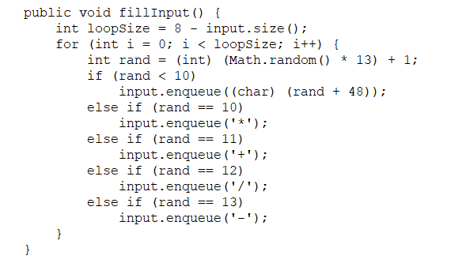
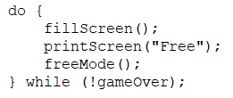

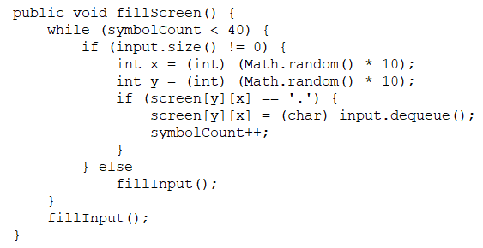
Functıons for screen
AlgorIthm And Solutıon Strategıes
Notes:
In constructure we have a do-while loop that contains fillScreen, printScreen and freeMode method as you see.

Slide 14
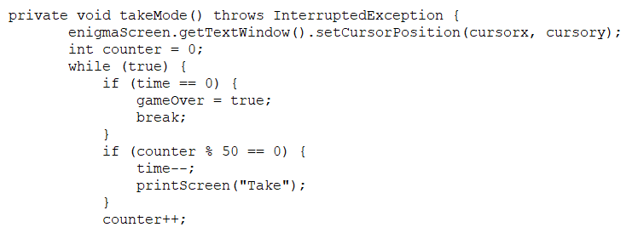
AlgorIthm And Solutıon Strategıes
TAKE MODE
The code part where we needed time flow.
Thread.sleep(20);
Notes:
At the beginning of takeMode(), here, if counter equals fifty’s multiple like fifty, one hundred; time is decreased and the screen is printed. The number is fifty. Because we have used twenty milliseconds in threadSleep() function. Hence, for an independent time, fifty times twenty equals one thousand milliseconds. It equals one real second approximately.

Slide 15
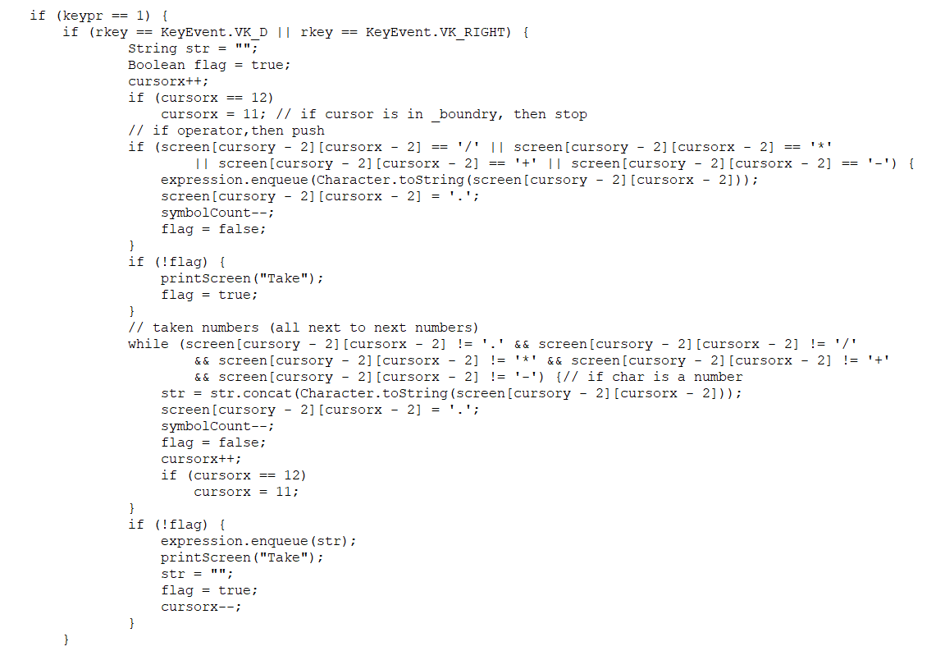
TAKE MODE
AlgorIthm And Solutıon Strategıes
One part as we consider only one spesific direction in take mode.
Notes:
Here, I’ll explain a little bit. If the user presses D or right arrow button, cursorx is increased. Then the program checks the boundary on the screen in case the cursor is out of screen boundary. Here if the element is an operator, it is inserted to expression queue. On the other hand, if the element is number, it is inserted totally until the number’s end. If the while loop works, then the taken express is inserted to expression queue.

Slide 16
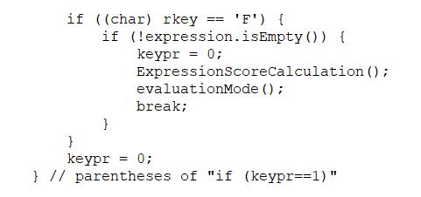
Take mode
AlgorIthm And Solutıon Strategıes
The part that we transmit to free mode and start score calculations.
Notes:
Lastly, if the user presses F key, expression score is calculated and evaluation mode is run.

Slide 17
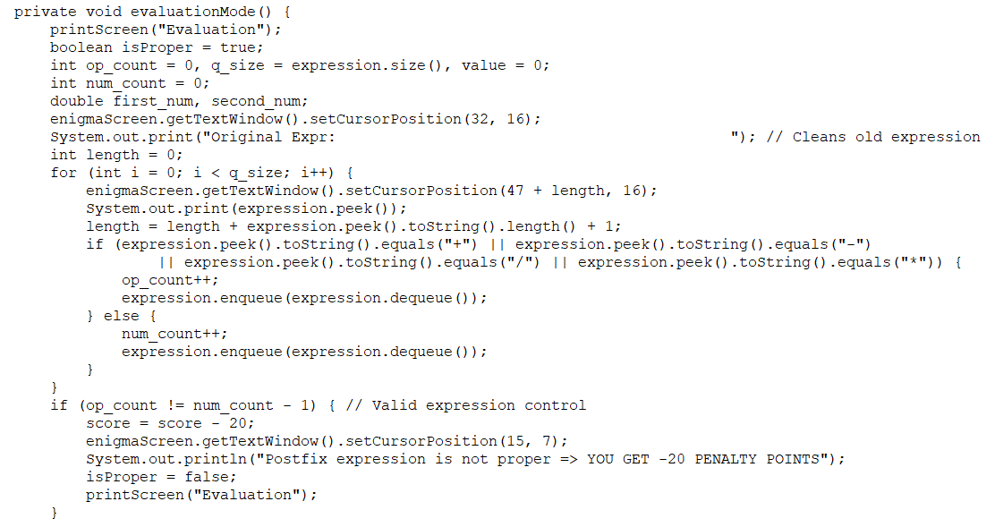
EVALUATıON MODE
AlgorIthm And Solutıon Strategıes

Slide 18
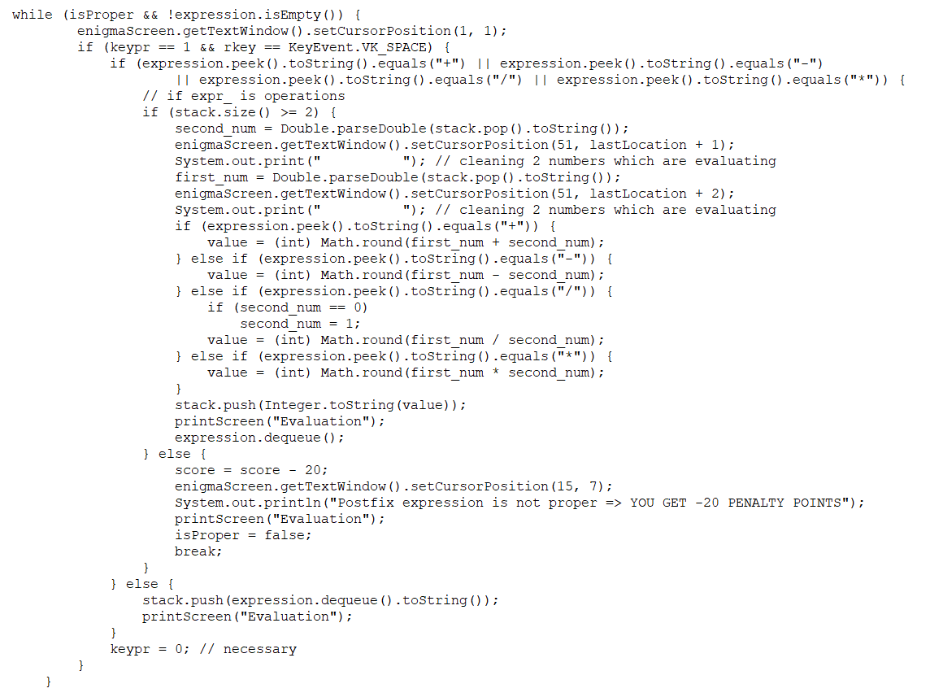
EVALUATıON MODE
AlgorIthm And Solutıon Strategıes

Slide 19
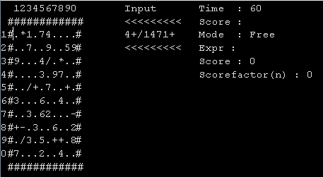
Screenshots Console screens
Notes:
Here it’s an example of the game. The game is started from FREE mode.

Slide 20
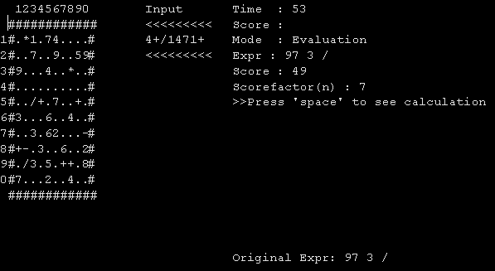
Screenshots
Notes:
Here expression is taken.

Slide 21
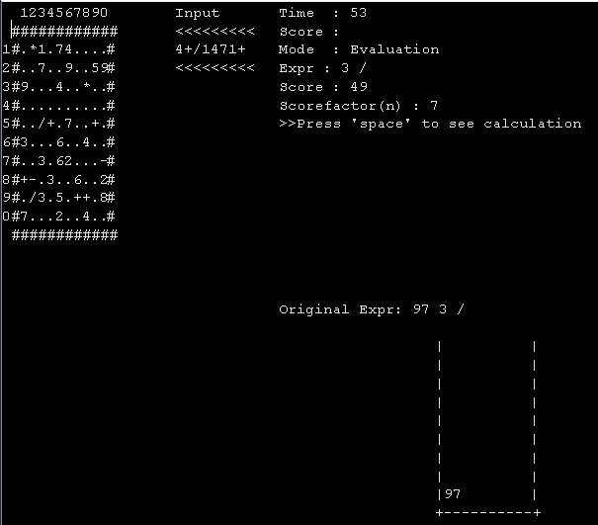
Screenshots
Notes:
Ninty seven is added to sample stack box.

Slide 22
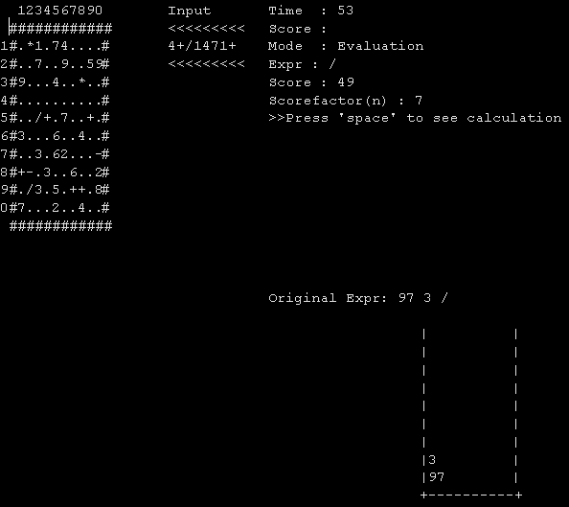
Screenshots
Notes:
Three is added to sample stack box.

Slide 23
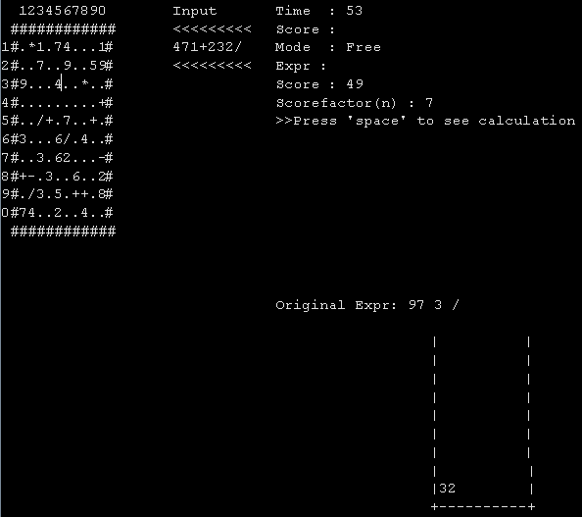
Screenshots
Notes:
Then Ninty seven is divided three.It rounds the result to the nearest integer.

Slide 24
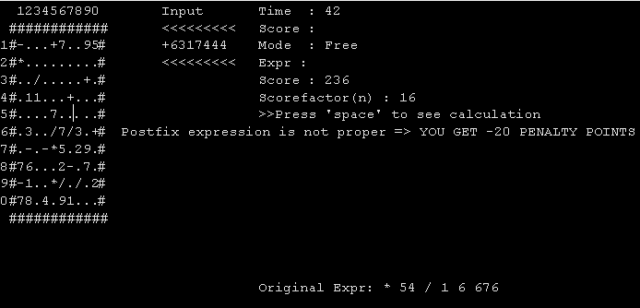
Screenshots
Notes:
What if the taken expression is not proper? In this case, the program will not print the stack step by step unnecessarily.

Slide 25



CONCLUSION
We have learned:
Effective usage of stack and circular queue
Usage of enigma
Working under tough condition
Notes:
So, WHAT WE HAVE LEARNED?? … We have learned: Effective usage of the stack, circular queue and usage of the enigma. Also, we have learned to work online. It was like hard at the beginning. But, we got used to it. I can honourably say that The project has been accomplished on time exactly and successfully.

Slide 26

REFERENCES
Stack, Dave L., Retrieved 9 March 2020 from https://stackoverflow.com/questions/38678268/stack-implementation-in-java
Circular Queue, Danislav Lyubenov, Retrieved 20 March 2020 from https://stackoverflow.com/questions/43156773/circular-queue-array
https://www.canva.com [Poster]
Notes:
Here, our references.
We make some reaserch from Stackoverflow to implament stack and circular queue.
Besides, we’ve used canva to make a poster.

Slide 27
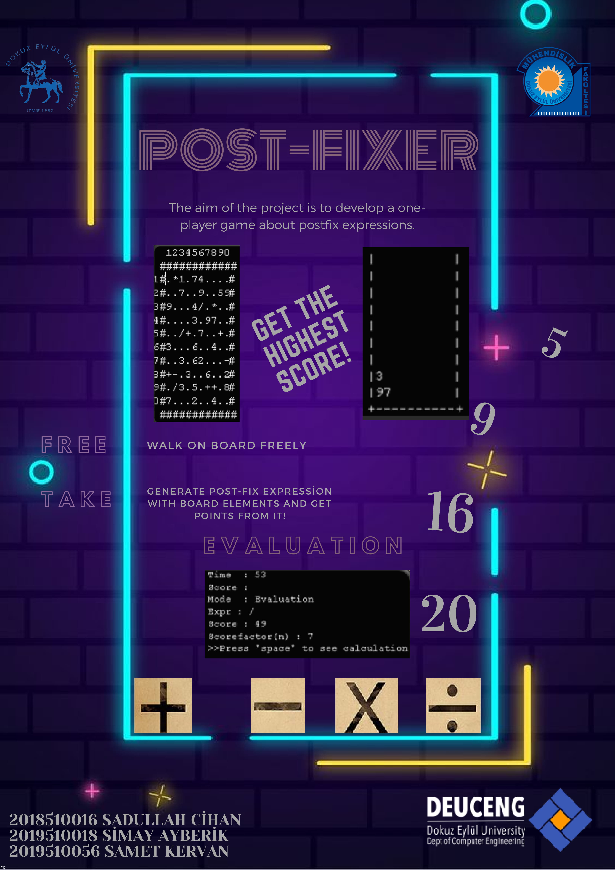
Poster
Notes:
This is our poster

Slide 28

Any questıons?

