Slide 1
Telegram bot for fitness in home.
Student: Madikhan Sadykov
Tutor: Aidana Kalahova
Individual project.
SE2002

Slide 2
Hello!
I am Madikhan
I'm here because I'd like to show you my project on educational practice.
You can find me at sssadyk.offf@gmail.com

Slide 3
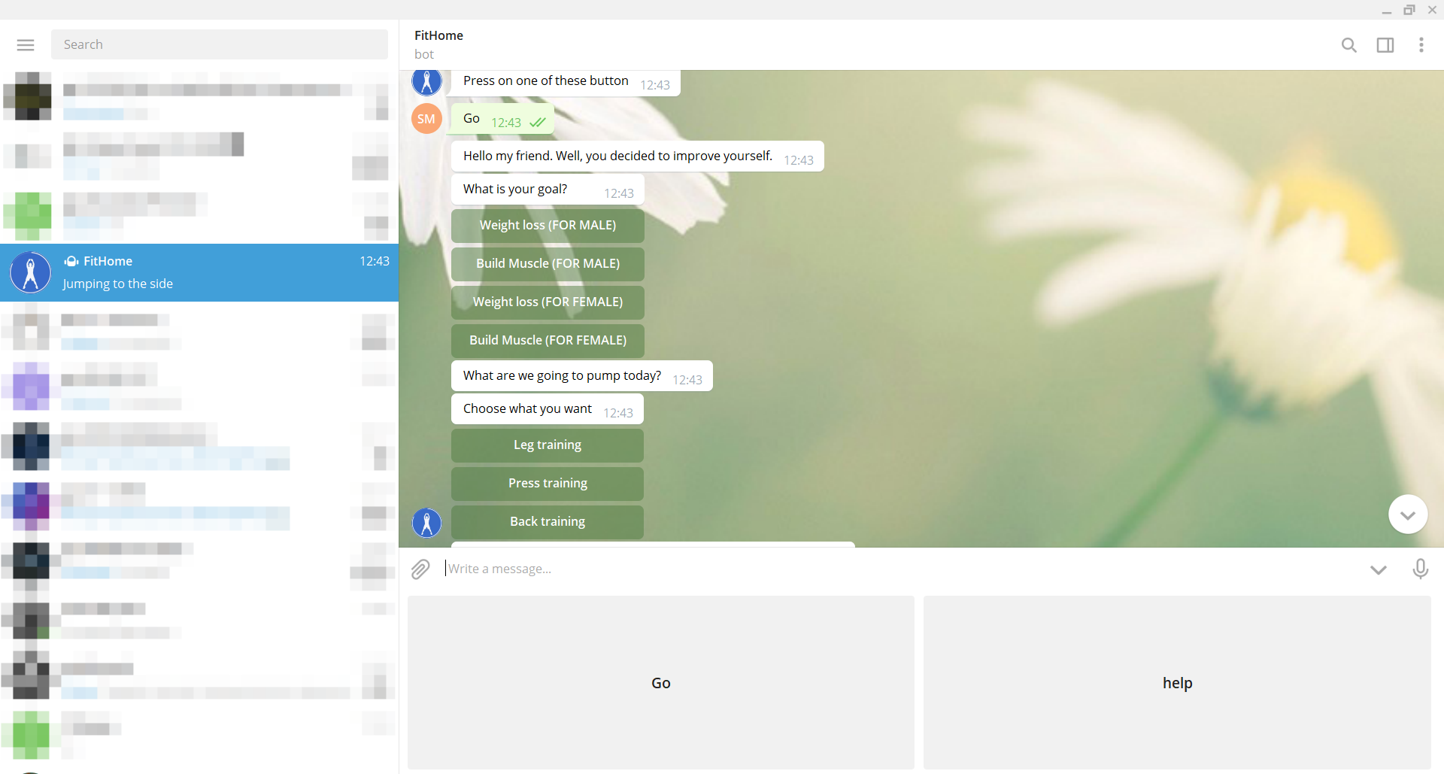
Telegram
bot
This telegram bot will allow you to train at home, without any equipment.
Place your screenshot here

Slide 4
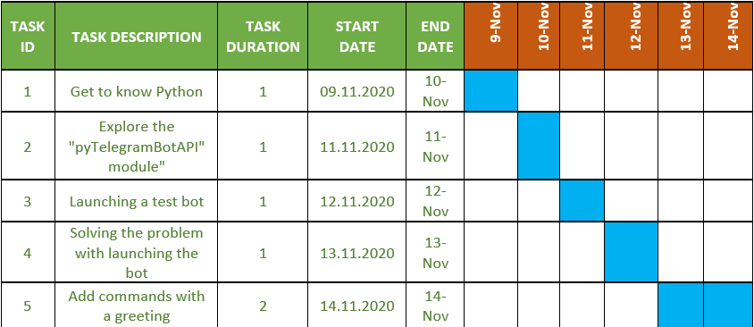
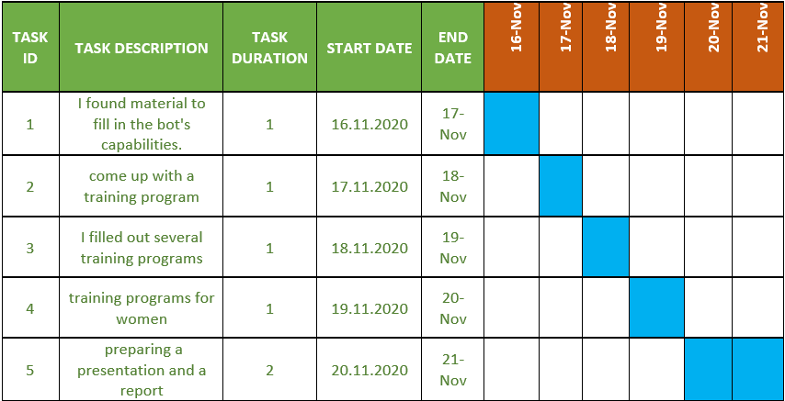

Slide 5
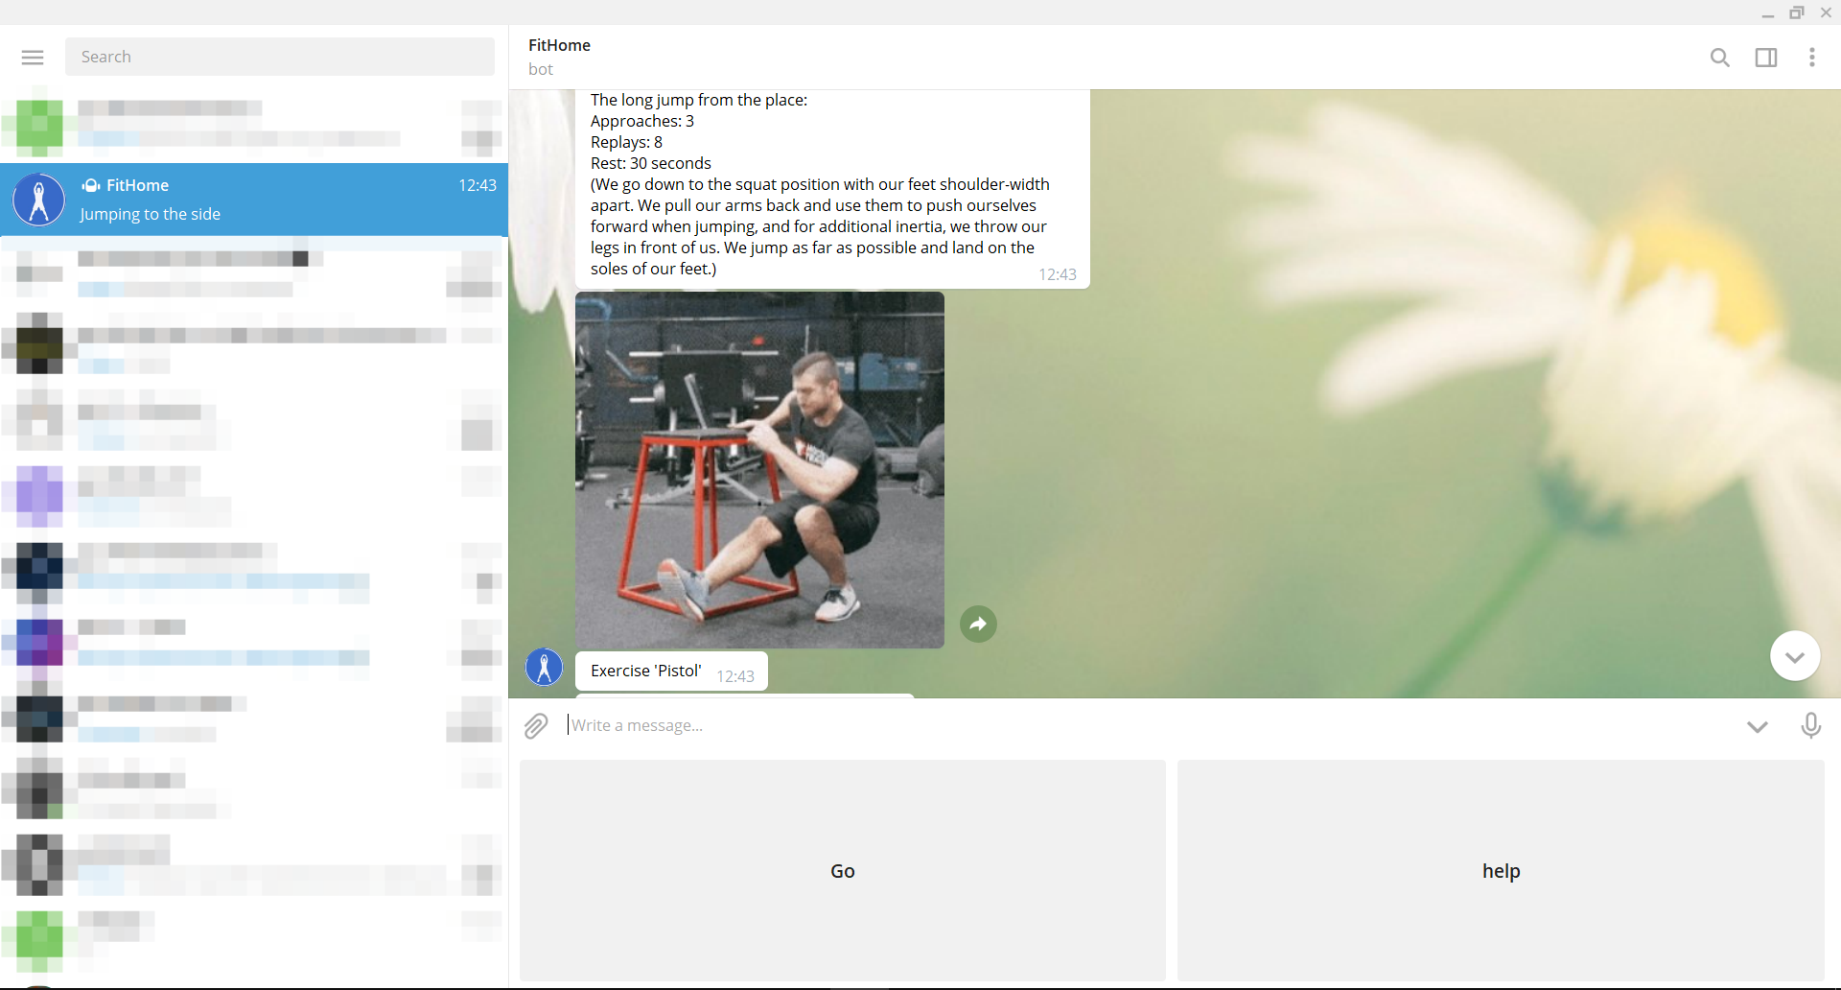

Slide 6
import telebot
bot = telebot.TeleBot("TOKEN")
@bot.message_handler(commands=['start', 'help'])
def send_welcome(message):
bot.reply_to(message, "How are you doing?")
@bot.message_handler(func=lambda message: True)
def echo_all(message):
bot.reply_to(message, message.text)
bot.polling()

Slide 7
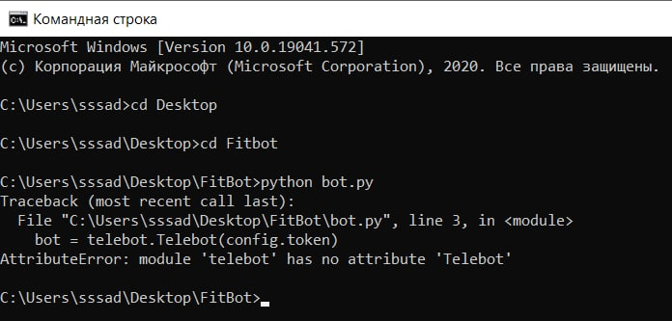

Slide 8
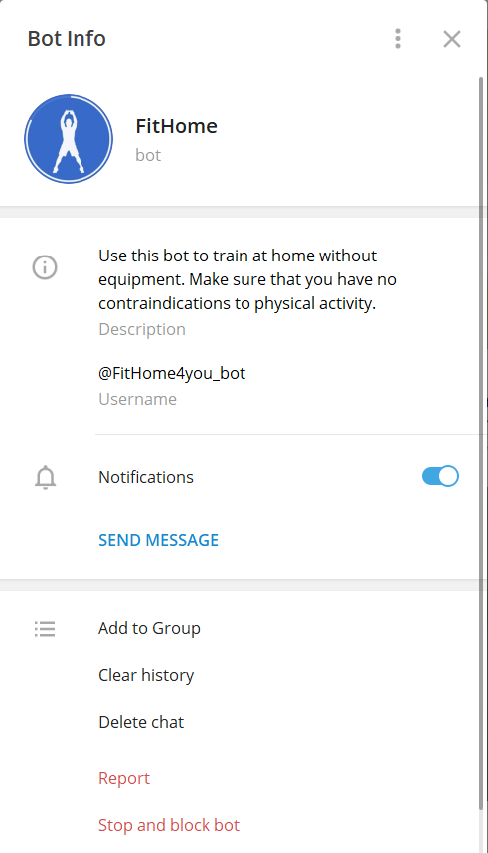
CONCLUSION
I managed to write a telegram bot myself. I realized that a software engineer always learns to solve problems on his own. Everything is based on self-education. And it was a good experience, because I already understand that projects will also be created in the future. Despite the fact that you still don't know much, you can always find information and learn something.

