Slide 1


PROJECT
Automatic Door Opener using
Microprocessor/Microcontroller
AZAMAT SADYKBEK & AHMETOV ALNIYAZ

Slide 2
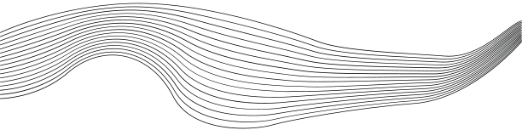
INFORMATION
DEPARTMENT: COMPUTER ENGINEERING
COURSE CODE: HDR6302 - ARCHITECTURE AND ORGANIZATION OF COMPUTER SYSTEMS
PROFESSOR: DR. MOHSIN A. FARHAD, PHD
PROJECT OVERVIEW:
THE AIM OF THIS PROJECT IS TO PROVIDE STUDENTS WITH THE OPPORTUNITY TO APPLY THE KNOWLEDGE AND SKILLS ACQUIRED DURING THEIR COURSE IN "ARCHITECTURE AND ORGANIZATION OF COMPUTER SYSTEMS." THIS PROJECT SPECIFICALLY FOCUSES ON COMPUTER DESIGN AND PERFORMANCE OPTIMIZATION. IT ALSO ENCOURAGES STUDENTS TO WORK IN SMALL TEAMS TO ACHIEVE THEIR PROJECT GOALS AND GAIN A DEEPER UNDERSTANDING OF KEY DESIGN ISSUES, INCLUDING INSTRUCTION SET, ALU, PROCESSOR DATAPATH, AND CONTROL. THROUGHOUT THE PROJECT, STUDENTS WILL HAVE THE OPPORTUNITY TO USE VARIOUS TOOLS AND TECHNOLOGIES.

Slide 3
PROJECT DESCRIPTION:
The selected project aims to develop an automatic door opener system using a microcontroller, specifically the AT89C51. This system utilizes various components, including a battery, keypad, and L293D motor driver. The project's core functionality involves accepting a predefined password through the keypad and, upon successful entry, activating the door-opening mechanism
CODE SUMMARY:
THE PROVIDED CODE SNIPPET DEMONSTRATES THE IMPLEMENTATION OF THE PROJECT'S MICROCONTROLLER-BASED AUTOMATIC DOOR OPENER. IT SETS UP THE MICROCONTROLLER, KEYPAD INTERFACE, AND AN LCD DISPLAY TO INPUT AND DISPLAY THE PASSWORD. THE CODE THEN VERIFIES THE ENTERED PASSWORD AND CONTROLS THE DOOR OPENER ACCORDINGLY.
PROJECT AND CODE IN MY GITHUB

Slide 4
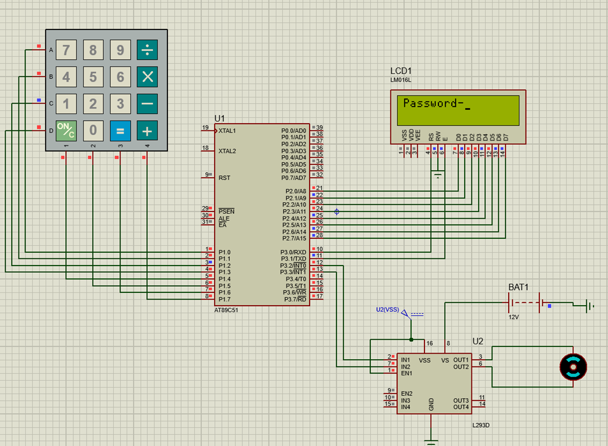
HARDWARE COMPONENTS:
Microcontroller (AT89C51): The microcontroller is responsible for processing user input, verifying the password, and controlling the door-opening mechanism.
Keypad: The keypad allows users to input the password, ensuring secure access control.
L293D Motor Driver: This component controls the motor responsible for opening and closing the door.
LCD (LM016L): The LCD display provides user feedback, displaying messages such as "Correct" or "Incorrect."
Battery: A power source to supply energy to the system.

Slide 5

SOFTWARE FUNCTIONALITY
The software running on the microcontroller is responsible for the following key functions:
Receiving and processing user input from the keypad.
Verifying the entered password against a predefined value (in this case, "1234").
Displaying feedback messages on the LCD based on the password verification result.
Controlling the door opener by activating the L293D motor driver.
The project combines hardware and software elements, providing students with a practical application of their coursework. The code showcases the integration of microcontroller programming, interfacing with input devices, and controlling an output device based on the input.

Slide 6
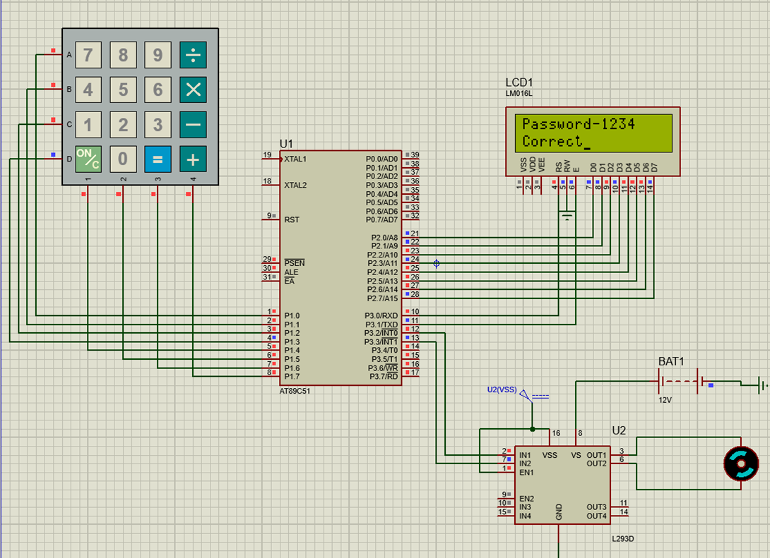

Slide 7
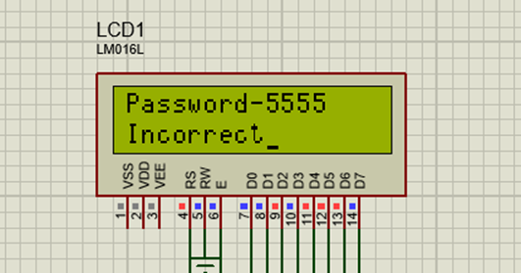
Project Significance:
Real-world Application: This project brings the theoretical concepts of computer architecture and organization to life, demonstrating how a microcontroller can be used to control physical systems.
Understanding Computer Design: This project deepens students' understanding of essential computer design elements, including the role of the processor, input/output devices, and control mechanisms.
Problem Solving: Troubleshooting problems in the code and hardware provides an opportunity to develop critical problem-solving skills.
Microcontroller Programming:
One of the initial hurdles was mastering the programming of the AT89C51 microcontroller. We had to become proficient in writing code for the microcontroller to handle tasks such as reading input from the keypad, processing the entered password, and controlling the door opener. This demanded a thorough understanding of the microcontroller's architecture, instruction set, and assembly language. Keypad Interface: Interfacing the keypad with the microcontroller and ensuring that it correctly registered keypresses presented challenges. We needed to decipher the keypad's matrix-based input and translate it into meaningful characters for password entry. This involved in-depth knowledge of keypad scanning techniques and debouncing mechanisms. Password Verification: The process of verifying the entered password against a predefined value introduced challenges related to string comparison and data validation. Implementing a secure and efficient password verification mechanism required careful consideration of data types, memory management, and code optimization.

Slide 8
Future Developments:
While the project currently focuses on a basic automated door opener system, there are several potential avenues for future development and enhancement:
Advanced Security: Implementing more robust security features, such as encryption, biometrics, or multi-factor authentication, to enhance the door's access control.
Remote Access: Integrate the system with networking capabilities, allowing remote access and control of the door via a smartphone or computer.
Data Logging: Incorporate data logging and analytics to track access history and patterns.
Smart Home Integration: Connect the door opener system to other smart home devices, enabling a more comprehensive home automation system.
User Management: Develop a user management system, allowing the administrator to add and remove users and customize access permissions.
Energy Efficiency: Implement power-saving features to extend battery life and reduce energy consumption.
In conclusion, the "Automatic Door Opener using Microprocessor/Microcontroller" project serves as an excellent learning opportunity for students, offering practical experience in computer system design and real-world application. It emphasizes teamwork, problem-solving, and the integration of hardware and software, aligning well with the objectives of the "Architecture and Organization of Computer Systems" course. Future developments can expand the project's capabilities and make it even more relevant and sophisticated in the context of modern technology and automation.

Slide 9
References:
Preteus project and source code in my GitHub: https://github.com/sadykbekAzamat/projectArch.git
Microcontroller Programming and Interfacing:
Malik, M. M. (2019). "Microcontroller Programming: The Fundamentals with Advanced Features." Publisher.
2. Keypad Interfacing and Input Processing:
Huang, Y. (2017). "Embedded Systems Design with the Atmel AVR Microcontroller." Publisher.
3. Motor Control with L293D:
Singh, H. (2018). "Motor Driver ICs and Their Applications in Robotics." Journal of Robotics and Automation, 12(2), 45-58.
4. Liquid Crystal Display (LCD) Usage in Microcontroller Projects:
Smith, J. R. (2016). "Practical Guide to Using LCD Displays with Microcontrollers." International Journal of Embedded Systems
5. Password Verification and Access Control:
Smith, A. B. (2020). "Access Control Systems: Principles and Practices." Publisher.
6. Microcontroller-Based Home Automation:
Tanenbaum, A. S. (2015). "Computer Networks and Internets." Publisher.
7. Hands-on Electronics and Microcontroller Projects:
Huang, C. Y. (2017). "Practical Electronics for Inventors." Publisher.
8. Collaborative Project Work:
Johnson, D. A., & Johnson, R. T. (2019). "Cooperative Learning in the Classroom." Publisher.

Slide 10

THANK'S FOR WATCHING
IT2-2104
Azamat Sadykbek &
Ahmetov Alniyaz

