Slide 1

RockFestService
Арсений Забара
Александр Демиров
Марат Рамазанов
Антон Тепляков

Slide 2
Список компонентов

Slide 3
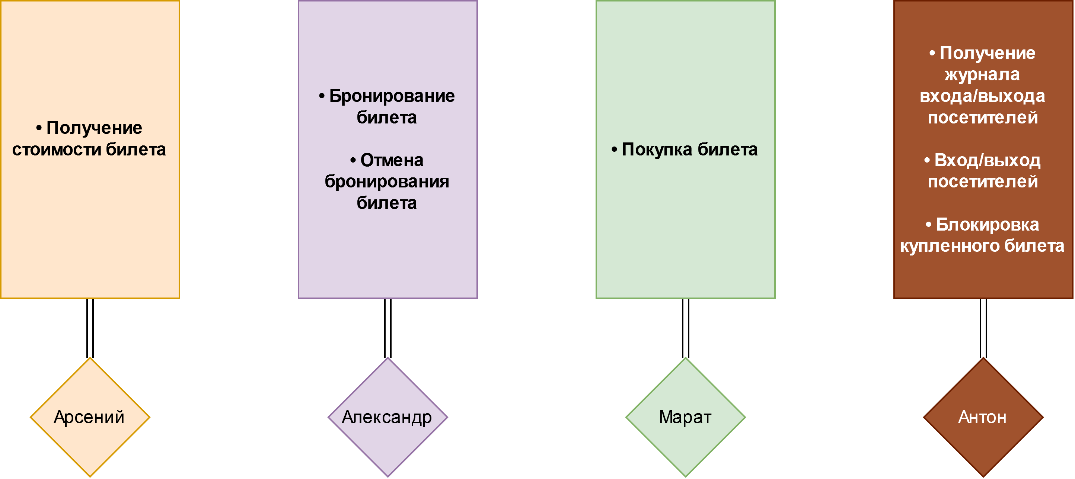
Декомпозиция

Slide 4
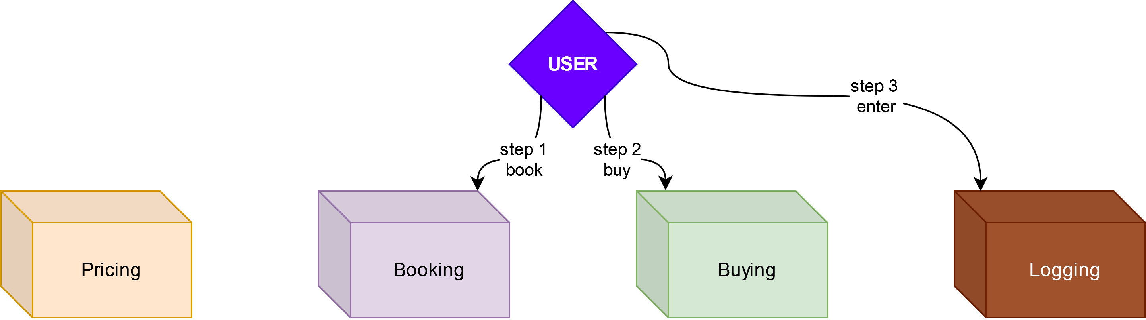
Схема сервисов

Slide 5
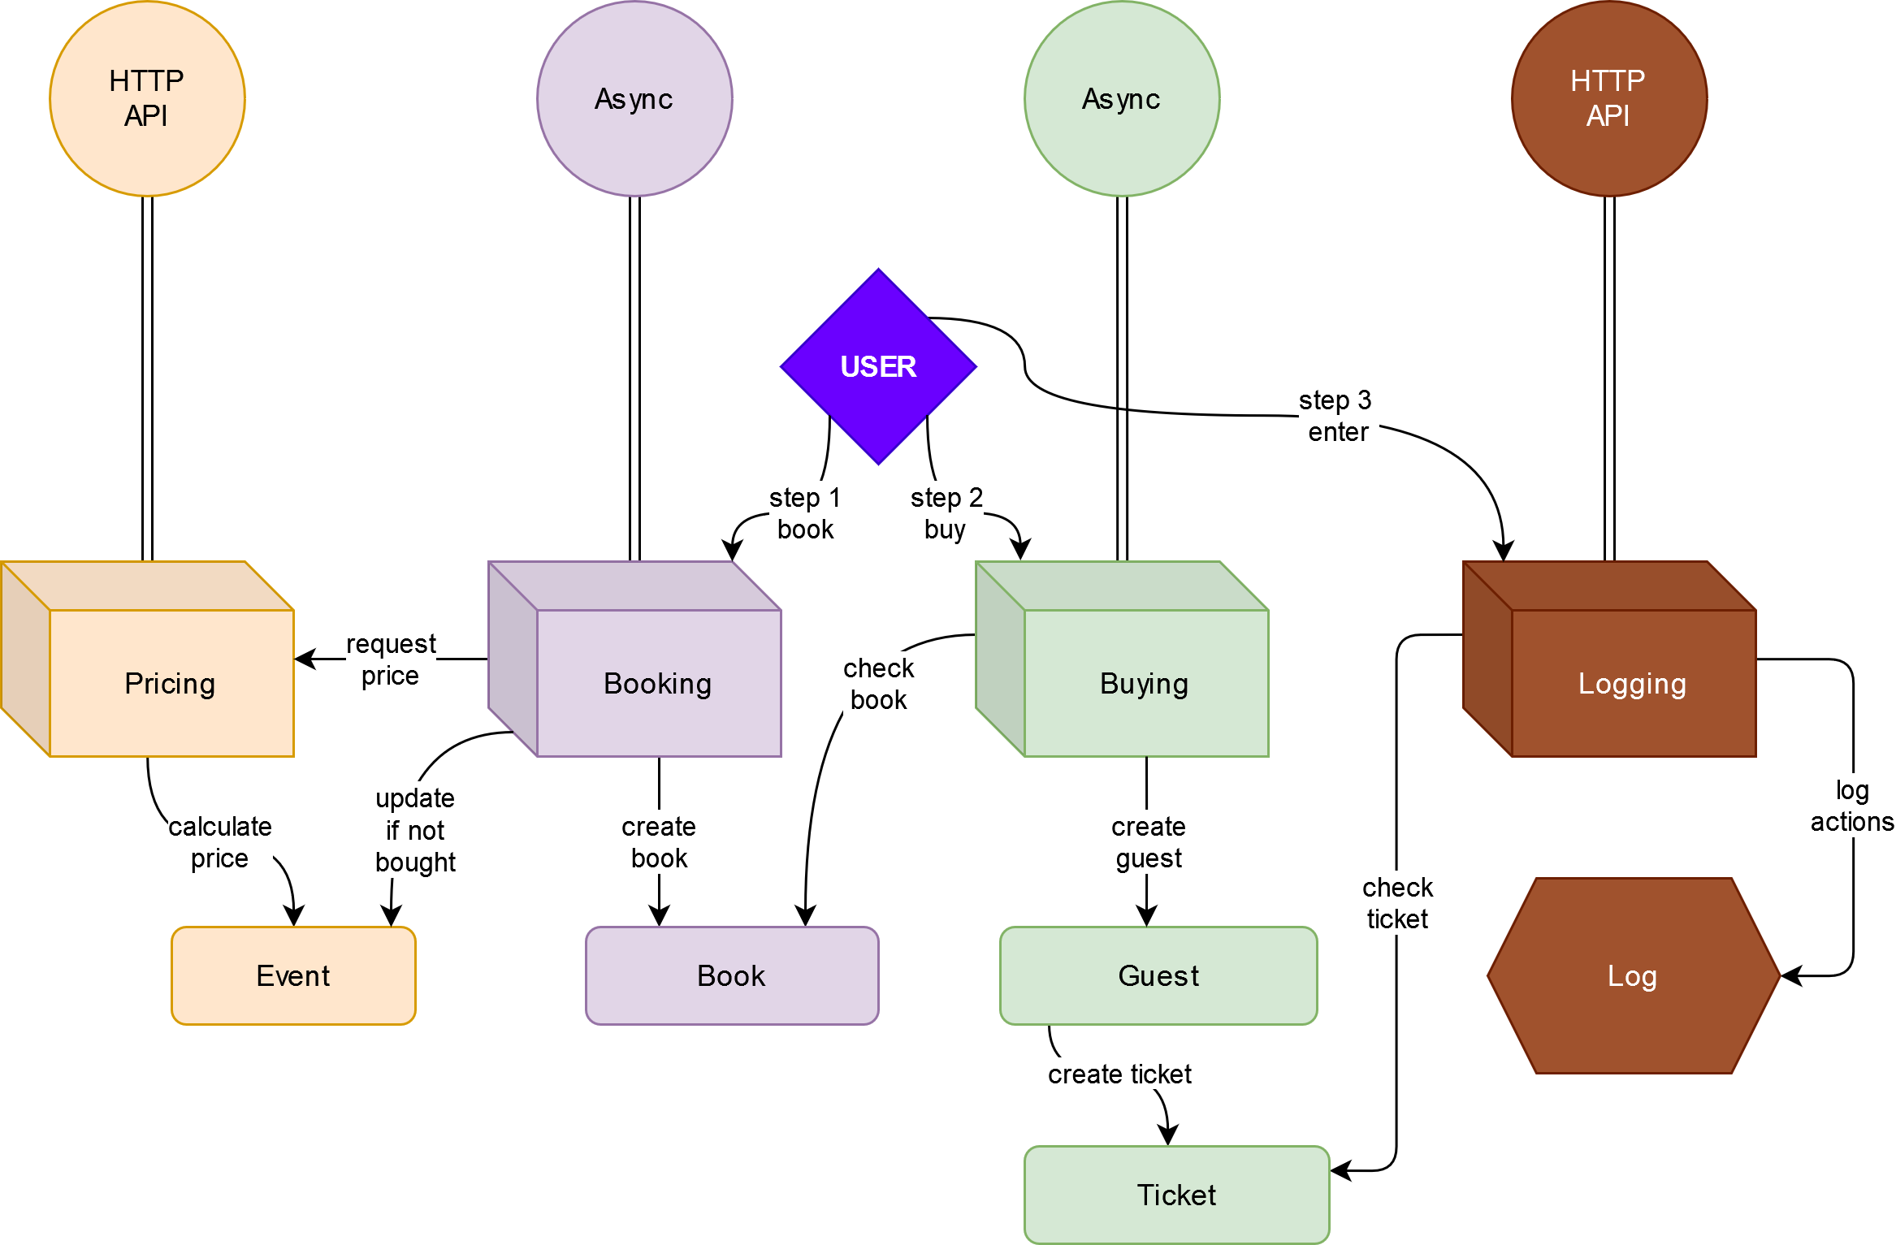
Схема сервисов

Slide 6
Описание API

Slide 7
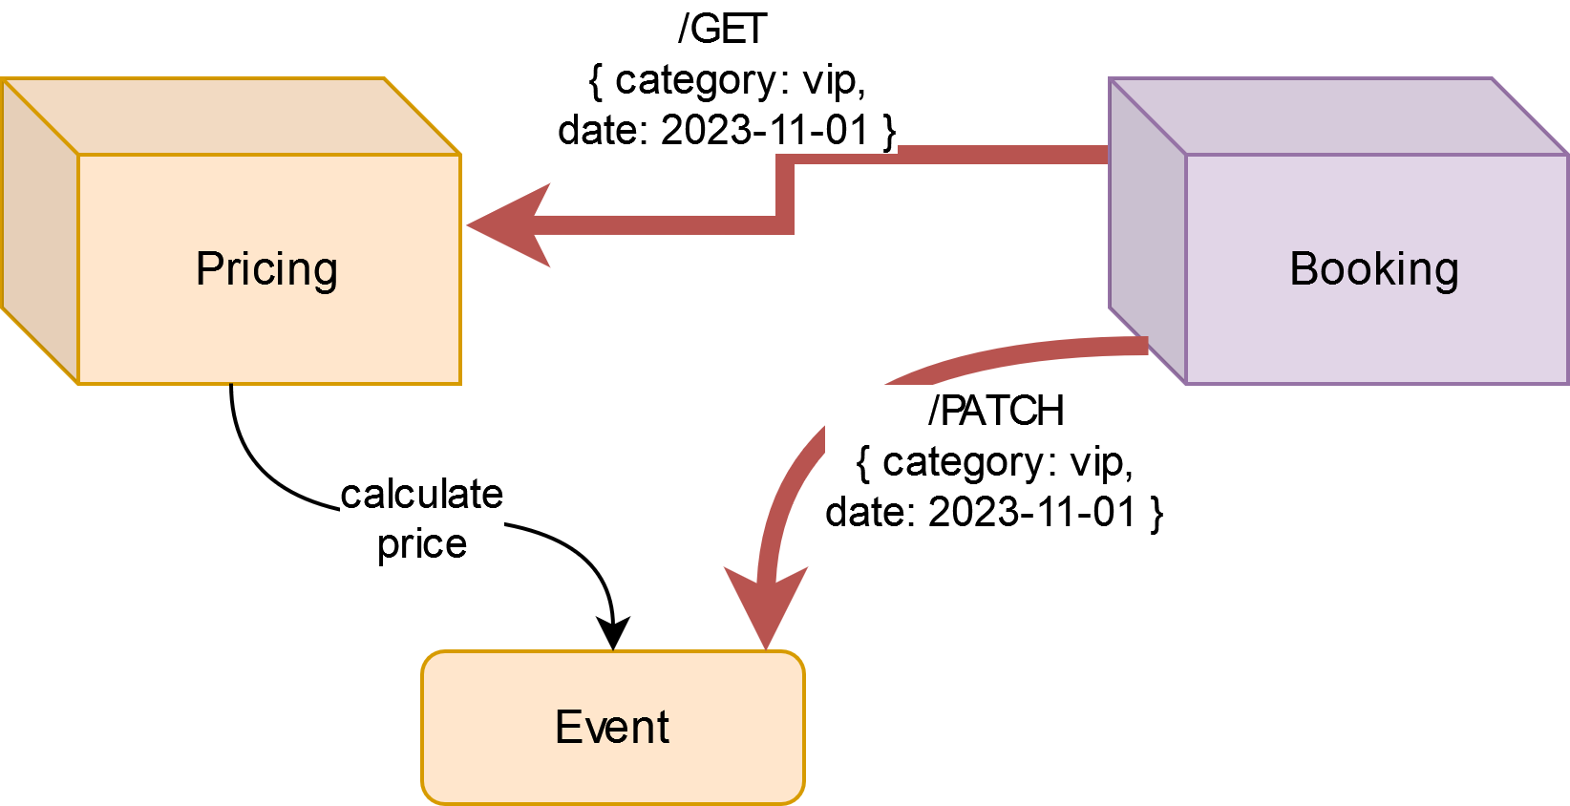
Pricing-Booking
TO | METHOD | REQUEST | RESPONSE | FROM
Pricing | count_price | GET /events/date/category | { “result”: 2000 } | Booking
Pricing | increase_ tickets | PATCH /events/date/category | { “result”: “success” } | Booking
Booking | book_ticket | POST /bookings { date: 2012-12-12, “category”: “vip” } | { “id_book”: 54 } | User
Booking | book_cancel | DELETE bookings/id_book | {“deleted_id”: 54 } | User

Slide 8
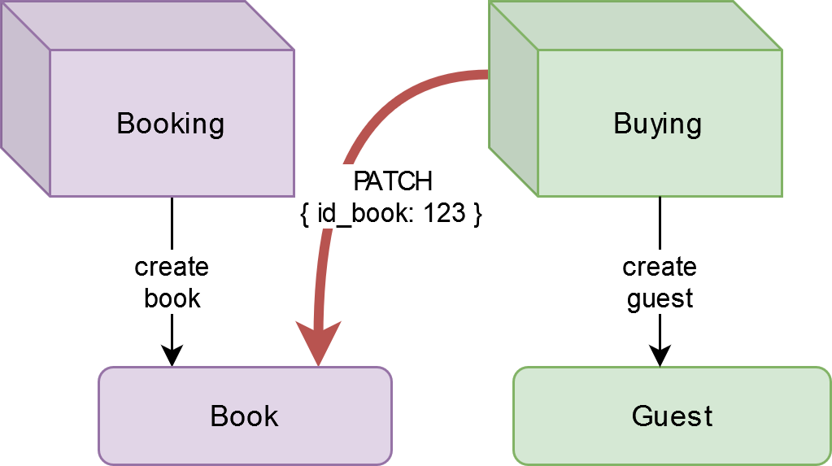
Booking-Buying
TO | METHOD | REQUEST | RESPONSE | FROM
Booking | find_book | PATCH /bookings/id_book { “status”: "bought"} | JSON { “id_book”:123, category: "vip", date: Mon Jun 02, “price”: 2000, “status”: “bought” } | Buying
Buying | buy_ticket | POST /buy_ticket { “id_guest” } | Render: User_data_form Redirect_to: Payment terminal { “id_guest”: 23 } | User

Slide 9
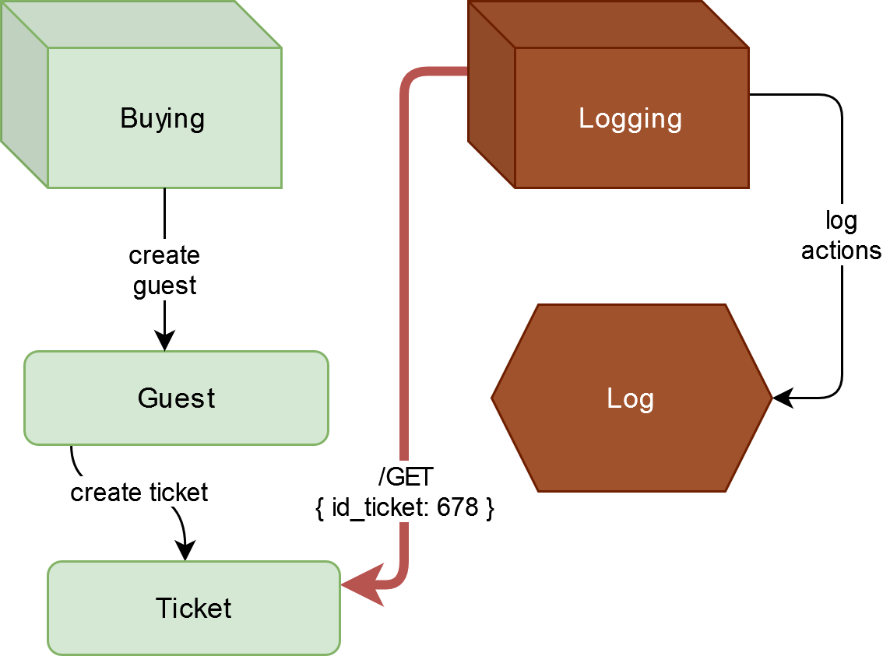
Buying-Logging
TO | METHOD | REQUEST | RESPONSE | FROM
Buying | check_ticket | GET /check_ticket? id_ticket=678 | JSON { “result”: true, “id_ticket”: 678, “category”: "vip", “doc_type”: "passport", “doc_num”: “214003”, “date”: Mon Jun 02 } | Logging
Logging | enter | GET /enter? id_ticket=678 | { “id_ticket”: 678 } | User
Logging | index | GET /logs | JSON {“id”: 1, “id_ticket”: 12, “date_time”: Mon Jun 02 12:15:36, name: “Anton“, type: „entering“, result: true} | User (admin)
Logging | show | GET /logs/1

Slide 10
Схема БД

Slide 11
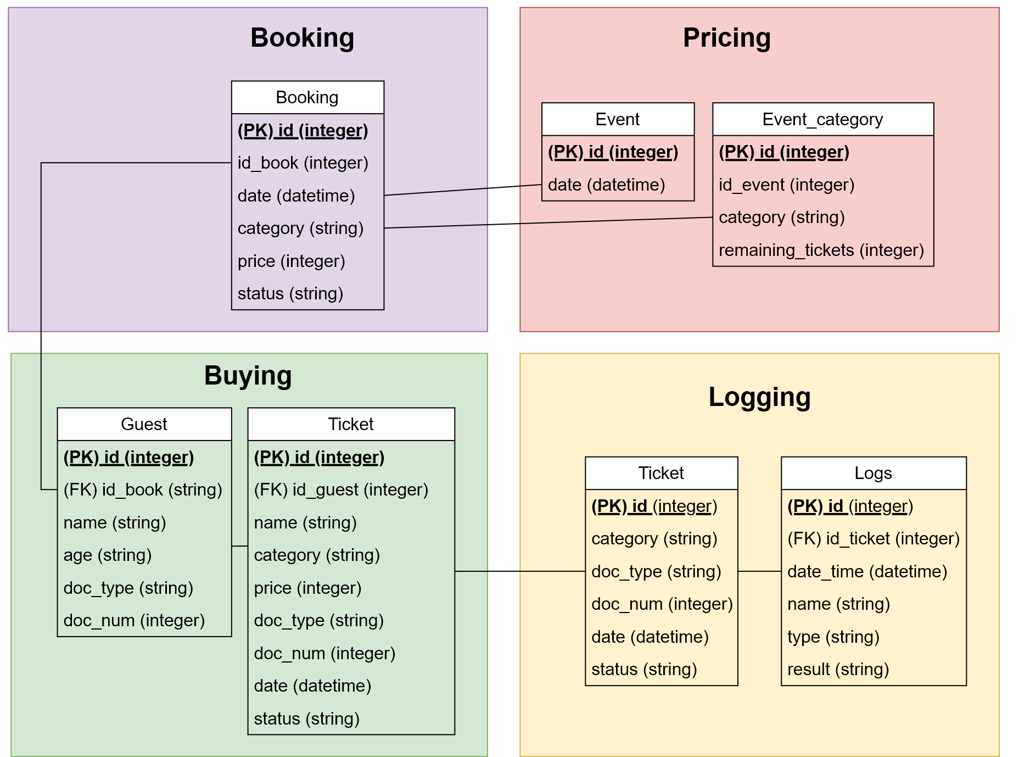

Slide 12
Спасибо за внимание!

