Slide 1
Model Driven Engineering with Capella and AADL Bassem Ouni, Pierre Gaufillet, Eric Jenn, Jérôme Hugues

Slide 2
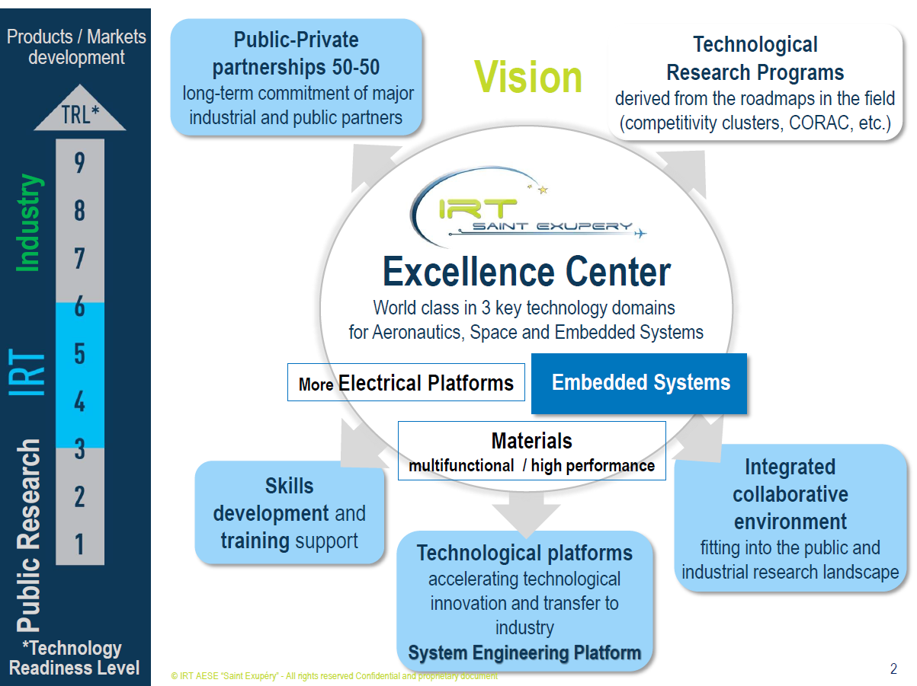

Slide 3
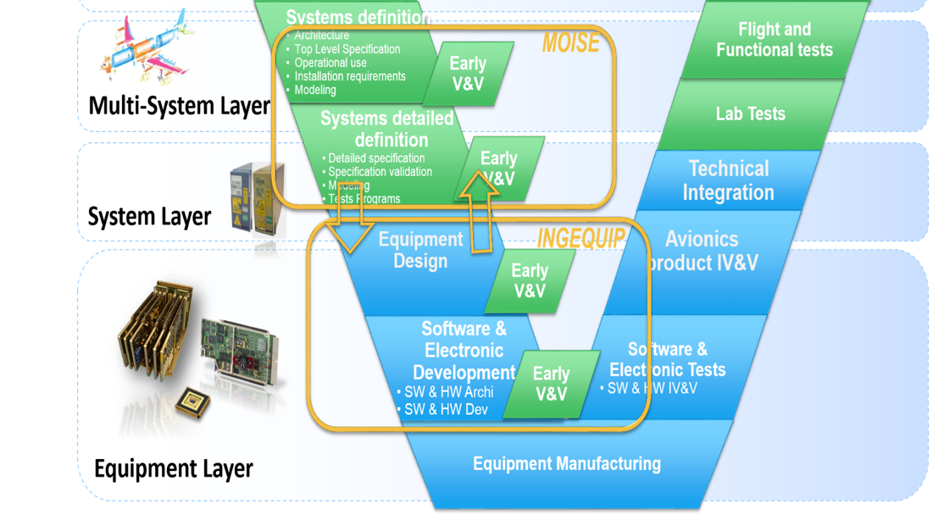
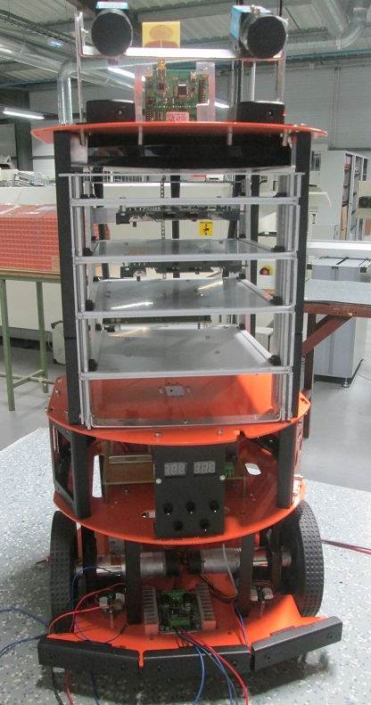
Introduction
Projects INGEQUIP and MOISE at IRT Saint Exupéry
INGEQUIP
Co-development agility to assist Equipment design
An activity focused on HW-SW Co-design
Applies methods and tool on large demonstrator
Mobile vehicle or Rover TwIRTee
MOISE
MOdels and Information Sharing for System engineering in Extended enterprise
From document-based specification process to model-driven specification process
Ensure multi-view system design and verification in a heterogeneous context
Collaborative engineering processes and methods in a regulation (“certification”)

Slide 4
Why Capella to AADL?
Capella is positioned on the most abstract part of the system development while AADL doesn’t offer operational or system analysis
AADL goes further than Capella in terms of detailed architecture with explicit hardware components – device, processor, memory, bus – and explicit software components – process, thread, subprogram.
Capella
AADL
Operational Analysis
System Analysis
Abstraction level
Logical architecture
Abstract architecture
Physical architecture
Detailed architecture
Behavioral model
Error model

Slide 5
Target chain
System Functional breakdown
Arcadia
Allocation
IP-XACT
System Logical architecture
Allocation
System Physical Architecture
Generation
Preliminary Software Architecture
Refinement
Applications
Software Architecture
Distributed Application Framework
AADL
Source code skeletons
Functional Source code
Generation
Manual
Completion

Slide 6
Target chain
System Functional breakdown
Capella
Allocation
IP-XACT tree editor
VLAB
Space Studio
System Logical architecture
Allocation
System Physical Architecture
EMF, Acceleo, Java
Preliminary Software Architecture
Refinement
Applications
Software Architecture
Distributed Application Framework
AADL
Source code skeletons
Functional Source code
OCARINA
Manual
Completion

Slide 7
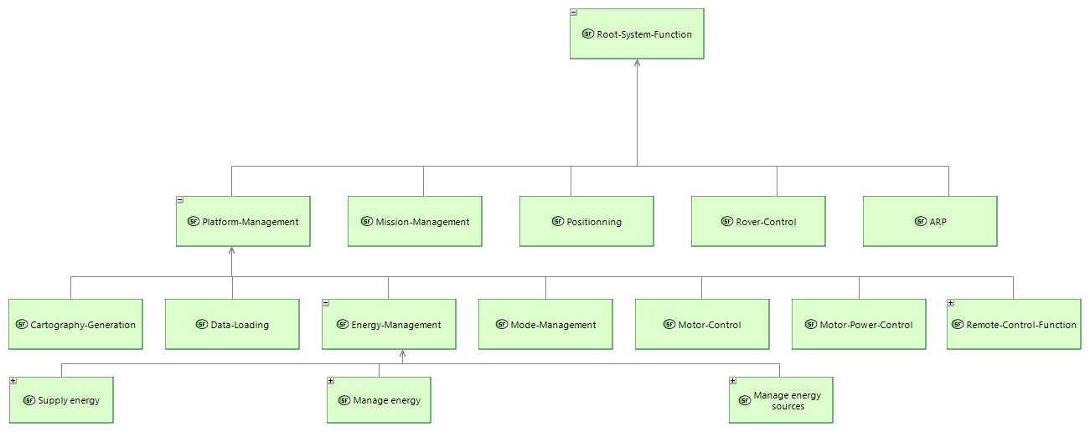
TwIRTee Functional Breakdown

Slide 8
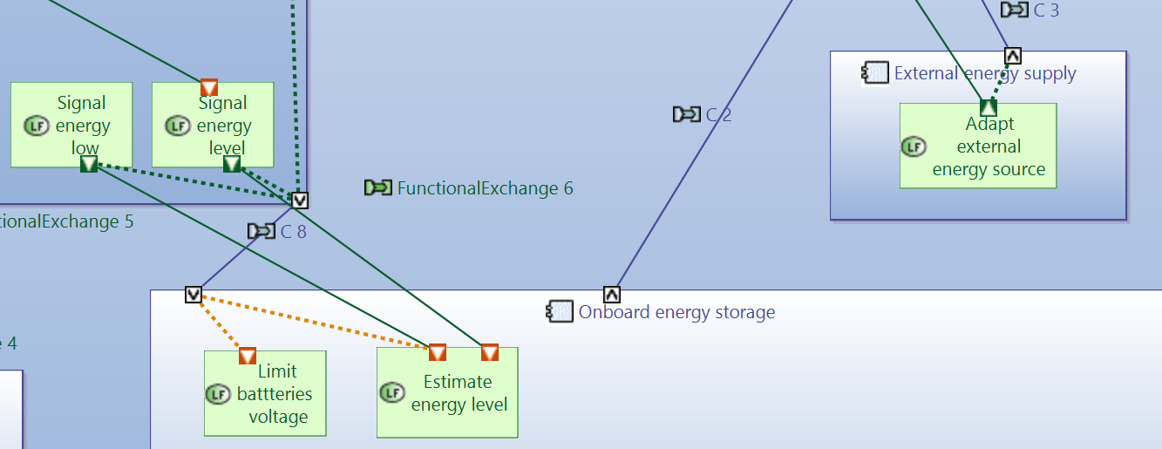
TwIRTee Logical Architecture

Slide 9
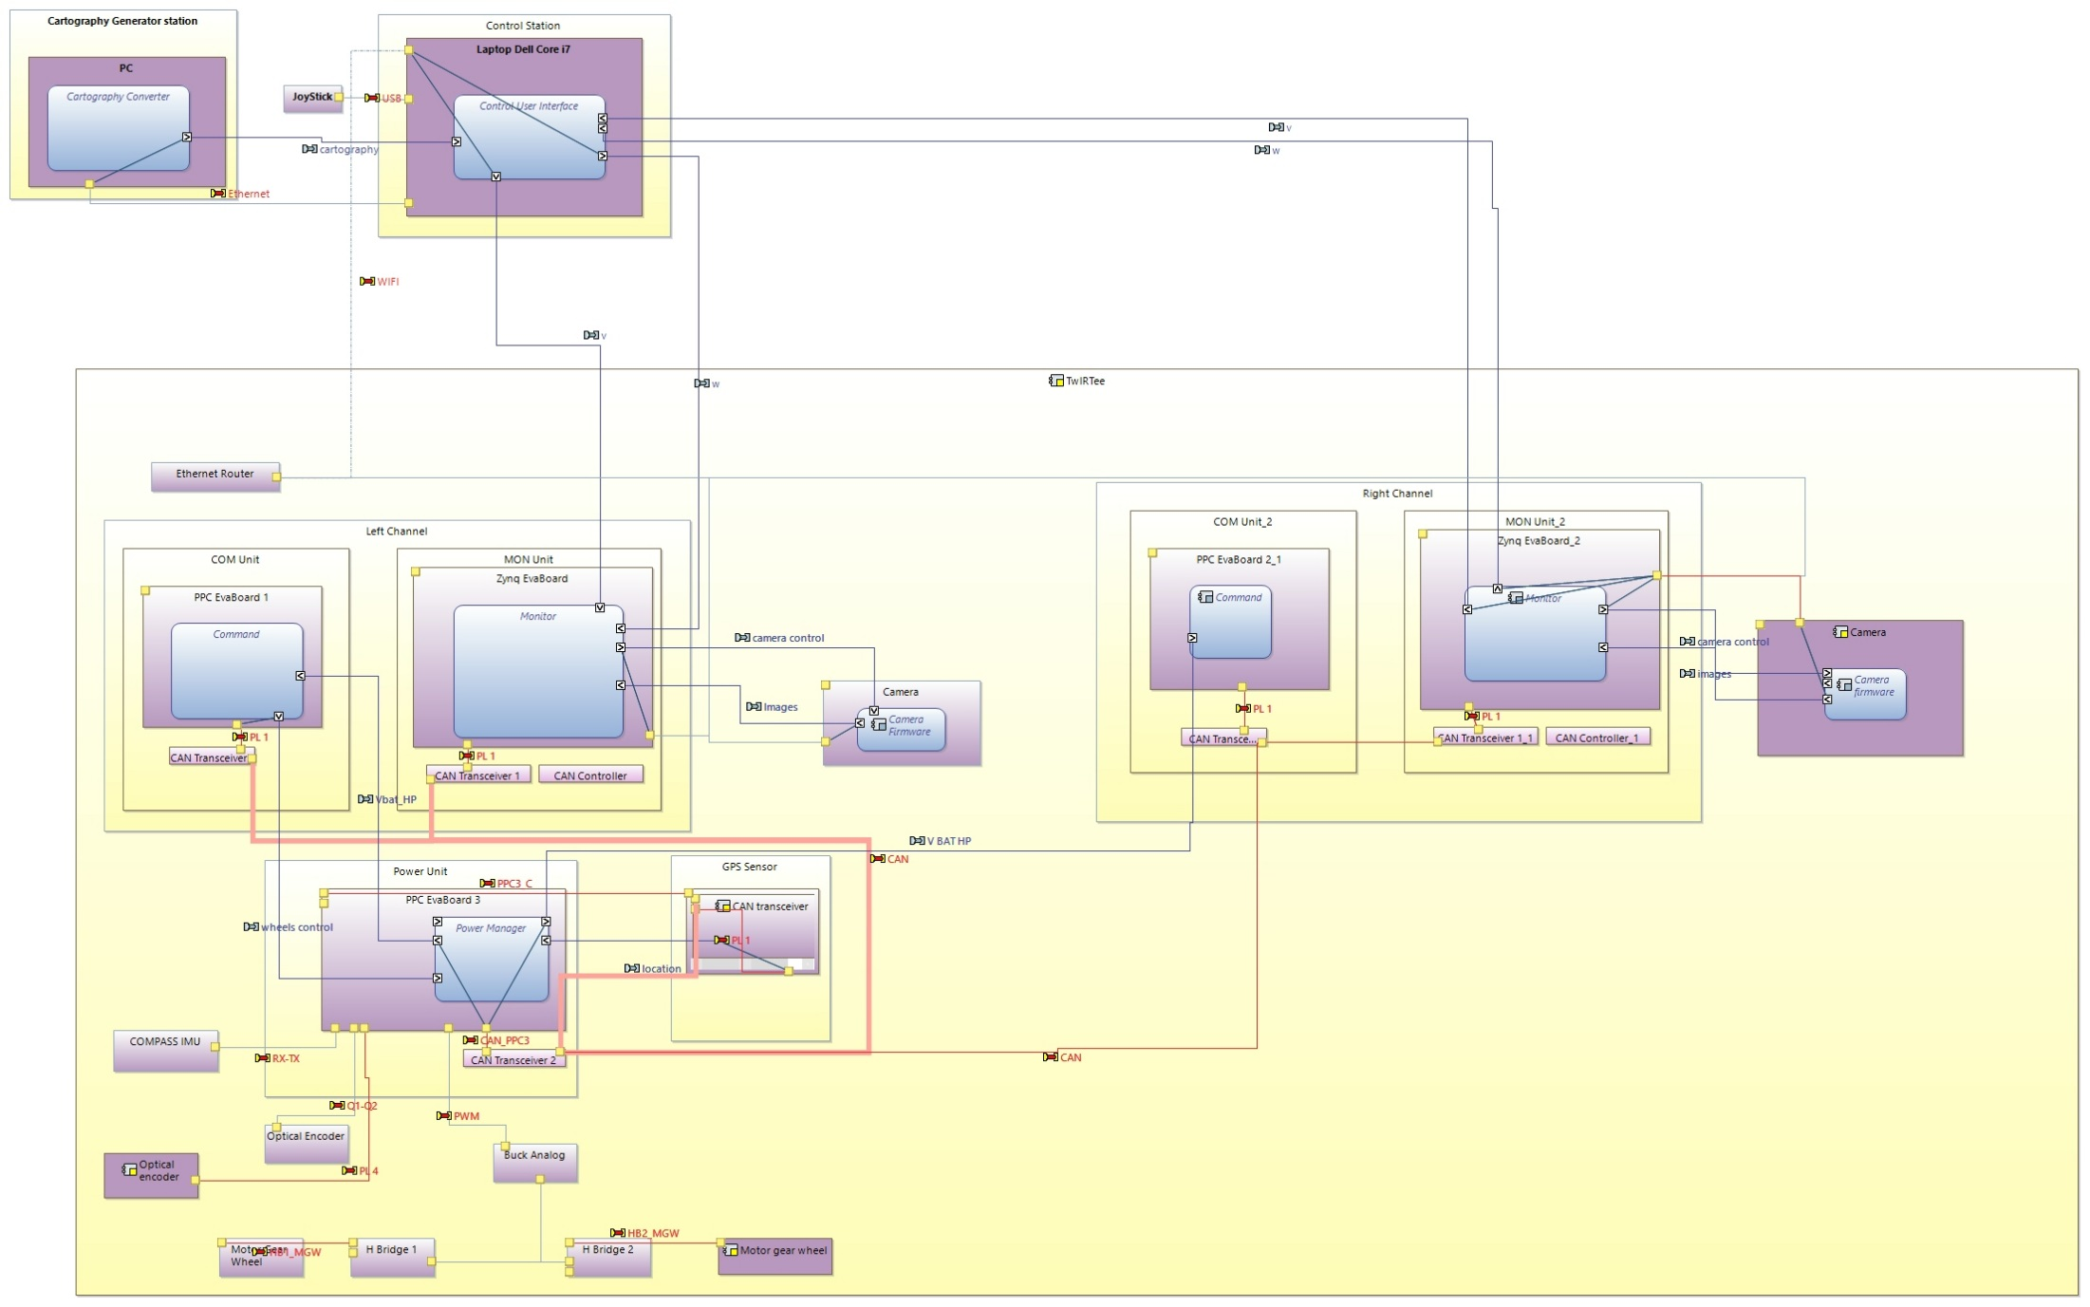
TwIRTee Physical Architecture

Slide 10
System architecture with Capella
Modelling conventions
Physical architecture breakdown stops when a leaf is allocated to hardware – device - or software – application.
Flows are neither typed nor constrained
Interconnected ports implicitly define a bus
Software is allocated to CPUs and logical flows to physical flows
System functions are not used

Slide 11
Capella to AADL mapping

Slide 12
Extraction of Bus
PC1
PC2
PC1.1
PC2.1
PP1
PL2
PC1.1.1
Bus 1
PL3
Bus 2
PC1.2
PL1
-Gathering groups of physical links which are connected to each other.
-Each group will be mapped in a physical bus (Physical component with Bus port).
-Connected Physical Links are translated into requires access connectors to a bus
through intermediate ports.
PC: Physical component
PL: Physical link
PP: Physical port

Slide 13
Extraction of Bus
PC1
PC2
PC1.1
PC2.1
PP1
PL2
1
5
2
4
PC1.1.1
3
8
Bus 1
9
PL3
6
Bus 2
10
7
PC1.2
PL1
-Considering the architecture as a tree, we first search the external ports (Last level of the tree).
-Bus ports are connected to external ports.
-Synthetic links and synthetic ports are generated=> mapped to AADL connections and requirements of bus accesses.

Slide 14
Extraction of logical connections
Components exchanges are translated into oriented abstract flows through intermediate ports.

Slide 15
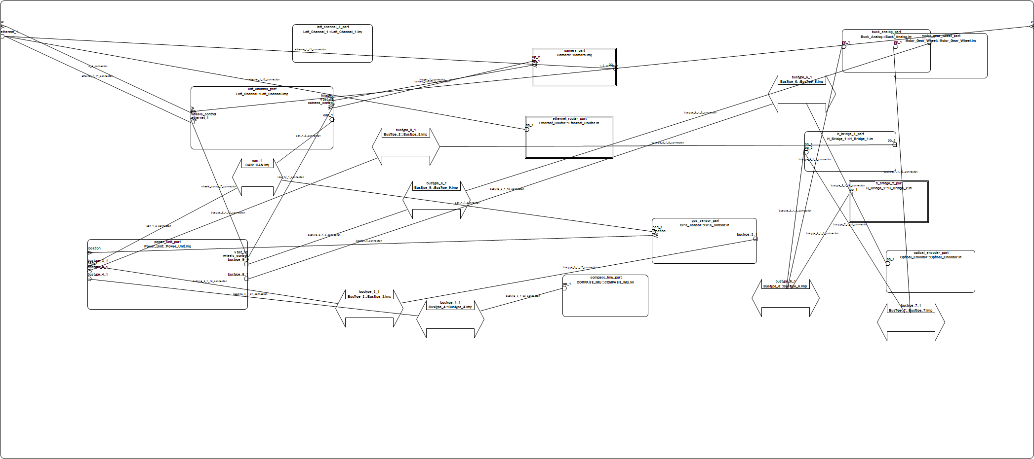
Preliminary Software Architecture with AADL
Fully generated from Capella
Read-only artefact – Regeneration is straight-forward

Slide 16
Software Architecture with AADL
Inherits from the preliminary architecture
Refined manually by adding
Internal application objects: tasks, buffers, semaphores, etc.
Typed flows
Static software architecture: application subsets, API
Real Time constraints
Abstract behaviour
Impacts of modification in the preliminary architecture are easily identified thanks to inheritance and refinement relationships.
Can be used for formal behavior verification

Slide 17
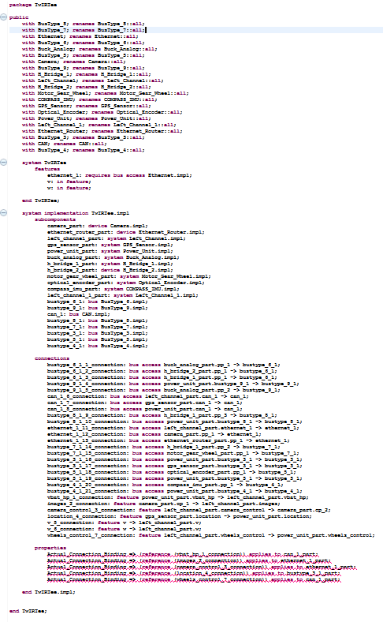
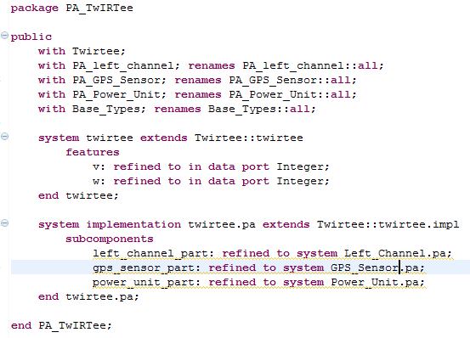
Software Architecture with AADL

Slide 18
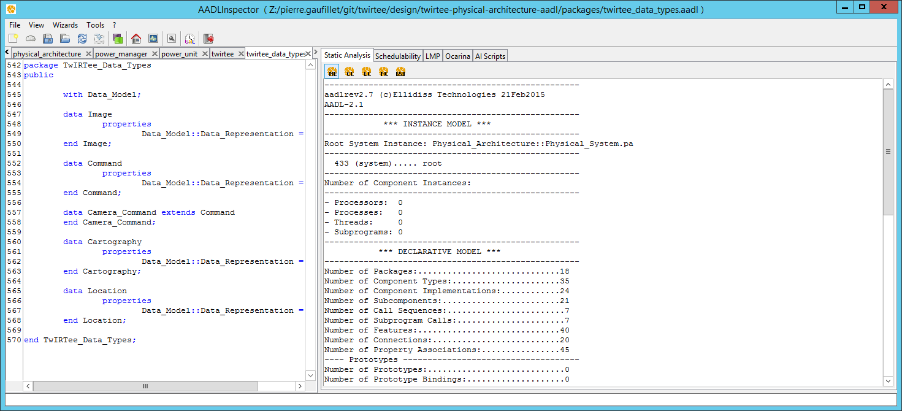
Software Architecture with AADL
Validation with AADL inspector
Structural properties
Scheduling with Marzhin and Chedar (TBD)

Slide 19
Distributed applications Framework with PolyORB
OCARINA generates code skeletons for each application from the software architecture in AADL including:
Tasks management
Synchronization/Communication glue
The generated code relies on a distributed application framework: PolyORB HI (C, ADA)
The functional code is completed by hand

Slide 20
Capella2AADL in brief
Role
Initializes hardware/software design from system physical architecture
Job done
AADL analysis and meta-modeling
AADL Prototyping
Experimentation on TwIRTee
Issues
Multiplexed communications needed in AADL not supported by Capella
Limitations
Global transformation only – Subsets not supported
Capella to AADL Roadmap
Support transparent components on physical flows – transceivers, routers, etc.
Improved naming – ports, flows, etc.
Open the door to better exchanges of information between system and software engineers

Slide 21
Questions ??? Thanks a lot for your attention

