Slide 1
AADL v2.1 errata -> 3.0 issues Jan 2016
Software Engineering Institute
Carnegie Mellon University
Pittsburgh, PA 15213
Peter Feiler
Notes:
Title Slide
Title and Subtitle text blocks should not be moved from their position if at all possible.

Slide 2
V2.1 Errata
Only those items that really need to be addressed before V2.2/V3.0
Status: Approved, closed, open errata lists available on the public Wiki and in AS2C working Documents at www.sae.org
Updated Standard document with change tracking available as working document at www.sae.org

Slide 3
Abstract feature with classifier
Issue: abstract feature currently allows for feature prototype, but not classifier
system s prototypes fp: feature d; features f1: feature fp; --ok
f2: feature d; -- not ok end s;
data d end d;
Proposed correction: Allow classifier.
Do we want to say port without the specific port type? Abstract feature includes bus access.
We had it in V2.0 but removed it.
Approved. Not implemented yet.

Slide 4
End to End Flow Specification
Addresses: How to specify requirements on end to end flows without already having a design.
Ability to define end to end flow without the connection
Specify flow with existing information and refine later with connection information (by refinement statement or by inline editing)
system implementation sys.impl subcomponents a : process A; b : process B; flows fl : end to end flow a.out_flow -> b.in_flow; end sys.impl;
Approved. Not documented, implemented yet.

Slide 5
Properties on Internal Features
Issue: in property definition the applies to need to be updated for those properties that are allowed.
Should internal features be a subclass of features, thus, all properties of features apply to internal features?
Making internal features a subclass would allow properties only for internal features, but we have automatic inheritance of all feature properties.
Internal features are an independent entity in the meta model, thus, we have to go through and add its meta model name to those predeclared properties that are allowed.
Need white paper to exercise the example of expanding a design beyond internal feature as an abstraction.

Slide 6
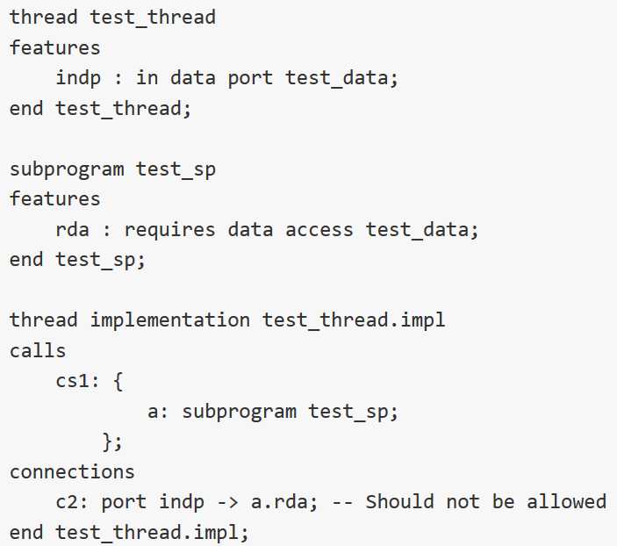
Connection rule too restrictive
Issue: "If the port connection declaration represents a connection between ports down the containment hierarchy, then the source and destination must both be incoming ports. If the source connection end is a data access feature, then it must be a requires access feature; if it is a destination connection end it must be a provides access feature“
V3.0 Consideration
Confusion about access direction or too restrictive

Slide 7
Transfer of Aggregate Data
Issue
Transfer of data from multiple sources as single message
AADL V1 specification
Feature group with property indicating intended transfer as single message
Flexibility of switching between aggregate and individual message transfer
AADL V2 specification
Outer component with port that has a data component with subcomponents
Users explicitly connect an inner port to the data subcomponent of the outer port
Manual change of model to change transmission protocol
Desirable
Treat the issue as a protocol issue!!
Bind collection of connections to an appropriate virtual bus (protocol)
V3.0 Consideration
Notes:
Key points (Objectives of the Slide): What is covered in this section
Slide Content Description:
Presentation Script: We address the following subjects in this section
Modeling and embedded systems engineering
What is modeling?
What is Software Architecture?
Model * Engineering
Definition of terms – putting them in perspective
Motivation for model-based engineering
The AADL Language – We discuss:
That it is aStandard
Overview of the Language
Insight into how the language came to be – development pattern -New WG activities
We are presenting Version 2
Model-based Embedded systems engineering and the role of aadl (MBSE role of aadl)
Software and Systems Engineering
Focus of the SAE AADL
33-38
Definition and History of aadl
42 -43
AADL Language Overview
The grammar, syntax, and semantics
AADL tools
Extensions to the language

Slide 8
Pass through Connections
Issue
Model pass through from incoming pin to outgoing pin direct wiring. In AADL terms map an incoming port of a system to an outgoing port, where the system has subsystems.
Interpretation 1: one semantic connection whose target is the component connected to the outgoing port.
Interpretation 2: two semantic connections, incoming and outgoing with a ID (in->out) function by the system
Last time our response was that flow specification indicates input to output mapping
Notes:
Key points (Objectives of the Slide): What is covered in this section
Slide Content Description:
Presentation Script: We address the following subjects in this section
Modeling and embedded systems engineering
What is modeling?
What is Software Architecture?
Model * Engineering
Definition of terms – putting them in perspective
Motivation for model-based engineering
The AADL Language – We discuss:
That it is aStandard
Overview of the Language
Insight into how the language came to be – development pattern -New WG activities
We are presenting Version 2
Model-based Embedded systems engineering and the role of aadl (MBSE role of aadl)
Software and Systems Engineering
Focus of the SAE AADL
33-38
Definition and History of aadl
42 -43
AADL Language Overview
The grammar, syntax, and semantics
AADL tools
Extensions to the language

Slide 9
Mode Transition Triggers (new/old)
Issue
Memory and bus can have modes, but no ports. Ports are used to model external mode transition triggers.
Proposal
Allow ports on memory and buses.
How to connect to those ports:
Hardware to hardware: processor or device to manage modes
Application layer to hardware: same issue as connections from application to processor
Discussion:
Stay with event ports for triggering mode transitions. Event based dispatch effectively represents an implicit mode state machine. OK.
Buses and memory should have modes themselves and they are triggered by event ports. They could also inherit modes from an enclosing component, which would lead to everyone wrapping memory and buses with modes.
Notes:
Key points (Objectives of the Slide): What is covered in this section
Slide Content Description:
Presentation Script: We address the following subjects in this section
Modeling and embedded systems engineering
What is modeling?
What is Software Architecture?
Model * Engineering
Definition of terms – putting them in perspective
Motivation for model-based engineering
The AADL Language – We discuss:
That it is aStandard
Overview of the Language
Insight into how the language came to be – development pattern -New WG activities
We are presenting Version 2
Model-based Embedded systems engineering and the role of aadl (MBSE role of aadl)
Software and Systems Engineering
Focus of the SAE AADL
33-38
Definition and History of aadl
42 -43
AADL Language Overview
The grammar, syntax, and semantics
AADL tools
Extensions to the language

Slide 10
Priority on Data Access (new)
Issue
Concurrency control may make use of priorities to manage exclusive access. Priority is currently not allowed on data access features.
Proposal
Allow priority on data access.
Ok for V2.1
Notes:
Key points (Objectives of the Slide): What is covered in this section
Slide Content Description:
Presentation Script: We address the following subjects in this section
Modeling and embedded systems engineering
What is modeling?
What is Software Architecture?
Model * Engineering
Definition of terms – putting them in perspective
Motivation for model-based engineering
The AADL Language – We discuss:
That it is aStandard
Overview of the Language
Insight into how the language came to be – development pattern -New WG activities
We are presenting Version 2
Model-based Embedded systems engineering and the role of aadl (MBSE role of aadl)
Software and Systems Engineering
Focus of the SAE AADL
33-38
Definition and History of aadl
42 -43
AADL Language Overview
The grammar, syntax, and semantics
AADL tools
Extensions to the language

Slide 11
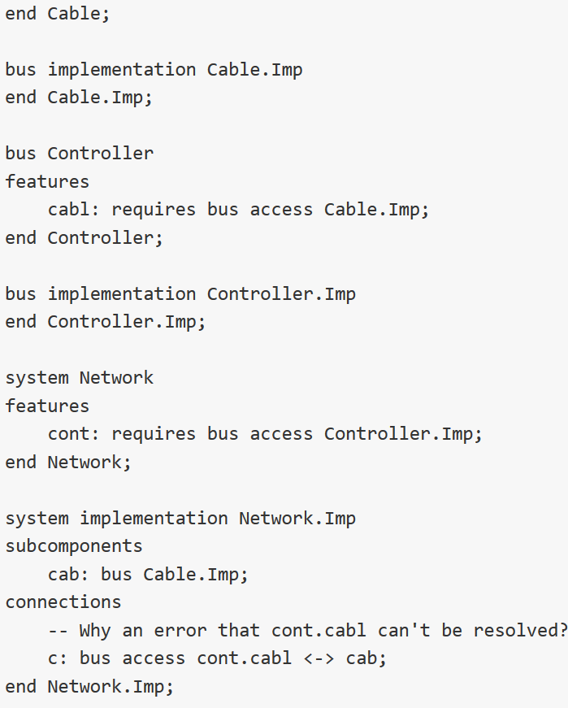
Bus access vs. Bus with Bus Access Needs
From Vestal: Inside Network I want to connect the cable to the requires access of the Controller bus for which I have requires access.
Current view: Visibility of access point: Network does not requires access to Controller but to cable. Someone outside then supplies the cable to an instance of Network.
Revised view: Bus becomes accessible inside Network, thus Network should be able to connect the cable.

