Slide 1
AADL Overview and Perspectives
Peter Feiler
Notes:
The Architecture Analysis and Design Language (AADL) and the Architecture Centric Virtual Integration Practice (ACVIP) framework supporting the virtual integration process with it is a critical technology promising significant impact on system affordability, enough to be transformational across competitors developing aviation systems.

Slide 2
Copyright 2019 Carnegie Mellon University.
This material is based upon work funded and supported by the Department of Defense under Contract No. FA8702-15-D-0002 with Carnegie Mellon University for the operation of the Software Engineering Institute, a federally funded research and development center.
The view, opinions, and/or findings contained in this material are those of the author(s) and should not be construed as an official Government position, policy, or decision, unless designated by other documentation.
NO WARRANTY. THIS CARNEGIE MELLON UNIVERSITY AND SOFTWARE ENGINEERING INSTITUTE MATERIAL IS FURNISHED ON AN "AS-IS" BASIS. CARNEGIE MELLON UNIVERSITY MAKES NO WARRANTIES OF ANY KIND, EITHER EXPRESSED OR IMPLIED, AS TO ANY MATTER INCLUDING, BUT NOT LIMITED TO, WARRANTY OF FITNESS FOR PURPOSE OR MERCHANTABILITY, EXCLUSIVITY, OR RESULTS OBTAINED FROM USE OF THE MATERIAL. CARNEGIE MELLON UNIVERSITY DOES NOT MAKE ANY WARRANTY OF ANY KIND WITH RESPECT TO FREEDOM FROM PATENT, TRADEMARK, OR COPYRIGHT INFRINGEMENT.
[DISTRIBUTION STATEMENT A] This material has been approved for public release and unlimited distribution. Please see Copyright notice for non-US Government use and distribution.
This material may be reproduced in its entirety, without modification, and freely distributed in written or electronic form without requesting formal permission. Permission is required for any other use. Requests for permission should be directed to the Software Engineering Institute at permission@sei.cmu.edu.
Carnegie Mellon® is registered in the U.S. Patent and Trademark Office by Carnegie Mellon University.
DM19-1081

Slide 3
Safety Critical Embedded Software System Challenge
SAE AADL Standard and Virtual System Integration to the Rescue
Embedded Software System Qualification and Assurance

Slide 4
The Safety Critical Embedded Software System Challenge
Problem:
Software increasingly dominates safety and mission critical system development cost.
80% of issues discovered post unit test.
Solution: Early discovery of system level issues through virtual Integration and incremental analytical assurance.
Approach:
International standard based technology matured into practice through pilot projects and industry initiatives.
Open source research prototyping platform continually enhances analysis, verification, and generation capabilities.
Reduced Defect Leakage through Early Analytical Assurance is Critical

Slide 5
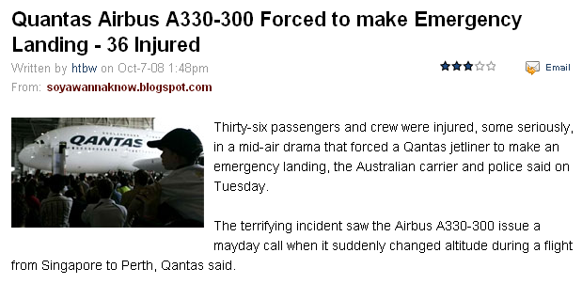
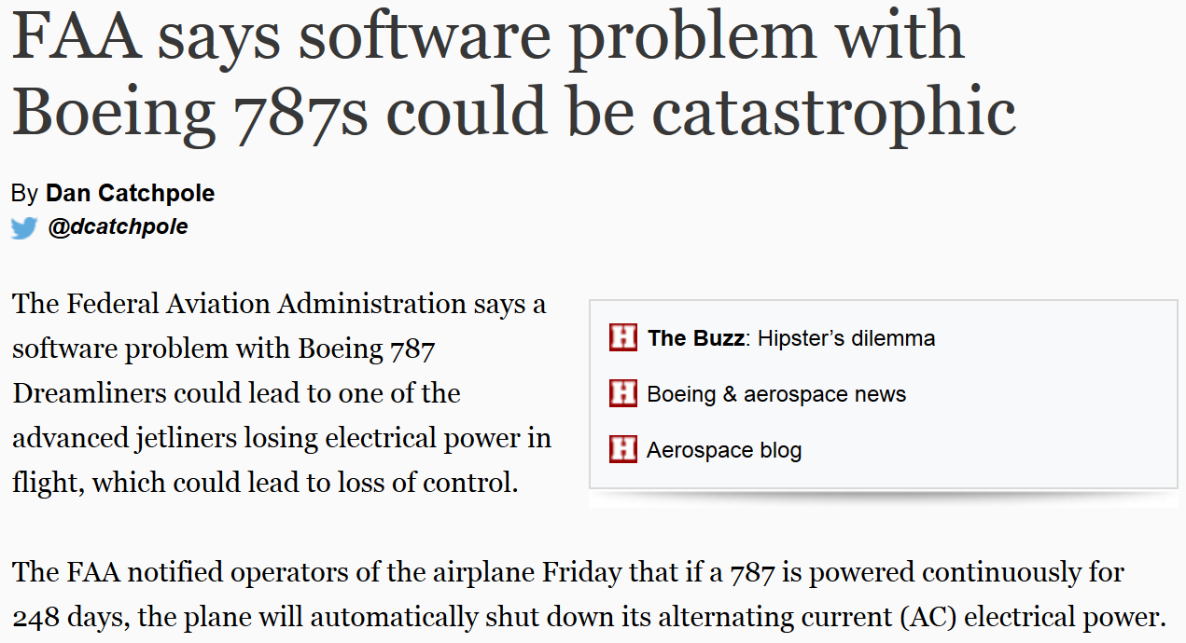
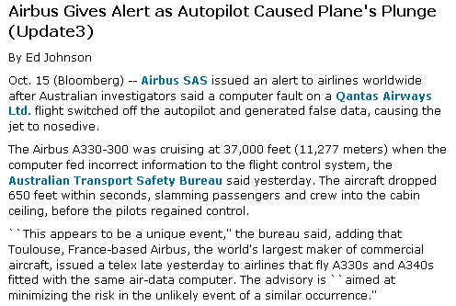
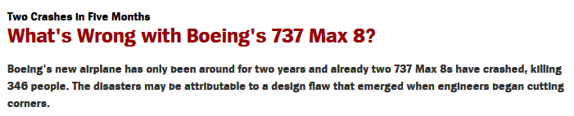
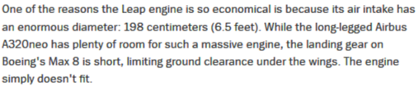
We Rely on Software for Safe System Operation
Embedded software systems introduce a new class of problems not addressed by traditional system safety analysis
Breakdown in human intensive safety assessment process
Notes:
Incident occurred on Oct 7, 2008.
Original articles shown on slide from Bloomberg website.
More details at http://en.wikipedia.org/wiki/Qantas_Flight_72

Slide 6
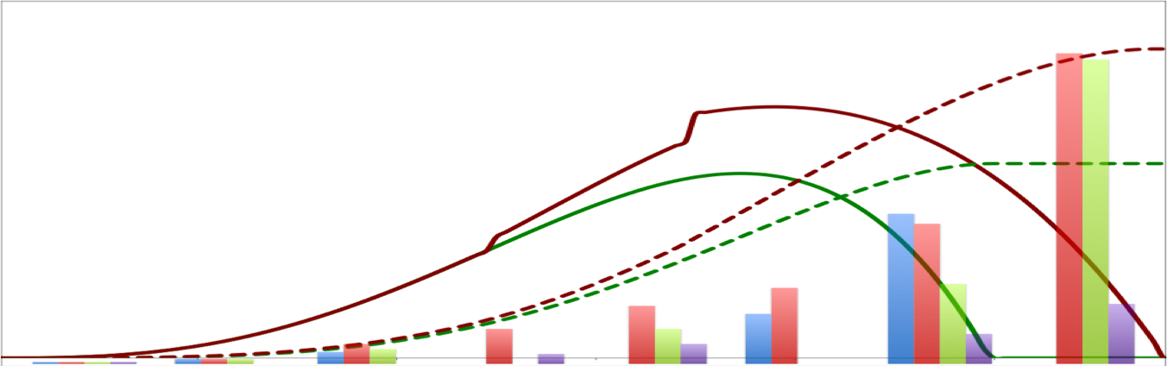
Current Practice: Impact on Cost and Schedule
High-level Design RFP Response
System Integration Checks
High-level Reqt’s in RFP
Reqt’s Changes
Target Completion
PDR
CDR
Trades
Req’s Define
Sys Design
Detailed Design
Sys Re-Design
Sys Development
Sys Integration
V&V
70% errors introduced
3.5% errors detected
1x cost to fix
10% errors introduced
80% errors detected
16-100x cost to fix
500-1000x (INCOSE 2011)
Sources:
NIST Planning report 02-3, The Economic Impacts of Inadequate Infrastructure for Software Testing, May 2002.
D. Galin, Software Quality Assurance: From Theory to Implementation, Pearson/Addison-Wesley (2004) B.W. Boehm, Software Engineering Economics, Prentice Hall (1981)
INCOSE Systems Engineering Handbook, Version 3.2.2, 2011
COST GROWTH
Trades &
Requirements
Design
Code
Unit Test
Item Test
System Test
Acceptance Test
SCHEDULE
DELAY
Operations
Software as % of total system development cost
1997: 45% 2010: 66% 2024: 88%
Post unit test software rework currently ~50% of total system development cost

Slide 7
Technical Challenges in Safety-Critical Embedded Software Systems
AADL Semantics Address the Challenges
System Engineer
Physical Plant Characteristics
System Hazards
Control Engineer
Measurement units
Boolean, integer, real, vs data abstraction
System
Under
Control
Control
System
System User/Environment
Time-sensitive Processing
Operator Error
Compute
Platform
Runtime
Architecture
Application
Software
Application Developer
Hardware
Engineer
Virtualization & Redundancy
Concurrency & Communication
Embedded SW System Engineer
Why do system level failures still occur despite best safety practices?
Embedded software systems have become a major safety and cyber security risk
Notes:
We need to understand the underlying technical issues introduced by Embedded Software Systems. System and control engineers focus on the physical system behavior and its effects on the safety of a system. Embedded software has become a major contributor to system malfunction representing a major safety as well as (cyber) security risk.
Embedded Software Systems introduce a new set of problems. They fall into several major categories:
Translation of physical measures into software variables raises issues of explicit measurement unit representation, and choice of variables to represent events, and value ranges in the application domain, e.g., 16 bit integers to represent speed.
Tasking and sampling vs. queued message and event communication and processing. A common mistake is sampling Boolean flags to identify events, where time jitter can cause the system to miss an event and reach an undesired state, e.g., the wheel braking system failing to operate. Concurrency can result in corrupted data as evidenced by even simple applications such as iTunes when dual-core processors came out.
Virtualization of resources, e.g., the use of ARINC653 partitions, results in physical redundancy becoming logical redundancy resulting in reduced reliability. In addition to virtualizing processors, memory, and networks as resources, the use of partitions can also result in virtualizing time, i.e., data may be sampled in the middle of a major frame rate than always at a known point in time.
Safety-critical systems process time sensitive data. While system and control engineers are concerned with physical latency, sampling latency, and algorithmic latency, embedded software introduces a long list of additional latency and jitter contributors.
The SAE International AADL standard suite addresses these technical challenges by providing standardized meaning for the types of components integrated in embedded software systems (system, processor, bus, memory, device, virtual processor, virtual bus, process, thread, subprogram), their connections, as well as dynamic changes to the embedded runtime architecture. It provides well-defined execution and communication timing semantics allowing for analysis of the execution of the software on the supporting computer hardware, communicating across buses and controlling the system physical components. It also provides a standardized specification of fault behavior associated with a system, which allows for safety and cyber security analysis.

Slide 8
Safety Critical Embedded Software System Challenge
SAE AADL Standard and Virtual System Integration to the Rescue
Embedded Software System Qualification and Assurance

Slide 9
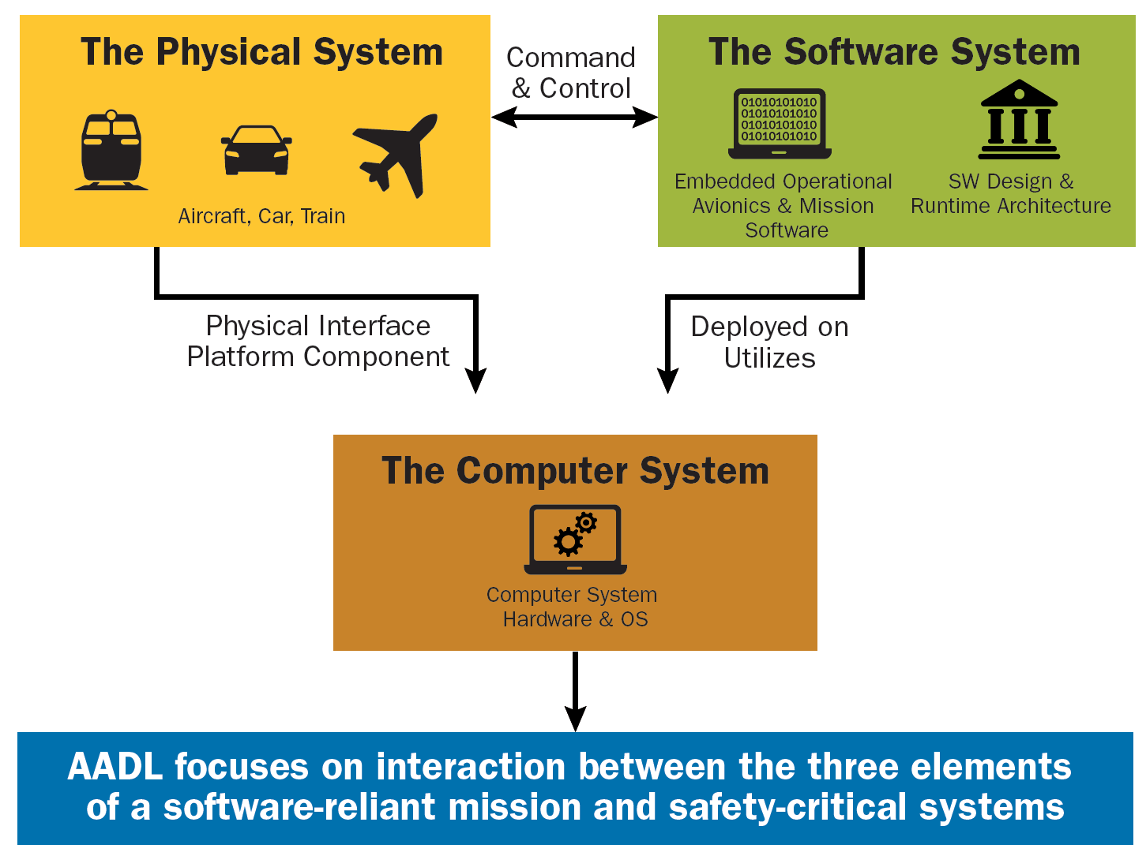
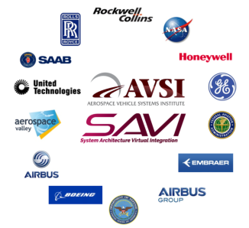


Architecture Analysis & Design Language (AADL) Standard Targets Embedded Software Systems
AS 5506 Standard Suite
Standards provide
long-term industry-wide solutions to support
multi-organization
model-based engineering
In 2008 Aerospace industry initiative chose AADL over SysML and other notations as it specifically addresses embedded software systems
AADL captures mission and safety critical embedded software system architectures in virtually integrated analyzable models to discover system level problems early and construct implementations from verified models
Notes:
The AADL provides standardized meaning for the types of components integrated in embedded software systems (processor, bus, memory, process, thread, subprogram, etc), their connections, and definition of the runtime interactions of the components, allowing analysis of the execution of the software on the supporting computer hardware, communicating across buses and controlling the system physical components. This is the capability required to do virtual integration of the system.
By providing standardized meaning, specifications in the AADL can be interpreted (or simulated), reused and analyzed by common analysis tools. Standardized meaning rather than customized meaning is an important aspect of building interchangeable specifications which provide advantages for integration, analysis, qualification, and generation of systems. Tools developed by one tool vendor can be chained to be used with tools from another vendor. Analyses can be selected based on their need and level of fidelity and the results integrated into the specification to impact the next level of specification. Analyses can be cross validated, within a domain of analysis, like safety, or across domains of architectural analysis, like safety, security, utilization, timing, scheduling, latency, etc. These integrations of analysis across a common specification provide a very powerful means for finding and resolving integration issues.
Standardized meaning is critical for analyzable open architecture, a key concept of Joint Multi-Role (JMR) and DoD objectives. Correct, safe and secure exchange, insertion, and update of components in architectures requires analyzability of the effects on emergent qualities of the system. Without standardized meaning that supports incremental and deep analysis such activities become higher risk by third party integrators increasing costs.
The Architecture Centric Virtual Integration Practice (ACVIP) takes advantage of this AADL virtual system integration capability, the cross domain analysis of a common specification, the tool chaining, and incremental refinement to discover the errors that occur during the development and refinement of requirements and design. This significantly reduces leakage of defects introduced during the requirements and design phases to system integration test.
Ref. SAE AS 5506 Standard
(1) The SAE Architecture Analysis & Design Language (referred to in this document as AADL) is a textual and graphical language used to design and analyze the software and hardware architecture of performance-critical real-time systems. These are systems whose operation strongly depends on meeting non-functional system requirements such as reliability, availability, timing, responsiveness, throughput, safety, and security. AADL is used to describe the structure of such systems as an assembly of software components mapped onto an execution platform. It can be used to describe functional interfaces to components (such as data inputs and outputs) and performance-critical aspects of components (such as timing). AADL can also be used to describe how components interact, such as how data inputs and outputs are connected or how application software components are allocated to execution platform components. The language can also be used to describe the dynamic behavior of the runtime architecture by providing support to model operational modes and mode transitions. The language is designed to be extensible to accommodate analyses of the runtime architectures that the core language does not completely support. Extensions can take the form of new properties and analysis specific notations that can be associated with components and are standardized themselves.
(2) AADL was developed to meet the special needs of performance-critical real-time systems, including embedded real-time systems such as avionics, automotive electronics, or robotics systems. The language can describe important performance-critical aspects such as timing requirements, fault and error behaviors, time and space partitioning, and safety and certification properties. Such a description allows a system designer to perform analyses of the composed components and systems such as system schedulability, sizing analysis, and safety analysis. From these analyses, the designer can evaluate architectural tradeoffs and changes.
(3) Since AADL supports multiple and extensible analysis approaches, it provides the ability to analyze the cross cutting impacts of change in the architecture in one specification using a variety of analysis tools. AADL is designed to be used with analysis tools that support the automatic generation of the source code needed to integrate the system components and build a system executive. Since the models and the architecture specification drive the design and implementation, they can be maintained to permit model driven architecture based changes throughout the system lifecycle.
See slide 12 for an illustration of the cross domain effects of change.

Slide 10
AADL Standard Suite (AS-5506 series)
Core AADL language standard [V1 2004, V2 2012, V2.2 2017]
Focused on embedded software system modeling, analysis, and generation
Strongly typed language with well-defined semantics for execution of threads, processes on partitions and processor, sampled/queued communication, modes, end to end flows
Textual and graphical notation
Revision V3 in progress: interface composition, system configuration, binding, type system unification
Standardized AADL Annex Extensions
Error Model language for safety, reliability, security analysis [2006, 2015]
ARINC653 extension for partitioned architectures [2011, 2015]
Behavior Specification Language for modes and interaction behavior [2011, 2017]
Data Modeling extension for interfacing with data models (UML, ASN.1, …) [2011]
AADL Runtime System & Code Generation [2006, 2015]
AADL Annexes in Progress
Network Specification Annex
Cyber Security Annex
FACE Annex
Requirements Definition and Assurance Annex
Synchronous System Specification Annex
Notes:
The following is from the Ref. SAE AS 5506 Standard
(1) The SAE Architecture Analysis & Design Language (referred to in this document as AADL) is a textual and graphical language used to design and analyze the software and hardware architecture of performance-critical real-time systems. These are systems whose operation strongly depends on meeting non-functional system requirements such as reliability, availability, timing, responsiveness, throughput, safety, and security. AADL is used to describe the structure of such systems as an assembly of software components mapped onto an execution platform. It can be used to describe functional interfaces to components (such as data inputs and outputs) and performance-critical aspects of components (such as timing). AADL can also be used to describe how components interact, such as how data inputs and outputs are connected or how application software components are allocated to execution platform components. The language can also be used to describe the dynamic behavior of the runtime architecture by providing support to model operational modes and mode transitions. The language is designed to be extensible to accommodate analyses of the runtime architectures that the core AADL language does not completely support. Extensions can take the form of new properties and analysis specific notations that can be associated with components and are standardized themselves.
(2) AADL was developed to meet the special needs of performance-critical real-time systems, including embedded real-time systems such as avionics, automotive electronics, or robotics systems. The language can describe important performance-critical aspects such as timing requirements, fault and error behaviors, time and space partitioning, and safety and certification properties. Such a description allows a system designer to perform analyses of the composed components and systems such as system schedulability, sizing analysis, and safety analysis. From these analyses, the designer can evaluate architectural tradeoffs and changes.
(3) Since AADL supports multiple and extensible analysis approaches, it provides the ability to analyze the cross cutting impacts of change in the architecture in one specification using a variety of analysis tools. AADL is designed to be used with analysis tools that support the automatic generation of the source code needed to integrate the system components and build a system executive. Since the models and the architecture specification drive the design and implementation, they can be maintained to permit model driven architecture based changes throughout the system lifecycle.
See slide 10 for an illustration of the cross domain effects of change.

Slide 11
SAE AADL & Architecture-centric Virtual Integration
Evolution, Maturation and Transition
AMRDEC has funded AADL standards development since 1999
Army and other Government Shadow Projects
Future Vertical Lift
Architecture-centric Acquisition
JPL
Mission Data System
JMR TD: ACVIP Shadow Projects
Common
Avionics
Architecture
System
Apache
Block III
ATAM
CH47F
Health
Monitor
Virtual System Integration
System Assurance
System Architecture Virtual Integration (SAVI) Software & Systems Engineering
AADLV1
Timing
Software & System
Co-engineering
Multi-team
Safety
Requirements
Assurance
SAE AADL Standard & Tool Support: Research Transition Platform
DARPA
MetaH
ACME
AADLV1
Error Model
European
Commission
SLIM/FIACRE
DARPA
META
DARPA
HACMS
Security
US & European Research Initiatives
OMG
MARTE
Embedded
Systems
ARINC653
Partitions
Avionics Network
Standards
System Safety Practice Standards
Regulatory Guidance
NRC, FDA, UL
Other Standards and Regulatory Guidance
2004
2008
2010
2012
2014
2016
2020
Notes:
To build competitive future software-reliant systems for Army Aviation , we need to integrate technologies from all three levels including SAVI and JMR TD. Technology, tools and processes need to be ready to support critical insertions like JMR TD and FVL.
Our international competition could easily lead us in applying this new paradigm for system development and qualification and for rapid architecture-centric system upgrades.

Slide 12
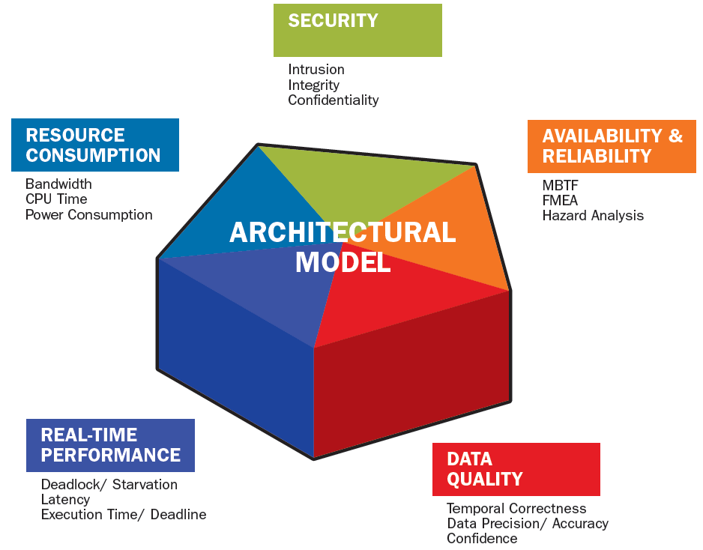
Analysis of System Properties via Architecture Model A Contribution to Single Source of Truth
Change of Encryption from 128 bit to 256 bit
CYBER
SECURITY
One change drives multiple system issues
Availability
Integrity
Confidentiality
SAFETY & RELIABILITY
Hazard Analysis
FMEA
FTA
MTBF
Higher CPU Demand
Potential New Hazard
SAE AS5506 AADL
Single Source of Truth Across Analysis Models
Affects Temporal Correctness
Increased Latency
Notes:
AADL with its built-in semantics for time sensitive processing and annex standards to address additional issues such as safety becomes a single source of truth for analysis results.
Analytical models are generated from the annotated AADL model and analyses along multiple functional and non-functional dimensions are run from the same source.
This establishes consistency across analysis results. It also allows for understanding the impact of a system change that affects multiple system properties. This is illustrated with a change to the encryption algorithm from 128 bit to 256 bit. Higher CPU demand results in change in latency and its jitter, which can result in a sampled event being missed, which in turn can cause a weapon release protocol to lock up or a braking system to malfunction, presenting a new safety hazard. Such issues can be very expensive to find and deadly in effect, yet seemingly totally unrelated to the encryption change.
As mentioned earlier, the SAE International AADL standard suite addresses these technical challenges by providing standardized meaning for the types of components integrated in embedded software systems (system, processor, bus, memory, device, virtual processor, virtual bus, process, thread, subprogram), their connections, as well as dynamic changes to the embedded runtime architecture. It provides well-defined the execution and communication timing semantics allowing for analysis of the execution of the software on the supporting computer hardware, communicating across buses and controlling the system physical components. It also provides a standardized specification of fault behavior associated with a system, which allows for safety and cyber security analysis.
This allows for continuous incremental verification and reverification of the system as its architecture model is modified and refined to greater detail. This provides immediate insight into the impact of such changes and refinements and reduces late discovery during system integration.

Slide 13
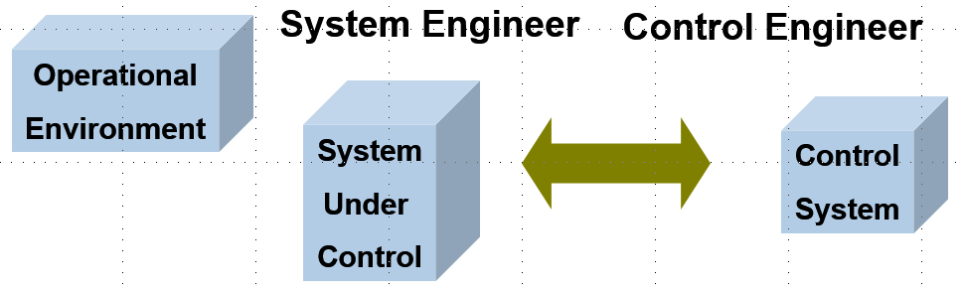
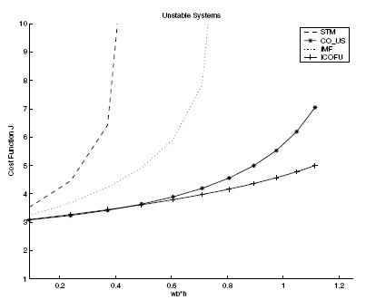
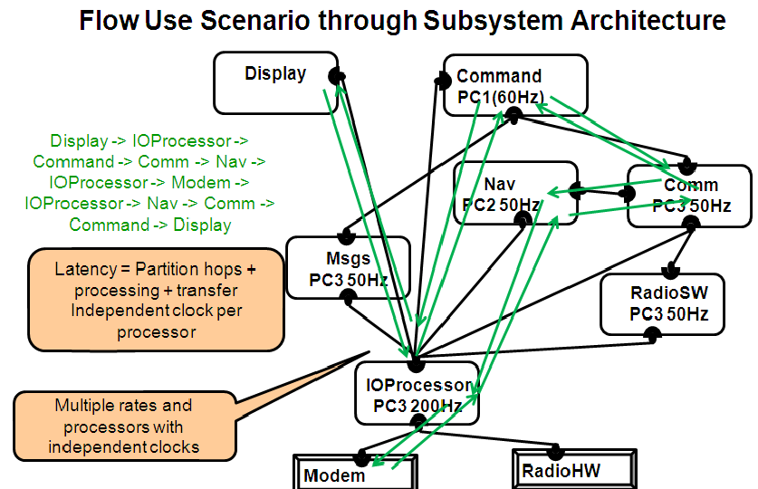
Latency and Jitter Contributors
Control System Engineering View
Processing latency
Sampling latency
Physical signal latency
Software System Latency Contributors
Execution time variation: algorithm, use of cache
Processor speed
Resource contention
Preemption
Legacy & shared variable communication
Rate group optimization
Protocol specific communication delay
Partitioned architecture
Migration of functionality
Fault tolerance mechanisms
Impact of Scheduler Choice on Controller Stability
A. Cervin, Lund U.
CCACSD 2006
Notes:
Here is a list of latency contributors due to choices in the the software runtime architecture.

Slide 14
Safety Critical Embedded Software System Challenge
SAE AADL Standard and Virtual System Integration to the Rescue
Embedded Software System Qualification and Assurance

Slide 15

Assurance & Qualification Improvement Strategy
Assurance: Sufficient evidence that a system implementation meets system requirements
2010 SEI Study for AMRDEC Aviation Engineering Directorate
Architecture-led Requirement Specification
Architecture-centric Virtual System Integration
Static Analysis & Compositional Verification
Incremental Assurance Plans & Cases throughout Life Cycle
Model Repository
Operational & failure modes
Mission Requirements
Function
Behavior
Performance
Architecture Model
Component Models
Resource, Timing & Performance Analysis
Survivability Requirements
Reliability
Safety
Security
System Implementation
Reliability, Safety, Security Analysis
System configuration
Data-Driven
High Leverage
Cost Effective
Architecture Centric Virtual System Integration Practice (ACVIP)
Architecture Led Incremental System Assurance (ALISA)
Notes:
The framework is an integration of technology concepts from architecture-centric model-based engineering (ACVIP) using the SAE AADL standard suite, system theoretic approach to safety analysis (Leveson MIT), safety cases & software assurance, model checking & static analysis of models and code, requirements formalization.
Requirements expressed in the context of an intended system. Both mission and reliability requirements must be validated for completeness and soundness.
The requirements are mapped onto the system architecture and its decomposition as claims. The system model and implementation must be verified against these mission and reliability claims (requirements). The confidence in this verification is determined by the by the coverage of the claims, the effectiveness of the verification methods, and the validity of assumptions made by the models and the verification methods.
Parts of this framework are embodied in the Aerospace Vehicle Systems Institute (AVSI) System Architecture Virtual Integration (SAVI) industry initiative.
Other parts have been prototyped by the Architecture-Led Incremental System Assurance (ALISA) an SEI funded toolset that is an extension to the OSATE toolset for AADL.
The resulting development environment provides a rich infrastructure for a data driven approach cost effective embedded software system development.

Slide 16
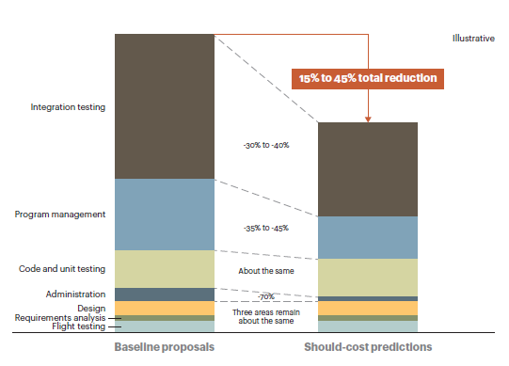
Cost Reduction Potential through Virtual Integration of Embedded Software Systems
Reduction through Focus on Verification of Architecture
ROI on AADL Pilot
Nominal development cost reduction of 26.1% ($2.391B out of $9.186B) for a 27 MSLOC system
Source: ROI Analysis of the System Architecture Virtual Integration Initiative
CMU/SEI-2018-TR-002
ATKearney “Software: The Brains Behind U.S. Defenses Systems”
Notes:
The cited paper by A.T. Kearney [https://www.atkearney.com/documents/10192/247932/Software-The_Brains_Behind_US_Defense_Systems.pdf/69129873-eecc-4ddc-b798-c198a8ff1026] identifies architecture as a key element for reducing cost in defense systems. Similar recommendations have been made by studies such as the 2007 National Research Council study “Software for Dependable Systems”.
Kearney shows “illustrative” figures for cost savings
A pilot study by the Aerospace industry consortium Aerospace Vehicle Systems Institute at Texas A&M under the System Architecture Virtual Integration (SAVI) in 2008 chose AADL as primary candidate to address the Embedded Software System affordability problem.. In that context they performed a return on investment study based on experiences by member companies with an AADL-based pilot project and in-house. The study showed an estimated cost savings of 26.1%. These numbers were verified by several company’s in-house teams using their cost estimation tools.
SAVI members included Boeing Commercial, Airbus, Embraer, Honeywell, Rockwell Collins, GE Aviation, as well as NASA, FAA, U.S. Army AMRDEC, and SEI.

Slide 17
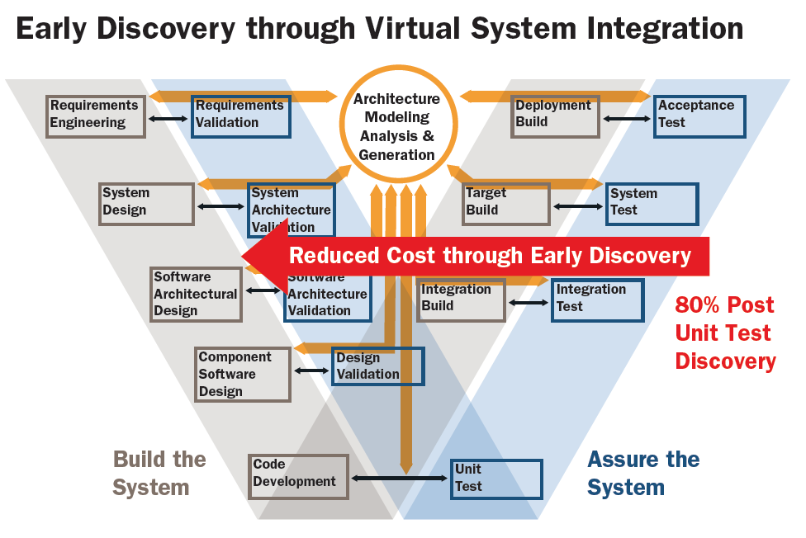

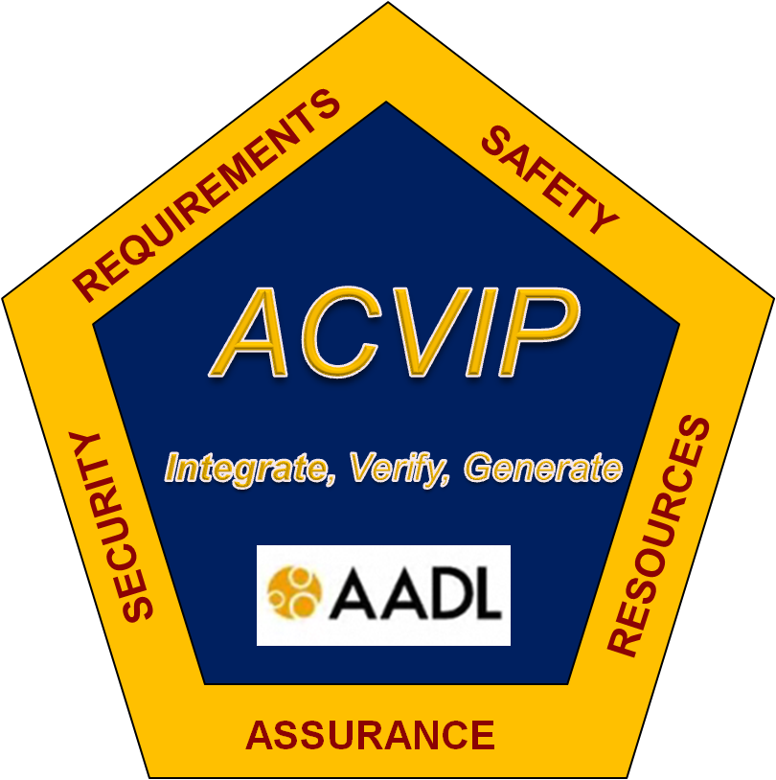
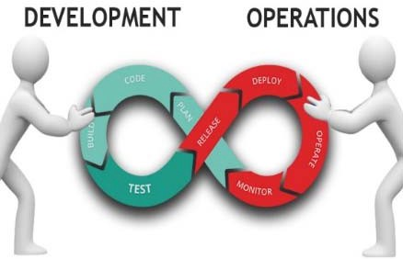
Benefits of Virtual System Integration & Continuous Lifecycle Assurance
Increased Confidence through Continuous Verification And Testing
Notes:
ACVIP changes the traditional life cycle V of development on the left and testing on the right into a double V:
The development V extends from the left to the right in that integration, calibration, and configuration parameters must be managed.
The assurance extends to the left in that architecture and detailed design models are integrated, analyzed, and verified incrementally throughout the life cycle.
As such ACVIP aligns with DevOp, whose focus is on managing the development and deployment of source code incrementally on a continuous basis.

Slide 18
Summary
Safety Critical Embedded Software Systems are facing exponential growth in software development cost exceeding 70% of total system development cost.
AADL is basis for a set of technologies and practices that specifically have been designed to provide early detection and continuous verification throughout the life cycle.
A number of case studies and pilot projects by different organizations have demonstrated the benefit of virtual system integration with AADL.

