Slide 1
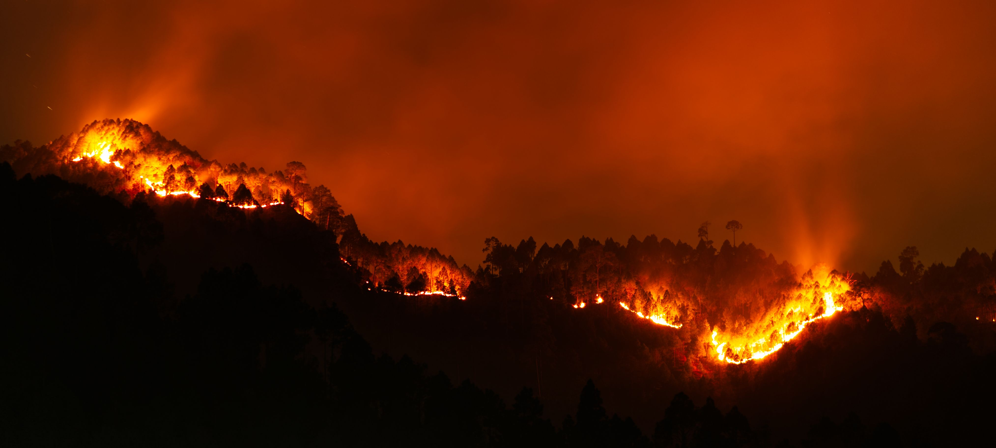
Predicting Wildfire Ignition in the USA
Juan Calvo Sánchez
Ricardo Higginson
Notes:
Title slide. Replace the placeholders with your names and the bootcamp name.

Slide 2

The data behind the project
US Wildfire Dataset 2014–2025 (FireCastRL, Kaggle) — weather from GRIDMET, ignitions from IRWIN
How we summarise the weather
126K
26.5%
Today
Same-day conditions on the reference day
labelled observations
wildfire cases
7 days
Average / median / min / max of the previous week
15
75
14 days
Two-week background conditions
GRIDMET weather variables
days of weather per observation
30 days
Monthly drought and heat build-up
Each row = one location on one reference day ("Today"), with the weather of the previous 60 days. Negative (non-fire) samples were synthesised by the dataset authors using spatial and temporal offsets.
Weather variables: precipitation, specific & relative humidity, solar radiation, min/max temperature, wind speed, vapour pressure deficit, evapotranspiration, fuel moisture, ERC, burning index.
Wildfire Ignition Risk Prediction
Notes:
Introduce the dataset and the time-window framework (Today / 7 / 14 / 30 days) which is the same framework the dashboard and the model use.

Slide 3
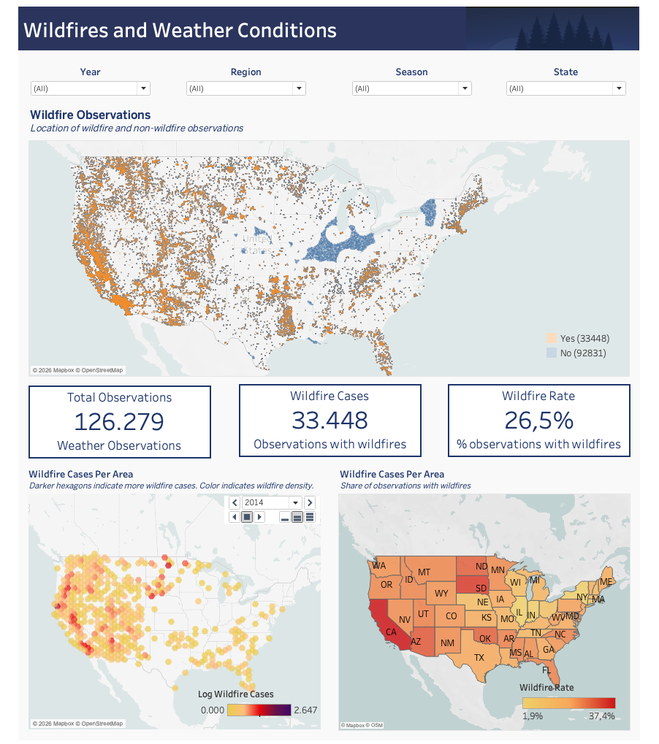



Dashboard · Where do wildfires happen?
Tableau page 1 — every observation on the map, plus wildfire density and wildfire rate by state
What the page shows
Observation map
Orange = wildfire, blue = non-fire. Filters for year, region, season and state drive every chart on the page.
33,448 wildfires of 126,279 observations
A 26.5% wildfire rate across the continental US, 2014–2025.
Density & rate by state
Hexagons show where fires cluster; the choropleth shows wildfire rate from 1.9% up to 37.4% — California leads.
Wildfire Ignition Risk Prediction
Notes:
Bridge slide: show briefly, then switch to Tableau and walk through the map, KPIs, hex density (2014 selected) and state wildfire rate. Use one filter (e.g. Season = Summer or State = CA) to show interactivity.

Slide 4
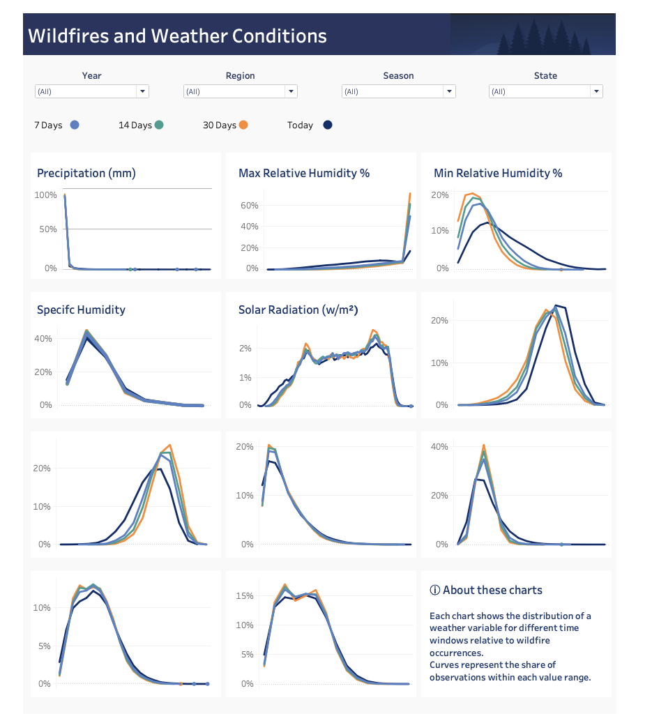


Dashboard · How is the weather distributed?
Tableau page 2 — distribution of each weather variable for Today, 7, 14 and 30 days before the reference day
How to read it
One chart per weather variable
Curves show the share of observations within each value range — a distribution, not a time series.
Four curves = four time windows
Dark navy is Today; blue, green and orange are the 7-, 14- and 30-day aggregates.
Today vs. the long windows
Today's curves are wider and shifted: e.g. minimum humidity today is spread out, while 30-day minimums are concentrated at low values.
Wildfire Ignition Risk Prediction
Notes:
Explain that this page is about data distribution. Point out the Today vs 30-day difference on Min Relative Humidity and Precipitation. Then hand over to the ML part.

Slide 5

Part 2
Building the model
Pipeline · Performance · Thresholds · Limitations
Wildfire Ignition Risk Prediction
Notes:
Section divider — one sentence: 'Once the data was prepared, we started the ML process.'

Slide 6
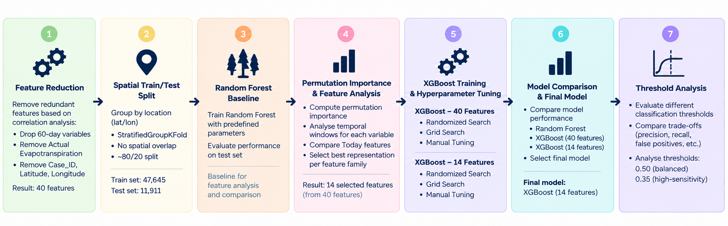

Machine-learning training pipeline
Seven steps from 40 candidate features to a tuned 14-feature XGBoost model
Spatial split by lat/lon — zero location overlap between train and test, so no spatial leakage.
Permutation importance on a Random Forest baseline ranked the features; one best window per weather family.
Out-of-fold re-check within the training set gave virtually identical results (69.3% vs 69.4%).
Wildfire Ignition Risk Prediction
Notes:
SPEECH — Slide 1 (ML pipeline): identifiers and redundant variables removed → 40 features. Spatial split by lat/lon to avoid leakage. Random Forest baseline + permutation importance. OOF re-check: results virtually unchanged. 40 → 14 features; XGBoost trained and tuned with both sets.

Slide 7
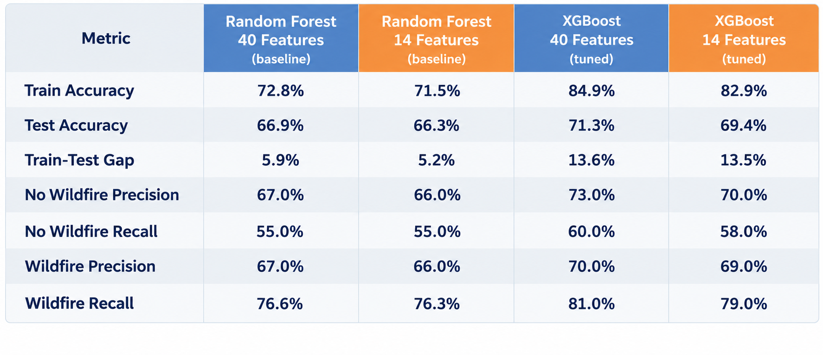
Model performance
Untouched spatial test set — 11,911 observations
Final model
XGBoost · 14 features
69.4%
test accuracy
79%
wildfire recall
65% fewer inputs than the 40-feature benchmark, for ~2 points of accuracy. Simpler to explain, simpler to demo.
Wildfire Ignition Risk Prediction
Notes:
SPEECH — Slide 2 (performance): final model = XGBoost 14 features; chosen because much simpler with similar performance. 69% test accuracy, 79% wildfire recall. 40-feature model kept as benchmark.

Slide 8
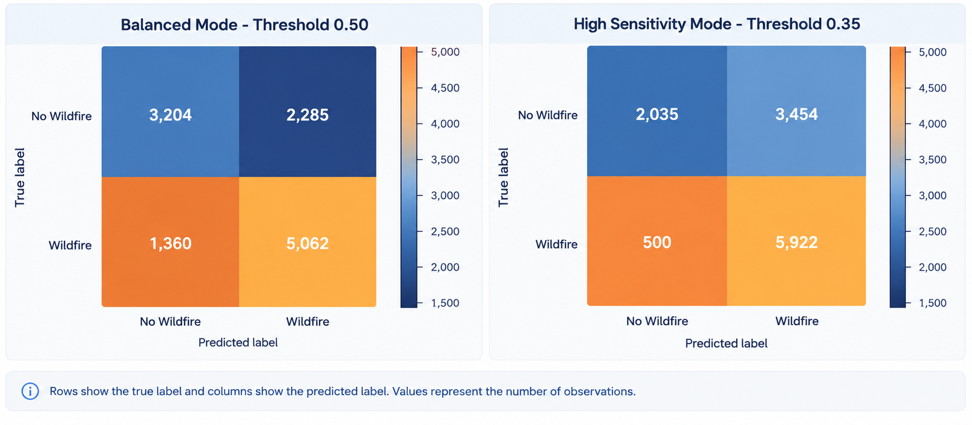
Two operating modes: balanced vs. high sensitivity
Same model, different classification threshold — evaluated on the test set
0.50
Balanced mode
0.35
High-sensitivity mode
−63%
Missed wildfires
5,062 wildfires detected · 1,360 missed · 2,285 false alarms
5,922 detected · only 500 missed · but 3,454 false alarms
Lower threshold catches more fires at the cost of more false positives
Wildfire Ignition Risk Prediction
Notes:
SPEECH — Slide 3 (thresholds): at 0.50 we detect ~5K wildfires and miss ~1.4K. At 0.35 we detect almost 6K and miss only ~500, but get ~3.5K false positives. Lower threshold = more fires caught, more false alarms.

Slide 9
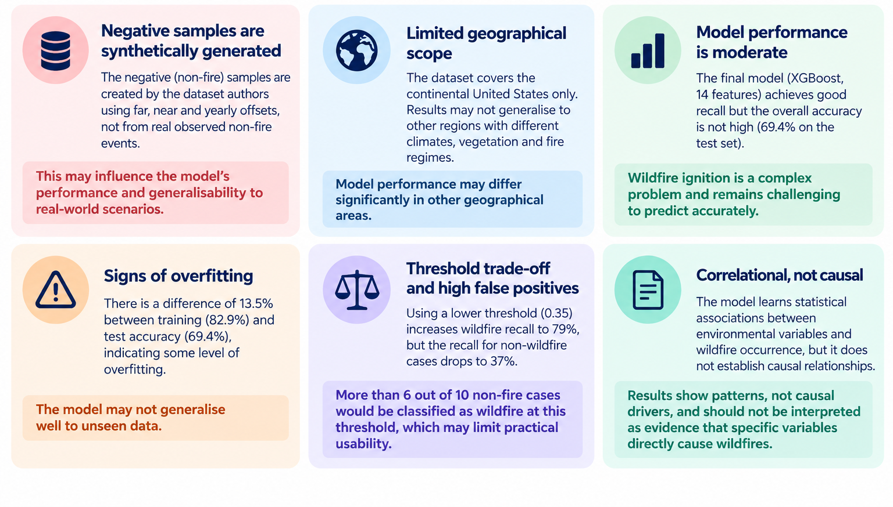
Key limitations
An experimental predictive model — not an operational wildfire warning system
Wildfire Ignition Risk Prediction
Notes:
SPEECH — Slide 4 (limitations): synthetic negatives; continental US only; overfitting (13.5 pp train-test gap); correlation not causation. Conclusion: experimental predictive model, not an operational warning system.

Slide 10

Part 3
Live demo
From 14 weather inputs to a wildfire probability — and the reasons behind it
Wildfire Ignition Risk Prediction
Notes:
Section divider. One sentence and move on to the 'how the demo works' slide.

Slide 11




How the demo works
A Jupyter interface (ipywidgets) wrapping the final XGBoost model, its thresholds and a SHAP explainer
1
2
3
4
Enter 14 conditions
Or load a preset
Pick a mode
Read the result
10 historical aggregates (7/14/30-day) + 4 same-day values. Each card shows unit, meaning and valid range.
Two controlled scenarios: 🌳 Low-risk (wet, cool, calm) and 🔥 High-risk (dry, hot, windy).
Balanced (threshold 0.50) or High-sensitivity (0.35) — the same trade-off we just saw.
Wildfire probability, the class decision, and the Top-5 SHAP contributors with their direction.
Under the hood: xgb_reduced_final.pkl · feature_metadata.json · shap.TreeExplainer — same prediction logic also available as a terminal app
Wildfire Ignition Risk Prediction
Notes:
Explain the 4 steps quickly (≈45 s), then switch to the notebook.

Slide 12





The 14 inputs the model needs
One best-performing time window per weather family, plus four same-day readings
Precipitation
30-day avg
mm/day
↓
Specific humidity
30-day median
kg/kg
↓
Min relative humidity
30-day min
%
↓
Max relative humidity
7-day max
%
↓
Solar radiation
7-day median
W/m²
↑
Min daily temperature
14-day min
°C
↑
Max daily temperature
30-day max
°C
↑
Wind speed
30-day median
m/s
↑
Vapour pressure deficit
30-day median
kPa
↑
Potential evapotranspiration
30-day median
mm/day
↑
Solar radiation
Today
W/m²
↑
Min relative humidity
Today
%
↓
Vapour pressure deficit
Today
kPa
↑
Wind speed
Today
m/s
↑
↑ higher value generally increases wildfire risk ↓ higher value generally decreases wildfire risk · 30-day precipitation is the strongest single predictor (17% of mean |SHAP|)
Wildfire Ignition Risk Prediction
Notes:
Optional slide — show only if the audience asks what the inputs are, or refer to it while filling the demo. Note the mix: 10 historical windows + 4 Today values.

Slide 13

Thank you
Questions?
126K observations, 12 years, one clear time-window framework
XGBoost with 14 features: 69% accuracy, 79% wildfire recall, spatially validated
Threshold choice is a policy choice: fewer missed fires vs. fewer false alarms
SHAP makes every single prediction explainable
Dataset: FireCastRL, US Wildfire Dataset 2014–2025 (Kaggle) · Weather: GRIDMET · Ignitions: IRWIN
Notes:
Close with the four takeaways and open for questions.

