Slide 1
UNIVERSITY SPRINT · PERCEPTION & ROBOTICS
Street View Robot
A mobile robot that drives a room and builds a 360° depth map at every stop.
TEAM
Saed Abu Fool
Saleh Khalil
Mahmod Stitia
Ahmad Khalifa
Ahmad Shalabi
Instructor: Mr. Rajaei Khatib

Slide 2



THE GOAL
Scan the surroundings → a 360° depth map
Park anywhere, spin once, and turn what the camera sees into a single 3D depth map of the room.
ONE ROOM, MANY STOPS
Drive to a spot
manual or autonomous
Spin 360° in place
10 stereo captures
Fuse into one cloud
a navigable 3D depth map
● stop ◌ 360° scan
STREET VIEW ROBOT
2

Slide 3





HARDWARE
What the robot is made of
Raspbot V2
Raspberry Pi 5
RealSense D405
4× Mecanum wheels
omnidirectional + spin
I2C motor board
8 GB RAM
runs the whole stack
headless, over Wi-Fi
stereo IR, 18 mm base
factory-calibrated
passive — no projector
ALSO ONBOARD
Ultrasonic rangefinder
obstacle distance
4× IR line-tracking sensors
ground reference / line following
STREET VIEW ROBOT
3

Slide 4

IMPLEMENTATION
Two ways to drive
MODE 1
MODE 2
Manual control
Autonomous line-following
Real-time WASD — omnidirectional + spin.
One keypress fires the scan routine.
Also drivable from the web dashboard.
Follows dark tape via 4 IR sensors.
Cross “stop markers” mark a scan point.
Halt → scan → resume to the next.
Both modes feed the same routine: rotate → capture → merge
STREET VIEW ROBOT
4

Slide 5



IMPLEMENTATION
A custom 3D-printed sensor mount
We modelled a mount in CAD and 3D-printed it to fix the D405 + pan/tilt camera on the car at the right height and angle.
Designed in CAD
3D-printed
PHOTO — add here
PHOTO — add here
modelled to fit the chassis + camera
mounted on the robot
STREET VIEW ROBOT
5

Slide 6
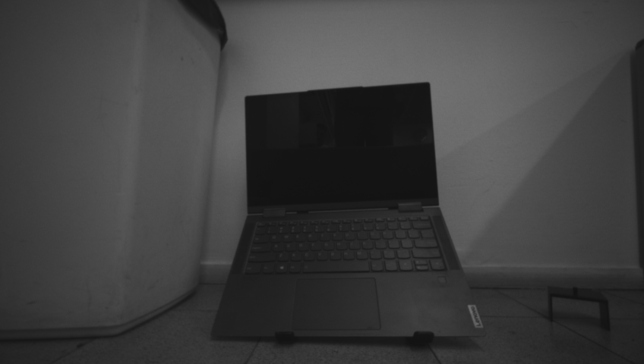
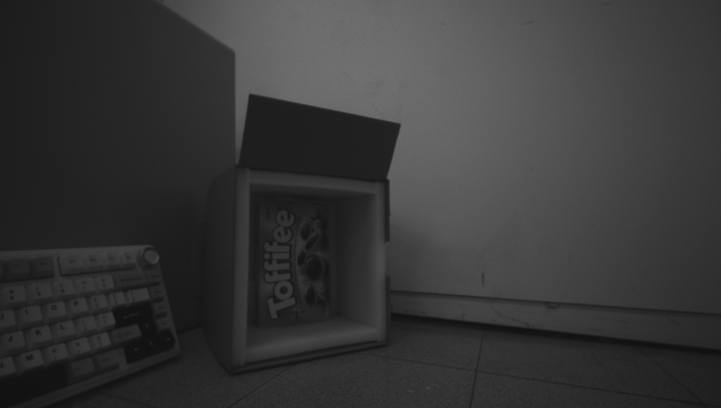
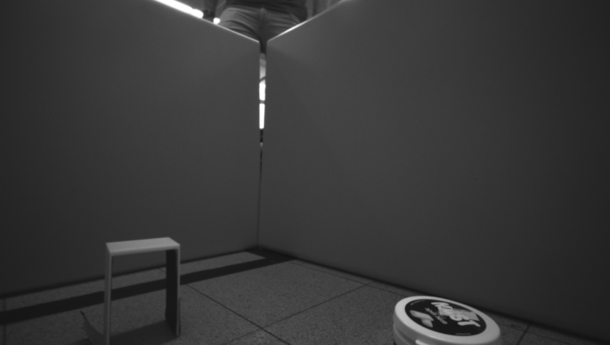
IMPLEMENTATION
Spin 360° · capture 10 shots
No IMU or wheel encoders — the spin is open-loop: timed motor pulses, calibrated once per floor. Stop every ~36°, take a stereo shot, repeat ×10.
WHAT IT CAPTURES (real shots)
shot 0
shot 3
shot 6
Each shot → captures/scan_<ts>/shot_NN/ with depth, the IR pair, intrinsics, and its cumulative angle.
10 stops · 36°
STREET VIEW ROBOT
6

Slide 7
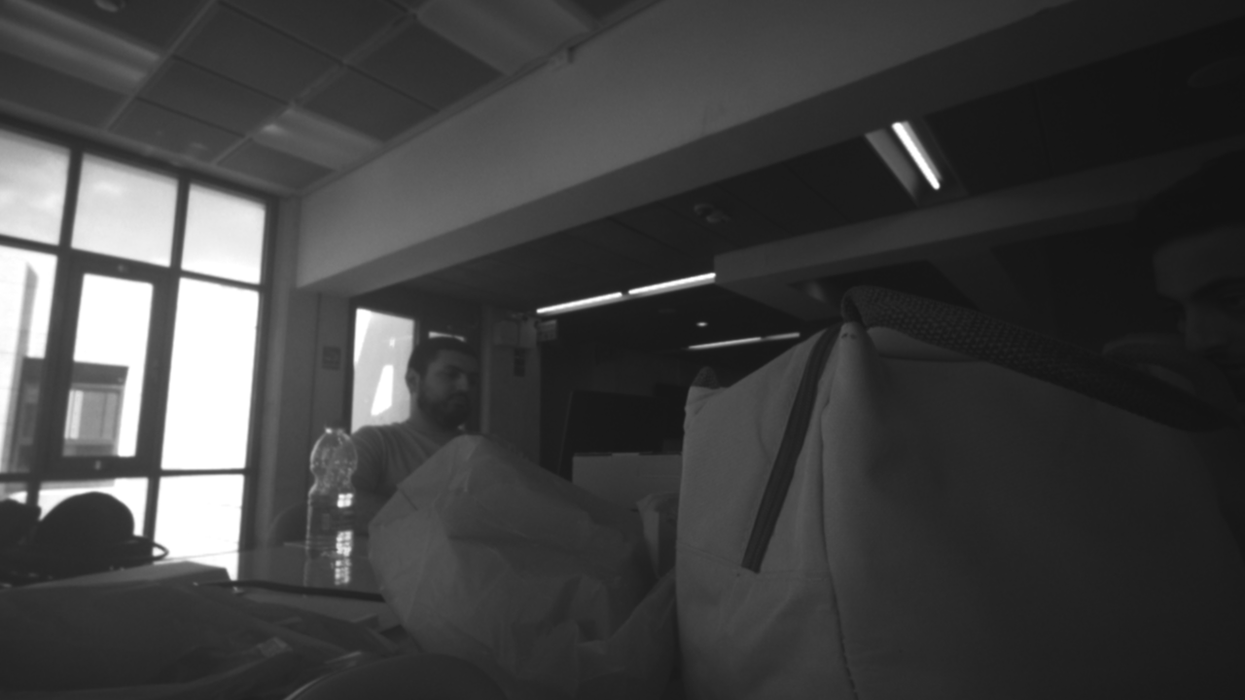
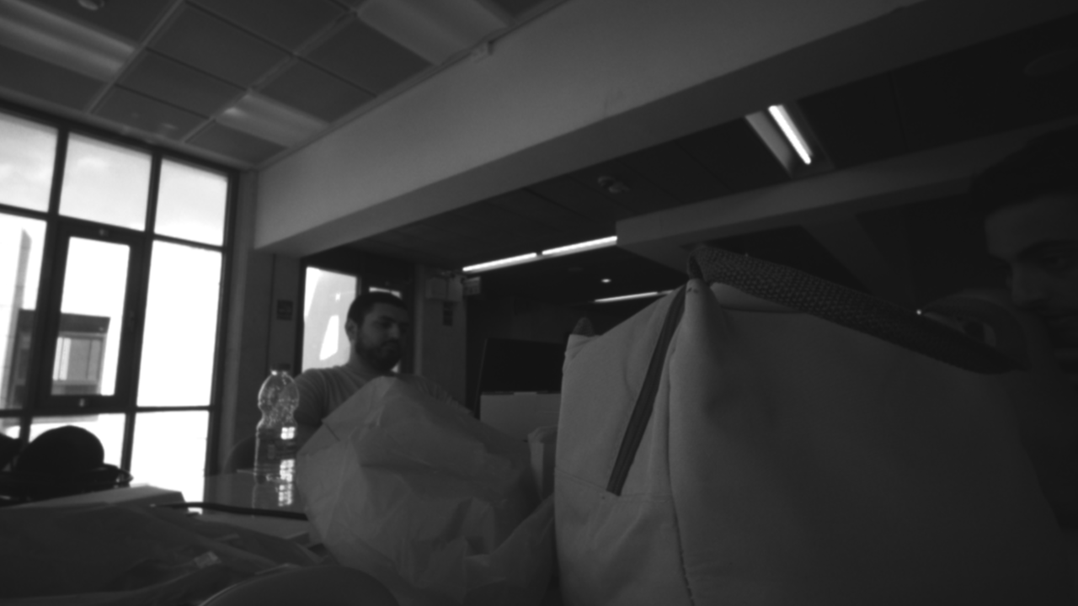
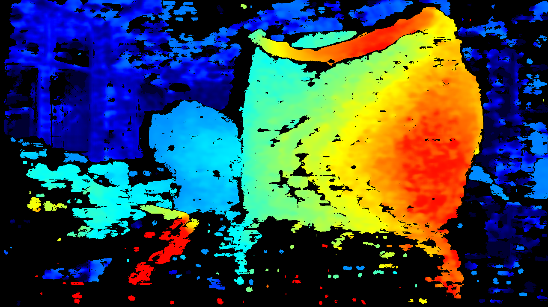

IMPLEMENTATION
Our own stereo depth — SGBM
Two IR views of the same scene are offset. Block matching finds each pixel’s left↔right shift (disparity); closer points shift more.
IR — left
IR — right
Depth — our SGBM
depth = f · B / disparity
Semi-Global Block Matching
smooths matches along many directions; optional WLS filter fills holes.
STREET VIEW ROBOT
7

Slide 8



IMPLEMENTATION
10 shots → 360° · ① match features
The robot’s turn is unreliable, so we don’t trust the angle — we measure it from what the cameras saw. First, find and match features between overlapping shots.
CLAHE-enhance the IR
the D405 IR is dim (~55/255) — boost contrast first
WHY CLAHE MATTERS
Raw, dim shots give the detector almost nothing — the ring breaks. Contrast-boosting first reveals the real texture:
Detect ORB / SIFT keypoints
thousands of corners per shot
53
992
keypoints / shot
Match overlapping pairs
filter false matches with a 2D fundamental test
4/10
10/10
shots registered
STREET VIEW ROBOT
8

Slide 9
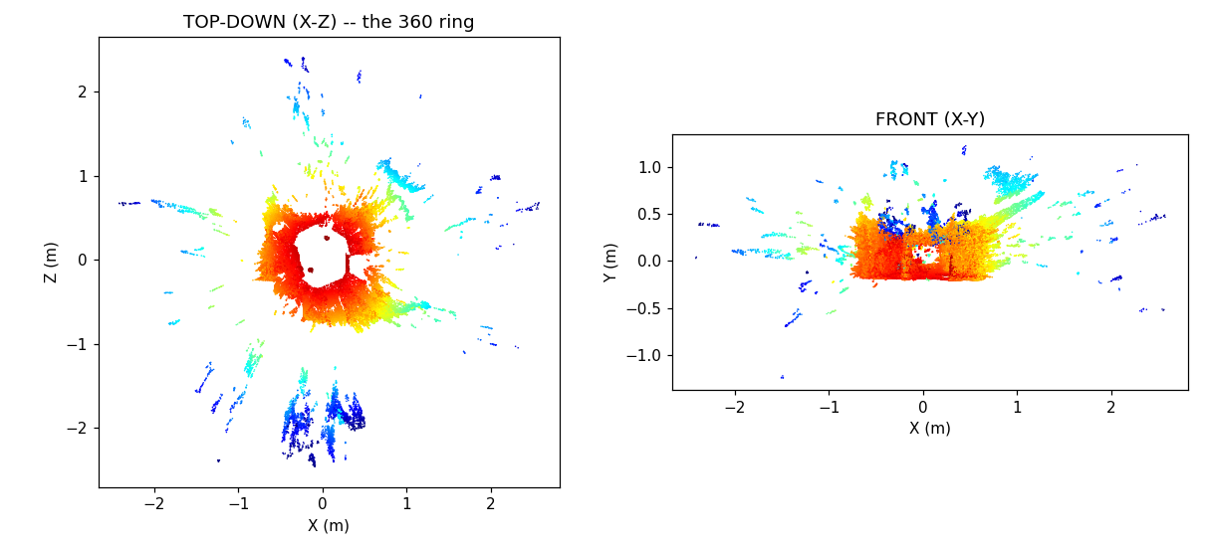
IMPLEMENTATION
10 shots → 360° · ② solve the geometry
1
Lift each matched feature to 3D through the depth map.
2
Per pair: Kabsch + RANSAC → a rigid transform (no angle guess).
3
Pose graph: neighbours = odometry, the rest = loop closures.
4
Global optimisation spreads drift → fuse, voxel 5 mm.
pose graph
Result: all 10 shots in one connected 360° cloud (red = near, blue = far)
STREET VIEW ROBOT
9

Slide 10

IMPLEMENTATION
Result — a full room scan
VIDEO — add here
Robot drives, spins, and the 360° cloud builds up
STREET VIEW ROBOT
10

Slide 11
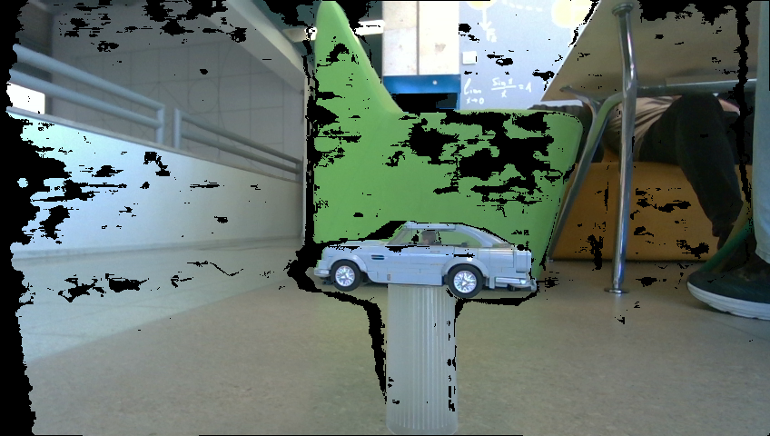
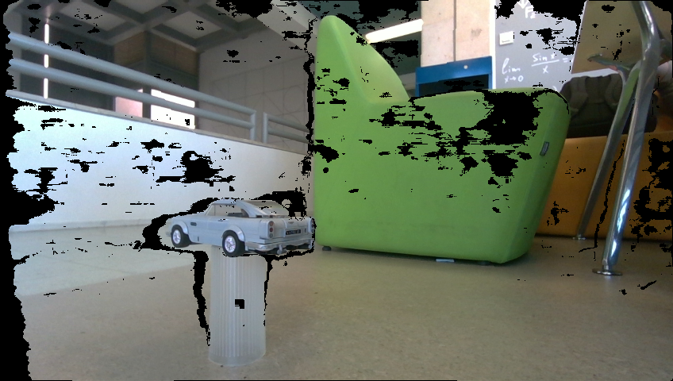
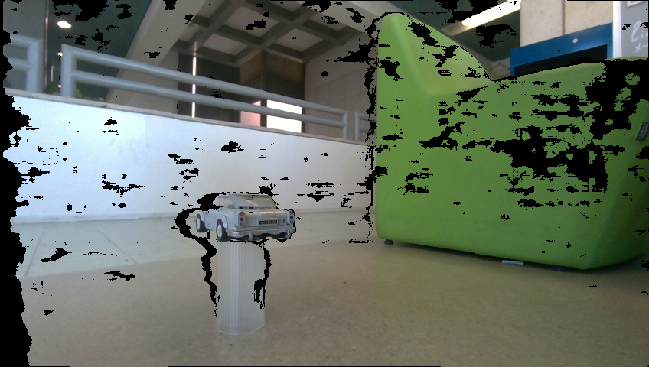
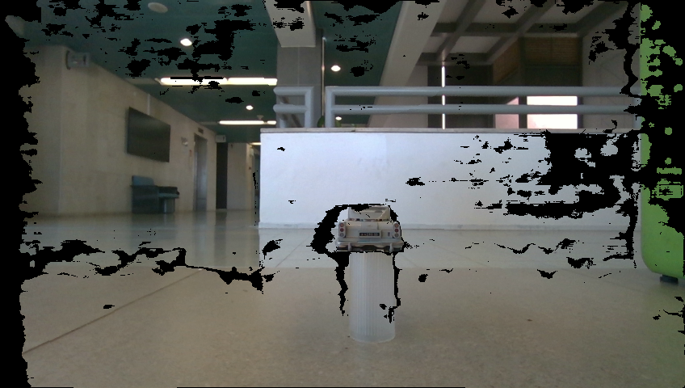


IMPLEMENTATION
Bonus — scan a single 3D object
Instead of mapping a room, orbit one object (D405 sweet spot: 7–50 cm) and reconstruct it as a clean point cloud + a textured mesh.
Robot orbits the object — background segmented out, object kept (real captures)
1. Segment
2. Angle prior
3. Multiway ICP + loop
4. Poisson mesh
STREET VIEW ROBOT
11

Slide 12
IMPLEMENTATION
Object scan — demo & result
VIDEO — add here
PHOTO — add here
Scanning the object (orbit / turntable)
The reconstructed 3D mesh
STREET VIEW ROBOT
12

Slide 13
IMPLEMENTATION
Autonomous line-following
A PID state machine reads the 4 IR sensors and steers to keep the tape centred. A cross marker (all 4 trip) = a scan stop.
VIDEO — add here
Robot following the tape to a stop marker
— tape ＋ stop marker ● 4 IR sensors
STREET VIEW ROBOT
13

Slide 14



RECAP
Everything the robot does
360° room depth map
Custom SGBM depth
Manual driving
spin + fuse into one 3D cloud
our own stereo depth, from scratch
WASD teleop + web dashboard
Autonomous line-follow
3D object scan
3D-printed mount
PID + stop-marker scanning
orbit → point cloud + mesh
custom CAD sensor rig
STREET VIEW ROBOT
14

Slide 15
Thank you
An autonomous robot that turns a room — or an object — into 3D.
Questions?

