Slide 1
First Steps in a Programming Career
Saad SayedAhmad

Slide 2
Outline
About me
Operating Systems
Package Managers
Command-line
Git
Software Engineering
Write Better Code
Medium
Github
Interviews
Job Offers
Extra Tips

Slide 3


About me
Academic:
  PPU - Bachelors of Science in Computer Science Engineering, 2017.
    Worked with Dr. Hani Salah and Eng. Mohammad Alfatafta on detecting malicious network packets.
  UNCG - Masters of Science in Computer Science (Data Science Track), 2019.
    Researched some Machine Learning Problems

Slide 4


About me
Professional:
  Itqan – Software Developer, 2017
    Desktop (C#) and Mobile (Android) Accounting & Management Software
  CentralSquare Technologies – Data Scientist, 2019-Present
    Public Safety
    Data Pipelines (ETL)
    Machine Learning
    Infrastructure (DevOps & Containerization)
    Software Development

Slide 5



Disclaimer
You don’t go from 0 to Hero in 1 day
Take your time and learn on your own pace
This presentation is based on my personal experience and the things I think are best practices

Slide 6

Operating Systems
Regardless of what you do, it’s good to know about Linux
Most servers in the word use Linux
You have more “control” on what you can do
Supports major programming languages out of the box.
Security and Privacy
Community support
It’s free and open source

Slide 7
Operating Systems
Understand Memory Management
Understand Task Scheduling
Understand Web 101
  HTTP Request Methods (GET, POST, DELETE, PUT, …)
  https://developer.mozilla.org/en-US/docs/Web/HTTP/Methods
  HTTP Headers (keep-alive, cache-control, user-agent, content-encoding, …)
  https://developer.mozilla.org/en-US/docs/Web/HTTP/Headers

Slide 8

Package Managers
They make it so intuitive to download and install tools, languages, libraries, applications, …
Windows
  chocolatey - https://chocolatey.org/install
  Windows Package Manager - https://devblogs.microsoft.com/commandline/windows-package-manager-preview/
Linux
  apt, yum, …
macOS
  Brew - https://brew.sh/
.Net
  NuGet - https://www.nuget.org/
Python
  Pip, Conda - https://pip.pypa.io/en/stable/ - https://docs.conda.io/en/latest/
Node.js
  Npm - https://www.npmjs.com/get-npm
Java
  Maven

Slide 9
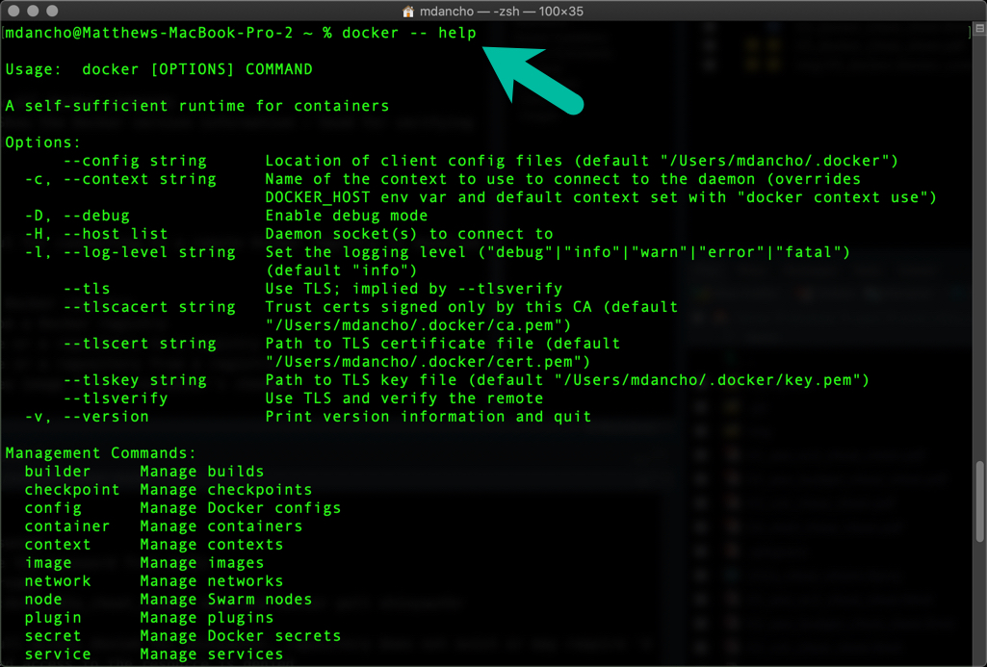
Command-line interface (CLI)
Also known as Shell scripting
  Windows has cmd and Powershell
  Unix-based OS has sh, bash, zshell, …
Why do you need to learn it?
  You don’t always have access to GUI, and most of the time you have more control over things with CLI.
  Cloud services are mostly command-line only
  Makes a lot of things easier.
Basic commands: ls, cd, pwd, mkdir, cp, mv, touch, cat, …

Slide 10

Git
A Version Control System (VSC)
Why do you need it?
  Organizes Coding Projects
  Makes it easier to collaborate and work in teams
  Easier to find bugs
  Not so complicated for simple usage
  It’s a “best practice”, everyone should you use it
How to use it?
  CLI - https://git-scm.com/book/en/v2
  GUIs - https://git-scm.com/downloads/guis

Slide 11

Software Engineering
Mostly Agile Scrum
Concepts:
  Projects
    Example: Search Engine
  Stories/Tickets/Tasks
    Example: Make search return results in alphabetical order
    Have estimates assigned to them to give them a time and complexity weight
  Sprints
    Multiple stories are worked on during a sprint
    Has a time limit, e.g. two weeks
  Scrum Master
    Distributes tasks between developers/engineers
    Monitors performance of devs/engs and velocity of the project
Tools:
  Project Management: Jira, PivotalTracker, Trello, …
  Code Management: Github, Gitlab, BitBucket, …

Slide 12
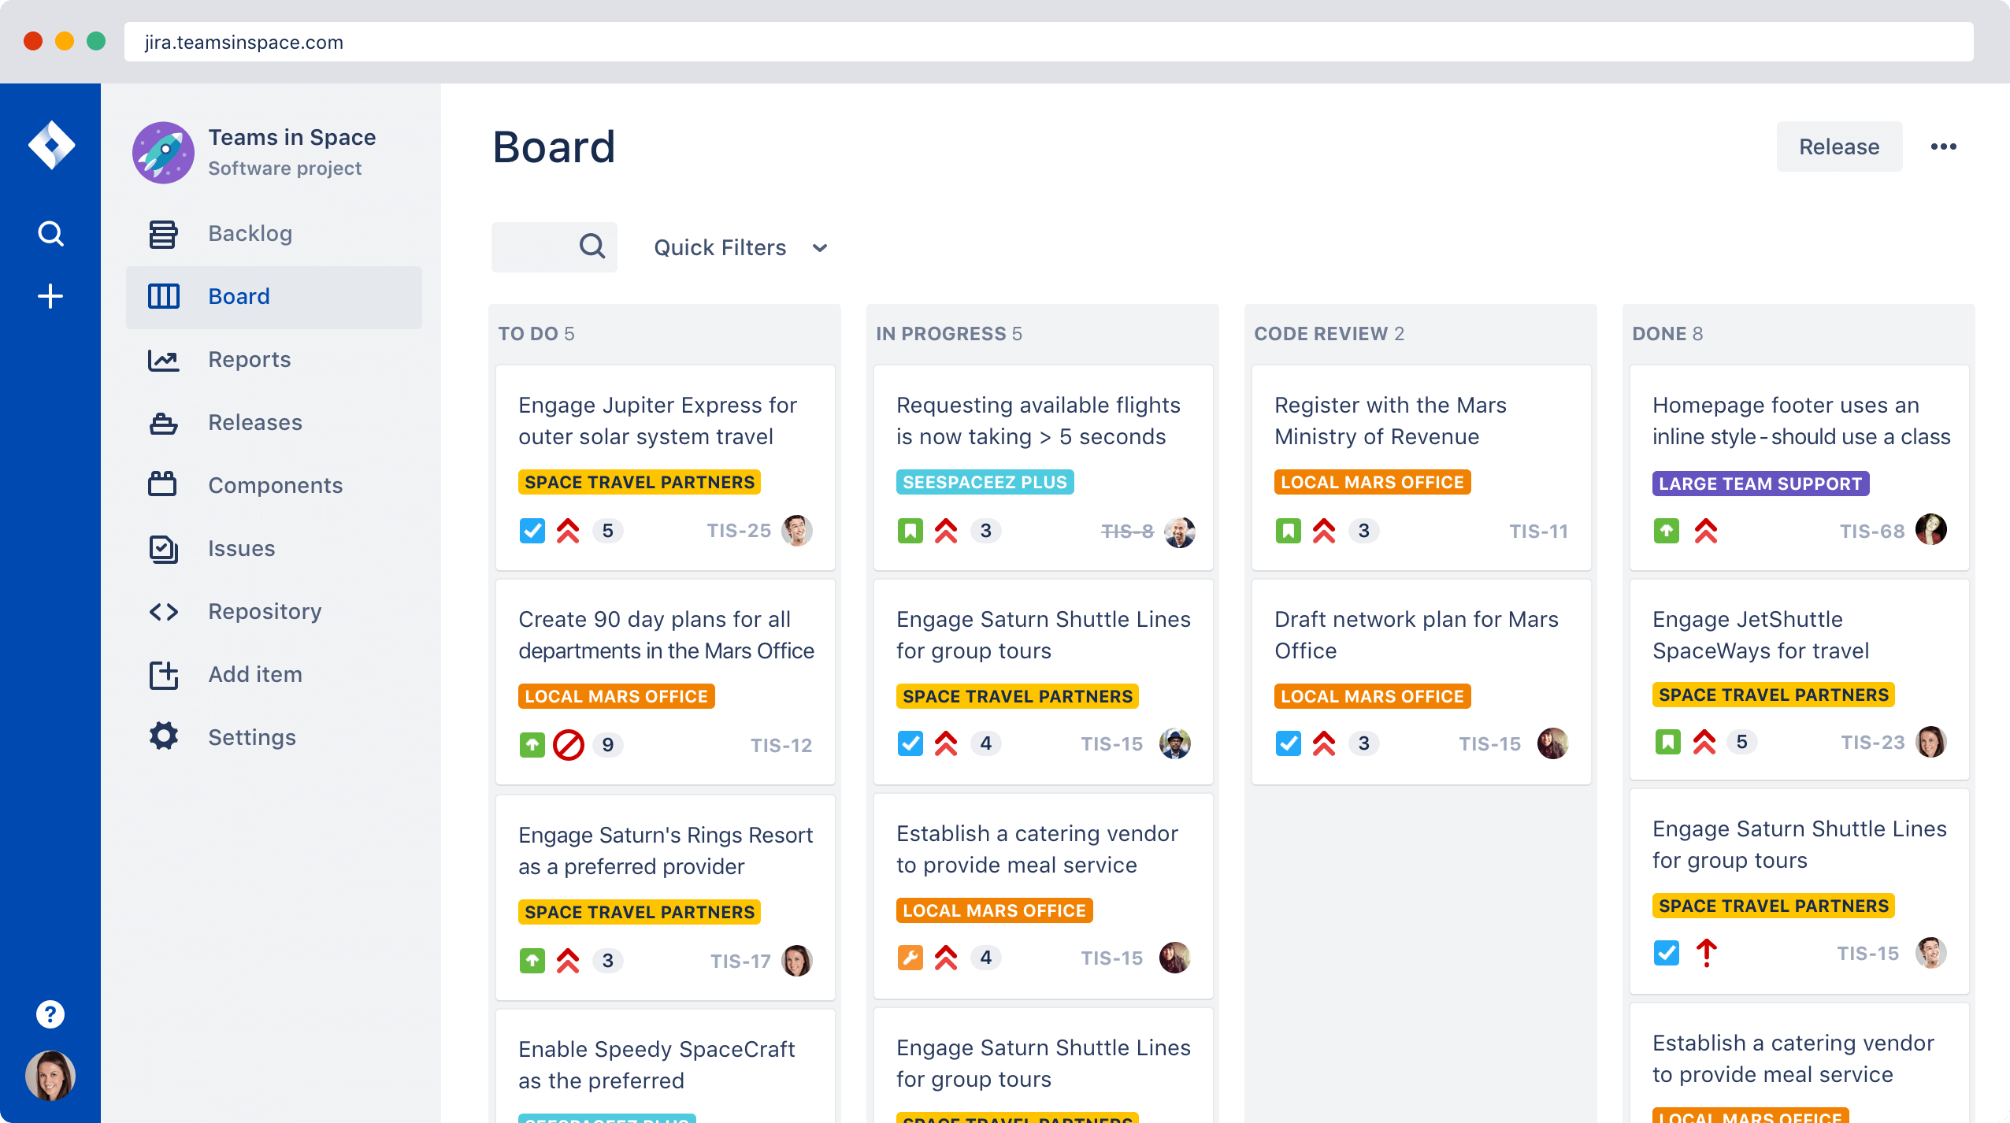

Slide 13
Write Better Code
Text Editors/IDEs
  GUI Editors
    Sublime Text by Sublime HQ - https://www.sublimetext.com/
    Atom by Github - https://atom.io/
    Visual Studio Code by Microsoft - https://code.visualstudio.com/
  CLI Editors
    vim, nano, emacs
Use Formatters to beautify and organize your code
  Python – Black
  Web – Prettier
  C# - Resharper
  Go - gofmt
Use code linters to ensure your code follows best practices and has no mistakes
  Just google “X Linter” or look it up in your IDEs plug-ins (X: is your programming language)
Learn your shortcuts
  Ctrl+S, Ctrl+A, Ctrl+W, Ctrl+Tab, Ctrl+Left/Right, Ctrl+Up/Down

Slide 14
Let’s show an example

Slide 15
Github
Explore the code behind your favorite libraries
Look at other top repositories/projects
  https://gitstar-ranking.com/freeCodeCamp/freeCodeCamp
  https://paperswithcode.com/

Slide 16




Medium.com
Read articles and insights from other software engineers, data scientists, machine learning engineers, data engineers, …
Has a lot of publications (blogs):
  Data Science: https://towardsdatascience.com/
  Software Engineering: https://levelup.gitconnected.com/ https://medium.com/better-programming
  Netflix Tech blog: https://netflixtechblog.com/

Slide 17
Applying for Jobs
Try to keep your Linkedin profile up-to-date
Expand your connection network (actual ones)
One-page resume
  Have different versions for different roles/positions
  Be detailed but don’t over-describe things, being able to explain things in fewer words is a skill
Have someone revise it for you, another professional or friend

Slide 18
Interviews
Accept interviews almost all the time
What to expect?
  Data Structures – Linked Lists, Arrays, Strings, …
  Algorithms – Math, Recursion, Dynamic Programming, …
  Problem Solving
How to prepare?
  Problem Solving & code, code, and code … www.leetcode.com
  Cracking the Code Interview … https://cin.ufpe.br/~fbma/Crack/Cracking%20the%20Coding%20Interview%20189%20Programming%20Questions%20and%20Solutions.pdf
Ask questions
  Tech stack
  Team size
  Duties
  Culture

Slide 19
Job Offers
What should you look for?
  Salary
  Benefits (insurance, retirement savings, …)
  Vacation; Planned/Personal Time Off (PTO) and work-life balance
  Keep an eye on non-compete terms
  Remote vs Office (Transportation, Housing, …)
  Negotiate

Slide 20
Final Tips
Nothing is impossible to learn
  Read the documentation
  Error and trial
Learn about Cloud Services (Infrastructure)
  Google Cloud Platform (GCP), Amazon Web Services (AWS), Microsoft Azure
Attend Conferences (Online or in-person) when possible.
  .Net Conference - https://www.dotnetconf.net/
  PyData Global - https://global.pydata.org/ - $10 Minumum
  AWS re-Invent - https://reinvent.awsevents.com/ - Free
Don’t reinvent the wheel
Learn how to write tests in your favorite languages
Learn about Continuous Integration & Continuous Deployment – CI/CD

Slide 21
Questions … ?

