Slide 1
A Primer on Python
سعد السيدأحمد

Slide 2


Who am I?
Bachelor’s in Computer Systems Engineering – PPU; 2017
Master’s in Computer Science – UNCG; 2019
Data Scientist – CentralSquare Tech; 2019-Present
  Software Engineering
  Data Engineering
  Machine Learning
  Frontend

Slide 3
Content
The What, When, and Why!
Python vs C++: a quick comparison
Installation and Environment
Coding!

Slide 4
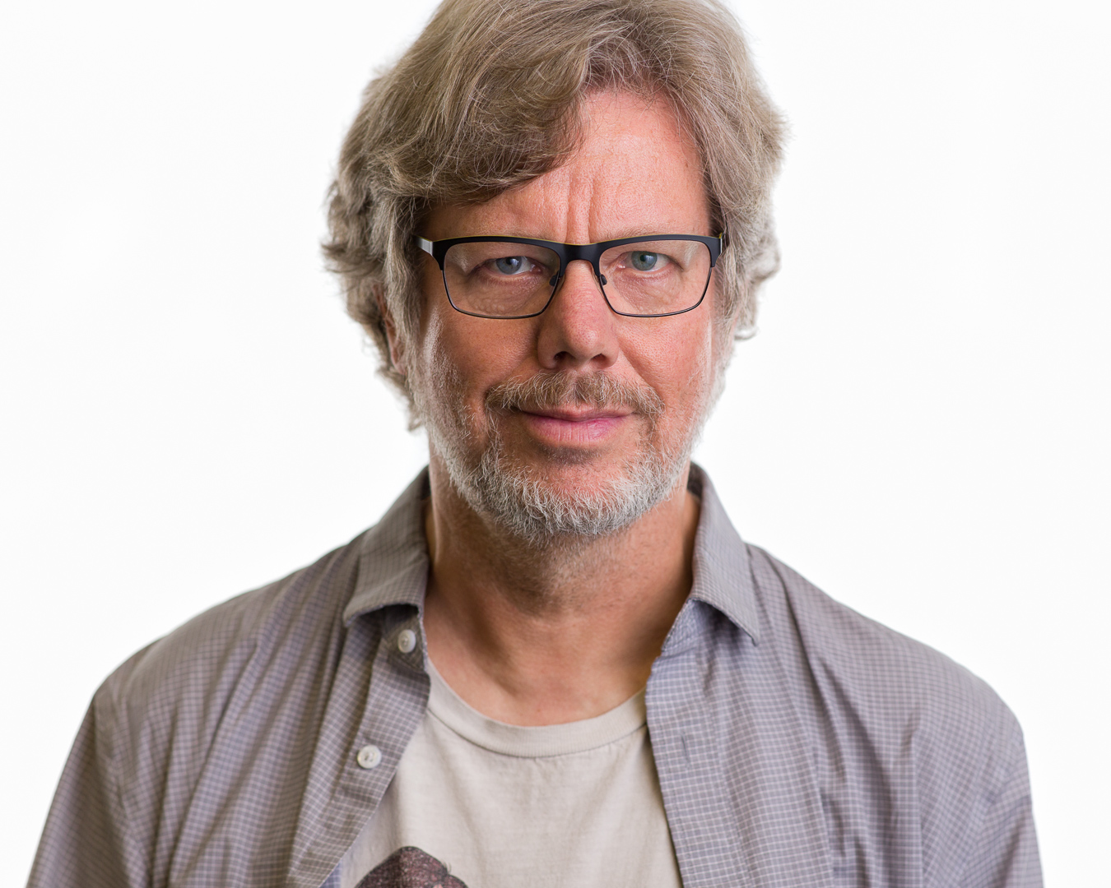
What is Python
Written by Guido van Rossum in 1991
Interpreted Language
High-level Language
General-Purpose
  You can almost do
  any “computation” with it

Slide 5
Why Python?
Short and concise
Easy to learn
De facto standard in Machine learning and Data science.

Slide 6
When Python?
I need to get things done fast!
I don’t care “too much” about the performance of the scripts/application.*

Slide 7
How to become good?
Nobody is born with knowledge.
Nobody masters from working with it one day every month.

Slide 8
How to become good?
Don’t be afraid to try and FAIL.
You’re always going to be afraid of what you don’t know.

Slide 9
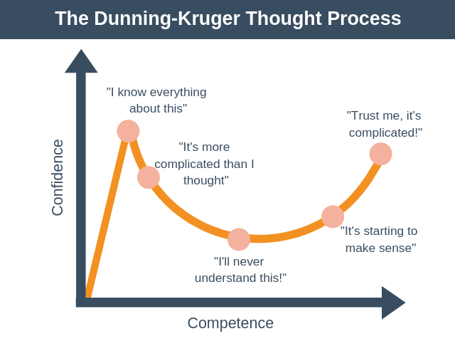

Slide 10
Installing Python
Compatible with Windows, Linux, and Mac OS
We can write Python from the command-line
We can write Python within the browser.
We can write Python within a text editor (or IDE).

Slide 11
Advise
Write simple code
  Less is “usually” better
Variable Names
Comments
Design Patterns

