Slide 1

SQL Project: BikeStore Database Analysis

Slide 2

Project Overview
Objective: Analyze the Bike Store database using SQL to derive insights about customer behavior, sales performance, and product categories.
Methodology:
Utilized SQL for data extraction and analysis.
Answered specific business questions relevant to the Bike Store operation.

Slide 3

Data Overview
Database Structure:
Schemas: production and sales
Key Tables: categories, brands, products, customers, stores, orders, order_items, staffs
Key Metrics: Sales, customer demographics, product categories

Slide 4
Selected Questions
Focus: We will explore answers to five key questions from the original 24.
Questions:
Which category rejected more orders?
How many categories does BikeStore have, and which one is the least liked?
Which store still have more products of the most liked brand?
What’s the product name, quantity, price, category, model year and brand name of product number 44?
How many bikes under the children category were sold in the last 8 months?

Slide 5
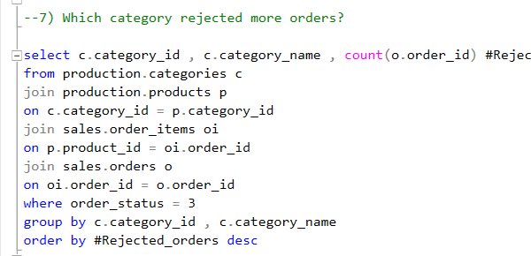
Which category rejected more orders?

Slide 6
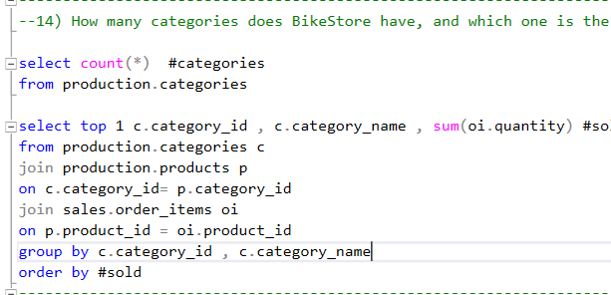
How many categories does BikeStore have, and which one is the least liked?

Slide 7
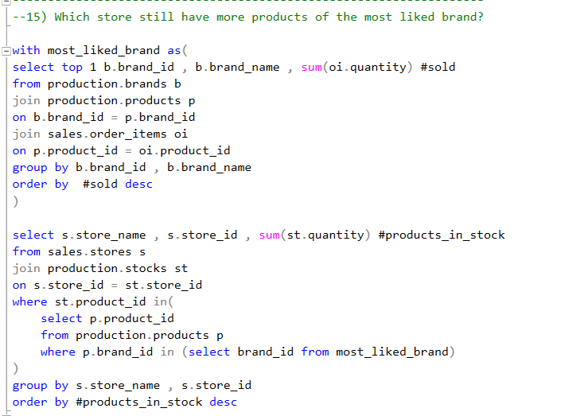
Which store still have more products of the most liked brand?

Slide 8
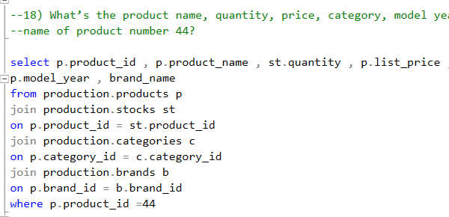
What’s the product name, quantity, price, category, model year and brand name of product number 44?

Slide 9
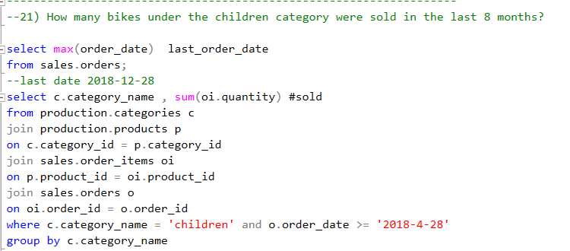
How many bikes under the children category were sold in the last 8 months?

