Slide 1

Medical Presentation
Medical Data Cleaning and Dashboard Analysis

Slide 2

Agenda
Introduction
Overview of the project and objectives.
Uncleaned Data Overview
Issues and challenges with the raw data.
Data Transformation Process
Cleaning the data using Power Query.
Integrating the datasets with Power Pivot.
Cleaned Data Overview
Improvements made after transformation.
Key new features and consistency.
Dashboard Insights
Medical insights from the data.
Financial and sales analysis.

Slide 3

Dataset Structure and Integration
The dataset consists of three separate files, each serving a unique purpose in the analysis of healthcare data:
1- Healthcare Facts
This file contains detailed records of patient encounters, including data such as Blood type, Medical Condition, and Admission Type . It serves as the central fact table for analysis.
2- Doctors Dimension
This file includes information about the doctors, such as their IDs, names
3- Hospitals Dimension
This file contains data about the hospitals, including their IDs, names

Slide 4
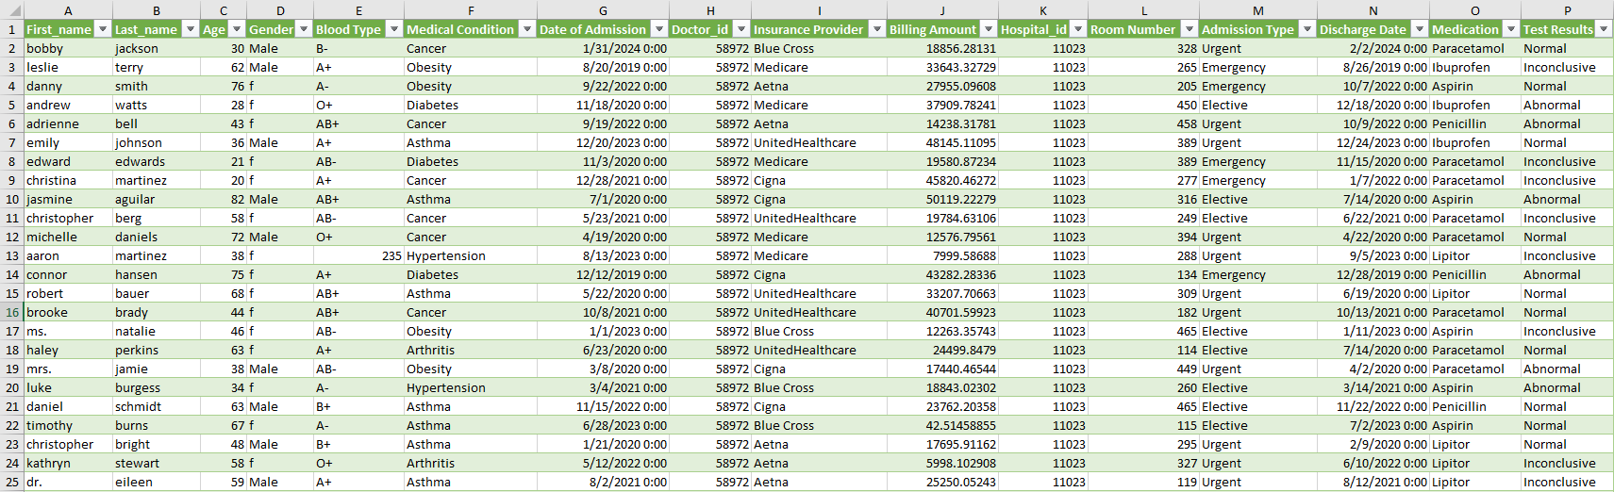
Overview of Data: Healthcare data

Slide 5
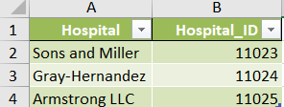
Overview of Data: Hospitals data

Slide 6
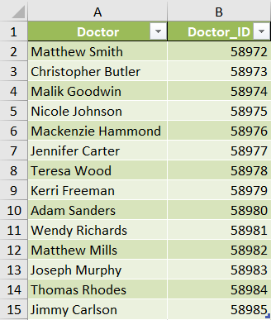
Overview of Data

Slide 7
Data Transformation and Integration:
Power Query: Used to clean and prepare the data by removing or imputing missing values.
Creating new features such as "Length of Stay" for deeper analysis.
Power Pivot: After cleaning, the datasets were connected using Power Pivot, establishing relationships between the files to create a unified dataset for analysis and dashboards.

Slide 8
The uncleaned data presented several challenges that needed to be addressed to ensure its quality and consistency:
Inconsistent Data Entry:
Gender column: Some entries used inconsistent labels ( 'M', 'Male', 'F', 'female').
Test Results: Variations in text formatting (e.g., 'normal' vs 'Normal', 'positive' vs 'Positive').
Missing Values:
Doctor ID: Several records were missing Doctor IDs, making it difficult to analyze data by doctor.
Medical Conditions: Some entries lacked medical condition details, leading to incomplete records.
Duplicate Records:
Multiple entries for the same patient (same ID) were found, resulting in potential double-counting of certain cases.
Inconsistent Date Formats:
Date entries were inconsistent, with some in 'DD-MM-YYYY' format and others in 'MM/DD/YYYY' format, making time-based analysis difficult.
Invalid Categorical Values:
Certain categorical columns had invalid values, such as a Gender entry marked as 'Unknown' or non-sensical entries like 'N/A' in diagnosis columns.
Mixed Data Types:
Some numerical fields were stored as text (Doctor IDs, Age), causing issues in data analysis and calculations.

Slide 9
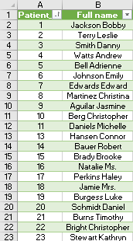
Primary Key for Each Patient:
A unique Patient ID was created for each individual in the dataset. This primary key ensures that each patient record is uniquely identifiable, allowing for easier data management and analysis.
Merging First Name and Last Name:
The first name and last name fields were merged to create a new field called Full Name. This consolidation simplifies the data presentation and allows for more intuitive identification of patients in reports and dashboards.

Slide 10
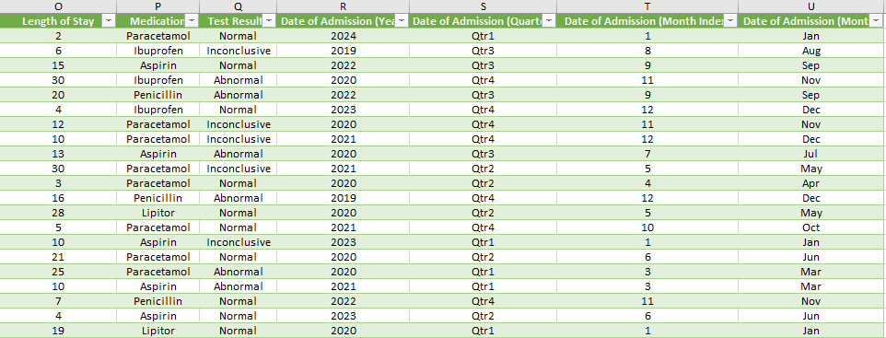
To enhance the dataset's analytical capabilities, we added several new columns:
Length of Stay:
Represents the duration of hospitalization for each patient.
Date of Admission (Year):
Extracted year of admission for better temporal analysis.
Date of Admission (Quarter):
Categorizes admissions into quarters of the year (Q1, Q2, Q3, Q4).
Date of Admission (Month Index):
Numeric representation of the admission month for easier sorting and analysis.
Date of Admission (Month):
Full name of the month for clearer reporting.
These enhancements allow for more detailed analysis and improved reporting capabilities within the dataset.

Slide 11
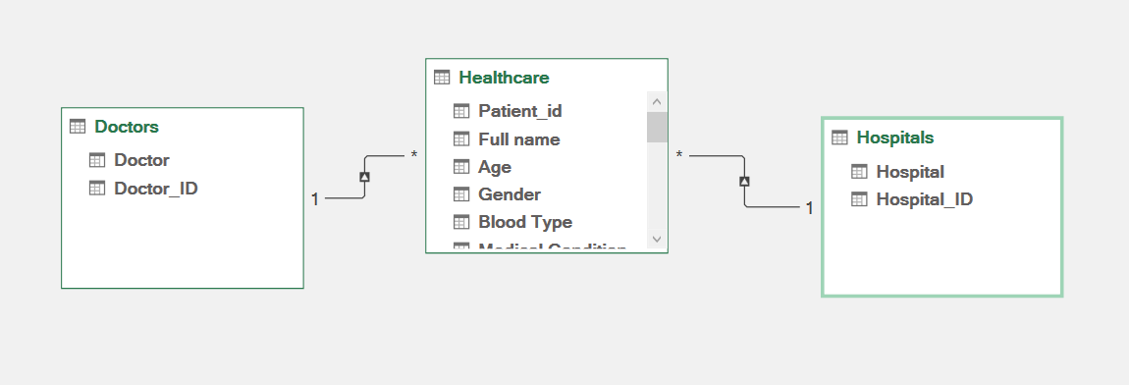
I connected these three files using Power Pivot to establish relationships between the fact and dimension tables. This integration allows for comprehensive data analysis and enables the creation of insightful dashboards and reports.

Slide 12
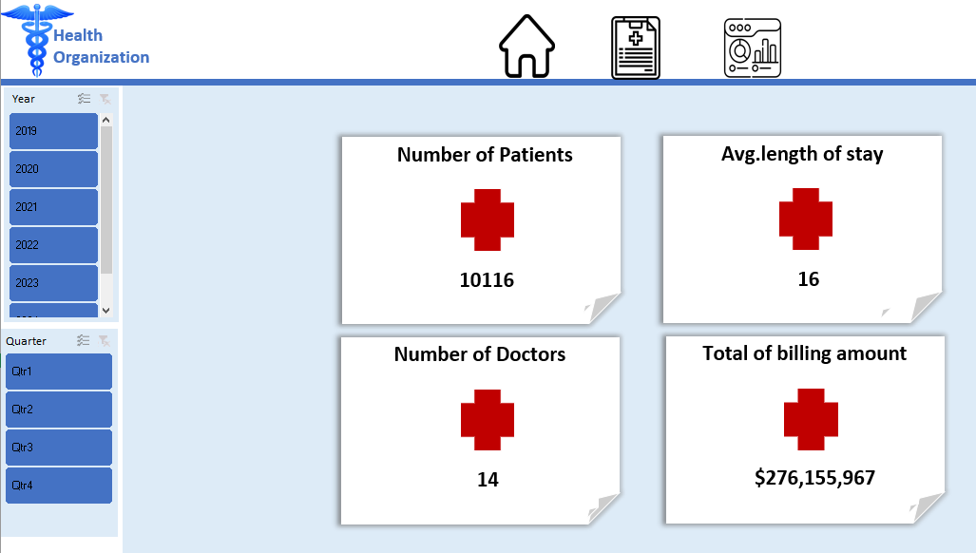

Slide 13
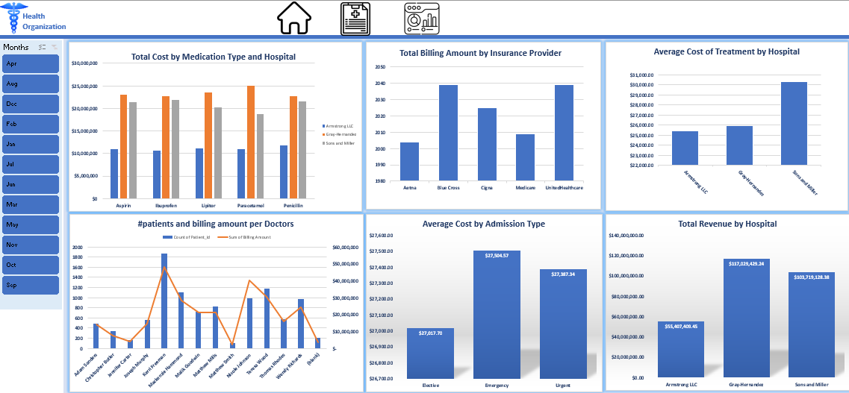

Slide 14
