Slide 1



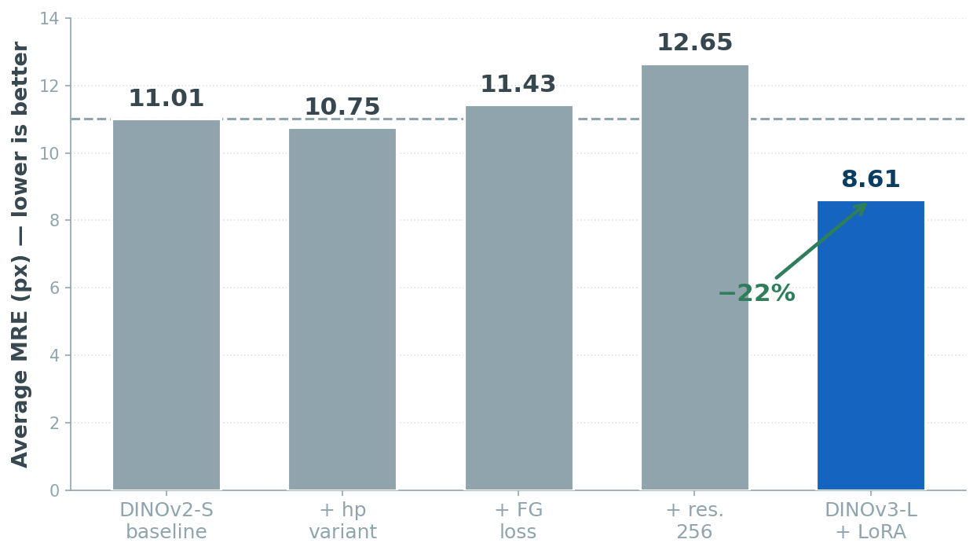
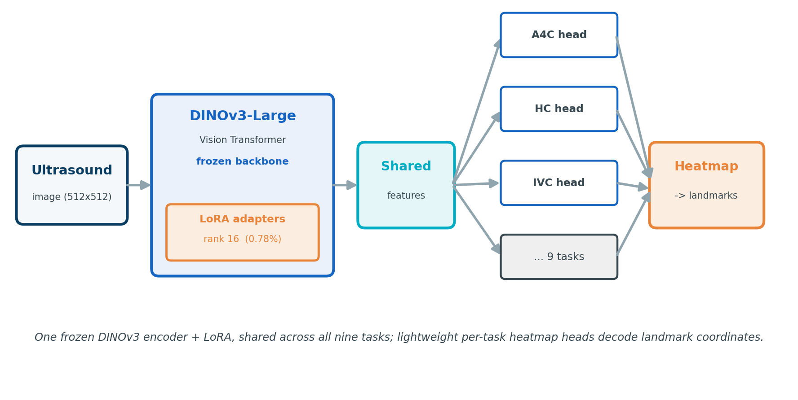
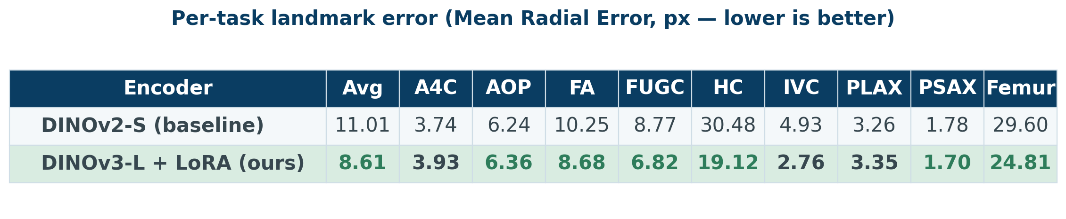
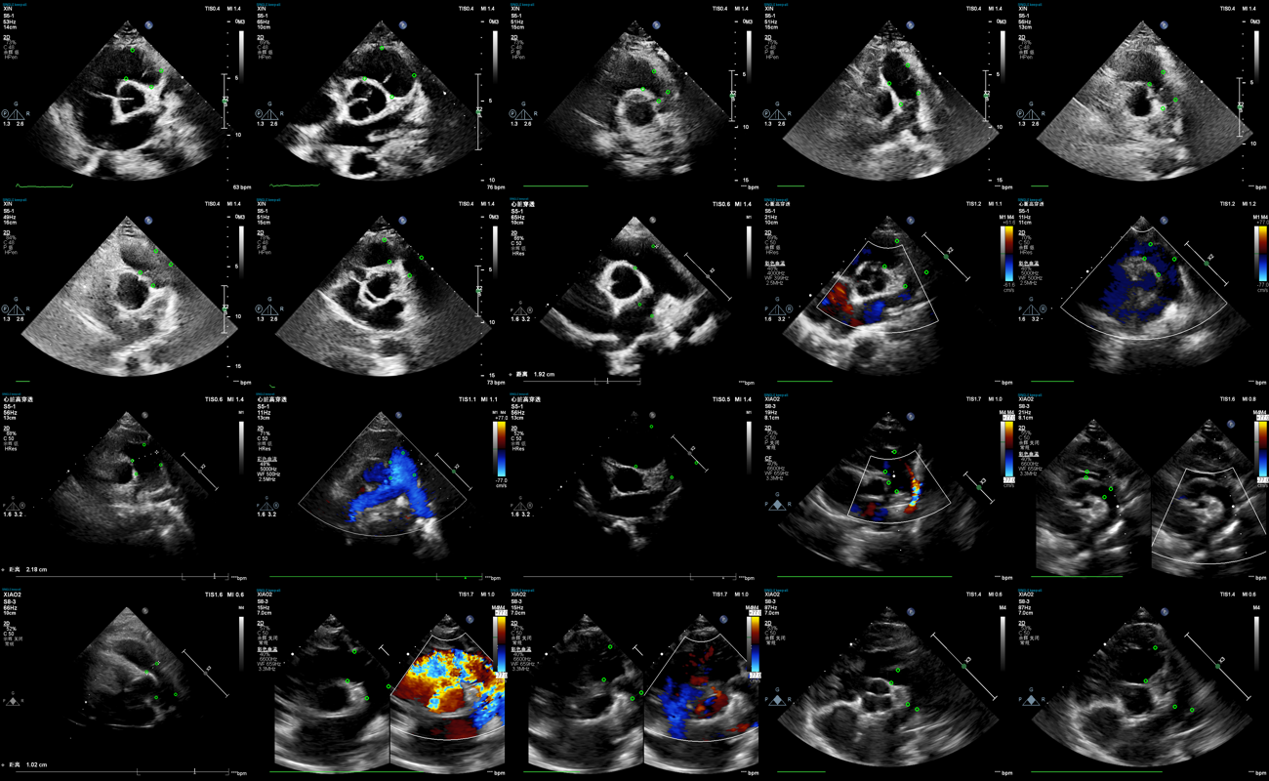
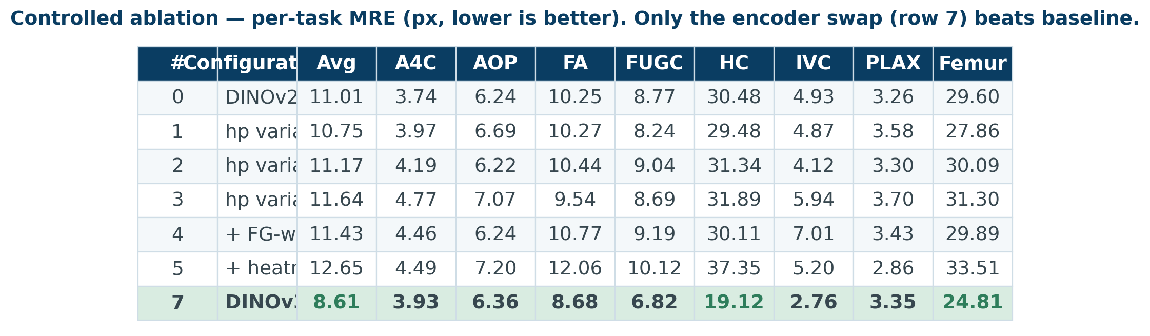
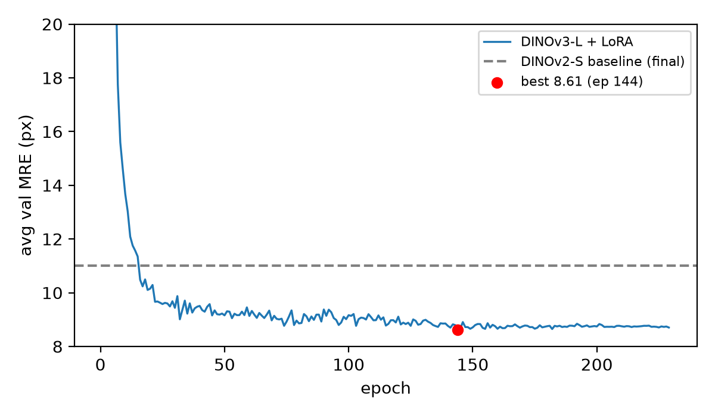
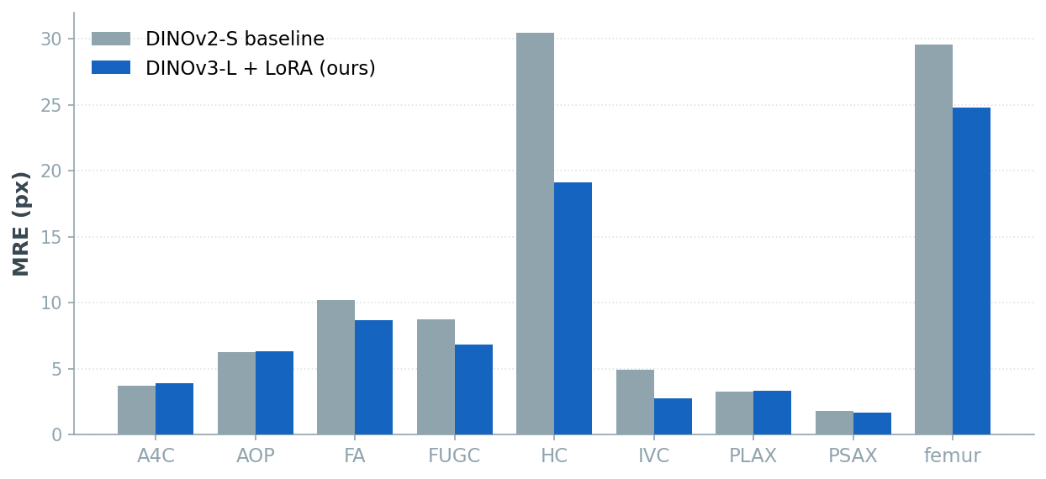
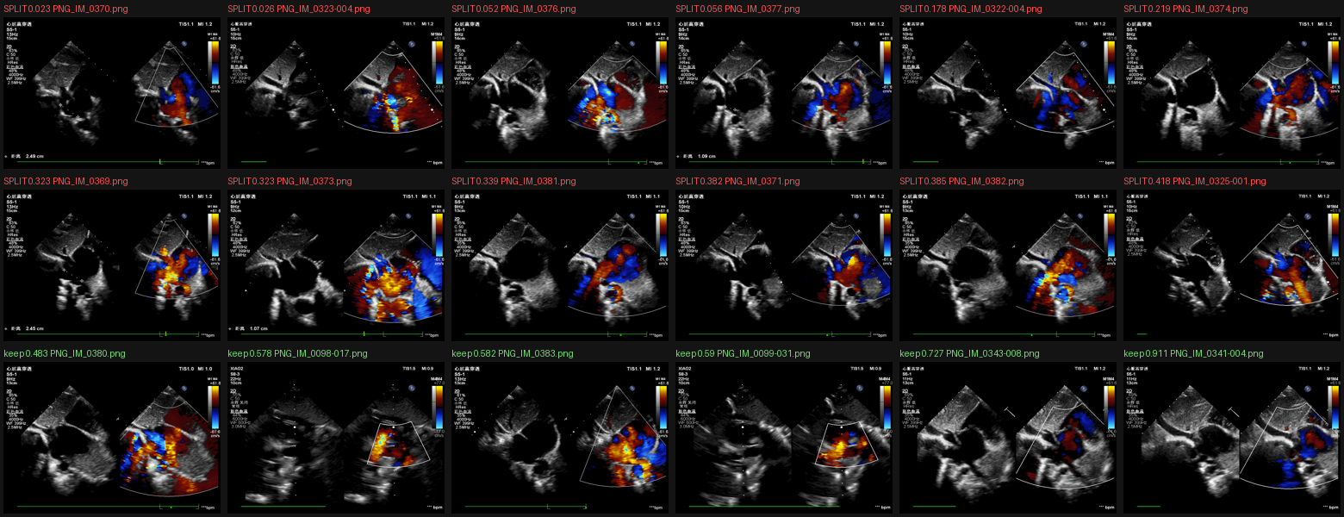
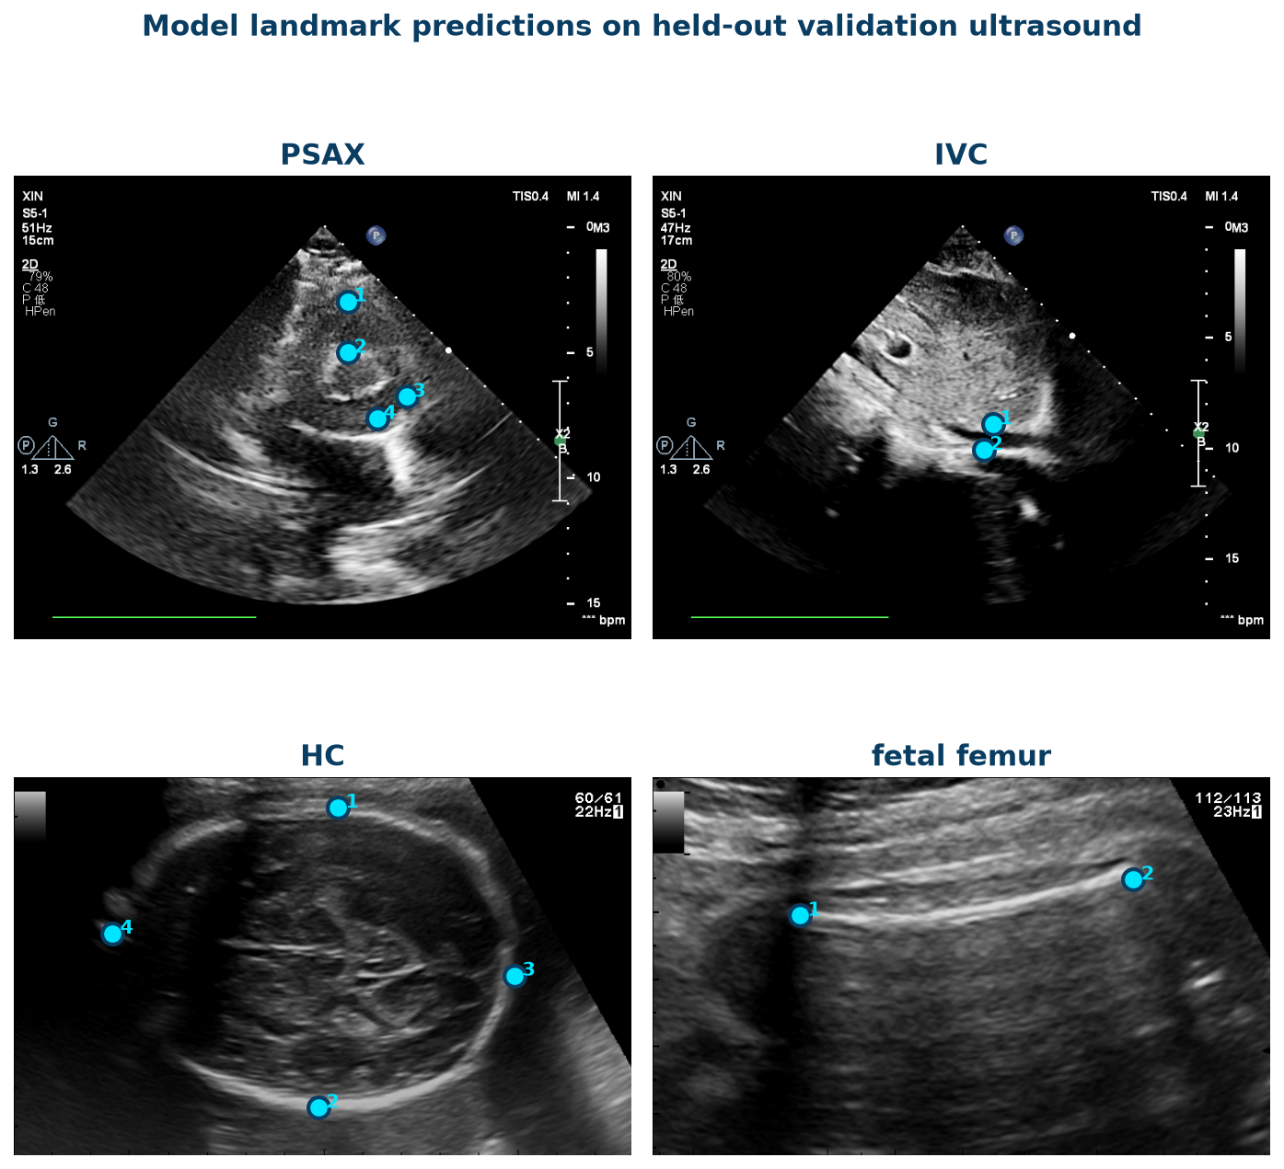

Encoder Capacity Is the Binding Constraint in
Unified Multi-Task Ultrasound Landmark Detection
FoundUS 2026 · Foundation Model for Ultrasound Biometry
Saeed Moosivand · Ziyang Wang | Aston University, Birmingham, UK
1. Clinical Motivation
5. Method
8. Main Results
Ultrasound biometry underpins diagnosis across fetal, cardiac and vascular care. Manual landmark measurement is slow and operator-dependent.
A unified model across all nine tasks would simplify deployment, but what limits accuracy: loss, resolution, or encoder capacity?
A single frozen DINOv3-Large encoder is shared across all nine tasks and adapted with LoRA. Per-task heatmap heads decode landmark coordinates.
Aim: identify the binding constraint via a controlled ablation.
2. Dataset & Setup
Official FoundUS 2026 benchmark: nine ultrasound biometry tasks, 200K+ images (prenatal, intrapartum, cardiac, vascular).
Split
per-task stratified 80/20 (seed 42)
Best: encoder swap alone cuts avg MRE 11.01 to 8.61 px (22% lower), HC 30.5 to 19.1.
Metric
Mean Radial Error (MRE), px
Only LoRA adapters (2.39M of 305M = 0.78%) and per-task heads are trained; backbone frozen. Loss: MSE on Gaussian landmark heatmaps.
Controlled ablation: vary one factor at a time (encoder, loss, resolution), architecture fixed.
6. Training Convergence (Fig. 1)
Annotated ultrasound (cardiac PSAX): expert landmarks per task.
3. Split-Screen Detection
Some cardiac acquisitions are dual-panel. A training-time detector crops the active panel for large gains.
DINOv3-L + LoRA (blue) falls well below the DINOv2-S baseline (dashed); best 8.61 px at epoch 144.
Per-task MRE: gains concentrate on the hardest tasks (HC, fetal femur).
7. Qualitative: Predictions
9. Robustness: Geometry Shift
Local 8.61 px vs. server 25.60 px. A distortion test isolates the cause:
Native aspect 1.48 (training)
10.5 px
Stretched to 1.90 (server-like)
35.1 px
Split-screen (red) vs. single-panel kept (green). IVC 40.2 to 2.76, PSAX 27.4 to 1.70 px (about 16x lower).
Aspect-ratio change alone triples the error.
4. Key Contributions
10. Conclusion
Unified DINOv3 + LoRA model for all 9 tasks, training only 0.78% of parameters.
A single LoRA-adapted DINOv3 encoder addresses all nine ultrasound biometry tasks. A controlled ablation shows encoder capacity is the binding constraint (avg MRE 11.01 to 8.61); negative results rule out loss and resolution engineering. The residual local-to-server gap is acquisition-geometry covariate shift, the key direction for deployable multi-task ultrasound biometry.
Controlled ablation isolating encoder capacity as the binding constraint.
Split-screen detection and acquisition-geometry covariate-shift analysis.
References
Limitations & Future Work
Code & Contact
[1] Oquab et al. DINOv2 / DINOv3: self-supervised vision features. 2024.
Model landmark predictions on held-out validation ultrasound (cardiac, vascular, fetal).
[2] Hu et al. LoRA: Low-Rank Adaptation of Large Language Models. ICLR 2022.
• Test geometries outside training range not covered.
Saeed Moosivand
240169451@aston.ac.uk
Ziyang Wang
z.wang47@aston.ac.uk
← scan for code
[3] FoundUS 2026: Foundation Model for Ultrasound Biometry, MICCAI 2026.
• Single-model inference; no ensemble or TTA.
[4] Deng et al. Baseline Method for the Foundation Model Challenge. 2026.
• Future: geometry-aware augmentation.
• Future: multi-centre training data.

